Slide 1
Docker 101 Tutorial
2022-09-29
Notes:
https://yeasy.gitbook.io/docker_practice/podman

Slide 2
Agenda
Virtualization: Virtual Machine and Container
Docker Architecture and Principles
Docker Use Cases
Podman: Daemonless and Rootless Container Engine

Slide 3
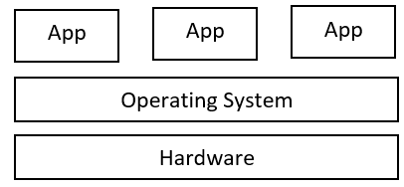
Physical Server Architecture

Slide 4
Physical Server: Problems
Limited servers
Run old and incompatible software
Develop cross-platform applications
Try new operating systems
Sandbox environment, such as virus testing
Notes:
https://www.vmware.com/topics/glossary/content/virtual-machine.html

Slide 5
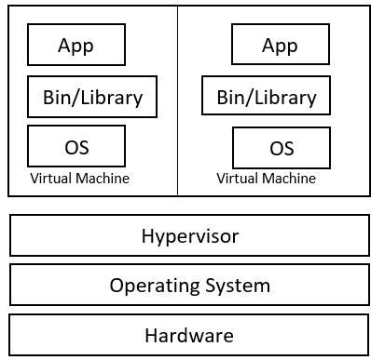
Virtual Machine: Type-2 Hypervisor
Hypervisor: Virtual Machine Manager/Monitor(VMM)
Hosted Hypervisor
Commercial products in 2000s
Typical Type-2 Hypervisor Products
VMWare Workstation Player/Pro
Oracle VM VirtualBox
QEMU
Notes:
https://www.wljslmz.cn/241.html
https://sumit-ghosh.com/articles/virtualization-hypervisors-explaining-qemu-kvm-libvirt/

Slide 6
Virtual Machine: Type-1 Hypervisor
Bare metal hypervisor
Typical Type-1 Hypervisor Products
VMWare ESX/ESXi(vSphere)
Microsoft Hyper-V
Oracle VM Server
Citrix Hypervisor(XenServer)
KVM
Notes:
https://www.wljslmz.cn/241.html
https://www.technewstoday.com/type-1-vs-type-2-hypervisor/
https://sumit-ghosh.com/articles/virtualization-hypervisors-explaining-qemu-kvm-libvirt/

Slide 7
Type-1 Virtual Machine: Real-World Examples
AWS Elastic Compute Cloud(EC2)
Microsoft Azure Virtual Machine(Azure)
Google Cloud Platform(GCP)
Alibaba Cloud Elastic Compute Service(ECS)
Tencent Cloud Virtual Machine(CVM)
SmartX(native hypervisor ELF, KVM based)
Notes:
阿里云ECS虚拟化，最早基于xen，同时在做基于kvm的虚拟化
http://pic.huodongjia.com/ganhuodocs/2016-10-10/1476067279.46.pdf

Slide 8
Virtual Machine: Problems
Resource intensive
Slow startup and shutdown
Deployment complexity
Scalability
Notes:
https://www.educative.io/answers/why-did-we-need-containers-when-we-had-virtual-machines
https://www.redhat.com/zh/topics/containers/containers-vs-vms
resource intensive: disk usage, memory, cpu等，因为hypervisor本身很大，hypervisor里的每个VM也很大，每个VM里的OS也占用内存和CPU

Slide 9
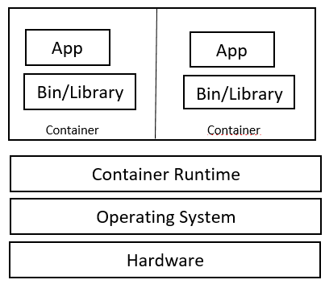
Container
OS-level virtualization, share OS kernel
Isolated process
LXC: Linux Container(2008)
Namespaces and CGroups
Notes:
https://www.docker.com/resources/what-container/

Slide 10
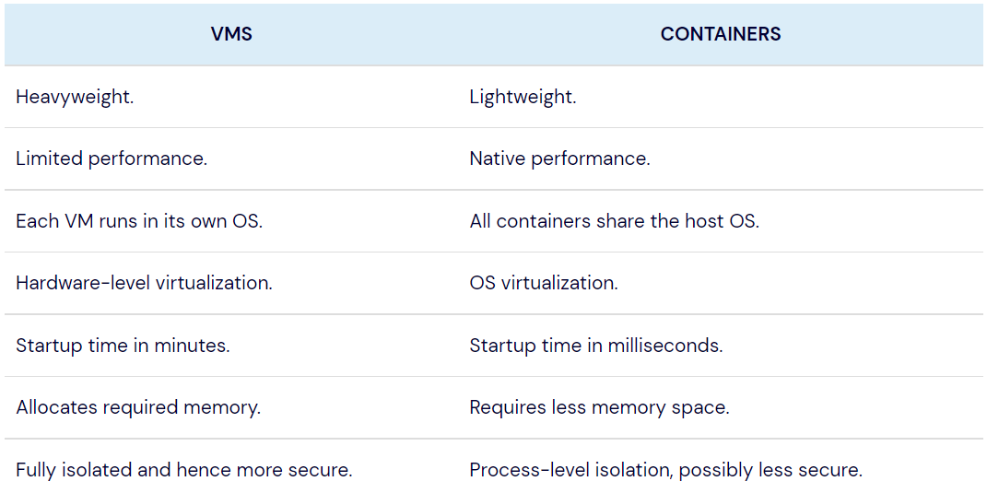
Virtual Machine vs. Container
Notes:
https://www.docker.com/resources/what-container/
https://www.redhat.com/zh/topics/containers/containers-vs-vms

Slide 11
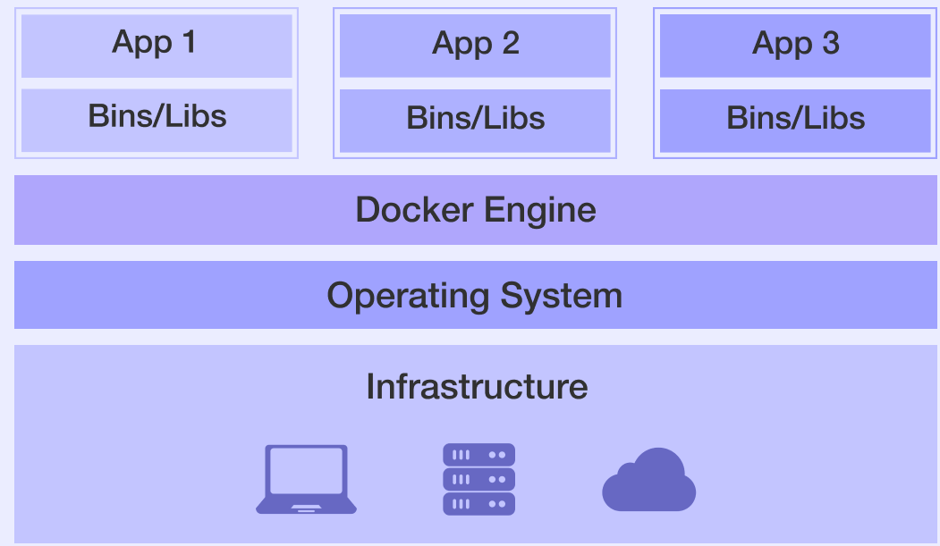
Docker Infrastructure
Container technology based
OS-level virtualization
Innovation on LXC(2013)
Docker Engine = dockerd + containerd + runC
Notes:
https://docs.docker.com/engine/faq/
https://www.backblaze.com/blog/vm-vs-containers/
https://www.tutorialworks.com/difference-docker-containerd-runc-crio-oci/
https://www.jianshu.com/p/2a917158b792
https://mp.weixin.qq.com/s/856ZpSCk24tYBQioowH_og
https://www.jianshu.com/p/7a1ce51a0eba

Slide 12
Docker Added to LXC
Portable deployment across machines
Application-centric
Automatic build: Dockerfile
Versioning
Component re-use
Sharing
Tool ecosystem
Notes:
https://docs.docker.com/engine/faq/
https://www.backblaze.com/blog/vm-vs-containers/
https://www.tutorialworks.com/difference-docker-containerd-runc-crio-oci/
https://www.jianshu.com/p/2a917158b792
https://mp.weixin.qq.com/s/856ZpSCk24tYBQioowH_og
https://www.jianshu.com/p/7a1ce51a0eba

Slide 13
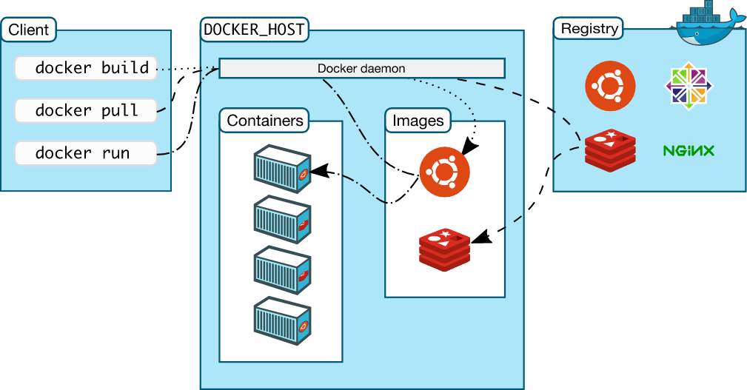
Docker Architecture: client/server
Notes:
https://geekflare.com/docker-architecture/

Slide 14
Docker Engine
Server: It is the docker daemon called dockerd. It can create and manage docker images, containers, networks, etc.
Rest API: It is used to instruct docker daemon what to do.
Command Line Interface (CLI): It is a client which is used to enter docker commands.
Notes:
https://www.tutorialworks.com/difference-docker-containerd-runc-crio-oci/
https://geekflare.com/docker-architecture/

Slide 15
Docker Registry
Similar to git repository
Store docker images
Public registry: Docker Hub
Private registry
Notes:
https://www.tutorialworks.com/difference-docker-containerd-runc-crio-oci/
https://geekflare.com/docker-architecture/
https://yeasy.gitbook.io/docker_practice/repository/registry

Slide 16
Docker Objects
images
containers
volumes
networks
Notes:
https://www.tutorialworks.com/difference-docker-containerd-runc-crio-oci/
https://geekflare.com/docker-architecture/

Slide 17
Docker Images
read-only template with instructions for creating a Docker container
image = base image + customization
package: code+configuration+dependencies
Dockerfile -> docker image
Notes:
https://www.tutorialworks.com/difference-docker-containerd-runc-crio-oci/
https://geekflare.com/docker-architecture/
An image is a read-only template with instructions for creating a Docker container. Often, an image is based on another image, with some additional customization. For example, you may build an image which is based on the ubuntu image, but installs the Apache web server and your application, as well as the configuration details needed to make your application run.You might create your own images or you might only use those created by others and published in a registry. To build your own image, you create a Dockerfile with a simple syntax for defining the steps needed to create the image and run it. Each instruction in a Dockerfile creates a layer in the image. When you change the Dockerfile and rebuild the image, only those layers which have changed are rebuilt. This is part of what makes images so lightweight, small, and fast, when compared to other virtualization technologies.

Slide 18
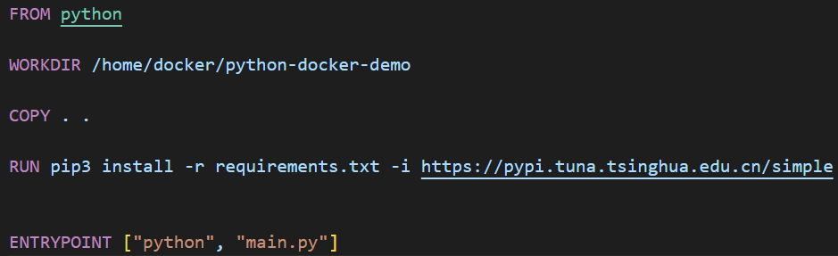
Dockerfile
docker build -t python-docker-image:tag path/to/Dockerfile
https://docs.docker.com/engine/reference/builder/
Notes:
https://www.tutorialworks.com/difference-docker-containerd-runc-crio-oci/
https://geekflare.com/docker-architecture/
An image is a read-only template with instructions for creating a Docker container. Often, an image is based on another image, with some additional customization. For example, you may build an image which is based on the ubuntu image, but installs the Apache web server and your application, as well as the configuration details needed to make your application run.You might create your own images or you might only use those created by others and published in a registry. To build your own image, you create a Dockerfile with a simple syntax for defining the steps needed to create the image and run it. Each instruction in a Dockerfile creates a layer in the image. When you change the Dockerfile and rebuild the image, only those layers which have changed are rebuilt. This is part of what makes images so lightweight, small, and fast, when compared to other virtualization technologies.

Slide 19
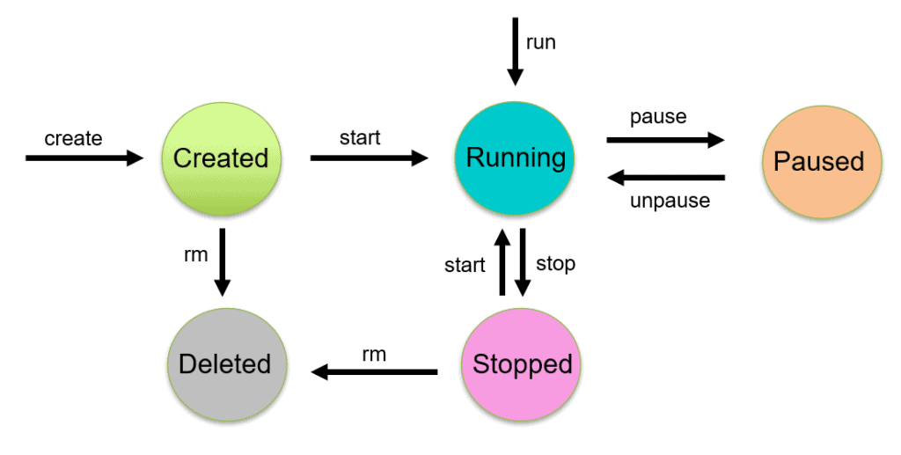
Docker Containers
container: runnable instance of image
All the applications and their environment run inside the container
Docker API or CLI to operate container
Notes:
https://www.tutorialworks.com/difference-docker-containerd-runc-crio-oci/
https://geekflare.com/docker-architecture/

Slide 20
Volumes
Store the persisting data generated by docker and used by Docker containers.
Volume's content exists outside the lifecycle of a container.
Notes:
https://www.tutorialworks.com/difference-docker-containerd-runc-crio-oci/
https://geekflare.com/docker-architecture/

Slide 21
Networks
Bridge: It is the default network driver for a container.
Host: no network isolation between host and container.
Overlay: This network enables swarm services to communicate with each other.
None: disable all the networking.
macvlan: Assigns mac address to containers to make them look like physical devices.
Notes:
https://www.tutorialworks.com/difference-docker-containerd-runc-crio-oci/
https://geekflare.com/docker-architecture/

Slide 22
Docker Practice
Docker installation
Docker use cases
Docker problems

Slide 23
Docker Installation
Desktop
Docker Desktop
Linux, Mac, Windows(10)
https://docs.docker.com/desktop/
Server
CentOS, Debian, Fedora, Ubuntu, RHEL, etc.
https://docs.docker.com/engine/install/

Slide 24
Docker Commands
management commands
commands
docker --help
https://docs.docker.com/engine/reference/commandline/docker/

Slide 25
Docker Scenarios
Application isolation
Build portable environment
Microservices
CI/CD
Notes:
https://medium.com/@BeNitinAgarwal/docker-usecases-3b62f4d68bc4

Slide 26
Docker Problems
Root priviledge: daemon binds unix socket
Docker user group
Security problems
Rootless mode: Docker Engine v20.10, limitations
https://docs.docker.com/engine/release-notes/
https://docs.docker.com/engine/security/rootless/
Notes:
https://docs.docker.com/engine/security/rootless/#known-limitations
https://murphypei.github.io/blog/2018/12/docker-add-group
https://docs.docker.com/engine/install/linux-postinstall/
http://blog.lujun9972.win/blog/2019/05/13/%E4%B8%BA%E4%BB%80%E4%B9%88%E8%AF%B4%E5%88%9B%E5%BB%BAdocker%E7%94%A8%E6%88%B7%E7%BB%84%E4%B8%8D%E6%98%AF%E4%B8%AA%E5%A5%BD%E9%80%89%E6%8B%A9/

Slide 27
Podman: Pod Manager
Daemonless and rootless container engine
Docker command compatible
alias docker=podman
https://podman.io/
Notes:
https://www.baeldung.com/ops/podman-intro

Slide 28
Key Takeaways
Virtualization Techniques: VM and Container
VM: type-1 hypervisor vs. type-2 hypervisor
Docker: A Container Engine
Docker can't replace VM
Package up application and all its dependencies
Podman: rootless container engine

Slide 29
Thoughts
Multiple containers on a single host machine?
Docker Compose
Multiple containers across multiple host machines?
Docker Swarm
Kubernetes(K8s)

Slide 30
References
https://www.docker.com/
https://podman.io/
https://yeasy.gitbook.io/docker_practice/
http://icyfenix.cn/immutable-infrastructure/container/
Notes:
https://mp.weixin.qq.com/s/856ZpSCk24tYBQioowH_og

Slide 31
Thanks
Q&A
Notes:
https://www.cnblogs.com/JasonCeng/p/14814888.html
image layer/reduce layer size, image size
one application per container

