Slide 1
What Bayesian optimization does
It searches for a good input when each evaluation is expensive
Unknown experiment
y = f(x) + ε
x* = arg max f(x)
x may be temperature, composition,
or a model setting. One y may require
a real experiment or long simulation.
BO uses a probability model to decide where the next evaluation is most valuable.
The true curve is shown only for explanation. BO observes only the values it evaluates.
Frazier 2018; project BO primer
01

Slide 2
Project goal and research pain point
When should BO stop without becoming confidently wrong?
Central question
Which stopping rule saves experiments while keeping the risk of an unacceptable recommendation below a stated level?
Stop too late
Stop too early
Project focus
We waste trials after the remaining value of information has become small.
A narrow or distant optimum may remain unseen even when the fitted GP reports low uncertainty.
Compare rules across objective shapes, acquisition policies, and both well-specified and misspecified GP models.
What makes this project useful
Measure evaluation savings together with simple regret, false-stop rate, non-trigger rate, runtime, and posterior calibration. The main result should explain when a rule works and when its confidence fails.
Project work plan; Makarova et al. 2022; Wilson 2024
02

Slide 3
The BO loop and the role of each term
One dataset supports several different decisions
Object | Question it answers | Typical output | Examples in this project
Objective f(x) | What does the real experiment return? | Observation y | Yield, quality, performance
GP surrogate | What functions remain plausible after the data? | Mean μ(x), uncertainty σ(x) | Matérn or RBF kernel
Acquisition a(x) | Which x should be evaluated next? | x next | EI, PI, UCB, TS, MVES
Stopping rule | Is another evaluation worth its cost? | Continue or stop | Budget, EI threshold, regret probability
Final choice | Which x should be returned at the end? | x hat | Best observed point or posterior mean maximizer
Fit GP
Compute posterior
Score candidates
Evaluate x next
Update data
Check stop
If the rule continues, the loop returns to model fitting. If it stops, the recommendation rule returns x hat.
Frazier 2018; Shahriari et al. 2016; project primer
03

Slide 4
What the Gaussian process learns
A posterior distribution over plausible functions, not one certain curve
Prior model
Small numerical example
f ~ GP(m(x), k(x,x′))
Observed points
Model settings
x = [0.25, 0.75]
y = [0.80, 0.20]
RBF kernel
ℓ = 0.25, σn = 0.05
Posterior at a new point x*
μ(x*) = m(x*) + k*ᵀC⁻¹(y − m)
σ²(x*) = k(x*,x*) − k*ᵀC⁻¹k*
Prediction at x* = 0.50
C = K + σn²I
μ(x*) ≈ 0.533
σ(x*) ≈ 0.594
μ is the current prediction. σ measures uncertainty under the fitted model and its assumptions.
The mean lies between the observations, but uncertainty remains high because the midpoint was never evaluated.
Project numerical GP example; Rasmussen and Williams notation
04

Slide 5
Acquisition, stopping, and recommendation
The same posterior supports three different decisions
Decision | Mathematical form | Plain meaning | Main setting
UCB acquisition | a(x) = μ(x) + κσ(x) | Prefer high predictions and uncertain points | κ controls exploration
Expected improvement | EI(x) = E[(f(x) − fbest)+ | Dt] | Expected gain above the current best | Incumbent and numerical accuracy
Stopping target | P(f* − f(x hat) ≤ ε | Dt) ≥ 1 − δ | The recommendation is probably close enough | Tolerance ε and risk δ
Recommend x | x hat = arg max μ(x), or best observed x | Choose the final input after stopping | Must be declared before comparison
Two candidates under UCB with κ = 2
UCB selects B for the next experiment. A stopping rule may still decide that neither experiment is worth its cost.
A: μ = 0.72, σ = 0.06, UCB = 0.84
B: μ = 0.65, σ = 0.20, UCB = 1.05
Jones et al. 1998; Srinivas et al. 2010; Wilson 2024
05

Slide 6
One BO iteration with simple numbers
A chemistry example shows how mean and uncertainty compete
Observed reaction yields
GP candidate summaries
Temp. | Yield
40°C | 0.31
60°C | 0.72
90°C | 0.49
x | μ(x) | σ(x) | μ + 2σ | Action
65°C | 0.74 | 0.05 | 0.84 | Exploit nearby
78°C | 0.66 | 0.18 | 1.02 | Evaluate next
Current best = 0.72 at 60°C
1
2
3
4
Select 78°C
Run the experiment
Append and refit
Check stopping
Its lower mean is offset by larger uncertainty
Suppose the measured yield is 0.83
Dt+1 = Dt ∪ {(78, 0.83)}
Continue unless the declared rule now fires
The new observation changes both the fitted curve and its uncertainty. The next decision uses the updated posterior.
Illustrative numbers from project learning notes
06

Slide 7
Everyday analogy: tuning an espresso recipe
Each cup is an evaluation, and the best recipe is the recommended x
Controllable input x
Observed outcome y
Noise ε
Goal
Water temperature
Grind size
Taste score
from one cup
Taster variation
and small brewing changes
Find a recipe worth
saving and repeating
GP
Acquisition
Stopping
Recommendation
A map of which recipes might taste good and where the uncertainty is high
Choose the next cup that best balances a promising score and useful information
Decide whether another cup is likely to improve the final choice enough to justify its cost
Save one temperature and grind setting as the final recipe
The analogy is simple, but the project adds a strict question: how much risk of choosing the wrong recipe is acceptable?
07

Slide 8
A minimal BoTorch implementation
The library handles modeling and acquisition. The project supplies stopping and evaluation
1 Build the GP
model = SingleTaskGP(train_X, train_Y,
outcome_transform=Standardize(m=1))
mll = ExactMarginalLogLikelihood(
model.likelihood, model)
fit_gpytorch_mll(mll)
acq = LogExpectedImprovement(
model=model, best_f=train_Y.max())
x_next, _ = optimize_acqf(
acq, bounds, q=1,
num_restarts=12, raw_samples=256)
SingleTaskGP connects the observations to a probabilistic surrogate.
2 Fit parameters
Marginal likelihood estimates length scale, output scale, noise, and mean.
3 Create acquisition
LogEI ranks candidate inputs without running the real experiment.
4 Optimize acquisition
Restarts and raw samples reduce the risk of a poor local solution.
5 Evaluate and append
Run the expensive objective once, add the new point, and refit.
6 Apply our observer
Stopping logic and final recommendation remain explicit project code.
Dense plots of the true function are allowed for benchmark evaluation, but the optimizer must never use them to choose x next.
Balandat et al. 2020; Ament et al. 2023; project examples/bo_intro.py
08

Slide 9
How GP hyperparameters change the decision
They alter the posterior before acquisition or stopping is applied
RBF kernel
Training covariance
k(x,x′) = σf² exp[−½ Σj (xj−x′j)² / ℓj²]
Cθ = Kθ + σn²I
Quantity
Where it appears
If it is too small
If it is too large or mismatched
Kernel family
Shape of k(x,x′)
May allow rough fits
Smooth mismatch can hide narrow peaks
Length scale ℓj
Distance divided by ℓj
Local influence and more exploration
Confidence spreads and stopping may occur early
Output scale σf²
Scales covariance K
Large changes look unlikely
Wide intervals may delay stopping
Noise σn²
Diagonal of C
Fits random variation
Smooths away real structure
Mean m(x)
Baseline prediction
Unseen regions biased low
Unseen regions biased high
ARD uses one ℓj per normalized input. Smaller ℓj means faster variation along dimension j.
Decision settings κ, ε, and δ do not change the GP posterior. Jitter stabilizes computation and is not measurement noise.
Project hyperparameter guide; GP kernel and likelihood conventions
09

Slide 10
Model fitting and the next project phase
Fit carefully, test failure conditions, then scale the experiment
How the model is fitted
log p(y | X, θ) = −½(y−m)ᵀCθ⁻¹(y−m) − ½ log|Cθ| − n/2 log(2π)
Data fit
Complexity control
Numerical fitting
The quadratic term rewards covariance settings that explain the observed values.
The log determinant prevents the model from gaining likelihood through unlimited flexibility.
Normalize x, standardize y, use Cholesky solves, optimize in log space, and use multiple restarts.
Immediate next steps with Peter
1
Build a varied 2D function suite
2
Record ground truth and properties
3
Add BO policies and observers
4
Run a small pilot before scaling
Smooth, multimodal, narrow-peak, ridge, anisotropic, and noisy cases
Known optimum, domain, scaling, noise, and intended failure condition
EI, PI, UCB, Thompson sampling, MVES, plus stopping rules
Check code, runtime, calibration, false stops, and parameter trajectories
First deliverable: runnable 2D benchmark functions, a property table, reference optima, plots, and basic tests.
Project work plan; current direction from Dr. Petrus Zwart
10

Slide 11
Why Bayesian optimization
The objective is expensive, unknown, and accessible only through experiments
Goal
Find an input x with high f(x) while using as few evaluations as possible.
Examples
Reaction conditions
Instrument settings
Material composition
Model hyperparameters
Why ordinary optimization fails
The curve is hidden during optimization. We see only the points we choose to evaluate.
We cannot cheaply evaluate f everywhere or compute its gradient.
Frazier 2018; Shahriari et al. 2016
11
Notes:
Speaker script:
Bayesian optimization addresses problems where evaluating the objective costs much more than computing a model. We want a high value input, but we cannot scan the full domain or rely on gradients. A chemistry experiment is a good example. The input may contain temperature and composition, while the output is yield. The true curve on the right exists only for teaching. During optimization, we see only the outcomes of the experiments we chose. BO uses a probabilistic surrogate to decide which experiment has the greatest value next.
Sources:
- https://arxiv.org/abs/1807.02811
- https://ieeexplore.ieee.org/document/7352306

Slide 12
Five objects in a BO experiment
Each object answers a different question
Object | Question | Output | Example
Objective f(x) | What does the real experiment produce? | Observed y | Reaction yield
GP surrogate | What functions remain plausible? | μ(x), σ(x) | Posterior belief
Acquisition | Which x should we evaluate next? | x next | EI, UCB, MES
Stopping rule | Should we pay for another evaluation? | Continue or stop | EI threshold or regret probability
Recommendation | Which x should we return? | x hat | Best evaluated point
The GP describes uncertainty. The acquisition, stopping, and recommendation rules use that uncertainty for different decisions.
Frazier 2018; Jones et al. 1998; Srinivas et al. 2010; Wang and Jegelka 2017
12
Notes:
Speaker script:
I keep five objects separate. The objective is the real world relationship. The GP is a statistical belief about that relationship. The acquisition rule chooses the next experiment. The stopping rule decides whether another experiment justifies its cost. The recommendation rule chooses the final input. Several papers use the same GP but make different decisions from it. EI asks about improvement, UCB adds an uncertainty bonus, and MES asks how much an observation teaches us about the unknown maximum value.
Sources:
- https://arxiv.org/abs/1807.02811
- https://doi.org/10.1023/A:1008306431147
- https://arxiv.org/abs/0912.3995
- https://proceedings.mlr.press/v70/wang17e.html

Slide 13
The sequential BO loop
Every new observation changes the model and the next decision
1
Initial data
2
Fit GP
3
Build acquisition
Recommendation
Evaluate a small design
Learn posterior and hyperparameters
Convert belief into a score
If the rule stops, return x hat using a declared recommendation rule.
6
Stop or update
5
Run experiment
4
Choose x next
Important: stopping and recommendation occur after the same posterior update, but they answer different questions.
Check rule, then repeat
Observe a new y
Optimize the acquisition
Frazier 2018; Balandat et al. 2020
13
Notes:
Speaker script:
The loop begins with a small initial design. We fit a GP and obtain posterior mean and uncertainty. The acquisition function turns that belief into a value for each candidate. We optimize the acquisition and run the chosen experiment. The new observation enters the dataset, and the GP gets refitted. After each update, the stopping rule checks whether another evaluation remains worthwhile. If it stops, the recommendation rule returns the final input. This separation also guides the code structure and makes experiments easier to diagnose.
Sources:
- https://arxiv.org/abs/1807.02811
- https://arxiv.org/abs/1910.06403

Slide 14
A small GP posterior calculation
Two observations produce a prediction and an uncertainty at x = 0.50
Observed data
1 Build covariance
Interpretation
x = [0.25, 0.75]
y = [0.80, 0.20]
C = K + σn²I
[ 1.0025 0.1353 ]
[ 0.1353 1.0025 ]
The model predicts a middle value, but it remains uncertain because x = 0.50 has not been observed.
2 Compare x* = 0.50 with observations
RBF kernel
k* = [0.6065, 0.6065]
k(x,x′) = exp(−(x−x′)² / 2ℓ²)
ℓ = 0.25 σn = 0.05
3 Posterior at x*
μ(x*) = k*ᵀC⁻¹y = 0.533
σ²(x*) = 1 − k*ᵀC⁻¹k* = 0.353
σ(x*) = 0.594
The next decision uses both 0.533 and 0.594.
Posterior equations and BO interpretation: Frazier 2018
14
Notes:
Speaker script:
This example shows what the GP actually computes. We observe two points and choose an RBF kernel with length scale 0.25. The covariance matrix expresses how related the observations are. The vector k star expresses how related the test point is to both observations. Multiplying through the Gaussian conditioning equations gives posterior mean 0.533 and posterior standard deviation 0.594. The mean is our current best prediction, while the standard deviation measures remaining uncertainty under the fitted model. The acquisition function will combine both numbers.
Sources:
- https://arxiv.org/abs/1807.02811

Slide 15
The acquisition function chooses the next evaluation
A lower predicted value can win when its uncertainty creates more upside
UCB score
a(x) = μ(x) + κσ(x)
Use κ = 2
Candidate | μ | σ | UCB
A | 0.72 | 0.06 | 0.84
B | 0.65 | 0.20 | 1.05
B becomes x next
EI asks about improvement. MES asks how much the observation teaches us about the maximum value.
Jones et al. 1998; Srinivas et al. 2010; Wang and Jegelka 2017; Ament et al. 2023
15
Notes:
Speaker script:
The acquisition value is a decision score, not a new observation. In this UCB example, candidate A has the higher predicted mean, but candidate B has much more uncertainty. With kappa equal to two, A scores 0.84 and B scores 1.05, so the optimizer evaluates B. Some papers write the exploration weight as the square root of beta. Expected improvement instead measures gain over an incumbent. MES values information about the unknown maximum. LogEI improves the numerical calculation of EI, but it does not repair a wrong GP model.
Sources:
- https://doi.org/10.1023/A:1008306431147
- https://arxiv.org/abs/0912.3995
- https://proceedings.mlr.press/v70/wang17e.html
- https://arxiv.org/abs/2310.20708

Slide 16
GP hyperparameters shape downstream decisions
Posterior confidence depends on the model assumptions, not only on the observations
f ~ GP(m(x), k(x,x′))
RBF: k(d) = σf² exp(−d² / 2ℓ²)
Choice | What it controls | Main failure mode | Practical check
Kernel family | Allowed smoothness and local shape | A smooth kernel can hide a narrow peak | Compare RBF and Matérn cases
Length scale ℓ | How far one observation influences x | Large ℓ spreads false confidence | Stress test narrow peaks
Output scale σf² | Expected vertical variation | Wrong scale distorts uncertainty | Standardize y
Noise σn² | How strongly the GP trusts y | Noise and short-scale structure can be confused | Use repeats and residuals
Mean and ARD | Fallback level and dimension sensitivity | Units or prior level bias unseen regions | Normalize X and inspect ℓj
Shahriari et al. 2016; Balandat et al. 2020; Ament et al. 2023
16
Notes:
Speaker script:
Hyperparameters define which functions the GP considers plausible. The kernel family controls smoothness. Length scale controls horizontal reach. Output scale controls vertical variation. Observation noise controls how strongly the model trusts measurements. The mean function controls the prediction far from data. ARD assigns one length scale to each input, so the inputs must be normalized before comparing those values. Kappa, epsilon, and delta are decision settings rather than GP hyperparameters. Jitter only stabilizes matrix computations and should not represent scientific measurement noise.
Sources:
- https://ieeexplore.ieee.org/document/7352306
- https://arxiv.org/abs/1910.06403
- https://arxiv.org/abs/2310.20708

Slide 17
Length scale can cause a premature stop
The same physical distance can imply very different posterior confidence
At d = 0.2
ℓ = 0.1 ρ = 0.135
ℓ = 0.2 ρ = 0.607
ℓ = 0.5 ρ = 0.923
Failure mechanism
Overestimated ℓ
Confidence spreads too far
Acquisition values shrink
Stopping rule misses a narrow peak
A small ℓ usually delays stopping because uncertainty returns quickly between observations.
RBF correlation example; failure analysis connected to Wilson 2024
17
Notes:
Speaker script:
Length scale is central to this project because it controls how far evidence travels. At distance 0.2, length scale 0.1 gives correlation 0.135, while length scale 0.5 gives 0.923. With the larger value, a few observations can reduce uncertainty over a large region. If the real objective contains a narrow peak, the model may never explore it. Improvement and posterior regret estimates can then become small, and a stopping rule can fire with false confidence. A small length scale tends to be conservative because uncertainty rises again between observations.
Sources:
- https://proceedings.neurips.cc/paper_files/paper/2024/hash/b204de7078301292a8876a762eed3dcb-Abstract-Conference.html

Slide 18
Model fitting, calibration, and stopping
Small datasets can support different length scale and noise explanations
Fit θ with marginal likelihood
log p(y|X,θ) = −½(y−m)ᵀCθ⁻¹(y−m) − ½log|Cθ| − n/2 log(2π)
Standardized deviation: zᵢ = (yᵢ − μᵢ) / √(σᵢ² + σn²)
Step | Purpose | Check
Normalize X and y | Make scales comparable | Record transforms
Optimize θ | Fit kernel and noise | Use multiple starts
Update after each y | Condition on new evidence | Track parameter paths
Inspect deviations | Test calibration | Residual z scores and coverage
Stopping examples
Heuristic
EI(x next) < τ
Probability aware
P(regret ≤ ε | data) ≥ 1 − δ
Decision focused
Expected simple regret changes very little
Makarova et al. 2022; Ishibashi et al. 2023; Wilson 2024
18
Notes:
Speaker script:
We usually fit hyperparameters by maximizing marginal likelihood or a posterior objective. The first quadratic term rewards explaining the observations. The log determinant creates an Occam tradeoff. In practice, I normalize the data, use multiple initializations, refit after each observation, and track the fitted parameters. Standardized residuals and benchmark coverage test whether the uncertainty is calibrated. Stopping rules range from simple EI thresholds to posterior regret statements. Makarova emphasizes remaining opportunity and error control. Ishibashi connects stopping to simple regret. Wilson states the clearest epsilon and delta target. Every statement remains conditional on model quality and numerical accuracy.
Sources:
- https://proceedings.mlr.press/v188/makarova22a.html
- https://proceedings.mlr.press/v206/ishibashi23a.html
- https://proceedings.neurips.cc/paper_files/paper/2024/hash/b204de7078301292a8876a762eed3dcb-Abstract-Conference.html

Slide 19
A minimal BoTorch loop
Code mirrors the conceptual separation used in the experiment design
for step in range(max_steps):
model = SingleTaskGP(
train_X, train_Y,
input_transform=Normalize(d),
outcome_transform=Standardize(m=1))
mll = ExactMarginalLogLikelihood(
model.likelihood, model)
fit_gpytorch_mll(mll)
acq = LogExpectedImprovement(
model, best_f=train_Y.max())
x_next, log_ei = optimize_acqf(
acq, bounds, q=1, num_restarts=10,
raw_samples=256)
if log_ei.item() < math.log(tau):
break
y_next = experiment(x_next)
train_X, train_Y = append_observation(
train_X, train_Y, x_next, y_next)
x_hat = recommendation_rule(model, train_X, train_Y)
What each block does
1 Normalize data and fit the GP
2 Build a stable LogEI acquisition
3 Optimize acquisition to obtain x next
4 Apply an illustrative stopping rule
5 Run the experiment and update data
6 Apply a declared recommendation rule
Benchmark change: replace the τ rule with each stopping observer while keeping the trajectory fixed.
Implementation: Balandat et al. 2020; numerical stability: Ament et al. 2023
19
Notes:
Speaker script:
This simplified code follows the same loop as the diagram. It fits a SingleTaskGP, optimizes the marginal likelihood, constructs LogExpectedImprovement, and optimizes the acquisition. The log EI threshold is only an illustrative heuristic. The benchmark will also use probability aware and regret oriented observers. After evaluating x next, the code appends the new data and refits. Finally, the recommendation returns the best evaluated point in the noiseless pilot. Keeping these blocks separate lets us change one decision rule without silently changing the others.
Sources:
- https://arxiv.org/abs/1910.06403
- https://arxiv.org/abs/2310.20708

Slide 20
Next implementation plan
A small complete run comes before the full benchmark
1
2
3
4
5
Close Phase 1
Build benchmarks
Add observers
Run a pilot
Freeze and scale
Check Tasks 1.1 to 1.3 in a clean environment
Known optima and narrow peak stress cases
Keep acquisition, stopping, and recommendation separate
Small matrix to expose numerical and model failures
Record configs and seeds before full experiments
Measurements to report
Decisions to confirm with Petrus
Simple regret
False stop rate
Evaluations used
Non trigger frequency
Runtime and calibration
Which reliability claim should the first pilot support?
Which ε and δ values have scientific meaning?
How should matched and misspecified GP cases be separated?
Plan synthesizes the ten paper reading list and the Phase 1 work plan
20
Notes:
Speaker script:
The next step is a small complete run, not the full experiment matrix. I will first reproduce the Phase 1 material in a clean environment. Then I will build benchmark functions with known optima, including narrow peak cases that challenge the length scale. After implementing the acquisition and stopping methods, I will profile a small matrix to identify numerical and runtime problems. Only then will I freeze the configuration and run 600 BO trajectories. The most important discussion with Petrus concerns the reliability claim, because epsilon, delta, confirmation runs, and reporting all depend on that choice.
Sources:
- https://github.com/phzwart/stophere
- Ten paper reading list in docs/reading_list.md

Slide 21
Project progress since Phase 1
The project now covers benchmark design, a structured discrete case, and BO stopping behavior
1
2
3
Phase 1
Phase 2
Phase 3 prototype
BO foundation
Benchmark bank + Ising MRF
Policy and stopping characterization
A tested 1D BoTorch loop established the modeling and acquisition workflow.
24 continuous cases plus a 3 × 3 binary Ising MRF created controlled test problems.
540 trajectories measured model sensitivity, search quality, and early stopping failures.
Current status
The code and results are separated into Phase 2 and Phase 3 branches. Main remains unchanged.
Project status: phase2-benchmarks and phase3-characterization branches
21

Slide 22
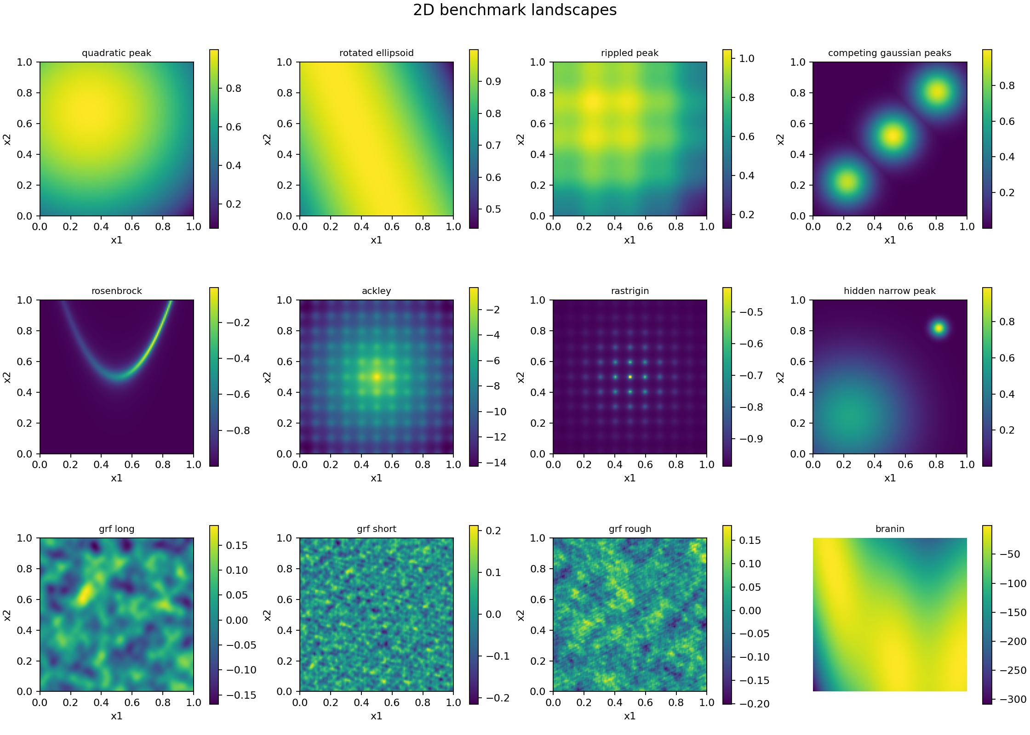
Phase 2 benchmark bank
Known optima and varied landscape structure provide reproducible BO stress tests
24
11
continuous benchmark cases
benchmark families
2D / 3D
normalized search domains
What the bank tests
Smoothness
Anisotropy
Multiple modes
Narrow peaks
Curved valleys
Source: PHASE2_README.md and results/phase2/gallery/benchmark_gallery_2d.png
22

Slide 23
The 3 × 3 Ising MRF extension
A small structured discrete problem adds interactions that continuous benchmarks do not contain
Energy-based objective
s1
s2
s3
f(s) = Σᵢ hᵢsᵢ + Σ(i,j) Jᵢⱼsᵢsⱼ
s4
s5
s6
Why it matters
The objective depends on neighboring variables.
Exact enumeration gives a trusted MAP reference.
The pilot still uses a generic encoded-space kernel, so graph-aware covariance remains future work.
s7
s8
s9
9 binary variables
2⁹ = 512 exact states
Source: src/benchmarks.py, tests/test_mrf_benchmark.py, and docs/benchmarks.md
23

Slide 24
Phase 2 verification and outputs
The benchmark layer is tested before it is used to compare optimization policies
33
Repository structure
benchmark and MRF tests passed
src/benchmarks.py
Definitions, bounds, known optima
tests/test_benchmarks.py
Continuous-case validation
512
tests/test_mrf_benchmark.py
Discrete state and MAP checks
MRF states checked against exact MAP
examples/phase2_gallery.py
Reproducible landscape figures
results/phase2/gallery/
Generated benchmark plots
Phase 2 provides test landscapes. It does not claim that one BO method or stopping rule is reliable.
Verification command: pytest tests/test_benchmarks.py tests/test_mrf_benchmark.py
24

Slide 25
Phase 3 experimental matrix
One-factor contrasts isolate how objectives, model assumptions, and acquisition choices affect BO
9
12
5
9 × 12 × 5 = 540 trajectories
systems
configurations
paired seeds
Systems
Model contrasts
Search policies
Shared protocol
Smooth and anisotropic 2D
Rippled and narrow peaks
Rosenbrock and Ackley 3D
Rough random field
Ising MRF
RBF and Matérn kernels
Length scale ×0.5 and ×2
Matched 3% observation noise
UCB with β = 0.5, 2, or 8
Expected improvement
Probability of improvement
Random search
5 initial observations
24 evaluations maximum
Finite candidate catalogues
Normalized regret ≤ 0.05
Source: experiments/phase3_characterization.py and docs/phase3_characterization.md
25

Slide 26
Fixed-budget performance across selected configurations
Success means final normalized regret no greater than 0.05 after 24 evaluations
100%
69.3%
80%
76%
78%
pooled success across all 540 trajectories
71%
73%
64%
60%
44%
0.129
40%
pooled mean normalized regret
20%
The strongest average row is a follow-up candidate, not a universal winner. Results vary sharply by system.
0%
Random
RBF length ×2
Nominal RBF + UCB
EI
Matérn 5/2
Matérn 3/2 + length ×2
Source: results/phase3/characterization/summary.csv; five seeds per system/configuration
26

Slide 27
Performance depends strongly on the objective
The nominal RBF/UCB setting solves several grids but fails on the curved 3D valley
0.9
0.859
Key failure cases
0.8
Rosenbrock 3D
0.859 nominal regret
0.6
0.4
Hidden narrow peak
0.158 nominal regret
0.2
0.158
0.089
0.038
0.039
0.000
0.000
0.000
0.000
0.0
A pooled score hides systems that require more budget or different modeling assumptions.
Smooth 2D
Anisotropic 2D
Competing modes
Ackley 3D
Rippled 2D
Ising MRF
Rough field
Hidden narrow
Rosenbrock 3D
Source: nominal rows in results/phase3/characterization/summary.csv
27

Slide 28
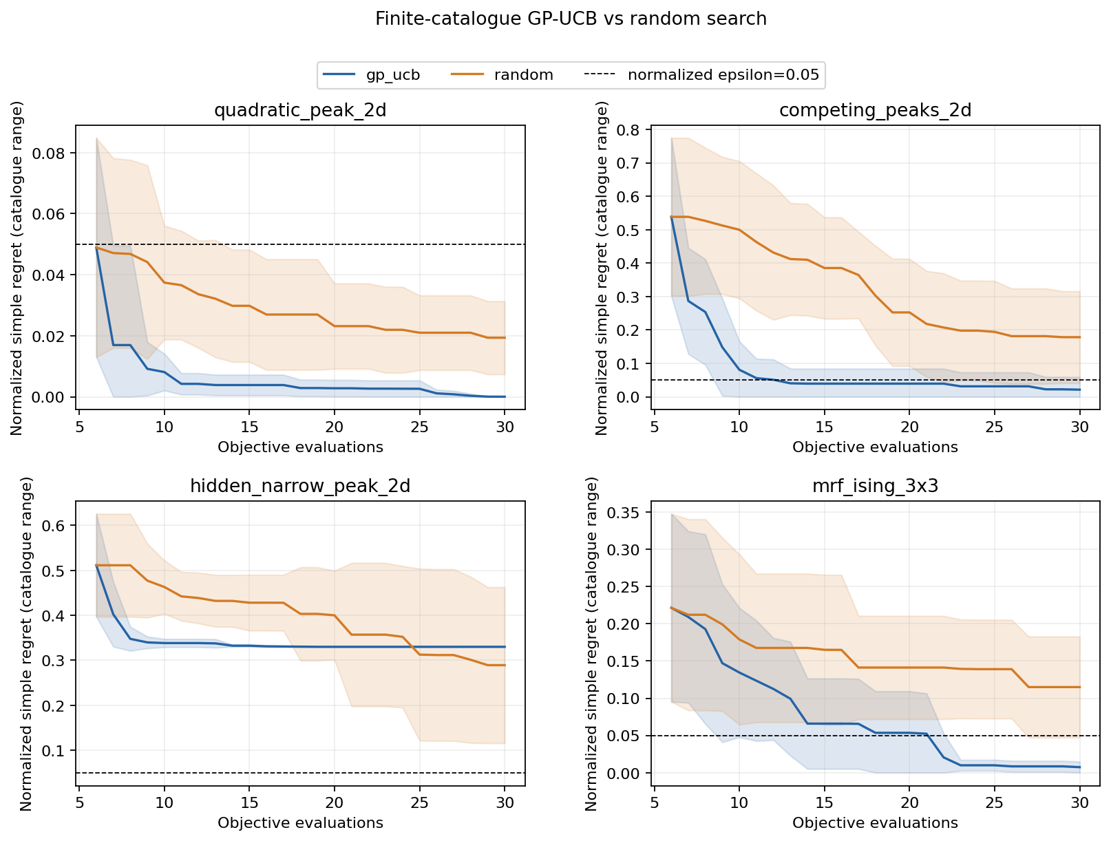
MRF pilot: GP-UCB outperforms random search
The encoded-space GP-UCB policy reaches a useful Ising solution consistently in this small pilot
Ising MRF results
100%
GP-UCB success
20%
random-search success
Mean normalized regret
GP-UCB 0.007
Random 0.115
Source: results/phase3/mrf_bo_pilot/summary.csv and regret_curves.png; 10 seeds
28

Slide 29
Stopping rules trade savings for reliability
The current diagnostics reduce evaluations, but false stops remain too frequent
False-stop rate
Mean evaluations saved
50%
12
43.9%
10.57
40%
10
32.2%
33.5%
8
30%
6
20%
4
3.27
2.42
10%
2
0%
0.0
Global UCB gap
P(improve)
Patience-5
Global UCB gap
P(improve)
Patience-5
Patience saves the most evaluations, but it stops unsuccessful runs too often. The posterior rules are more conservative and still false-stop about one third of runs.
Source: results/phase3/characterization/stopping_rules.csv; 24-evaluation maximum
29

Slide 30
Next research steps
The prototype identifies failure modes. The next phase turns them into a common BoTorch comparison.
1
Complete Phase 3
Implement LogEI, LogPI, UCB, Thompson sampling, and MES in one protocol
2
Confirm findings
Use common budgets, initial points, seeds, and success criteria
3
Build Phase 4
Implement common-EI, confidence-gap, and posterior-regret stopping observers
4
Calibrate reliability
Sweep thresholds and report regret, false stops, and evaluation savings together
Main conclusion
Finding a good candidate and deciding that optimization can safely stop require separate evidence.
Planned next work: formal BoTorch Phase 3 followed by calibrated Phase 4 stopping rules
30

