Slide 1
Project progress since Phase 1
The project now covers benchmark design, a structured discrete case, and BO stopping behavior
1
2
3
Phase 1
Phase 2
Phase 3 prototype
BO foundation
Benchmark bank + Ising MRF
Policy and stopping characterization
A tested 1D BoTorch loop established the modeling and acquisition workflow.
24 continuous cases plus a 3 × 3 binary Ising MRF created controlled test problems.
540 trajectories measured model sensitivity, search quality, and early stopping failures.
Current status
The code and results are separated into Phase 2 and Phase 3 branches. Main remains unchanged.
Project status: phase2-benchmarks and phase3-characterization branches
11

Slide 2
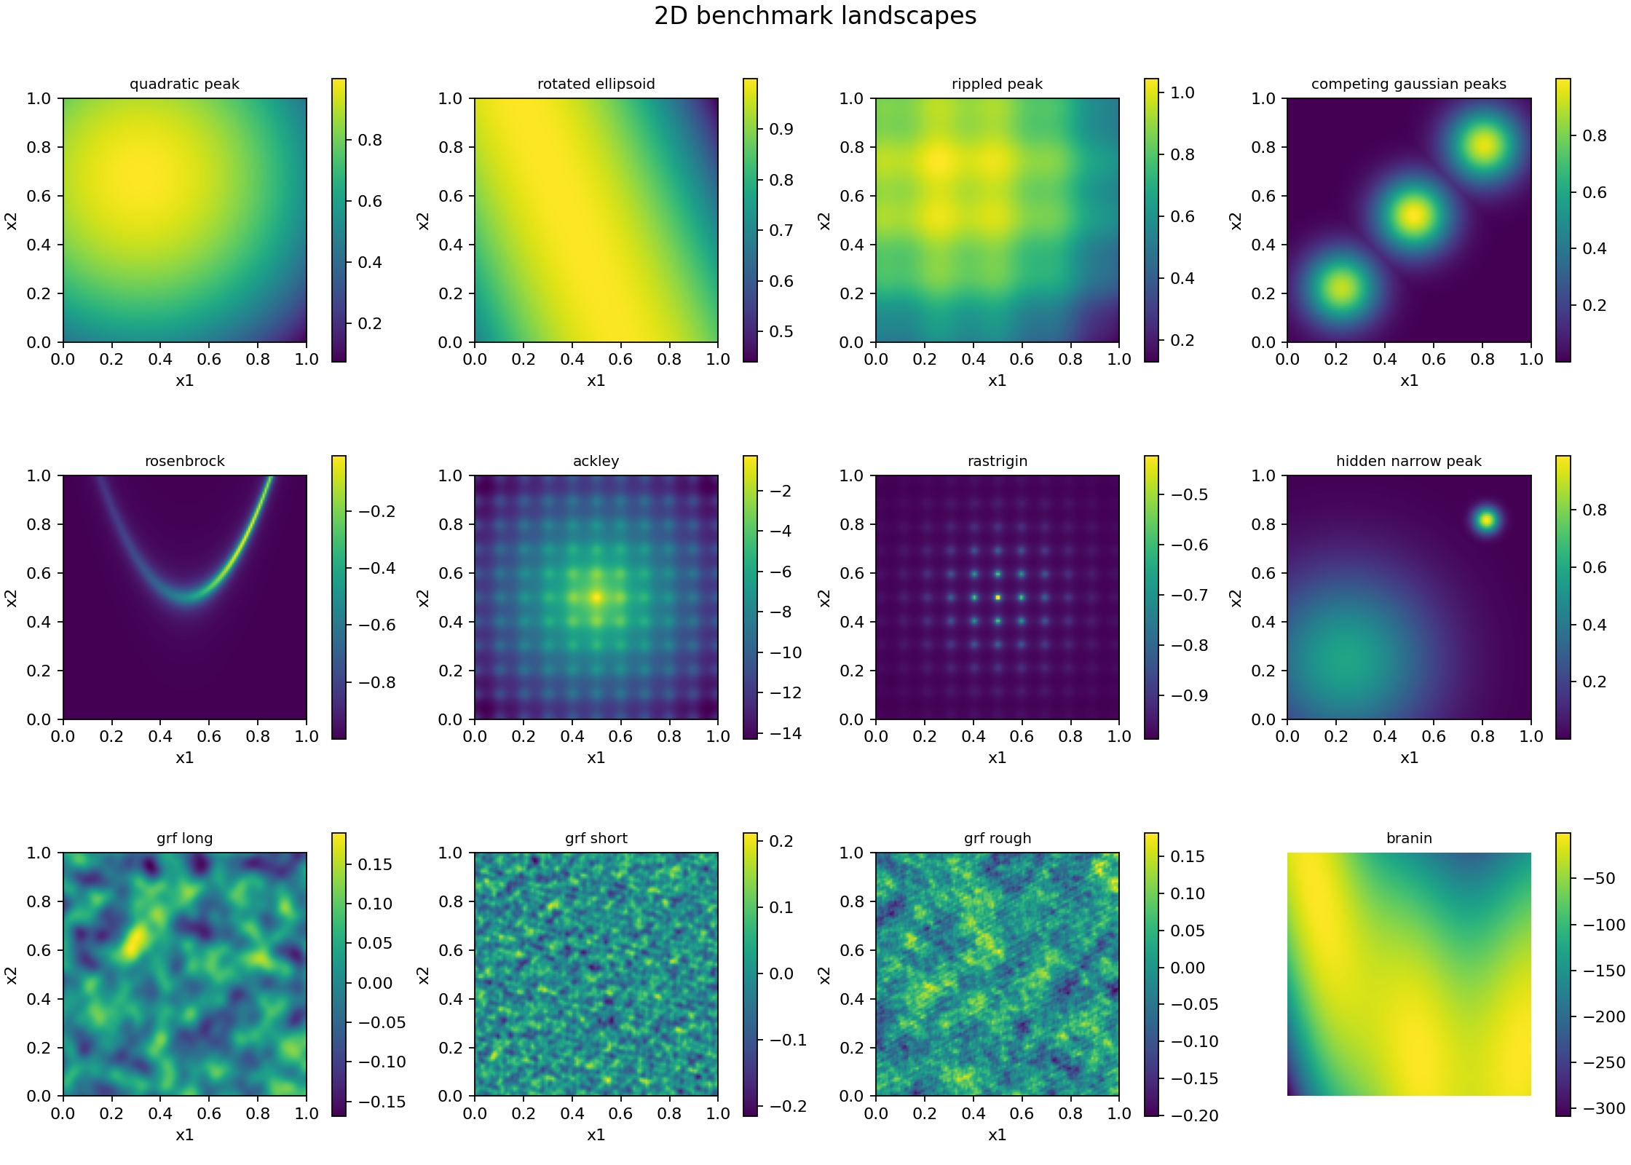
Phase 2 benchmark bank
Known optima and varied landscape structure provide reproducible BO stress tests
24
11
continuous benchmark cases
benchmark families
2D / 3D
normalized search domains
What the bank tests
Smoothness
Anisotropy
Multiple modes
Narrow peaks
Curved valleys
Source: PHASE2_README.md and results/phase2/gallery/benchmark_gallery_2d.png
12

Slide 3
The 3 × 3 Ising MRF extension
A small structured discrete problem adds interactions that continuous benchmarks do not contain
Energy-based objective
s1
s2
s3
f(s) = Σᵢ hᵢsᵢ + Σ(i,j) Jᵢⱼsᵢsⱼ
s4
s5
s6
Why it matters
The objective depends on neighboring variables.
Exact enumeration gives a trusted MAP reference.
The pilot still uses a generic encoded-space kernel, so graph-aware covariance remains future work.
s7
s8
s9
9 binary variables
2⁹ = 512 exact states
Source: src/benchmarks.py, tests/test_mrf_benchmark.py, and docs/benchmarks.md
13

Slide 4
Phase 2 verification and outputs
The benchmark layer is tested before it is used to compare optimization policies
33
Repository structure
benchmark and MRF tests passed
src/benchmarks.py
Definitions, bounds, known optima
tests/test_benchmarks.py
Continuous-case validation
512
tests/test_mrf_benchmark.py
Discrete state and MAP checks
MRF states checked against exact MAP
examples/phase2_gallery.py
Reproducible landscape figures
results/phase2/gallery/
Generated benchmark plots
Phase 2 provides test landscapes. It does not claim that one BO method or stopping rule is reliable.
Verification command: pytest tests/test_benchmarks.py tests/test_mrf_benchmark.py
14

Slide 5
Phase 3 experimental matrix
One-factor contrasts isolate how objectives, model assumptions, and acquisition choices affect BO
9
12
5
9 × 12 × 5 = 540 trajectories
systems
configurations
paired seeds
Systems
Model contrasts
Search policies
Shared protocol
Smooth and anisotropic 2D
Rippled and narrow peaks
Rosenbrock and Ackley 3D
Rough random field
Ising MRF
RBF and Matérn kernels
Length scale ×0.5 and ×2
Matched 3% observation noise
UCB with β = 0.5, 2, or 8
Expected improvement
Probability of improvement
Random search
5 initial observations
24 evaluations maximum
Finite candidate catalogues
Normalized regret ≤ 0.05
Source: experiments/phase3_characterization.py and docs/phase3_characterization.md
15

Slide 6
Fixed-budget performance across selected configurations
Success means final normalized regret no greater than 0.05 after 24 evaluations
100%
69.3%
80%
76%
78%
pooled success across all 540 trajectories
71%
73%
64%
60%
44%
0.129
40%
pooled mean normalized regret
20%
The strongest average row is a follow-up candidate, not a universal winner. Results vary sharply by system.
0%
Random
RBF length ×2
Nominal RBF + UCB
EI
Matérn 5/2
Matérn 3/2 + length ×2
Source: results/phase3/characterization/summary.csv; five seeds per system/configuration
16

Slide 7
Performance depends strongly on the objective
The nominal RBF/UCB setting solves several grids but fails on the curved 3D valley
0.9
0.859
Key failure cases
0.8
Rosenbrock 3D
0.859 nominal regret
0.6
0.4
Hidden narrow peak
0.158 nominal regret
0.2
0.158
0.089
0.038
0.039
0.000
0.000
0.000
0.000
0.0
A pooled score hides systems that require more budget or different modeling assumptions.
Smooth 2D
Anisotropic 2D
Competing modes
Ackley 3D
Rippled 2D
Ising MRF
Rough field
Hidden narrow
Rosenbrock 3D
Source: nominal rows in results/phase3/characterization/summary.csv
17

Slide 8
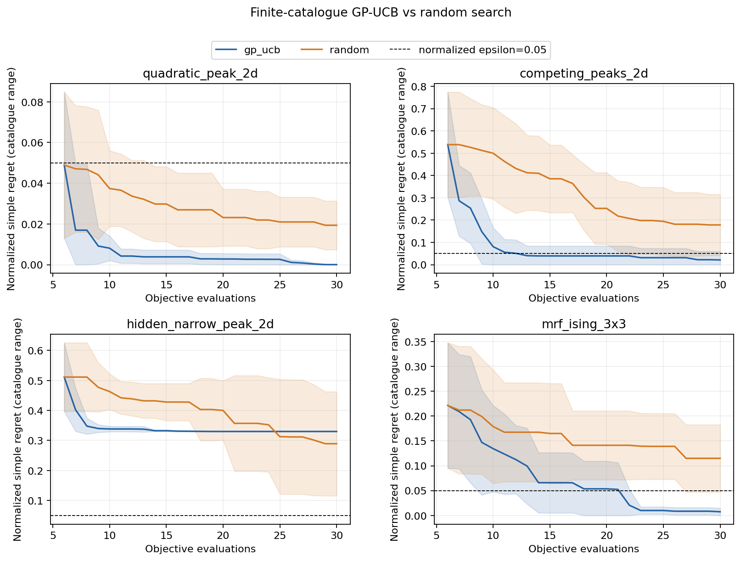
MRF pilot: GP-UCB outperforms random search
The encoded-space GP-UCB policy reaches a useful Ising solution consistently in this small pilot
Ising MRF results
100%
GP-UCB success
20%
random-search success
Mean normalized regret
GP-UCB 0.007
Random 0.115
Source: results/phase3/mrf_bo_pilot/summary.csv and regret_curves.png; 10 seeds
18

Slide 9
Stopping rules trade savings for reliability
The current diagnostics reduce evaluations, but false stops remain too frequent
False-stop rate
Mean evaluations saved
50%
12
43.9%
10.57
40%
10
32.2%
33.5%
8
30%
6
20%
4
3.27
2.42
10%
2
0%
0.0
Global UCB gap
P(improve)
Patience-5
Global UCB gap
P(improve)
Patience-5
Patience saves the most evaluations, but it stops unsuccessful runs too often. The posterior rules are more conservative and still false-stop about one third of runs.
Source: results/phase3/characterization/stopping_rules.csv; 24-evaluation maximum
19

Slide 10
Next research steps
The prototype identifies failure modes. The next phase turns them into a common BoTorch comparison.
1
Complete Phase 3
Implement LogEI, LogPI, UCB, Thompson sampling, and MES in one protocol
2
Confirm findings
Use common budgets, initial points, seeds, and success criteria
3
Build Phase 4
Implement common-EI, confidence-gap, and posterior-regret stopping observers
4
Calibrate reliability
Sweep thresholds and report regret, false stops, and evaluation savings together
Main conclusion
Finding a good candidate and deciding that optimization can safely stop require separate evidence.
Planned next work: formal BoTorch Phase 3 followed by calibrated Phase 4 stopping rules
20

