Slide 1
CPH 200C — Problem Set 1 + 2
Risk Stratification for 30-Day Diabetic Readmission
2026-05-14

Slide 2
Overview
OVERVIEW
CPH 200C — Problem Set 1 + 2

Slide 3
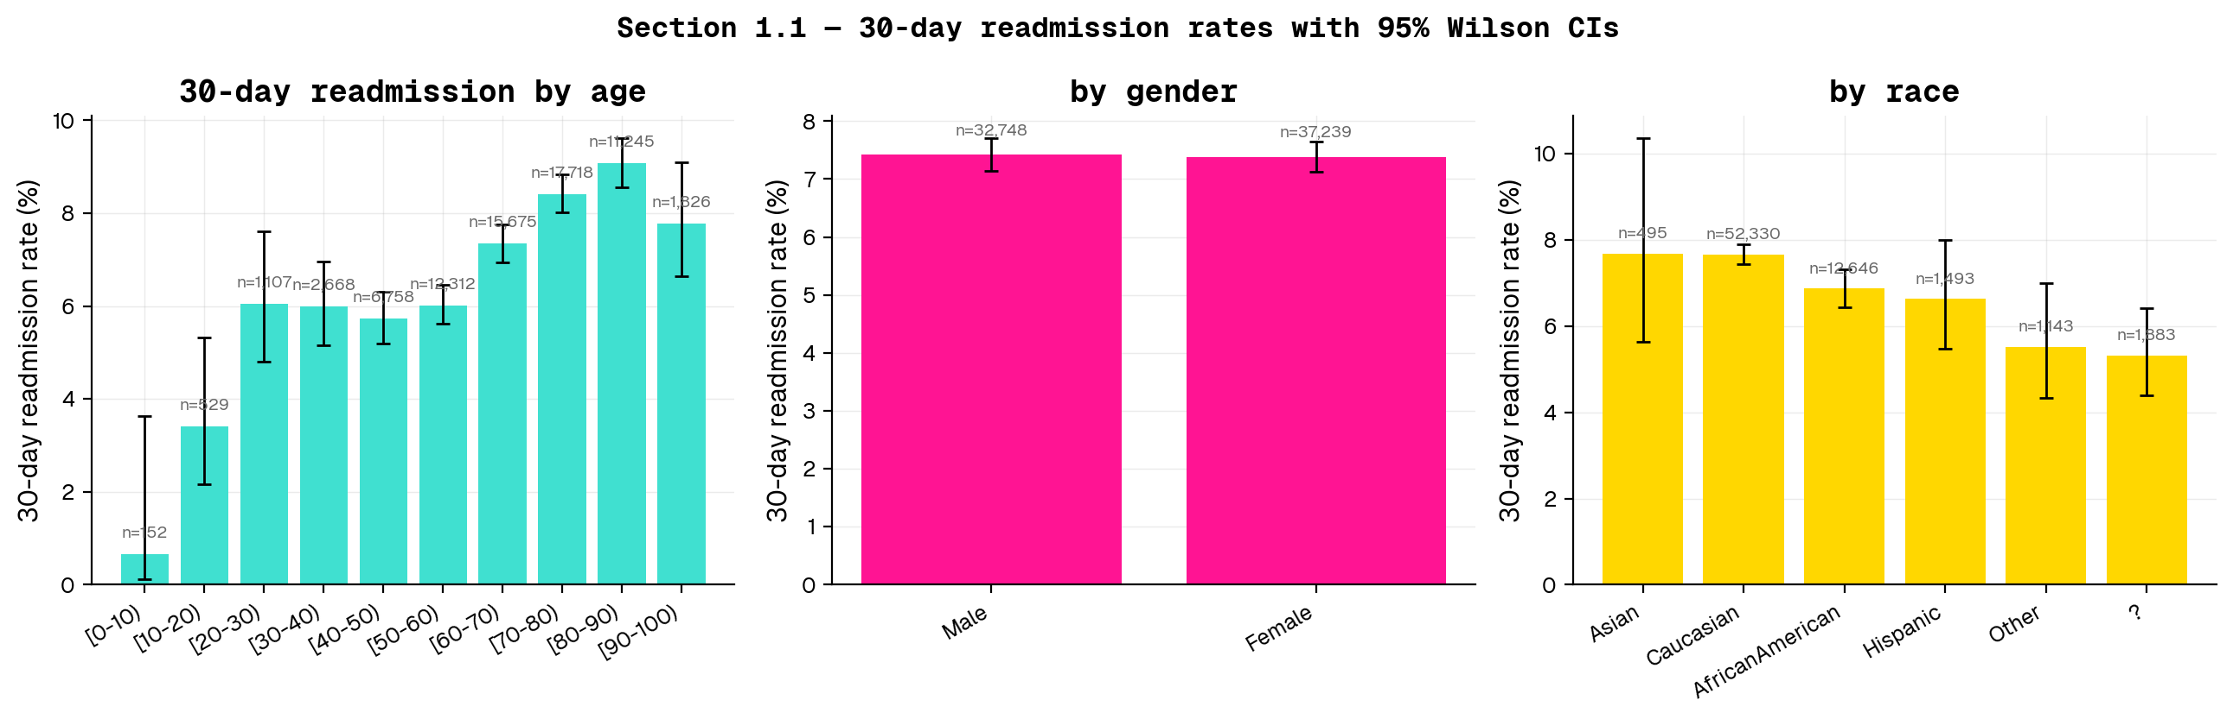
1.1 — Data Exploration · Figure 1
CPH 200C — Problem Set 1 + 2 · 2026-05-14

Slide 4
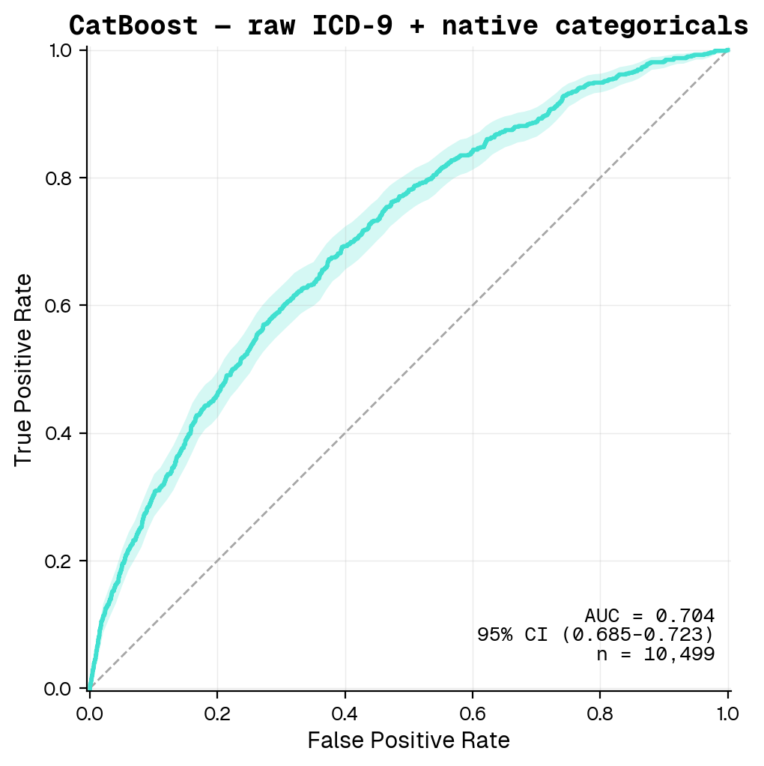
1.1 — Data Exploration · Figure 2
CPH 200C — Problem Set 1 + 2 · 2026-05-14

Slide 5
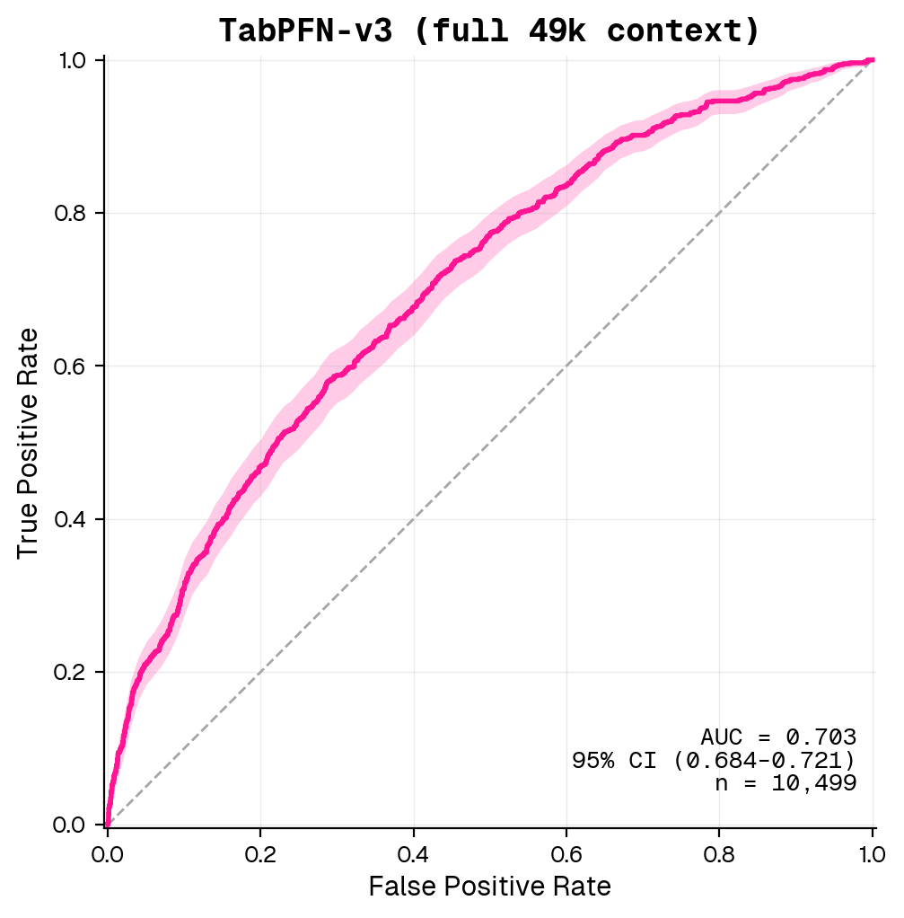
1.1 — Data Exploration · Figure 3
CPH 200C — Problem Set 1 + 2 · 2026-05-14

Slide 6
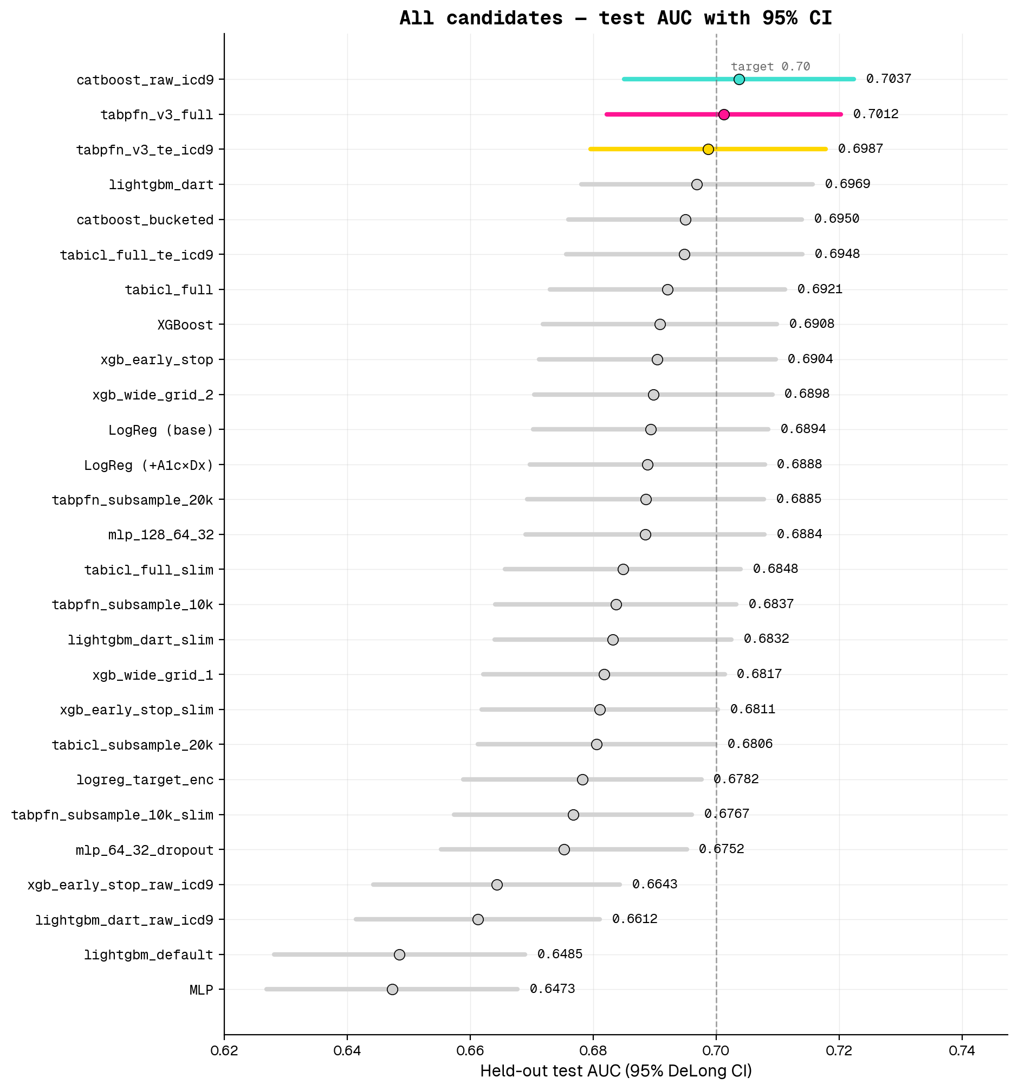
1.1 — Data Exploration · Figure 4
CPH 200C — Problem Set 1 + 2 · 2026-05-14

Slide 7
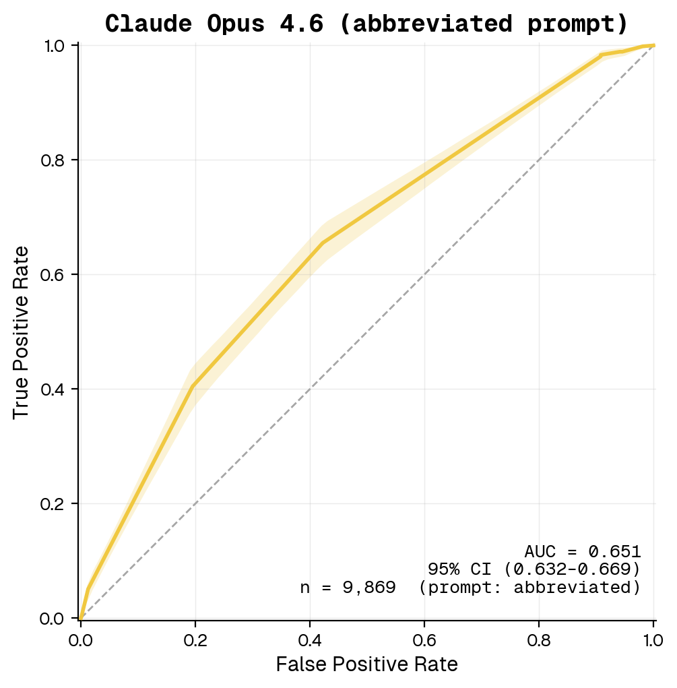
1.1 — Data Exploration · Figure 5
CPH 200C — Problem Set 1 + 2 · 2026-05-14

Slide 8
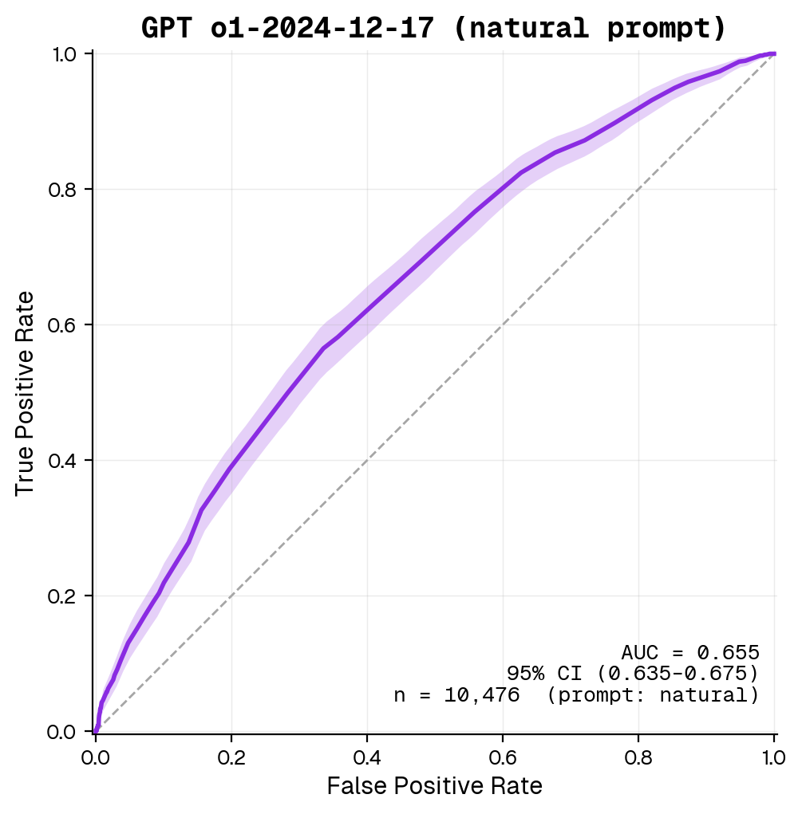
1.1 — Data Exploration · Figure 6
CPH 200C — Problem Set 1 + 2 · 2026-05-14

Slide 9
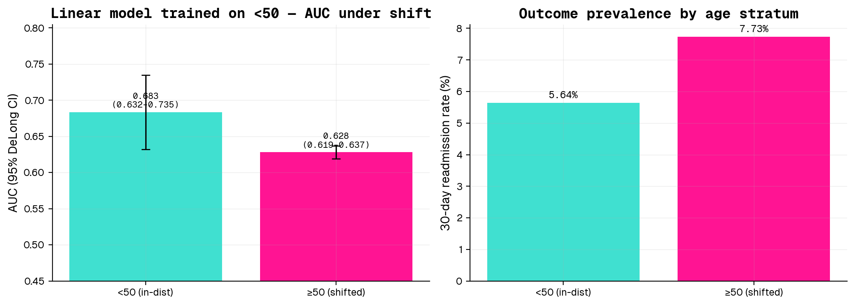
1.1 — Data Exploration · Figure 7
CPH 200C — Problem Set 1 + 2 · 2026-05-14

Slide 10
Thanks

