Slide 1


CPH 200C PS3 · REGIONAL AI · 2026
Three Governing Systems for AI
How the US, Europe, and Asia deploy AI: policy, funding, technical developments, and landscape by region
Curtis Chambers · Jinchi Wei
CPH 200C · Computational Precision Health
2026-06-04

Slide 2
FRAMING
Curtis Chambers · Jinchi Wei
·
CPH 200C · Computational Precision Health
·
Three Governing Systems for AI
Notes:
Framing
Opening section: the one-slide thesis and the regulate/build/deploy lens.

Slide 3
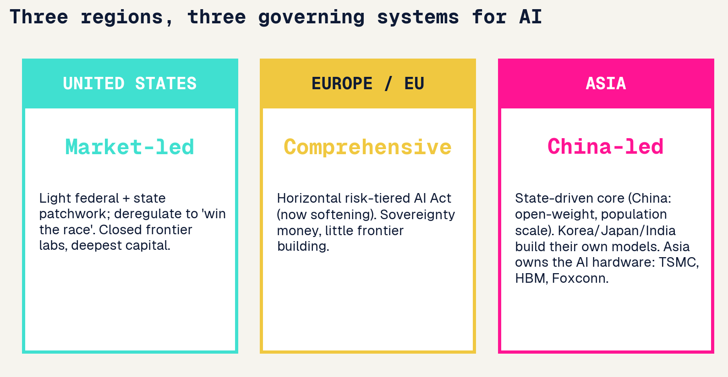
Three governing systems for AI
Same technology, three different games. The rest of the deck is this slide, scope by scope.
Curtis Chambers · Jinchi Wei · CPH 200C · Computational Precision Health · Three Governing Systems for AI · 2026-06-04
Notes:
Three governing systems for AI
Three governing systems What this shows: a one-glance comparison of the three regions' AI 'governing systems'. What to say: the core thesis. The US, Europe, and China are not at different points on one road; they run fundamentally different systems. The US is market-led (light federal rules, deepest private capital, closed frontier labs). Europe is comprehensive-regulatory (one big horizontal law, the AI Act, now softening, plus sovereignty money but little frontier building). China is state-driven (iterative ministry rules, heavy industrial policy, open-weight models, population-scale deployment). Transition: the cleanest lens for the rest of the talk is three verbs.

Slide 4
Regulate, build, deploy
UNITED STATES
EUROPE / EU
ASIA
REGULATE
Light, late, contested
Heaviest, first-mover
State-led to light (varies)
BUILD
Frontier leader
ASML chokepoint only
Fast follower + owns hardware
DEPLOY
Enterprise SaaS
Compliance-gated, slow
Population scale
Curtis Chambers · Jinchi Wei · CPH 200C · Computational Precision Health · Three Governing Systems for AI · 2026-06-04
Notes:
Regulate, build, deploy
What this shows: a 3x3 scorecard, regions across the top, the three verbs down the side. What to say: almost no region does all three well. The US builds the frontier but regulates lightly and late. Europe regulates hardest and first but barely builds (its one real asset is ASML). China is the deployment champion at population scale and a fast-closing builder, governed by iterative state rules. The point to land: 'winning AI' is not one race, it is three, and each region is winning a different one. Transition: let us take them scope by scope, starting with the rules.

Slide 5
What leaders predicted, and what’s different now
CHINA
UNITED STATES
EUROPE / EU
Kai-Fu Lee
Eric Schmidt et al.
Mario Draghi
AI Superpowers (2018)
The Age of AI (2021); NSCAI
EU Competitiveness Report (2024)
The age of implementation: execution and data, not breakthroughs, decide the race, favoring China.
AI is a national-security race the US must win; warned of China closing the gap fast.
Europe regulates but does not build; structurally behind on compute, capital, and scale.
WHAT'S DIFFERENT NOW (2025):
None predicted a Chinese OPEN model (DeepSeek) would reset the frontier while US labs re-closed. Lee's implementation thesis holds, but the ROI gap shows capability is not yet value.
Curtis Chambers · Jinchi Wei · CPH 200C · Computational Precision Health · Three Governing Systems for AI · 2026-06-04
Notes:
What leaders predicted, and what’s different now
Predictions vs now Framing slide that earns the research framing. Three influential thinkers each forecast the AI race. China: Kai-Fu Lee's AI Superpowers (2018), the age of implementation, where execution and data decide the winner, favoring China. US: Eric Schmidt, co-author of The Age of AI and chair of the National Security Commission on AI, framed it as a national-security race the US must win. Europe: Mario Draghi's 2024 competitiveness report, Europe regulates but does not build. What's different now (purple band): the 2025 open-weight surge surprised everyone, a Chinese OPEN model reset the frontier while US labs re-closed. Lee's implementation thesis largely held; the ROI gap shows capability is not yet value. Transition: take the scopes one by one, starting with policy.

Slide 6
POLICY & REGULATION
Curtis Chambers · Jinchi Wei
·
CPH 200C · Computational Precision Health
·
Three Governing Systems for AI
Notes:
Policy & regulation
Transition: how each region writes the rules.

Slide 7
United States: executive whiplash plus a state patchwork
Executive whiplash
Trump rescinded Biden EO 14110 (Jan 2025); the July 2025 AI Action Plan deregulates to win the race; a Dec 2025 EO directs agencies to preempt state laws.
State patchwork
Colorado AI Act, Texas TRAIGA (Jan 2026), California SB 53, New York RAISE Act. A federal moratorium on state AI laws failed in the Senate 99 to 1.
Anti-woke procurement
EO 14319 bars federal purchase of LLMs that fail an ideological-neutrality test.
Frontier safety (Jun 2026)
Voluntary EO: labs grant up to 30-day pre-release access to NSA-designated frontier models + a Treasury cyber clearinghouse. No mandatory licensing, security-framed, not clinical.
Net effect
Light federal touch, a thickening state patchwork, and an open fight over who governs AI.
Curtis Chambers · Jinchi Wei · CPH 200C · Computational Precision Health · Three Governing Systems for AI · 2026-06-04
Notes:
United States: executive whiplash plus a state patchwork
US policy What to say: US federal AI policy reversed on day one of the Trump term. The Biden executive order was rescinded; the July 2025 AI Action Plan is explicitly deregulatory (win the race). With no federal framework, states wrote their own (Colorado, Texas, California, New York), creating a patchwork. The Senate killed a proposed 10-year moratorium on state laws 99 to 1, and a December 2025 executive order now tries to preempt those state laws through the courts. The newest, a June 2026 order, asks labs to voluntarily give the government up to 30 days of pre-release access to NSA-designated frontier models and sets up a Treasury cyber clearinghouse, but bars any mandatory licensing, so even the frontier-safety touch is voluntary and security-framed, not regulatory and not clinical. Net: light federal touch, thickening state rules, unresolved fight over who is in charge. Transition: contrast that with Europe, which did the opposite.

Slide 8
European Union: the AI Act, now softening
The AI Act
In force Aug 2024, phased: prohibited practices Feb 2025, foundation-model rules Aug 2025, high-risk 2026 to 2027. Penalties up to 35M euros or 7 percent of global turnover.
The softening
The Nov 2025 Digital Omnibus delays high-risk rules to 2027 and 2028 under competitiveness pressure; the separate AI Liability Directive was scrapped.
Regulates, does not build
Only 11 percent of EU firms use AI; 73 percent of foundation models are US-origin. Draghi: it is too late to build systemic challengers to US cloud.
Sovereignty money
InvestAI aims to mobilize 200B euros and build AI gigafactories, but ~90 percent of EU digital infrastructure is foreign-controlled.
Curtis Chambers · Jinchi Wei · CPH 200C · Computational Precision Health · Three Governing Systems for AI · 2026-06-04
Notes:
European Union: the AI Act, now softening
EU policy What to say: Europe took the opposite bet, the world's most comprehensive horizontal AI law. It entered force in 2024 and phases in through 2027, with serious penalties (up to 7 percent of global turnover). But in late 2025, under a competitiveness panic crystallized by the Draghi report, Brussels began walking it back, the Digital Omnibus delays the high-risk rules and the AI liability directive was scrapped. The hard truth: only 11 percent of EU firms use AI and almost three-quarters of foundation models are American. Europe is pouring sovereignty money in (InvestAI 200B euros), but it regulates far better than it builds. Transition: China is a third species entirely.

Slide 9
China: vertical rules and alignment to state values
Vertical, not omnibus
No single AI law; iterative ministry rules. The 2023 Interim Measures govern public GenAI; 748 services were filed with regulators by Dec 2025.
Mandatory labeling
Since Sept 1 2025, all AI-generated content must carry explicit and hidden (metadata) labels.
Aligned to state values
Models must uphold core socialist values; China dropped a comprehensive AI law from its 2025 agenda in favor of pilots and standards.
Governance offensive
At the 2025 World AI Conference, Beijing proposed a World AI Cooperation Organization, courting the Global South against US go-it-alone policy.
Curtis Chambers · Jinchi Wei · CPH 200C · Computational Precision Health · Three Governing Systems for AI · 2026-06-04
Notes:
China: vertical rules and alignment to state values
China policy What to say: China governs AI with neither the US's light touch nor the EU's omnibus, but a stack of vertical, fast-iterating ministry rules. Public-facing GenAI must be filed with regulators (748 services by end-2025); since September 2025 all AI content must be labeled, visibly and in metadata. Distinctively, models must align to core socialist values, an alignment-to-the-state regime quite unlike Western safety rules. And China is going on the offensive internationally, proposing its own global AI governance body to court the Global South. Transition: so the three philosophies, side by side.

Slide 10
Asia’s regulatory split
China
State-vertical
Iterative ministry rules, AI-content labeling, alignment to state values. No omnibus law.
South Korea
Comprehensive
AI Basic Act (effective Jan 2026), the 2nd after the EU, but far lighter (fines cap ~$21k).
Japan
Innovation-first
AI Promotion Act (2025): no penalties, guidance and name-and-shame only.
India
Light-touch
IndiaAI Governance Guidelines (Nov 2025); no standalone AI law, existing statutes adapted.
Singapore
Voluntary + tooling
Model AI Governance Framework + AI Verify, the first government AI-testing toolkit.
Curtis Chambers · Jinchi Wei · CPH 200C · Computational Precision Health · Three Governing Systems for AI · 2026-06-04
Notes:
Asia’s regulatory split
Asia's regulatory split What to say: this is the slide that breaks the lazy habit of treating Asia as one bloc. It is five different regimes. China is state-vertical (iterative rules, content labeling, state-values alignment). South Korea just became the second jurisdiction after the EU with a comprehensive AI law, but it is far lighter, fines top out around 21 thousand dollars. Japan went the opposite way, an innovation-first law with literally no penalties. India and Singapore are light-touch, India adapts existing statutes rather than passing a new law, Singapore leans on voluntary frameworks plus its AI Verify testing toolkit. So Asia spans the entire regulatory spectrum, from the most statist to among the most permissive. Transition: but where Asia is genuinely unified and dominant is hardware.

Slide 11
Regulatory philosophy, side by side
LIGHT-TOUCH
COMPREHENSIVE
STATE-VERTICAL
US, UK, Japan, India
EU, South Korea
China
Innovation first. Few or no penalties. Rules follow harm, if at all.
One horizontal law, risk-tiered, ex-ante. Heaviest compliance load.
Iterative sector rules + industrial policy + alignment to state values.
ASIA SPLITS
Japan: AI Promotion Act (2025), no penalties. South Korea: AI Basic Act (effective Jan 2026), EU-style comprehensive. India: light-touch + the IndiaAI Mission.
Curtis Chambers · Jinchi Wei · CPH 200C · Computational Precision Health · Three Governing Systems for AI · 2026-06-04
Notes:
Regulatory philosophy, side by side
Regulatory philosophy What to say: three genuinely different species of regulation, not points on one line. Light-touch (US, UK, Japan, India): innovation first, rules follow harm. Comprehensive (EU and now South Korea): one horizontal risk-tiered law applied up front, the heaviest compliance load. State-vertical (China): iterative sector rules fused with industrial policy and state-values alignment. The purple band makes the point that Asia is not monolithic, Japan and India went light-touch, South Korea went full EU-style. Transition: rules are one thing, but the hard physical fight is over chips.

Slide 12
GEOPOLITICS & COMPUTE
Curtis Chambers · Jinchi Wei
·
CPH 200C · Computational Precision Health
·
Three Governing Systems for AI
Notes:
Geopolitics & compute
Transition: the chip war and the physical constraints, compute and energy.

Slide 13
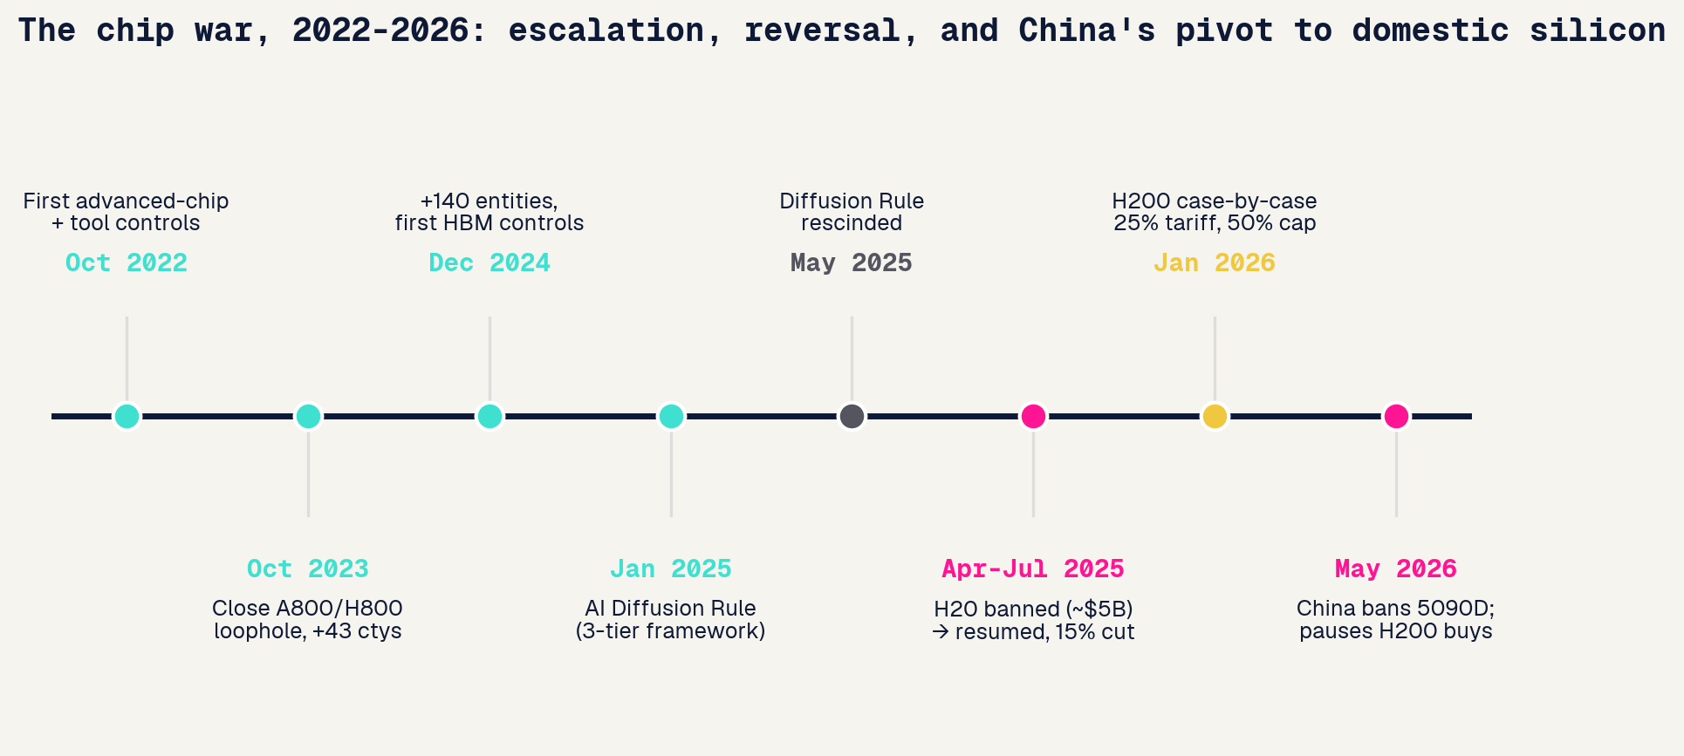
The chip war, 2022 to 2026
Sources: BIS / Commerce rules, NVIDIA filings, Tom's Hardware. The US tightened for three years, abruptly reversed in 2025, and China decoupled regardless.
Curtis Chambers · Jinchi Wei · CPH 200C · Computational Precision Health · Three Governing Systems for AI · 2026-06-04
Notes:
The chip war, 2022 to 2026
Chip war timeline How to read it: a left-to-right timeline of US export controls and NVIDIA-China events. What to say: from October 2022 the US progressively tightened controls on advanced chips and tools, closing loopholes (the A800/H800 trick) and adding memory and entities. The January 2025 AI Diffusion Rule created a three-tier country system, then the new administration rescinded it in May 2025. The H20 chip was banned in April 2025, then allowed back in July under an unprecedented deal giving the US government 15 percent of the China revenue. By 2026 H200 sales are case-by-case with a 25 percent tariff, and China responded by banning NVIDIA's workaround card and pushing its own silicon. Transition: that pivot to domestic chips is the next slide.

Slide 14
The NVIDIA saga and China’s domestic stack
EXPORT CONTROLS + NVIDIA
CHINA'S DOMESTIC STACK
H20 banned Apr 2025 (~$5B NVIDIA charge), resumed Jul 2025 with a 15% cut of China revenue to the US government.
Huawei Ascend 910C ~60% of an H100; CloudMatrix 384 links 384 chips to rival NVIDIA racks.
H200 moved to case-by-case Jan 2026: 25% tariff, 50% volume cap, US testing.
Nine domestic chips put on the secure-and-reliable procurement list; state data centers must buy local.
NVIDIA China share fell below 60%; the House AI Overwatch Act would bar Blackwell for two years.
Chinese firms shipped 1.65M AI GPUs in 2025; China banned the 5090D and paused H200 buys.
Curtis Chambers · Jinchi Wei · CPH 200C · Computational Precision Health · Three Governing Systems for AI · 2026-06-04
Notes:
The NVIDIA saga and China’s domestic stack
NVIDIA saga + domestic stack What to say: the left panel is the US-NVIDIA story, an on-again-off-again ban on the China-specific H20, ending in a remarkable arrangement where Washington takes a 15 percent cut of NVIDIA's China sales, and now case-by-case H200 with a 25 percent tariff. The right panel is the consequence: China doubled down on domestic silicon. Huawei's Ascend is roughly 60 percent of an H100 per chip but ganged into competitive systems; nine domestic chips are now the mandated procurement list; Chinese firms shipped 1.65 million AI GPUs in 2025. The export controls accelerated exactly the self-sufficiency they were meant to prevent. Transition: but the binding constraint may not be chips, it is power.

Slide 15
Scale versus constraint: two paths to better models
UNITED STATES: SCALE
CHINA: CONSTRAINT
Answer the race with compute: Stargate ($500B), ~$700B hyperscaler capex in 2026, nuclear power deals. Frontier models stay closed. Abundant GPUs mean less pressure to economize.
Capped on advanced GPUs by export controls, efficiency becomes the edge: mixture-of-experts, distillation, DeepSeek's ~$6M training run, cheap inference. Necessity drives method innovation.
Stargate; hyperscaler capex 2026
DeepSeek-V3 technical report, 2025
EUROPE: the upstream chokepoint. ASML's EUV monopoly is the gate the controls run through.
The provocative read: the GPU ceiling may be pushing China toward genuine methodology innovation, while the US mostly scales hardware. May 2026: Huawei's chairman publicly thanked the US for export controls, saying they 'supercharged' China's chip industry (Tom's Hardware; SCMP).
Curtis Chambers · Jinchi Wei · CPH 200C · Computational Precision Health · Three Governing Systems for AI · 2026-06-04
Notes:
Scale versus constraint: two paths to better models
Scale vs constraint The most interesting technical point, representing both sides. The US answers the race with scale, Stargate, roughly 700 billion in 2026 hyperscaler capex, nuclear deals, frontier models kept closed. China, capped on advanced chips, is pushed toward method innovation: mixture-of-experts, distillation, DeepSeek's ~6-million-dollar run, cheap inference. Europe's leverage is upstream, ASML's EUV monopoly. The provocative read: the export-control ceiling may be backfiring. Fresh evidence, end of May 2026, Huawei's rotating chairman publicly thanked the US for the controls, saying they supercharged China's chip industry, and Huawei pitched a data-throughput scaling law to route around EUV it cannot buy. Treat the architecture claim as unverified (SCMP asks breakthrough or hype), but the posture, China openly framing the controls as counterproductive, is the point. Transition: who owns the hardware.

Slide 16
Compute and energy: the binding constraints
UNITED STATES
CHINA
EUROPE / EU
16 GW
~400 GW
EUR 200B
data-center pipeline, but only ~5 GW under construction. ~$700B hyperscaler capex in 2026. Power is the bottleneck.
projected spare power by 2030 (added 430 GW wind+solar in 2025). 40 GW DC by end-2026. Energy is the advantage.
InvestAI + AI gigafactories. ASML holds the EUV monopoly. Compute and capital are the gap.
Curtis Chambers · Jinchi Wei · CPH 200C · Computational Precision Health · Three Governing Systems for AI · 2026-06-04
Notes:
Compute and energy: the binding constraints
Compute & energy What to say: each region hits a different wall. The US has the chips and the capital (700B dollars of hyperscaler capex in 2026) but is power-constrained, a 16 GW pipeline with only about 5 GW actually under construction, Microsoft has an 80B dollar Azure backlog it cannot power. China is the mirror image: chip-constrained but energy-rich, projected to sit on roughly 400 GW of spare power by 2030 after adding 430 GW of wind and solar in a single year. Europe's constraint is compute and capital, with one irreplaceable asset, ASML. Cheap, abundant energy may be China's real structural edge. Transition: now to the companies actually building models.

Slide 17
Asia owns the AI hardware
TSMC
HBM
Foxconn
Taiwan
South Korea
Taiwan
Fabricates essentially all leading-edge AI chips. NVIDIA booked >60% of its CoWoS advanced-packaging capacity.
SK Hynix holds ~62% of HBM memory and is NVIDIA's lead supplier; with Samsung, a global duopoly.
Builds >40% of the world's AI servers, the lead integrator for NVIDIA GB200/GB300 racks.
The hedge: sovereign AI means local-language models on foreign chips. Singapore runs Qwen; Malaysia runs DeepSeek on Huawei. Asia makes the hardware the world's AI runs on, but rents the models.
Curtis Chambers · Jinchi Wei · CPH 200C · Computational Precision Health · Three Governing Systems for AI · 2026-06-04
Notes:
Asia owns the AI hardware
Asia owns the hardware What to say: this is Asia's single biggest structural advantage, and it spans the region, not just China. The physical AI supply chain runs through a Taiwan-Korea spine. TSMC in Taiwan fabricates essentially every leading-edge AI chip, and the real bottleneck, its CoWoS advanced packaging, is >60% booked by NVIDIA alone. South Korea owns the memory, SK Hynix has roughly 62% of the HBM that every AI accelerator needs and is NVIDIA's lead supplier. Foxconn, also Taiwan, assembles more than 40% of the world's AI servers. The callout is the irony: Asia makes the hardware the entire world's AI runs on, yet much of Asia rents its models, Singapore on Alibaba's Qwen, Malaysia on DeepSeek. Sovereignty over silicon, dependence on models. Transition: speaking of models, here is Asia beyond China.

Slide 18
CORPORATE & MODELS
Curtis Chambers · Jinchi Wei
·
CPH 200C · Computational Precision Health
·
Three Governing Systems for AI
Notes:
Corporate & models
Transition: who actually builds the models in each region.

Slide 19
United States: the closed frontier and a capital arms race
$5.2T
$852B
~$965B
$700B
NVIDIA market cap (world #1)
OpenAI valuation
Anthropic (press-reported)
2026 hyperscaler capex
The frontier shifted back to CLOSED: after Llama 4 stumbled and DeepSeek leveraged its open weights, even Meta pivoted toward proprietary models. OpenAI, Anthropic, and Google keep their best models closed to recoup training cost and limit misuse.
Curtis Chambers · Jinchi Wei · CPH 200C · Computational Precision Health · Three Governing Systems for AI · 2026-06-04
Notes:
United States: the closed frontier and a capital arms race
US corporate What to say: the US story is scale of capital and a return to closed models. NVIDIA is the most valuable company on earth at over 5 trillion dollars; OpenAI and Anthropic carry near-trillion-dollar valuations (the Anthropic figure is press-reported, flag that). The strategic shift is the callout: the frontier moved back to closed. After Meta's open Llama 4 underwhelmed and DeepSeek used Meta's own open weights to leapfrog, even Meta pivoted toward proprietary models. US labs keep their best models closed. Transition: Europe could not be more different.

Slide 20
Europe: one chokepoint, a thin application layer
Mistral (FR)
ASML
EUR 11.7B; ASML took ~11%
The one irreplaceable asset. Monopoly on EUV lithography (~90% share, ~$250M/machine); EUR 32.7B 2025 sales. Every advanced NVIDIA or TSMC chip depends on it. Europe's leverage is hardware, not models.
Helsing (DE)
defense AI, EUR 12B
ElevenLabs / Synthesia
$11B / ~$4B; application layer
Curtis Chambers · Jinchi Wei · CPH 200C · Computational Precision Health · Three Governing Systems for AI · 2026-06-04
Notes:
Europe: one chokepoint, a thin application layer
Europe corporate What to say: Europe has exactly one piece of irreplaceable leverage in the entire AI stack, and it is hardware, not software, ASML, the Dutch company with a monopoly on the EUV machines every advanced chip requires. Note ASML even became Mistral's largest shareholder. Beyond ASML, Europe has well-funded champions, Mistral, Helsing, ElevenLabs, but they sit mostly at the application layer; the frontier models and the cloud remain American. Europe builds the machine that makes the chips, but not the chips or the models. Transition: China took the opposite path, open weights at scale.

Slide 21
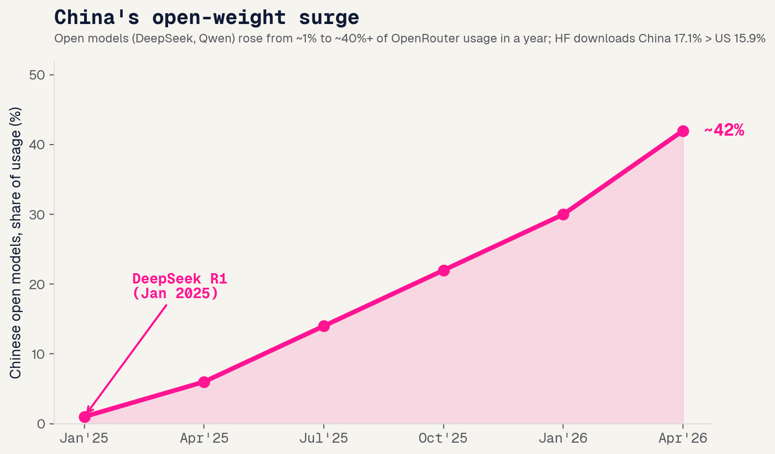
China: the open-weight surge
The DeepSeek moment
R1 (Jan 2025), trained for a reported ~$5.6M, topped the US App Store and wiped ~$600B off NVIDIA in a day.
An open-weight ecosystem
Qwen, Ernie, Kimi, GLM, Doubao, Pangu. Price wars (Qwen cut up to 97%); Doubao serves >120T tokens/day.
Global South adoption
Singapore's government chose Qwen; Malaysia's stack runs on DeepSeek. Open weights are becoming an export.
Curtis Chambers · Jinchi Wei · CPH 200C · Computational Precision Health · Three Governing Systems for AI · 2026-06-04
Notes:
China: the open-weight surge
China open-weight How to read the chart: Chinese open models went from about 1 percent to over 40 percent of usage on a major model router in roughly a year. What to say: the turning point was the DeepSeek moment in January 2025, a frontier-quality model trained for a tiny reported budget that briefly wiped 600 billion dollars off NVIDIA. China then leaned into open weights across the board, Qwen, Ernie, Kimi, GLM, Doubao, with brutal price wars. The strategic payoff: the Global South is increasingly deploying Chinese open models for AI sovereignty, Singapore and Malaysia among them. Open weights are becoming geopolitical infrastructure. Transition: so who actually uses all this?

Slide 22
Asia beyond China
INDIA
SOUTH KOREA
POPULATION-SCALE
CLINICAL-AI EXPORTER
Sarvam (govt-backed sovereign LLM) + Krutrim, under the national IndiaAI Mission. AI layered on UPI / Aadhaar at population scale; Qure.ai screens TB nationally.
Naver HyperCLOVA X, LG EXAONE (open-weight), Samsung Gauss, backed by a national AI fund. Lunit + VUNO export FDA-cleared clinical AI worldwide.
IndiaAI Mission; PIB 2025
MSIT; TechCrunch 2025
JAPAN
SOUTHEAST ASIA
INNOVATION-FIRST
THE BATTLEGROUND
Sakana AI, the country's top unicorn; SoftBank owns ~11% of OpenAI. No-penalty AI law; AI-hospital pilots; Rapidus chasing a 2nm fab.
SEA-LION switched from Meta's Llama to Alibaba's Qwen; Sahabat-AI (Indonesia), FPT (Vietnam). US and Chinese models compete for the next billion users.
AI Promotion Act 2025
TechNode 2025
Curtis Chambers · Jinchi Wei · CPH 200C · Computational Precision Health · Three Governing Systems for AI · 2026-06-04
Notes:
Asia beyond China
What to say: China is Asia's model heavyweight, but it is not the whole story, and I'm framing each by its distinctive role rather than by spend. India is population-scale: a government-anointed sovereign model effort (Sarvam) and the world's most interesting deployment substrate in UPI and Aadhaar. South Korea is the clinical-AI exporter: national-champion models (Naver, LG's open-weight EXAONE) at home, and Lunit and VUNO selling FDA-cleared clinical AI globally. Japan is innovation-first, a no-penalty AI law, Sakana as its most valuable unicorn, and SoftBank, which owns roughly 11 percent of OpenAI. Southeast Asia is the live battleground, and tellingly its flagship model SEA-LION switched from Meta's Llama to Alibaba's Qwen. Transition: now, who actually uses all of this?

Slide 23
DEPLOYMENT & ADOPTION
Curtis Chambers · Jinchi Wei
·
CPH 200C · Computational Precision Health
·
Three Governing Systems for AI
Notes:
Deployment & adoption
Transition: from who builds to who uses, and how.

Slide 24
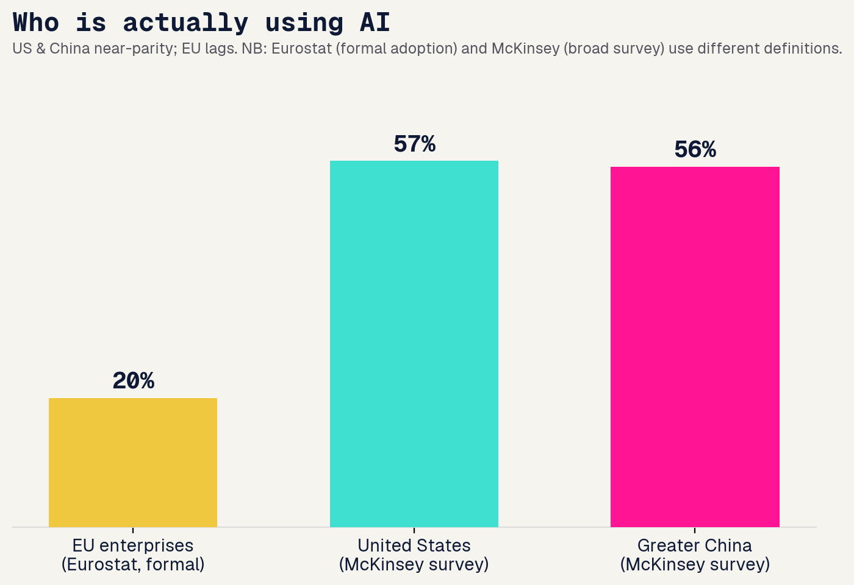
Who actually uses AI
Near-parity on use
McKinsey: 88% of organizations use AI somewhere, but only ~1/3 have scaled it and 39% see real EBIT impact.
Consumer
ChatGPT ~900M weekly users, ~2.5x Gemini. China runs on its own: Doubao ~155M, DeepSeek ~82M. Western apps are absent there.
Eurostat measures formal adoption; McKinsey is a broad survey. Different definitions, same conclusion: the EU lags.
Curtis Chambers · Jinchi Wei · CPH 200C · Computational Precision Health · Three Governing Systems for AI · 2026-06-04
Notes:
Who actually uses AI
Who uses AI How to read it: enterprise AI use by region. What to say: the US and Greater China are essentially tied on enterprise use (high 50s percent in McKinsey's survey), while the EU lags badly, only about 20 percent of EU enterprises formally use AI per Eurostat. Flag the methodology gap honestly (Eurostat formal vs McKinsey broad survey), but the conclusion holds. On the consumer side, ChatGPT has roughly 900 million weekly users globally, while China runs an entirely separate consumer stack, Doubao and DeepSeek, with no meaningful Western presence. And note the sober counterpoint: 88 percent use AI somewhere, but only a third have actually scaled it. Transition: how AI gets deployed differs as much as how much.

Slide 25
How AI gets deployed
CHINA
UNITED STATES
EUROPE / EU
Super-app + state
Enterprise SaaS
Compliance-gated
AI agents inside WeChat; agentic commerce; state-coordinated, hardware-integrated. Deployment is centralized and consumer-facing.
AI flows through the vendor layer (Microsoft, Google, Salesforce). Specialized-vendor buys succeed ~67% vs ~1/3 for internal builds.
~60% of EU/UK developers report AI Act launch delays; deployment is slowed by the rulebook it wrote.
Curtis Chambers · Jinchi Wei · CPH 200C · Computational Precision Health · Three Governing Systems for AI · 2026-06-04
Notes:
How AI gets deployed
What to say: the channel differs by region. China deploys through super-apps and the state, AI agents inside WeChat, agentic commerce, hardware-integrated, centralized. The US deploys through the enterprise-SaaS vendor layer, and notably, buying from a specialized vendor works about twice as often as building in-house. Europe's deployment is gated by its own compliance regime, around 60 percent of EU and UK developers report launch delays tied to the AI Act. Same technology, three very different distribution systems. Transition: but does any of it pay off yet?

Slide 26
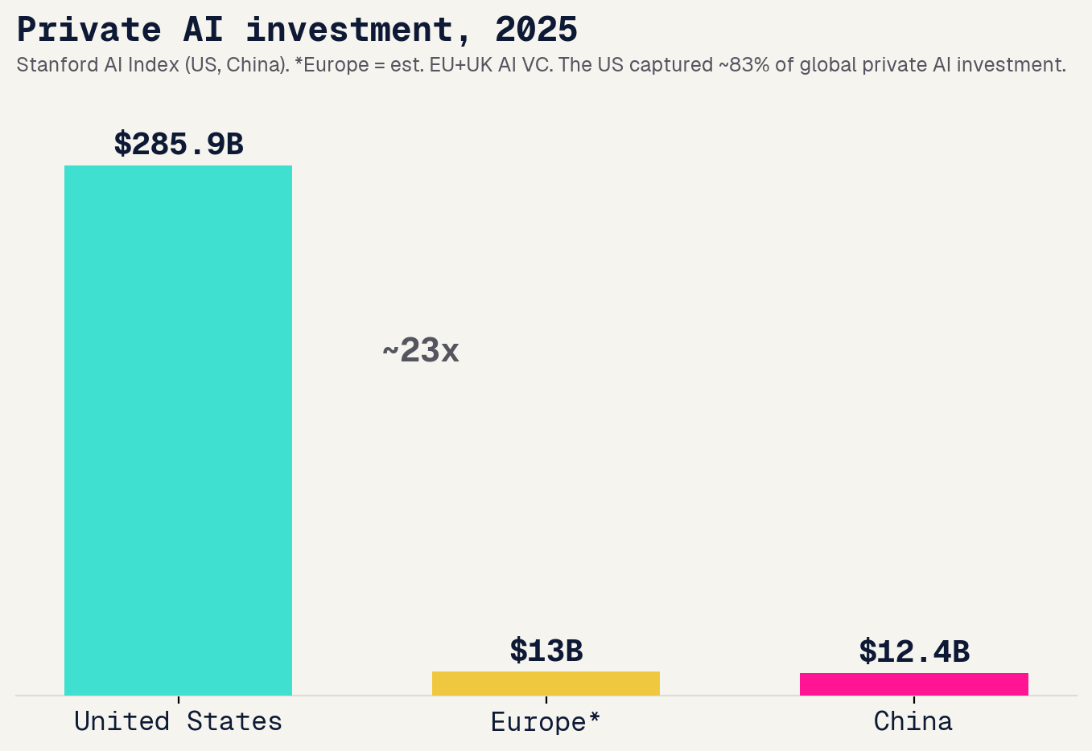
The capability scoreboard and the ROI gap
Models (2025)
US ~50 / China ~30 notable models
Frontier
Opus 4.8 / GPT-5.5 / Gemini 3.1 lead; DeepSeek V4 near-frontier at ~1/10 cost (US still on top)
Patents
China holds ~70% of granted AI patents
Investment
US ~83% of global private AI funding
The ROI gap: MIT found 95% of enterprise generative-AI pilots delivered no measurable P&L impact, despite $30-40B spent. Capability and capital are not the same as realized value.
Curtis Chambers · Jinchi Wei · CPH 200C · Computational Precision Health · Three Governing Systems for AI · 2026-06-04
Notes:
The capability scoreboard and the ROI gap
Scoreboard + ROI gap What to say: on raw capability the US dominates, roughly 83 percent of global private AI investment, and far more notable models than China or Europe, about 50 to China's 30 in 2025. Crucially, the US also holds the absolute frontier: Claude Opus 4.8, GPT-5.5, and Gemini 3.1 lead the top tier, while China's best, like DeepSeek V4, stays within a few percent on the leaderboards and wins on cost, near-frontier quality at roughly a tenth of the price, but does not lead. China's standout metric is patents, nearly 70 percent of granted AI patents. But the bottom band is the reality check, and the most important slide for a deployed-models audience: MIT found that 95 percent of enterprise generative-AI pilots delivered no measurable financial impact, despite tens of billions spent. Capability and capital are not the same thing as realized value, the gap between what is built and what actually works in production is the real story of 2025. Transition: so where does the money and support come from?

Slide 27
STARTUPS & SUPPORT
Curtis Chambers · Jinchi Wei
·
CPH 200C · Computational Precision Health
·
Three Governing Systems for AI
Notes:
Startups & support
Transition: capital, regulatory leniency, government support, and talent.

Slide 28
Capital and leniency
$222B
state
gap
US AI startup funding (65% of all US VC)
China private VC fell <25%; guidance funds filled in (140+ gov deals)
Europe: structural late-stage capital gap
LENIENCY, most permissive to ship fast:
US
China
UK
EU
permissive ---------------------------------------------------------------------------------> constraining (EU sandboxes now delayed to Aug 2027)
Curtis Chambers · Jinchi Wei · CPH 200C · Computational Precision Health · Three Governing Systems for AI · 2026-06-04
Notes:
Capital and leniency
Capital & leniency What to say: two forces shape startups, money and rules. On money, the US is overwhelming, AI startups took 222 billion dollars, two-thirds of all US venture capital. China's private VC actually pulled back sharply, but the state stepped in with guidance funds. Europe's problem is structural, plenty of seed but a late-stage capital gap. On leniency, ranked by how fast you can ship: the US and China are most permissive, the UK is the most pro-innovation of the rules-based regimes, and the EU is the most constraining, its own mandated regulatory sandboxes are now delayed to 2027. Transition: governments are also writing checks.

Slide 29
Government support
UNITED STATES
EUROPE / EU
$500B Stargate (privately financed) + CHIPS Act spillover. Light direct funding, heavy private capital.
InvestAI EUR 200B; France alone pledged EUR 109B at the Paris summit, the largest single-event government commitment.
UNITED KINGDOM
CHINA
AI Growth Zones, a Sovereign AI Unit up to GBP 500M, and a pledge to grow sovereign compute 20x by 2030.
National VC Guidance Fund (~$143B over 20 yrs); the guidance-fund system runs ~2,178 funds worth ~$900B, plus procurement preference.
Curtis Chambers · Jinchi Wei · CPH 200C · Computational Precision Health · Three Governing Systems for AI · 2026-06-04
Notes:
Government support
What to say: the spending models differ. The US barely funds AI directly, the headline 500-billion-dollar Stargate is privately financed; Washington's role is permitting and CHIPS-Act chip money. Europe is the opposite, big public ambition, InvestAI at 200 billion euros and France alone pledging 109 billion, the largest single government commitment anywhere. The UK is making a focused sovereign-compute bet. China runs the most systematic state-capital machine on earth, a guidance-fund system of over 2,000 funds worth roughly 900 billion dollars, plus procurement preferences. Transition: the last input is people.

Slide 30
Talent, immigration, and founder-friendliness
UNITED STATES: drawbridge UP
CHINA: drawbridge DOWN
A $100,000 per-petition H-1B fee took effect Sept 2025, a startup tax. ~60% of top US AI startups had an immigrant founder; ~70% arrived on student visas.
The new K-visa (Oct 2025) is uncapped, 5-year, no employer sponsor, aimed at STEM/AI. Returnee sea-turtles anchor frontier labs, timed to exploit US restrictions.
Founder-friendliness: US = capital + market, rising talent cost. China = state capital + deployment speed, but directed + walled. EU = subsidy + legal certainty, heaviest compliance. UK = most balanced.
Curtis Chambers · Jinchi Wei · CPH 200C · Computational Precision Health · Three Governing Systems for AI · 2026-06-04
Notes:
Talent, immigration, and founder-friendliness
Talent & founder-friendliness What to say: the two regions made opposite moves on talent in the same year. The US raised the drawbridge, a 100,000-dollar fee on each H-1B petition, which matters enormously because around 60 percent of top US AI startups had an immigrant founder. China lowered it, the new K-visa is uncapped with no employer sponsor needed, explicitly targeting the STEM and AI talent the US is now taxing. The purple band is the synthesis: the US still wins on capital and market but talent is getting expensive; China offers state capital and deployment speed but a directed, walled market; the EU offers certainty and subsidy but the heaviest compliance; the UK is the most balanced. Transition: now the health thread.

Slide 31
THE HEALTH THREAD
Curtis Chambers · Jinchi Wei
·
CPH 200C · Computational Precision Health
·
Three Governing Systems for AI
Notes:
The health thread
Transition: the same three governing systems applied to clinical AI, for the precision-health audience.

Slide 32
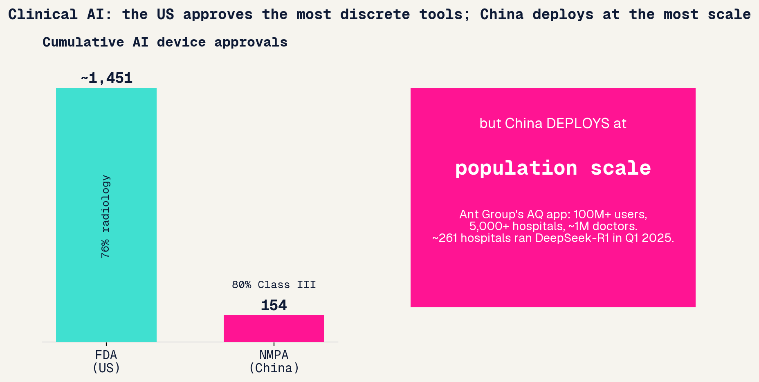
Clinical AI by region
United States
~1,451 AI devices cleared, 76% radiology, but reimbursement-starved and no pathway for generative/LLM clinical AI.
Deployed: Aidoc (1,600+ centers, 100M+ cases), Viz.ai stroke (1,800 hospitals).
Europe / EU
Medical AI is high-risk under the AI Act, stacked on MDR/IVDR, a double conformity burden; the health-data space is deferred to 2029.
Deployed: Oxipit ChestLink, world-first fully autonomous radiology AI (CE IIb).
China
Fewer approvals (154, 80% Class III) but deploys at population scale, state-coordinated.
Deployed: Infervision ~20k lung scans/day; Ant AQ 100M users; DeepSeek-R1 in 261 hospitals.
Curtis Chambers · Jinchi Wei · CPH 200C · Computational Precision Health · Three Governing Systems for AI · 2026-06-04
Notes:
Clinical AI by region
How to read it: left bars are cumulative AI device approvals, FDA versus China's NMPA; the pink box is deployment scale. What to say: the US approves by far the most discrete AI medical devices, around 1,451, but three-quarters are narrow radiology tools, reimbursement lags badly, and there is no clear FDA pathway for generative or LLM clinical AI. Europe regulates the hardest, medical AI is automatically high-risk under the AI Act and stacked on top of the existing device law, a double burden, and its health-data space does not fully arrive until 2029. China approves fewer devices but deploys at a scale neither matches, Ant Group's medical app reaches over 100 million users and 5,000 hospitals; some 261 hospitals ran DeepSeek in the first quarter of 2025. Transition: but where in the clinical stack does each region actually put AI?

Slide 33
Same scale, different layer of the stack
UNITED STATES
CHINA
EUROPE / EU
Around the core
Inside the core
No human, but only the easy cases
LLMs at scale, but OUTSIDE diagnosis: ambient scribes, medical coding, prior authorization, patient messaging. No FDA pathway for generative diagnosis, so AI stays off the diagnostic decision.
Clinical LLMs straight into diagnostic reasoning and the EHR: DeepSeek-R1 across 261 hospitals; Ant AQ reaches 100M users and ~5,000 hospitals.
The only fully AUTONOMOUS diagnosis, used pragmatically: Oxipit ChestLink auto-signs off NORMAL chest X-rays (the ~15-40% with no finding) and routes every positive to a radiologist. CE Class IIb, a clearance the FDA has not granted.
Abridge; Nuance DAX; Epic
Nature Medicine 2025
Oxipit / Sectra, 2026
Same massive scale, three bets on WHERE AI sits: the US automates the paperwork around the clinician, China augments the diagnostic reasoning, Europe removes the human, but only on the cases that are clearly normal.
Curtis Chambers · Jinchi Wei · CPH 200C · Computational Precision Health · Three Governing Systems for AI · 2026-06-04
Notes:
Same scale, different layer of the stack
Same scale, different layer Curtis's framing, and the sharpest clinical point in the deck. The US and China have both deployed clinical LLMs at massive scale, but in different parts of the stack. China puts them inside the diagnostic core, diagnostic reasoning and the EHR directly, DeepSeek-R1 across 261 hospitals and Ant's AQ reaching 100 million users. The US puts them around the core, in the administrative and ambient layer, ambient scribes like Abridge and Nuance DAX, medical coding, prior authorization, patient messaging, deliberately staying off the diagnostic decision because there is no FDA pathway for generative diagnosis. Europe is the only place to deploy fully autonomous diagnosis, but pragmatically: Oxipit's ChestLink auto-signs off only the NORMAL chest X-rays, the roughly 15 to 40 percent with no finding, and routes every positive to a radiologist, which clears the easy volume while keeping a human on anything that matters. Same scale, three very different bets on where AI sits in the clinical workflow. Transition: the regulate, build, deploy split, in medicine.

Slide 34
The regulate, build, deploy split, in medicine
UNITED STATES
EUROPE / EU
CHINA
APPROVES most
REGULATES hardest
DEPLOYS most
~1,451 discrete tools, device-by-device 510(k). But reimbursement is the bottleneck and LLM clinical AI has no pathway.
AI Act + MDR/IVDR double conformity, notified-body bottleneck. Germany's DiGA is the clearest working reimbursement route.
Population-scale platforms (AQ 100M users); 261 hospitals ran DeepSeek-R1. State coordination + volume procurement drive scale.
Curtis Chambers · Jinchi Wei · CPH 200C · Computational Precision Health · Three Governing Systems for AI · 2026-06-04
Notes:
The regulate, build, deploy split, in medicine
Regulate/build/deploy in medicine What to say: this is the framing slide from the start of the talk, now applied to medicine, and it holds perfectly. The US approves the most clinical-AI tools but is reimbursement-bottlenecked. Europe regulates the hardest, layering the AI Act on top of medical-device law. China deploys at population scale under state coordination. The deep lesson for a precision-health audience: whether clinical AI reaches patients is decided less by the model and more by the institutional governing system around it, regulation, payment, and coordination. Transition: let me pull it all together.

Slide 35
SYNTHESIS
Curtis Chambers · Jinchi Wei
·
CPH 200C · Computational Precision Health
·
Three Governing Systems for AI
Notes:
Synthesis
Transition: pull every scope into one table and the takeaways.

Slide 36
Beyond the big three
THE GULF: capital
THE GLOBAL SOUTH: the battleground
Sovereign money, not models. Stargate UAE (5 GW; G42, MGX), Saudi HUMAIN, and MGX committed up to $500B to US Stargate. Abundant capital and compute, thin domestic talent and market.
Where US and Chinese open models compete for the next billion users. Sovereign-language models (SEA-LION, Sahabat, TAIDE) run on rented compute, increasingly on Chinese open weights.
Three hubs build and govern AI. Everyone else deploys it, increasingly on Chinese open weights, which is itself a geopolitical outcome.
Curtis Chambers · Jinchi Wei · CPH 200C · Computational Precision Health · Three Governing Systems for AI · 2026-06-04
Notes:
Beyond the big three
What to say: a quick, honest acknowledgment that the world is bigger than three hubs, without pretending the others are co-equal. The Gulf matters for one thing, capital, UAE's Stargate, Saudi's HUMAIN, and MGX writing up-to-500-billion-dollar checks into US infrastructure, abundant money and compute but thin talent and market. The Global South is the deployment battleground, where US and Chinese open models fight for the next billion users, and where sovereign-language models run on rented, increasingly Chinese, open weights. The bottom line, in the purple band: three hubs build and govern AI; everyone else deploys it, and the fact that they increasingly deploy Chinese open weights is itself a geopolitical result. Transition: the master comparison.

Slide 37
The master comparison
Scope | United States | Europe / EU | Asia (China-led)
Governance | Market-led, light federal + states | Comprehensive AI Act (softening) | State-driven (China); mixed across Asia
Frontier models | Dominant, closed | Thin (Mistral; DeepMind under Google) | Open-weight (China); KR/JP/IN building
Capital | ~83% of global private AI $ | Late-stage capital gap | State guidance funds; Gulf money
Compute | Power-constrained | One chokepoint (ASML) | Owns the hardware: TSMC, HBM, Foxconn
Deployment | Enterprise SaaS | Compliance-gated | Super-app, population scale
Clinical AI | Most approvals, underpaid | Most regulated | Most deployed (China); Korea exports
Founder-friendly | Capital + speed; talent cost up | Subsidy + certainty; heavy rules | State capital (China); open (India/SEA)
Curtis Chambers · Jinchi Wei · CPH 200C · Computational Precision Health · Three Governing Systems for AI · 2026-06-04
Notes:
The master comparison
Master comparison What to say: the whole deck on one slide. Read down any column for a region's profile, or across any row to compare one scope. The US leads on models, capital, and approvals but is power- and increasingly talent-constrained; Europe leads only on regulation and holds one hardware chokepoint; Asia, led by China, leads on deployment, open-weight reach, and owns the hardware spine, constrained mainly by advanced-chip access, which it is engineering around. Transition: the takeaways.

Slide 38
Takeaways and outlook
01
No region does all three well. The US builds the frontier, China deploys at scale, the EU regulates, and each is winning a different race.
02
The structural divergence is open vs closed. China's open-weight surge is reshaping who deploys AI across the Global South, not just at home.
03
Constraints differ by region: US power, EU capital + its own rules, China advanced chips, but China's domestic stack and energy surplus are closing the gap.
04
In medicine the same split holds: US approves most, EU regulates hardest, China deploys most. The deployed-AI bottleneck is institutional, not just technical.
Curtis Chambers · Jinchi Wei · CPH 200C · Computational Precision Health · Three Governing Systems for AI · 2026-06-04
Notes:
Takeaways and outlook
Takeaways & outlook What to say, the four closers: one, there is no single AI race, the US builds, China deploys, the EU regulates, and calling any one of them the winner depends on which race you mean. Two, the open-versus-closed split is the structural story, China's open weights are becoming global infrastructure. Three, each region's binding constraint is different, and China is engineering around its chip constraint with domestic silicon and cheap energy. Four, for this audience, medicine recapitulates the whole pattern, and the lesson is that the bottleneck on deployed AI is institutional, regulation, payment, coordination, not just model quality. Outlook: watch whether the US power constraint or the China chip constraint binds harder, and whether Europe's softening turns regulation into building. Transition: sources.

Slide 39
References
Topic | Source
US AI Action Plan; preemption EO | White House (Jul 2025, Dec 2025)
EU AI Act + Digital Omnibus | White & Case; European Parliament (2025-26)
China GenAI + labeling rules | China-Briefing; Loeb (2023-25)
Chip controls; H20/H200; revenue-share | BIS; PBS; Tom's Hardware (2022-26)
China domestic chips; CloudMatrix | SemiAnalysis; Tom's Hardware (2025-26)
Adoption; ROI gap (95% pilots) | McKinsey; Eurostat; MIT/Fortune (2025)
Open-weight share; models; patents | MIT Tech Review; Stanford HAI (2025-26)
Investment; VC; valuations | Stanford AI Index; PitchBook (2025-26)
Talent: H-1B fee; China K-visa | Bulletin of Atomic Scientists; C&EN (2025)
Clinical AI: FDA / EU / NMPA | npj Digital Medicine; JMIR; Reed Smith (2025-26)
Full citations with URLs in the companion research.md.
Curtis Chambers · Jinchi Wei · CPH 200C · Computational Precision Health · Three Governing Systems for AI · 2026-06-04
Notes:
References
Leave up for questions. Everything is fully cited with URLs in the companion research.md dossier. The strongest single sources: Stanford HAI AI Index for capability/investment, the McKinsey State of AI and MIT NANDA study for adoption and the ROI gap, and BIS/Tom's Hardware for the chip war.

Slide 40


Thank You
Curtis Chambers · Jinchi Wei
CPH 200C · Computational Precision Health

