Slide 1

Outset · AI in Healthcare · Day 3 · Group 1
Picking good CRISPR guides before the lab
Given the 20 letters of a guide RNA, can a model tell -- before any lab work -- whether CRISPR-Cas9 will actually cut?
Jinchi Wei
Outset
2026-07-08

Slide 2
Overview
BACKGROUND
Jinchi Wei
·
Outset
·
Picking good CRISPR guides before the lab
Notes:
Background
Open with the clinical scene, no ML yet. Three ideas to plant: CRISPR is molecular scissors aimed by 20 letters; that cut is already a real therapy; and only guides that truly cut are useful. Transition: meet the scissors.

Slide 3
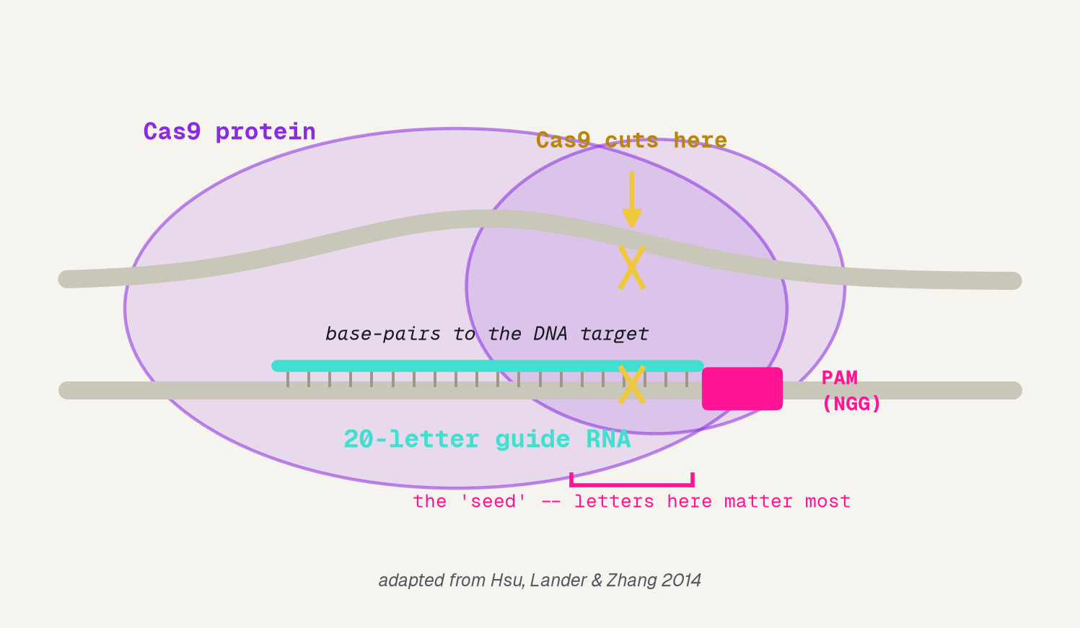
Molecular scissors, aimed by 20 letters
A 20-letter guide RNA steers Cas9 to one spot in DNA; it cuts about three letters from the PAM -- and the letters in the seed, next to the PAM, matter most.
Jinchi Wei · Outset · Picking good CRISPR guides before the lab · 2026-07-08
Notes:
Molecular scissors, aimed by 20 letters
Start concrete and physical. CRISPR-Cas9 is a protein (purple blob) that carries a 20-letter guide RNA (turquoise). The guide base-pairs to a matching DNA target; Cas9 grabs the PAM landmark (pink, NGG) and cuts about 3 letters upstream (amber). The pink bracket marks the seed -- the letters nearest the PAM, which matter most. Those 20 letters are exactly the input our model reads. No machine learning yet. Transition: why does that cut matter?

Slide 4
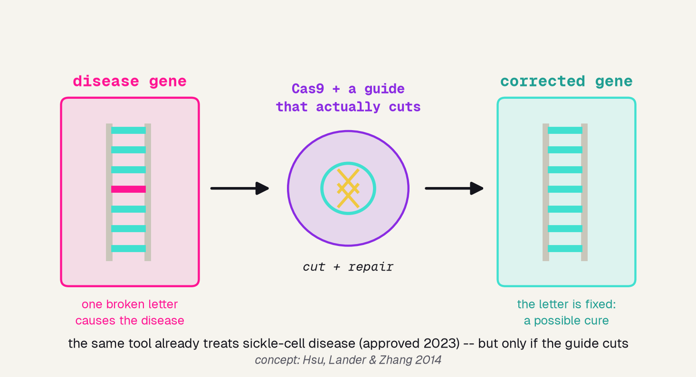
CRISPR as therapy: fixing a broken gene
THE CLINICAL SETTING
Who
patients with a genetic disease -- sickle-cell today, many more in trials
Where
research labs and gene-therapy clinics deciding what to build
The decision
which 20-letter guide to make -- the one that will actually cut
Jinchi Wei · Outset · Picking good CRISPR guides before the lab · 2026-07-08
Notes:
CRISPR as therapy: fixing a broken gene
Make the stakes real. This is not a toy: the same Cas9 cut is now an approved therapy for sickle-cell disease (2023). A broken letter in a disease gene is cut and corrected into a healthy one -- but only if the guide actually cuts. A dud guide fixes nothing. The three chips name the clinical setting the rubric asks for: who (patients with genetic disease), where (labs and clinics), and the decision (which 20-letter guide to build). Transition: so which guides cut? Not all letters count the same.

Slide 5
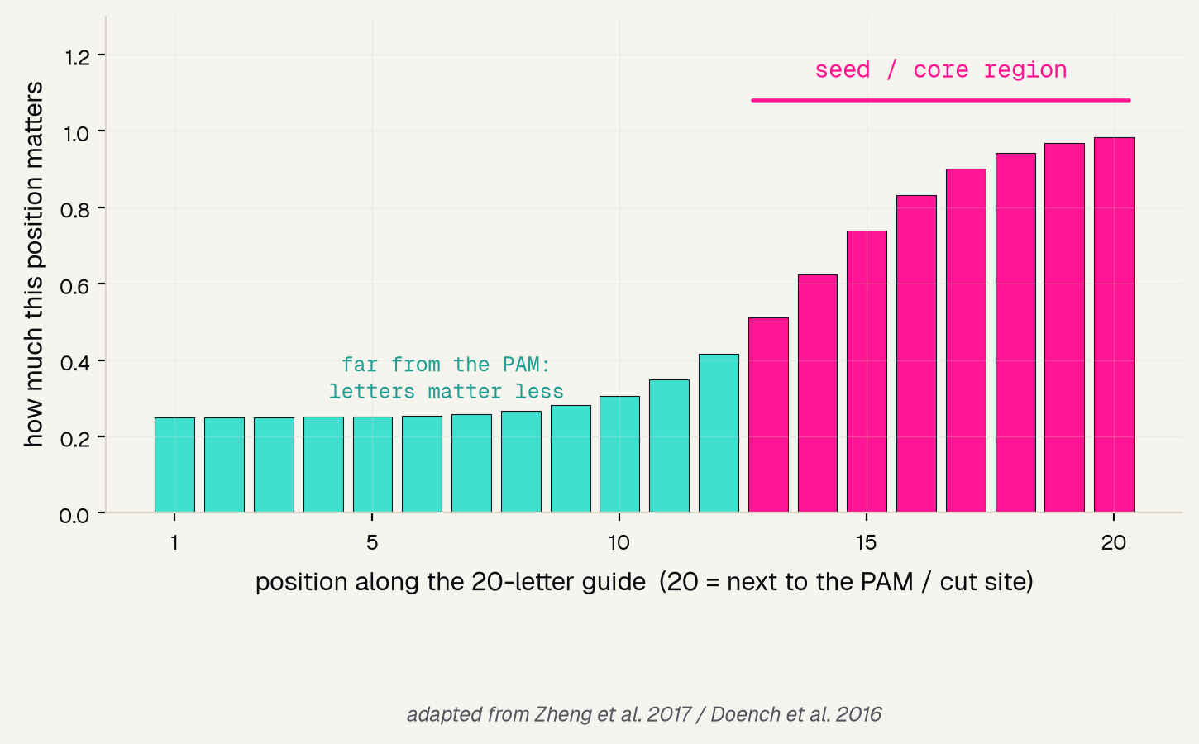
Not all 20 letters count equally
THE ONE BIT OF BIOLOGY
Cas9 lands on the PAM, then reads the handful of letters right beside it -- the seed.
Mismatch a seed letter and the guide usually fails to cut. So the letters near the PAM should carry the most signal -- far more than the ones at the far end.
Remember this -- our model will rediscover it.
Jinchi Wei · Outset · Picking good CRISPR guides before the lab · 2026-07-08
Notes:
Not all 20 letters count equally
The single biological intuition that makes the whole project work. Cas9 checks the seed -- the letters nearest the PAM -- most carefully, so mismatches there break cutting (Zheng 2017; Doench 2016). The bars rise toward position 20 (next to the PAM): those positions matter most, the far end barely at all. Plant this now, because in the Results section the model -- given only sequences and cut-scores -- will rediscover exactly this shape on its own. Transition: but there is a catch that makes a predictor worth building.

Slide 6
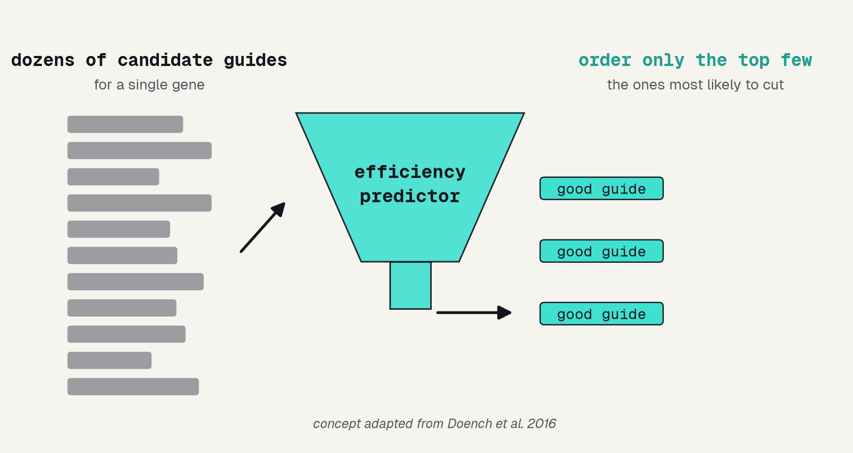
The catch: most candidate guides are duds
the old way
the tool
test dozens of guides in the lab, one by one -- weeks of work, and most turn out to be duds
score all of them from the letters in seconds, then order only the top few most likely to cut
Jinchi Wei · Outset · Picking good CRISPR guides before the lab · 2026-07-08
Notes:
The catch: most candidate guides are duds
This is the motivation for the whole tool. For one gene there are dozens of possible guides, and many barely cut. The funnel shows the fix: instead of testing each candidate in the lab (weeks of work, mostly duds -- the pink band), score them all from their letters in seconds and order only the top few (the turquoise band). That shortlist is what saves real lab time. Transition: to build that scorer, we need data -- guides whose cutting was actually measured.

Slide 7
Methodology
THE DATA
Jinchi Wei
·
Outset
·
Picking good CRISPR guides before the lab
Notes:
The data
Now the raw material. Why Doench 2016 is the right dataset -- real measured cut-scores, a spread of genes, and the benchmark the whole field trusts. Transition: what makes 5,300 lab-measured guides enough?

Slide 8
Why Doench 2016
5,310
17
the
guides, each ACTUALLY tested in the lab -- so every cut-score is a real measurement, not a simulation
genes targeted, a spread wide enough that the model learns sequence rules, not the quirks of one gene
benchmark: the dataset Doench built Rule Set 2 / Azimuth on -- what the whole field still compares against
Jinchi Wei · Outset · Picking good CRISPR guides before the lab · 2026-07-08
Notes:
Why Doench 2016
Justify the dataset in three facts. 5,310 guides, each one really tested in a lab, so the cut-scores are ground truth, not guesses. 17 different genes, so the model has to learn rules about the sequence itself rather than memorizing one gene. And it is THE benchmark -- the exact data behind Doench's Rule Set 2 / Azimuth, which the field still measures itself against. Real, broad, and trusted. Transition: even that landmark model is not perfect -- and that sets our expectations.

Slide 9
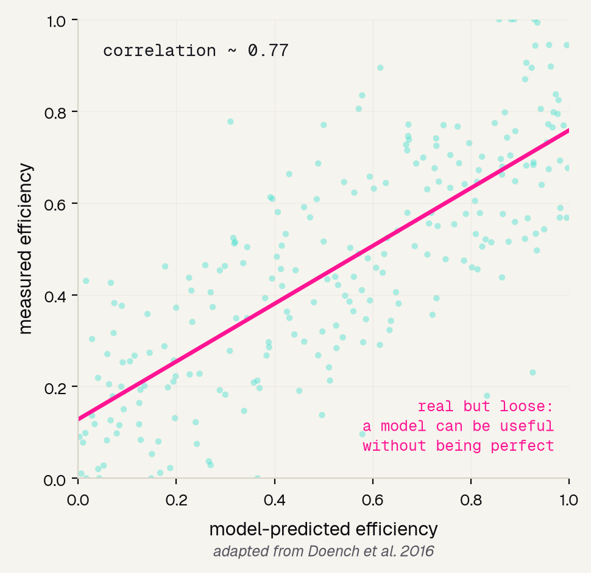
The benchmark that set the standard
SET HONEST EXPECTATIONS
Doench 2016 built Rule Set 2 (Azimuth) on exactly these guides -- the state of the art.
Even so, its predicted scores only loosely track the measured ones (the cloud scatters around the line).
So our goal is to capture the real signal -- not to expect a perfect predictor.
Jinchi Wei · Outset · Picking good CRISPR guides before the lab · 2026-07-08
Notes:
The benchmark that set the standard
A redraw of the landmark result, and a reality check. Doench 2016's Rule Set 2 is the best-known guide scorer, built on this very data -- yet its predicted-vs-measured plot scatters (correlation ~0.77), not a tight line. That is honest and important: guide cutting is only partly predictable from sequence, so a good model captures the signal without nailing every guide. It frames what counts as success for us. Transition: now our turn -- and the first job is turning letters into numbers.

Slide 10
Results
THE MODEL
Jinchi Wei
·
Outset
·
Picking good CRISPR guides before the lab
Notes:
The model
How we turn a DNA sequence into a prediction. First encode the letters as numbers, then let a bake-off pick the model, then pin down the exact recipe. Transition: a computer cannot multiply the letter A.

Slide 11
First, turn letters into numbers
a computer cannot do math on the letter A -- so one-hot flips 4 switches per position:
G
A
C
T
G
A
A
C
A
G
A
1
1
1
1
C
1
1
G
1
1
1
T
1
One switch ON per column -> 80 numbers that KEEP the order, so the seed near the PAM stays visible.
k-mer would just count letters and throw the order away -- so we use one-hot.
Jinchi Wei · Outset · Picking good CRISPR guides before the lab · 2026-07-08
Notes:
First, turn letters into numbers
The core new idea of a sequence task: text has to become numbers before any model can touch it. Read the grid as a truth table -- each column is one position of the guide, and exactly one of the four rows (A/C/G/T) is switched ON. Twenty positions times four switches gives 80 numbers, and crucially they KEEP the order, so the seed near the PAM is still visible. The alternative, k-mer, just counts letters and loses the order -- useless when position is the whole point. Transition: with numbers in hand, which model reads them best?

Slide 12
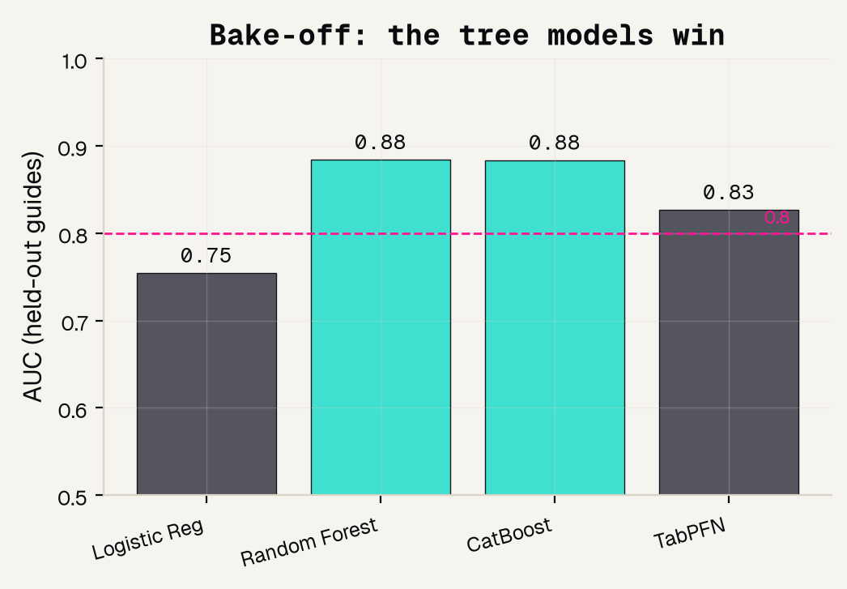
We tested four models – we did not guess
WE TESTED, WE DID NOT GUESS
0.88
the two TREE models (CatBoost and Random Forest) tie here -- both beat TabPFN (0.83) and crush logistic regression (0.75).
We pick CatBoost -- fast, strong, and reproducible.
Jinchi Wei · Outset · Picking good CRISPR guides before the lab · 2026-07-08
Notes:
We tested four models – we did not guess
The which-tool decision, made honestly. We ran four candidate models on held-out guides and let AUC judge: logistic regression (a straight-line rule) lagged at 0.75, TabPFN reached 0.83, and the two tree models -- CatBoost and Random Forest -- tied at the top, 0.88. Trees win because they can combine letters at different positions, which is exactly how seed biology works. Both tree models are essentially equal, so we pick CatBoost for speed and reproducibility. The habit to teach: measure, do not guess. Transition: here is the exact recipe.

Slide 13
Model and data processing
1
TASK
clearly-good (top-third efficiency) vs clearly-poor (bottom-third); the muddy middle is dropped
2
ENCODE
each 20-letter guide becomes an 80-number one-hot vector that keeps the position of every letter
3
SPLIT
a stratified 75% train / 25% test split -- every number we report is on guides the model never saw
4
MODEL
CatBoostClassifier, 600 trees, depth 6, learning rate 0.05, random_state 0 so it is reproducible
5
GRADE
AUC on the held-out test set -- not accuracy -- so a lazy one-class guess cannot game the score
Jinchi Wei · Outset · Picking good CRISPR guides before the lab · 2026-07-08
Notes:
Model and data processing
The reproducibility slide -- read it as a recipe, not trivia. One, we ask a clean question: clearly-good vs clearly-poor cutters, dropping the ambiguous middle third. Two, one-hot encode each guide into 80 order-preserving numbers. Three, a stratified 75/25 split so we always test on unseen guides. Four, the exact CatBoost settings, seeded for reproducibility. Five, grade on AUC, not accuracy, so nothing can be gamed. Any one of these done wrong quietly breaks the result. Transition: so how well does it actually pick?

Slide 14
Validation
RESULTS
Jinchi Wei
·
Outset
·
Picking good CRISPR guides before the lab
Notes:
Results
The payoff, every number named by how we measured it. A working AUC, the concrete 97 percent win, the biology the model rediscovered, and an honest word on fairness. Transition: first, how do you even grade a picker?

Slide 15
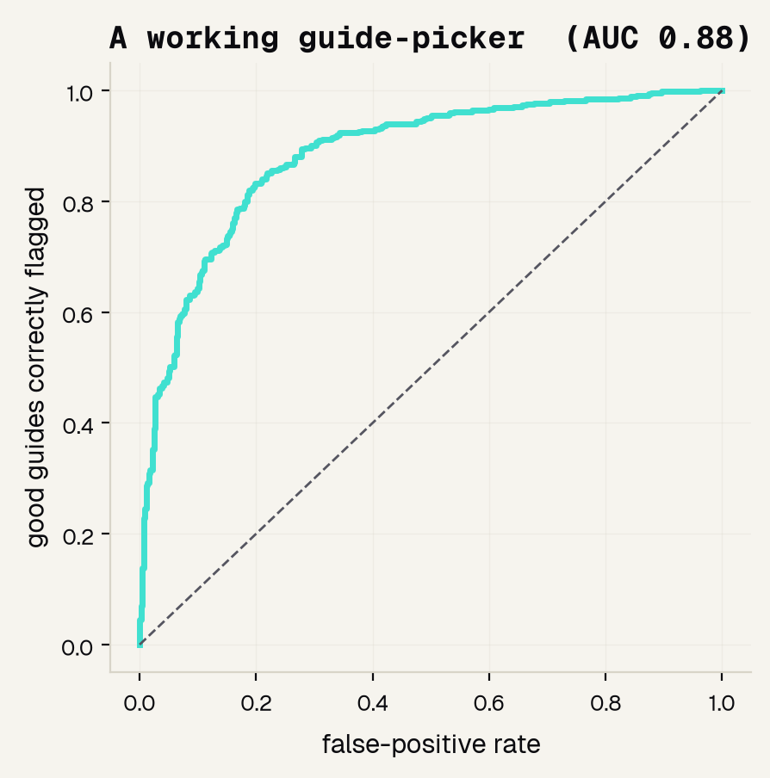
How we grade it: ROC and AUC
0.88
AUC -- the area under the ROC curve
The picker outputs a score, not a yes/no. The ROC curve sweeps every possible cut-off and plots good guides caught against false alarms; AUC is the area underneath.
0.5 = a coin flip 1.0 = perfect
Jinchi Wei · Outset · Picking good CRISPR guides before the lab · 2026-07-08
Notes:
How we grade it: ROC and AUC
Name the metric before the number. A picker outputs a score, so we grade it with the ROC curve -- every possible cut-off, plotting good guides correctly flagged against false alarms -- and AUC, the area underneath, where 0.5 is a coin flip and 1.0 is perfect. We use AUC, not accuracy, because our classes are balanced and AUC rewards good ranking. Ours is 0.88 and the curve hugs the top-left corner: a genuinely working picker. Transition: but what does 0.88 mean for a scientist at the bench?

Slide 16
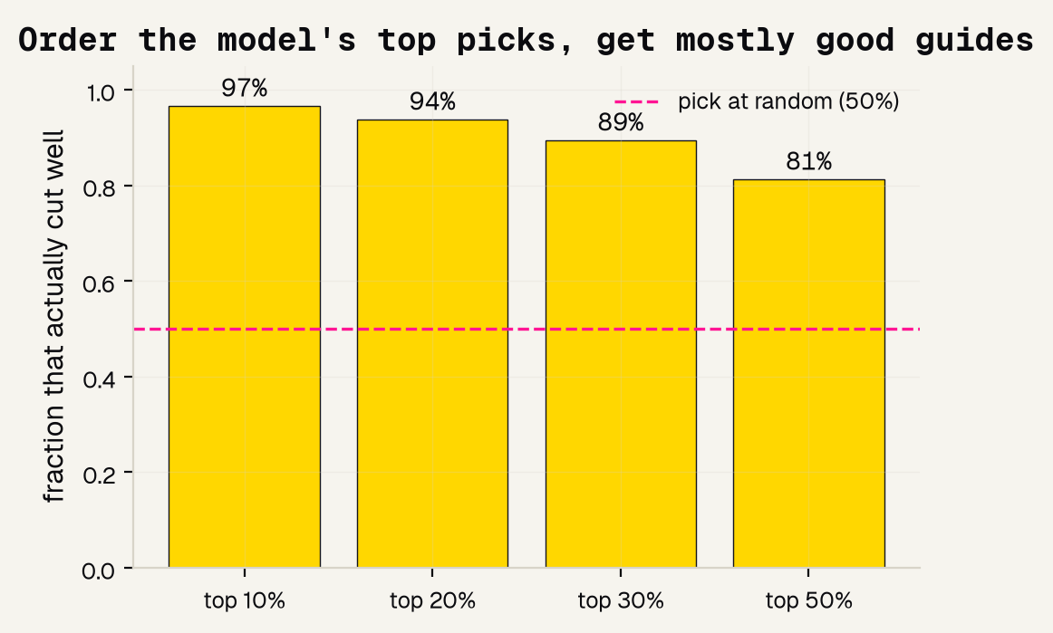
The win: order its top picks
97%
of the model's TOP 10% actually cut well
50%
if you pick guides at random -- the baseline
weeks
of lab time saved, because the shortlist is almost all winners
Jinchi Wei · Outset · Picking good CRISPR guides before the lab · 2026-07-08
Notes:
The win: order its top picks
The number a scientist actually feels. Rank every guide by the model's score and order only the top 10 percent: 97 percent of those really do cut well, versus 50 percent if you picked at random. The chart shows the shortlist stays clean even as you widen it (94 percent at the top 20 percent, 89 percent at 30). Put plainly: the tool hands you a shortlist that is almost all winners, which is weeks of bench work saved. This is the concrete, usable win. Transition: and it did not just work -- it worked for the right reason.

Slide 17
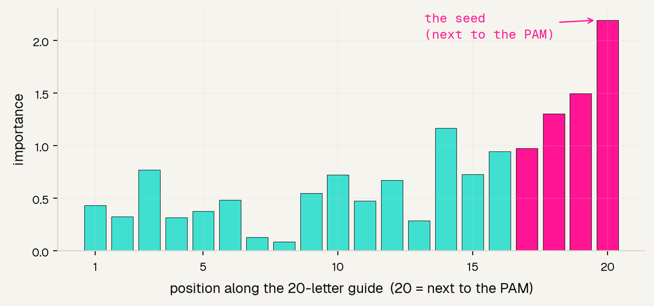
It rediscovered the biology
Feature importance = which positions the model leaned on. It peaks at position 20 -- right next to the PAM, the seed -- matching decades of CRISPR biology it was never told.
Jinchi Wei · Outset · Picking good CRISPR guides before the lab · 2026-07-08
Notes:
It rediscovered the biology
The trust-building payoff, and the callback to the Background. Feature importance for this model asks which positions it relied on -- the sequence-task version of SHAP. The tall bars cluster at the PAM end, peaking at position 20: the seed. Compare it to the seed slide from the intro -- the model, given only sequences and cut-scores, independently rediscovered biology that took the field years to establish. A model that is accurate AND agrees with known science is one people can trust. Transition: one honest word on fairness.

Slide 18
Fairness? There is nothing to audit – honestly
No patient. No demographics. Nothing to be unfair about.
Most medical-AI projects must check they work equally across sex, age, or skin tone. This one has no such groups -- the input is a 20-letter DNA sequence. Forcing a fake fairness analysis would be less honest than simply saying so.
The real equity question for CRISPR lives one step later -- in which patients a therapy is tested on and reaches -- outside this sequence model.
Jinchi Wei · Outset · Picking good CRISPR guides before the lab · 2026-07-08
Notes:
Fairness? There is nothing to audit – honestly
Handle fairness honestly instead of performatively. The rubric asks about fairness across demographic groups -- but this task has none. The input is a DNA sequence: no patient, no sex, no age, nothing to be unfair about. The right move is to say that plainly rather than invent a hollow analysis. Then point to where equity really does matter for CRISPR -- which patients a therapy reaches -- which sits one step beyond this sequence model. Naming the limit of the question is itself good science. Transition: so where does this leave us?

Slide 19
Overview
THE BOTTOM LINE
Jinchi Wei
·
Outset
·
Picking good CRISPR guides before the lab
Notes:
The bottom line
Good science states its own limits out loud. What the picker genuinely does, where the line sits, the papers behind it, and the one sentence to remember.

Slide 20
What it can and cannot do
IT WORKS
IT LEARNED REAL BIOLOGY
BUT IT IS A DEMO
A real guide-picker on the field's benchmark: AUC 0.88, and its top-10% shortlist is 97% good guides -- real lab time saved.
Importance peaks at the seed next to the PAM, matching decades of CRISPR science -- so we can trust WHY it works.
It cannot match a production tool, capture cell-type or chromatin effects, or say anything about off-target safety.
AUC 0.88 · 97% precision
rediscovered the seed
not a design tool -- yet
Jinchi Wei · Outset · Picking good CRISPR guides before the lab · 2026-07-08
Notes:
What it can and cannot do
Model the honesty the rubric rewards. Green: it genuinely works -- AUC 0.88 on benchmark data and a 97-percent-clean top-10-percent shortlist, which saves real lab time. Purple: it learned real biology, peaking at the seed, so we trust why it works, not just that it works. Pink: it is still a demo -- it cannot match a production tool like Azimuth, handle cell-type or chromatin effects, or judge off-target safety. State plainly: use it to build intuition and shortlist, not to finalize a guide. Transition: the papers behind it.

Slide 21
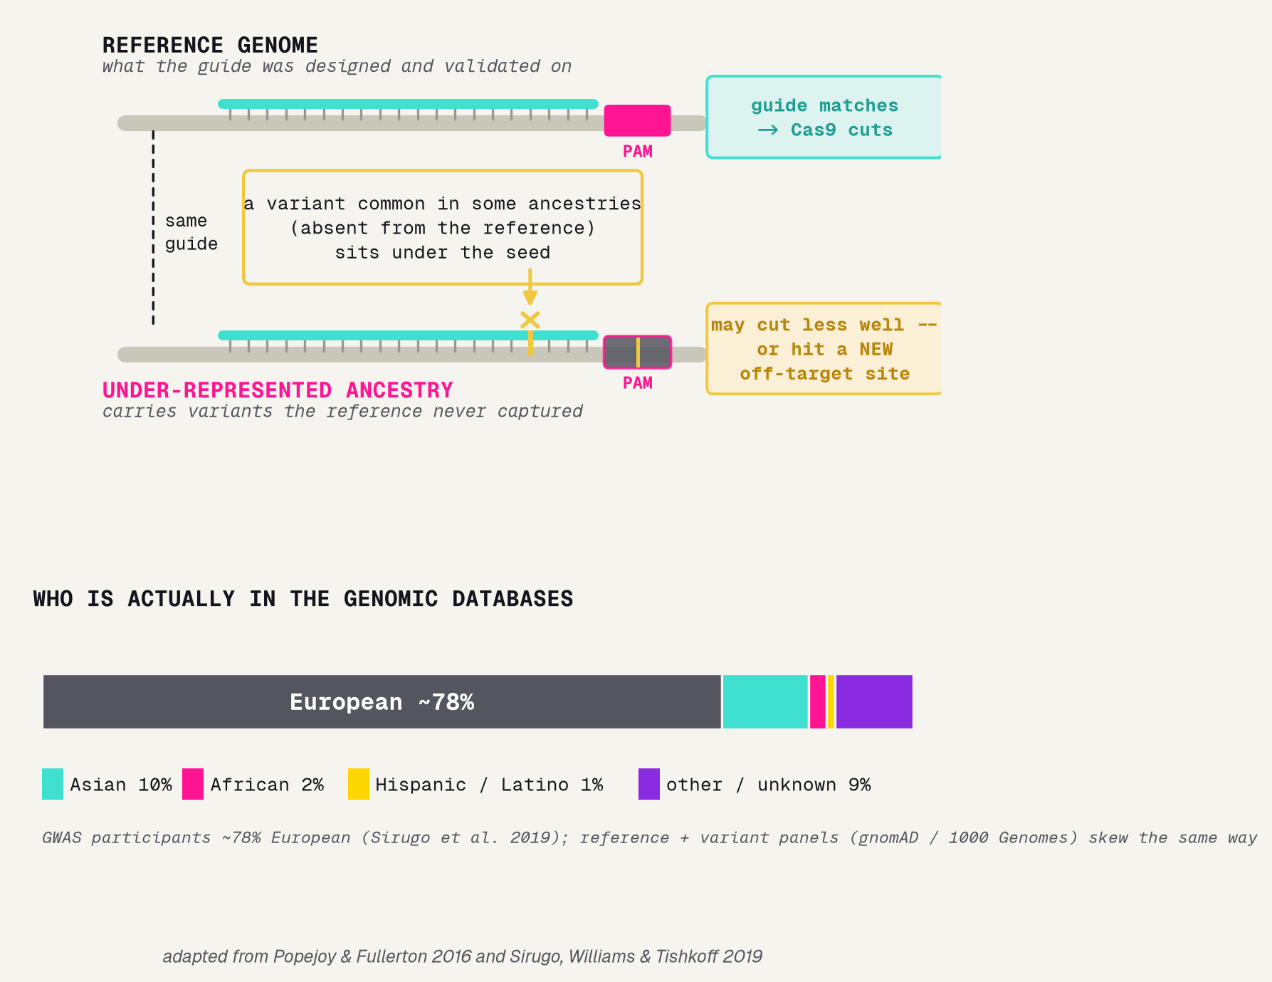
Where equity lives in genome editing
THE REAL EQUITY QUESTION
Our data is guide sequences -- no patients -- so per-guide fairness does not apply. The real equity issue in genome editing sits one step up.
THE MECHANISM
Reference genomes and variant databases skew heavily European. A variant common in some ancestries but absent from the reference can sit under the guide or PAM -- a mismatch, an altered PAM, or a new off-target site -- so the same guide may cut less well, or less safely, for those patients.
THE DATA THAT COULD CHECK IT
gnomAD and 1000 Genomes hold ancestry-labeled variant frequencies -- the raw material to flag risky guides before the lab.
[9] Popejoy & Fullerton 2016, Nature -- "Genomics is failing on diversity."
[10] Sirugo, Williams & Tishkoff 2019, Cell -- "The Missing Diversity in Human Genetic Studies."
Jinchi Wei · Outset · Picking good CRISPR guides before the lab · 2026-07-08
Notes:
Where equity lives in genome editing
Honest depth after 'what it can and cannot do'. Our data (guide sequences) has no patients, so per-guide fairness genuinely does not apply -- but genome editing DOES have a real equity problem one level up. Reference genomes and the variant databases we design against skew heavily European (GWAS participants are ~78% European, Sirugo et al. 2019). A variant that is common in an under-represented ancestry but absent from the reference can sit right under the guide or the PAM -- creating a mismatch, an altered PAM, or a brand-new off-target site -- so a guide that looks great on the reference may cut less well, or less safely, for those patients. The good news: the data to check this already exists -- gnomAD and 1000 Genomes carry ancestry-labeled variant frequencies, so guides overlapping ancestry-variable sites can be flagged before the lab. Two landmark commentaries frame the problem: Popejoy & Fullerton 2016 and Sirugo, Williams & Tishkoff 2019. Transition: the full reference list.

Slide 22
References
FOUNDATIONS & DATA
METHODS & REVIEWS
[1] Doench et al. 2016, Nat Biotechnol -- Rule Set 2 / Azimuth, and the dataset we use. [2] Doench et al. 2014, Nat Biotechnol -- Rule Set 1: position + PAM predict cutting. [3] Hsu, Lander & Zhang 2014, Cell -- how Cas9 is steered to a DNA site (the seed). [4] Zheng et al. 2017, Sci Rep -- direct evidence the PAM-proximal seed matters most.
[5] Chuai et al. 2018, Genome Biol -- DeepCRISPR: deep learning for guide design. [6] Kim et al. 2019, Sci Adv -- DeepSpCas9: more data + neural nets push accuracy further. [7] Konstantakos et al. 2022, NAR -- a survey of guide-efficiency predictors. [8] Abbaszadeh & Shahlai 2025, arXiv -- explainable AI + off-target safety.
EQUITY & DIVERSITY IN GENOMICS
[9] Popejoy & Fullerton 2016, Nature -- "Genomics is failing on diversity." [10] Sirugo, Williams & Tishkoff 2019, Cell -- "The Missing Diversity in Human Genetic Studies."
Jinchi Wei · Outset · Picking good CRISPR guides before the lab · 2026-07-08
Notes:
References
Give credit and show the trail. Left column, the foundations and the data: Doench's Rule Set 2 and the dataset [1], the earlier position/PAM rules [2], the Hsu review that explains the seed [3], and the direct seed evidence [4] -- [1], [3] and [4] are the papers we redrew in the intro. Right column, the methods and reviews: the deep-learning tools that push further [5][6], a survey of predictors [7], and a recent explainable-AI + off-target piece [8]. Transition: the one sentence to remember.

Slide 23
The honest bottom line
A guide-picker earns its keep by shortlisting the winners -- and explaining itself.
Use it to build intuition and narrow the field -- then use a validated tool and the lab to actually choose and confirm a guide.
Jinchi Wei · Outset · Picking good CRISPR guides before the lab · 2026-07-08
Notes:
The honest bottom line
Land the deck on one idea: a guide-picker is worth building when it both shortlists the winners AND explains itself -- ours did both, with AUC 0.88, a 97-percent-clean top slice, and importance that peaks at the seed. Leave them with the working habit of medical AI: a model you can measure and explain beats a fancy one nobody can check. Then hand the real decision back to a validated tool and the lab. Thank them.

Slide 24


Thank You
魏晉祺
Jinchi Wei
Outset
jinchikwei@gmail.com

