Slide 1

Outset · AI in Healthcare · Day 3 · Group 4
Fair for whom?
A skin-cancer screen you can actually audit -- because this dataset records skin tone -- and the dark-skin gap it exposes
Jinchi Wei
Outset
2026-07-08

Slide 2
Overview
BACKGROUND
Jinchi Wei
·
Outset
·
Fair for whom?
Notes:
Background
Open with the clinical scene, not the model. Three ideas to plant: the same skin-cancer exam runs across a whole range of skin tones; AI is pitched to reach people who cannot see a dermatologist; and a model is most accurate on the skin it saw most. Transition: let us meet the exam under the lens.

Slide 3
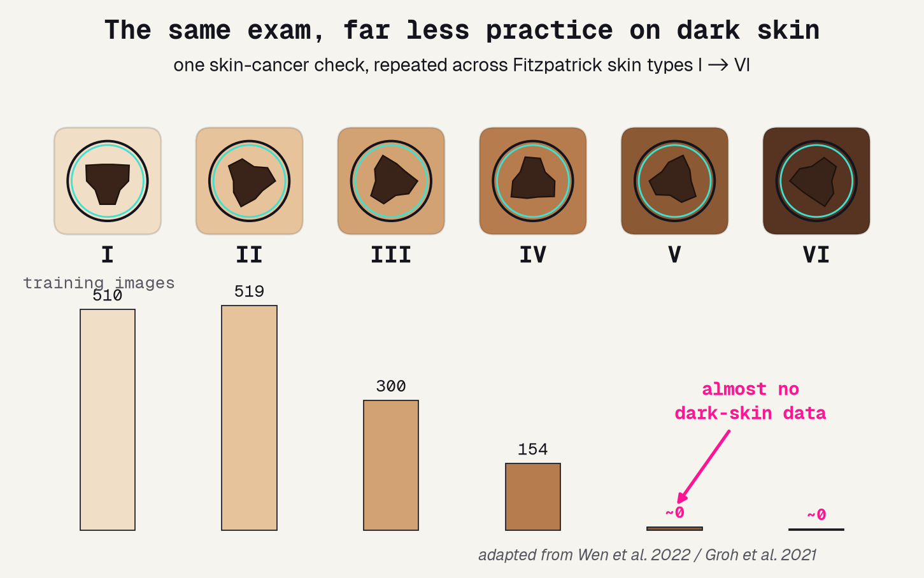
The same lesion, six different skins
The same skin-cancer check, from the lightest skin (I) to the darkest (VI) -- and how much training data any AI ever saw for each tone.
Jinchi Wei · Outset · Fair for whom? · 2026-07-08
Notes:
The same lesion, six different skins
Open concrete and physical. A dermatologist puts a dermatoscope on a spot and asks: is this cancer? Now run that same exam across Fitzpatrick I to VI. The exam does not change -- what changes is the bar under each tone: how many images the AI ever practiced on. Tall on the light end, almost nothing on the dark end. Do not mention fairness metrics yet; just let them SEE the skew. Transition: who is that dark-skin group in the real world?

Slide 4
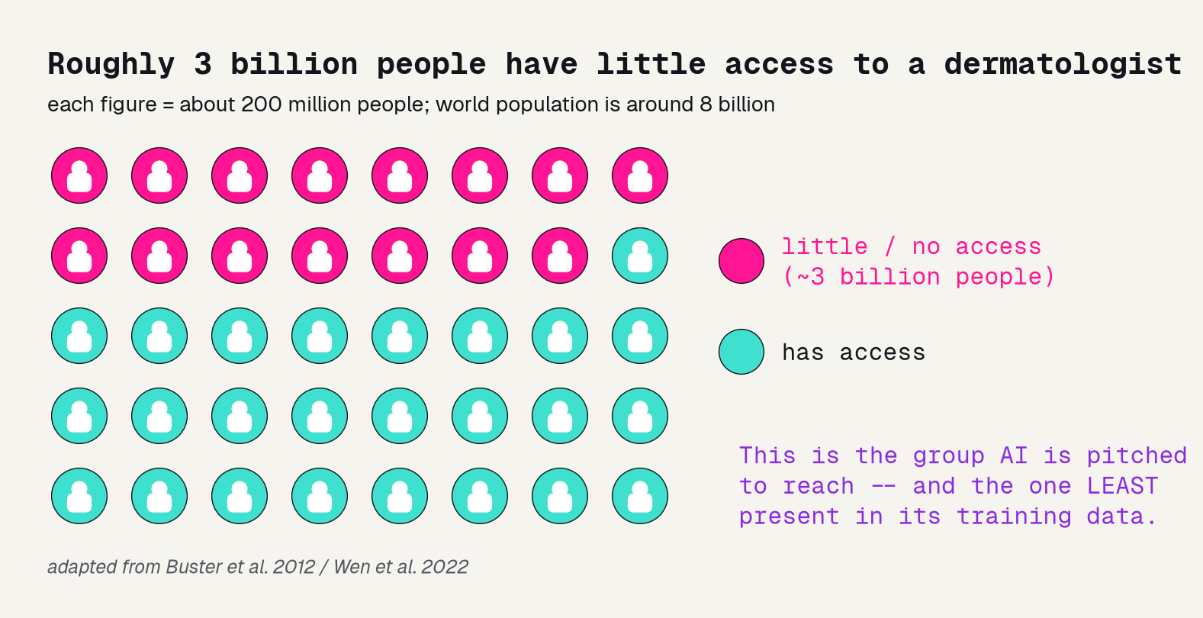
Who can even reach a dermatologist?
A PROMISE, AND AN IRONY
The promise: put a screen in a phone and reach the roughly three billion people who cannot see a dermatologist.
The irony: those same people -- often darker-skinned, and outside Europe and North America -- are the ones barely present in the training data.
A tool that works worst where care is scarcest can widen the very gap it was sold to close.
Jinchi Wei · Outset · Fair for whom? · 2026-07-08
Notes:
Who can even reach a dermatologist?
The stakes slide. Each figure in the waffle is about 200 million people; the pink block is the ~3 billion with little dermatology access -- the group the technology is pitched to serve. Spell out the irony in plain words: they are also the group least present in the data these models learn from. So a model that looks fine on average can fail exactly where it was meant to help. Transition: and this is a measured effect, not a worry.

Slide 5
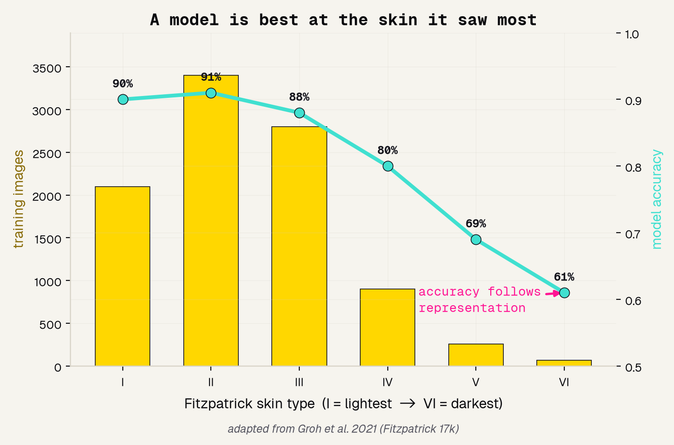
A model is best at the skin it saw most
16,577
I -> VI
2021
clinical images Groh labeled by Fitzpatrick type
the six skin types it audited separately
Groh et al., CVPR -- the result we redraw
Jinchi Wei · Outset · Fair for whom? · 2026-07-08
Notes:
A model is best at the skin it saw most
The evidence slide, redrawn from Groh 2021 (attributed). Gold bars are how many training images the model saw per Fitzpatrick type; the turquoise line is its accuracy. The line tracks the bars: high on the light types it saw a lot, dropping to the dark types it barely saw. This is the mechanism behind the whole equity worry -- a model gets best at what it practices most. Daneshjou 2022 confirmed it on biopsy-proven dark-skin images. Transition: so to check our own model, we need data that records skin tone.

Slide 6
Methodology
THE DATA
Jinchi Wei
·
Outset
·
Fair for whom?
Notes:
The data
The raw material, and the single fact that makes this project possible. PAD-UFES-20 is real clinical skin imaging that RECORDS the patient Fitzpatrick skin type -- most datasets do not, and without it a skin-tone gap is invisible. Transition: you can only audit what you record.

Slide 7
Why PAD-UFES-20
1,494
skin type
by patient
real clinical skin photos, each biopsy-labeled malignant or benign
PAD-UFES-20 records every patient Fitzpatrick skin tone -- rare, and the whole reason we can audit
train and test never share a patient, so the AUC we report is honest
Jinchi Wei · Outset · Fair for whom? · 2026-07-08
Notes:
Why PAD-UFES-20
Justify the dataset in three ideas. 1,494 real biopsy-labeled clinical photos -- enough to train a genuine screen. It RECORDS the Fitzpatrick skin type -- the rare, decisive feature; without it, no skin-tone audit is even possible. And we split by patient, so the score is not inflated by the model memorizing a person. The middle tile is the quiet reason this dataset beats a bigger, tone-blind pile of images. Transition: why does recording skin tone matter so much?

Slide 8
You can only audit what you record
MOST SKIN DATASETS
PAD-UFES-20
record the lesion -- and nothing about the patient. Skin tone is simply not in the file.
records each patient Fitzpatrick skin type, so the score can be split apart and checked.
?
?
?
skin tone: unknown
I-II
III-IV
V-VI
skin tone: recorded
CANNOT audit fairness by skin tone
CAN audit fairness by skin tone
Jinchi Wei · Outset · Fair for whom? · 2026-07-08
Notes:
You can only audit what you record
The pivot of the whole talk. Left: most skin datasets store the lesion and nothing about the person -- skin tone is a question mark, so a skin-tone gap is invisible no matter how hard you look. Right: PAD-UFES-20 writes down the Fitzpatrick type, so the score can be split apart by tone and held accountable. Same kind of model, but only one of these can be audited. Point out that this is why we chose this dataset over bigger, tone-blind ones. Transition: with an auditable dataset in hand, we build the screen.

Slide 9
Results
THE MODEL
Jinchi Wei
·
Outset
·
Fair for whom?
Notes:
The model
How we build a screen worth auditing. Transfer learning borrows a pretrained brain, we fine-tune on PAD-UFES, and we split by patient so the score is honest. Then a clear recipe makes it reproducible. Transition: we do not have millions of skin images, so we borrow a brain.

Slide 10
Borrow a brain, then split by patient
PRETRAINED
FINE-TUNE
SPLIT BY PATIENT
a network already trained on millions of everyday photos -- cats, cars, faces
train it further on PAD-UFES-20 clinical skin images
grade only on patients the model never saw during training
->
->
it knows edges, colors, shapes
it learns malignant vs benign
an honest AUC
The patient-level split is what keeps the score honest -- no person can appear in both training and test.
Jinchi Wei · Outset · Fair for whom? · 2026-07-08
Notes:
Borrow a brain, then split by patient
The modeling idea, in three stages. We have far too few skin images to teach a network from scratch, so we borrow a brain -- a net pretrained on millions of ordinary photos -- and fine-tune it on PAD-UFES skin. The third stage is the honesty step: split by PATIENT, so the same person never lands in both train and test, or the AUC would be inflated by memorization. Walk them left to right. Transition: here is the full recipe so anyone could rebuild it.

Slide 11
Model and data processing
1
MODEL
caformer_s18, pretrained, then fine-tuned with a fresh 2-class head
2
RESIZE
every clinical photo decoded to color and resized to 224x224 pixels
3
NORMALIZE
pixels rescaled to the fixed mean and scale the backbone was trained on
4
TASK
malignant (BCC, SCC, melanoma) vs benign -- one yes/no call
5
SPLIT & AUDIT
patient-level train/test split; then audit AUC by recorded skin tone
Jinchi Wei · Outset · Fair for whom? · 2026-07-08
Notes:
Model and data processing
The reproducibility slide -- read it as a recipe, not trivia. Five steps: a pretrained CAFormer fine-tuned to a 2-class head; every image resized to 224x224; normalized to the backbone range; the task framed as malignant vs benign; and a patient-level split whose held-out AUC we then audit by skin tone. Step 5 is where the equity work lives -- the split gives an honest number and the recorded tone lets us break it apart. Transition: so does the screen actually work?

Slide 12
Validation
RESULTS
Jinchi Wei
·
Outset
·
Fair for whom?
Notes:
Results
The payoff, in order: a working AUC, a fairness audit that comes out roughly fair where we can measure, the crisis of the 11 dark-skin patients we cannot measure, and where the model looks. Transition: first, does the screen even work?

Slide 13
A working screen
0.83
AUC on held-out patients
AUC is the area under the ROC curve: 0.5 is a coin flip, 1.0 is perfect. We grade on AUC, not accuracy, because a rare-cancer dataset rewards a lazy "always benign" guess.
A genuinely working screen -- which is exactly what makes the fairness audit worth doing.
Jinchi Wei · Outset · Fair for whom? · 2026-07-08
Notes:
A working screen
Lead with the headline, but say what it means. 0.83 AUC on patients the model never saw -- a real, working malignant-vs-benign screen. Name the metric in one breath: AUC sweeps every cut-off, 0.5 is a coin flip, 1.0 is perfect, and we use it instead of accuracy because a lazy always-benign guess would score high accuracy and catch nothing. The point of proving it works: auditing a broken model would tell us nothing. Transition: now the real question -- is it fair across skin tones?

Slide 14
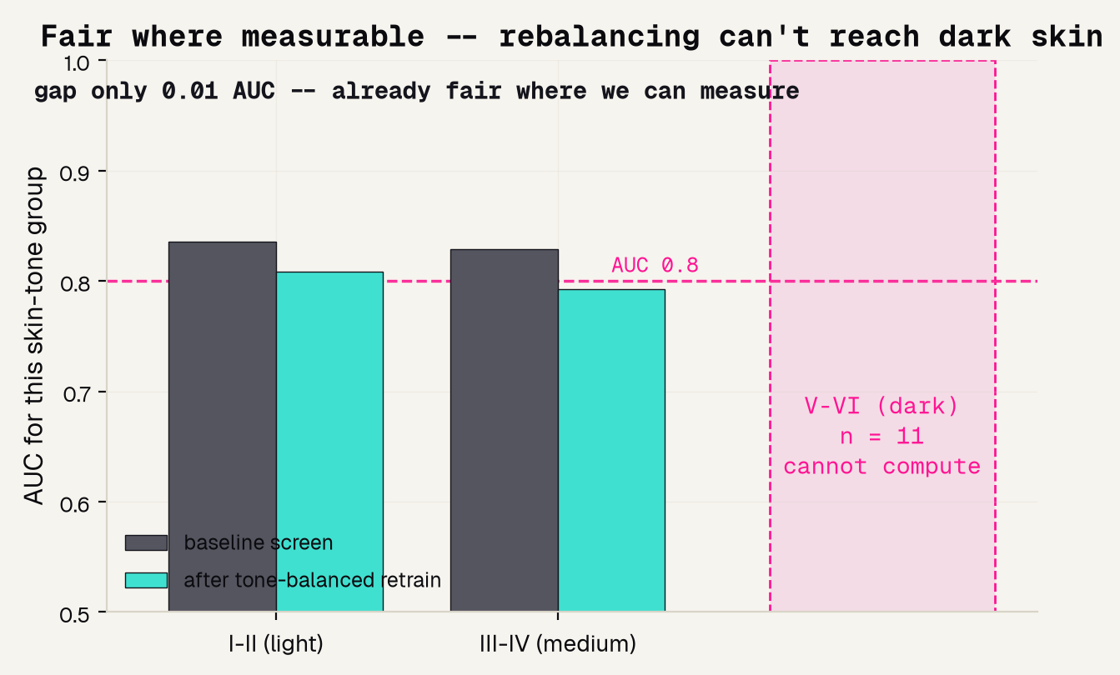
Fair across the tones we can measure
gap 0.01 AUC
dark skin: n = 11
light vs medium skin -- already roughly fair where we can actually measure it
a tone-balanced retrain cannot rebalance data that is not there -- the gap stays invisible
Jinchi Wei · Outset · Fair for whom? · 2026-07-08
Notes:
Fair across the tones we can measure
The honest fairness result. Because the data records tone, we compute AUC separately per group. Light 0.836 vs medium 0.829 -- a gap of only about 0.01, so the screen is already roughly fair where we can measure. The turquoise band says so plainly. The pink band is the catch: the dark group has 11 patients, and a common fairness fix -- oversampling the rare group -- did nothing here, because you cannot rebalance data that does not exist. Do NOT claim we fixed a gap. Transition: look at just how few those 11 are.

Slide 15
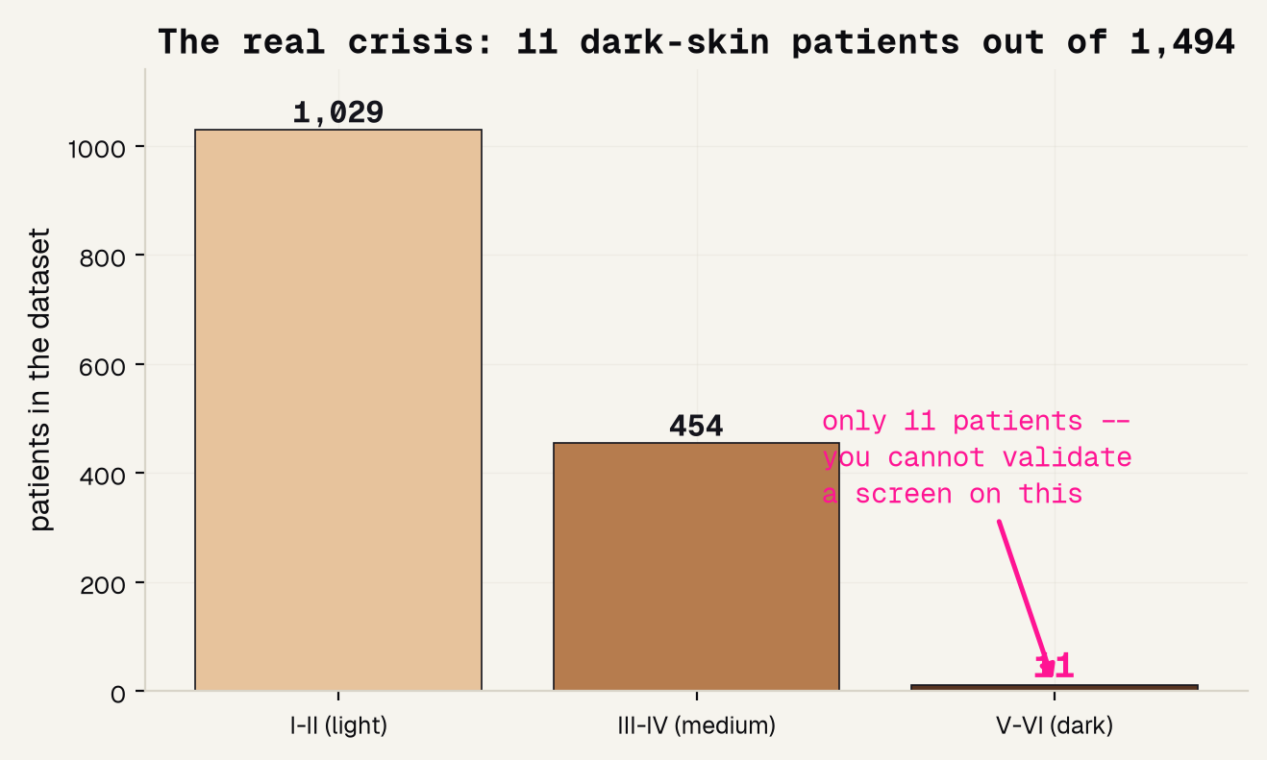
The real crisis: 11 patients
11
dark-skin patients, out of 1,494
You cannot validate a screen for a whole group of people from 11 of them -- no matter how good the overall average looks.
The under-representation is not a footnote. It is the finding.
Jinchi Wei · Outset · Fair for whom? · 2026-07-08
Notes:
The real crisis: 11 patients
The emotional peak of the deck. The average AUC looked fine, and the measurable tones looked fair -- but here is what the average hides: 11 dark-skin patients out of 1,494. Say the giant 11 out loud. You cannot certify a screen for dark skin from 11 people; the confidence interval alone would be enormous. This is the honest, constructive core of the project: the crisis is not a broken model, it is missing data. Transition: one more check on the model itself -- is it looking at the right thing?

Slide 16
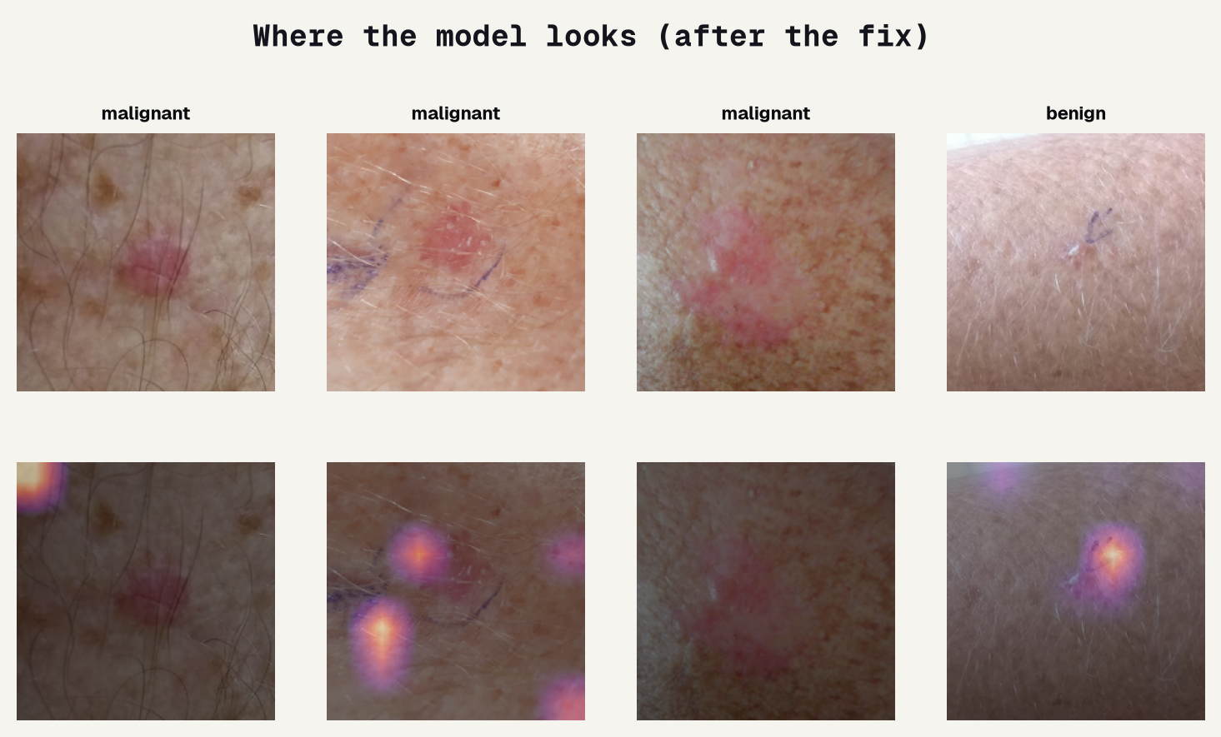
Where the model looks
Grad-CAM = feature importance for an image: the bright areas sit ON the lesion, the cues a clinician reads. It shows the model looks in the right PLACE -- not that it works on skin it never trained on.
Jinchi Wei · Outset · Fair for whom? · 2026-07-08
Notes:
Where the model looks
The image version of feature importance. For a table we would ask SHAP which columns mattered; for a photo we use Grad-CAM, which highlights WHERE the model looked. The heat lands on the pigmented lesion, not a pen mark or a hair -- reassuring evidence the screen reads the spot itself. But be precise about what this does and does not prove: it shows the model looks in the right place, not that it generalizes to skin tones absent from training. Only data can answer that. Transition: so where does this leave us, honestly?

Slide 17
Overview
BEING HONEST
Jinchi Wei
·
Outset
·
Fair for whom?
Notes:
Being honest
Good science states its own limits out loud. What the screen genuinely does, where the real gap is, the papers behind it, and the one sentence to remember. This is the section the rubric rewards most.

Slide 18
What this project shows
IT WORKS, AND WE COULD AUDIT IT
THE GAP IS WHO IS MISSING
THE FIX IS DATA, NOT A TRICK
AUC 0.83, and because PAD-UFES-20 records skin tone we could actually measure fairness -- which most skin datasets make impossible.
Only 11 dark-skin patients -- too few to validate. And no race or country is recorded, so those gaps stay invisible here.
Rebalancing cannot invent dark-skin patients. Fixing dark-skin performance means collecting representative data -- DDI, Fitzpatrick 17k.
AUC 0.83 · auditable
11 dark-skin patients
collect, do not resample
Jinchi Wei · Outset · Fair for whom? · 2026-07-08
Notes:
What this project shows
Model the honesty the rubric rewards, in three cards. Green: it genuinely works AND we could audit it -- AUC 0.83, and auditing was only possible because the data records skin tone. Pink: the real gap is who is missing -- 11 dark-skin patients, and no race or country recorded at all. Purple: the fix is data, not a resampling trick -- point students to DDI and Fitzpatrick 17k, which exist precisely to collect representative dark-skin images. This is a working solution with an honest edge, not a complaint. Transition: the papers behind it.

Slide 19
References
GAPS & LANDMARKS
DATA & ACCESS
[1] Fitzpatrick 1988, Arch Dermatol -- the six-point skin-type scale. [2] Groh et al. 2021, CVPR Workshops -- Fitzpatrick 17k; accuracy tracks representation. [3] Daneshjou et al. 2022, Sci Adv -- DDI; top models drop on dark skin. [4] Obermeyer et al. 2019, Science -- a fair-looking algorithm that underserved Black patients.
[5] Wen et al. 2022, Lancet Digital Health -- most public skin images are light skin. [6] Adamson and Smith 2018, JAMA Dermatology -- AI can widen dermatology care gaps. [7] Buster, Stevens and Elmets 2012, Dermatologic Clinics -- disparities and access.
Jinchi Wei · Outset · Fair for whom? · 2026-07-08
Notes:
References
Give credit and show the trail. Left column names the scale and the gap-measuring studies: Fitzpatrick [1], Groh Fitzpatrick 17k [2], Daneshjou DDI [3], and the Obermeyer proxy-bias case [4]. Right column is data and access: the review showing public images skew light [5], the warning that AI can widen care gaps [6], and the disparities-and-access background [7]. Point out that [2] is the study we redrew and [3] is the collect-better-data fix we recommend. Transition: the one sentence to remember.

Slide 20
The honest bottom line
A model can only be fair to the people the data remembers.
This screen works, and we could audit it only because the data recorded skin tone. Record who the patient is -- then go collect the data the model is missing.
Jinchi Wei · Outset · Fair for whom? · 2026-07-08
Notes:
The honest bottom line
Land the deck on one idea: a model can only be fair to the people the data remembers. Our screen works and we could audit it -- but only because PAD-UFES recorded skin tone, and even then 11 dark-skin patients is a gap no algorithm can close. Leave them with the constructive rule: record who the patient is, then go collect the data the model is missing. That is how you actually make dermatology AI fair. Thank them.

Slide 21


Thank You
魏晉祺
Jinchi Wei
Outset
jinchikwei@gmail.com

