Slide 1
Testng Framework
ccao@ecvictor.com

Slide 2
Agenda
TestNG testing framework
Improving use of JUnit
Testing integrated maven

Slide 3
What is TestNG?
Automated testing framework
NG = Next Generation
Similar to JUnit (especially JUnit 4)
Not a JUnit extension (but inspired by JUnit)
Designed to be better than JUnit, especially when testing integrated classes
Created by Dr. Cédric Beust (of Google)
Open source (http://testng.org)

Slide 4
Test class/method (JUnit 4 vs. TestNG)
import org.junit.Test; // JUnit 4
... or
import org.testng.annotations.Test; // TestNG
public class MyTestClass {
@Test
public void aTestMethod() throws ... { ... }
}

Slide 5
TestNG Assertions
import static org.testng.Assert.*;
import org.testng.annotations.Test;
public class MyTest {
@Test
public void myTestMethod() {
// ... Possibly some setup
// ... Call production method(s)
assertTrue(boolExpression);
// ... more assertions
}
}

Slide 6
Setup/Teardown (JUnit 3/4)
JUnit 3
protected void setUp() throws Exception { ... }
protected void tearDown() throws Exception { ... }
JUnit 4 (also, @After*; annotation package: org.junit)
@BeforeClass public static void before1() ...
@Before public void before2() ...
Multiple per class (order not defined)
These 4 annotations are “inherited” (order is [kind of] defined).

Slide 7
Setup/Teardown (TestNG)
@BeforeMethod
@BeforeClass (no need to be static)
@BeforeGroups ({“group1”, …})
@BeforeTest
@BeforeSuite
And @After*

Slide 8
testng.xml
Controls test runs
Optional
File can have any name (.xml suffix advised)
TestNG creates “testng-failed.xml”, for easy re-run.
Root: <suite> (then <test>/<classes>/<method>)
Suite can also point to a list of additional xml suite files.
Some of the available specifications are described next.

Slide 9
Disable Tests
TestNG
@Test(enabled = false)
Add to a group which is excluded
Exclude in other ways in testng.xml
JUnit 4: @Ignore, @Ignore(“reason”)
Can also annotate test class.
Runners report # ignored

Slide 10
Test Timeouts
TestNG
@Test(timeout = 1000)
testng.xml <suite|test> time-out attribute
JUnit 4
@Test(timeout = 1000)

Slide 11
Maven with Testng

Slide 12
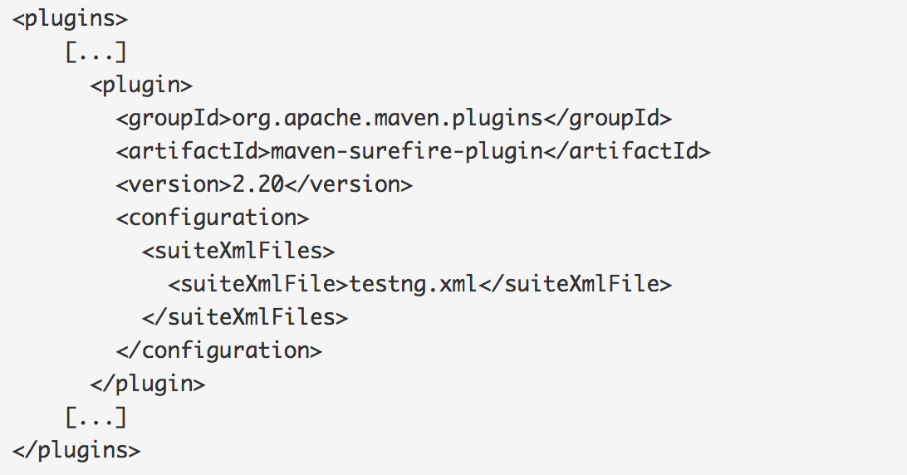
Using Suite XML Files
Notes:
<plugins> [...]
<plugin>
<groupId>org.apache.maven.plugins</groupId>
<artifactId>maven-surefire-plugin</artifactId>
<version>2.20</version>
<configuration>
<suiteXmlFiles>
<suiteXmlFile>testng.xml</suiteXmlFile>
</suiteXmlFiles>
</configuration>
</plugin> [...]
</plugins>

Slide 13
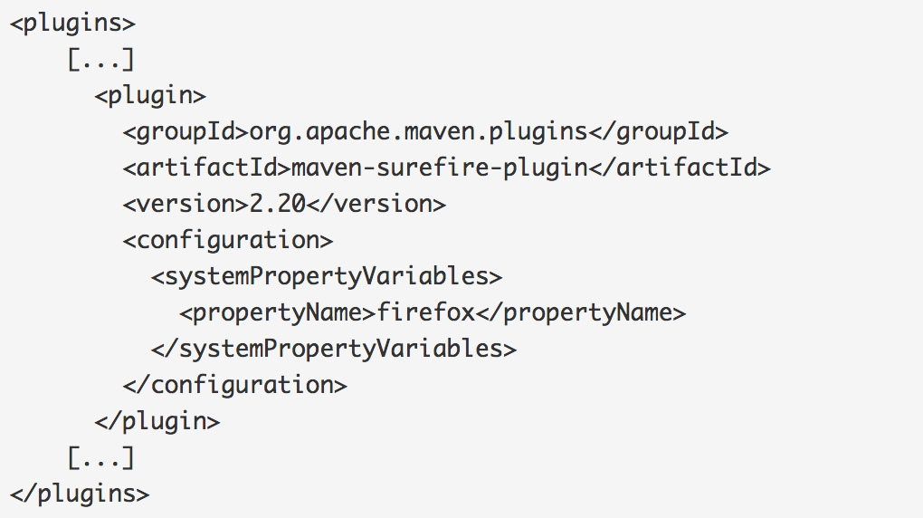
Specifying Test Parameters

Slide 14
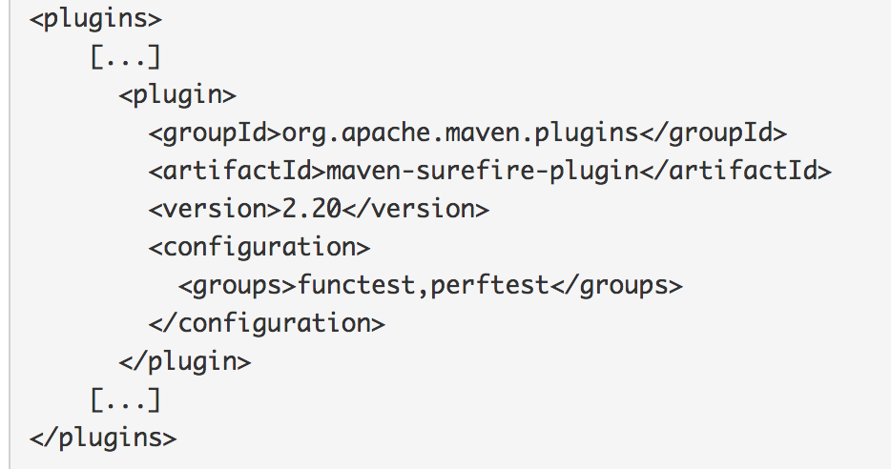
Using Groups

Slide 15
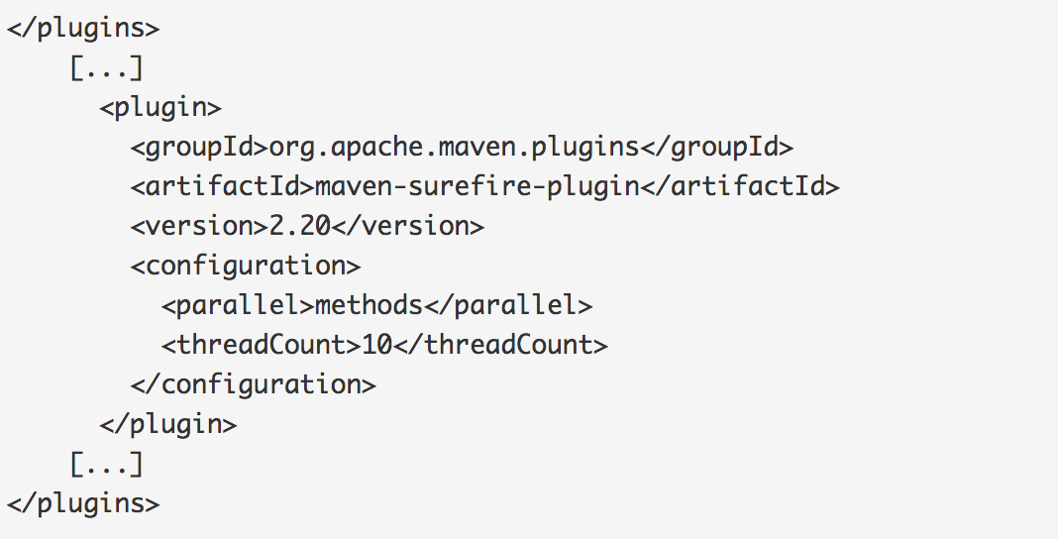
Running Tests in Parallel

Slide 16
Reference
http://testng.org/doc/
http://maven.apache.org/surefire/maven-surefire-plugin/examples/testng.html

