Slide 1
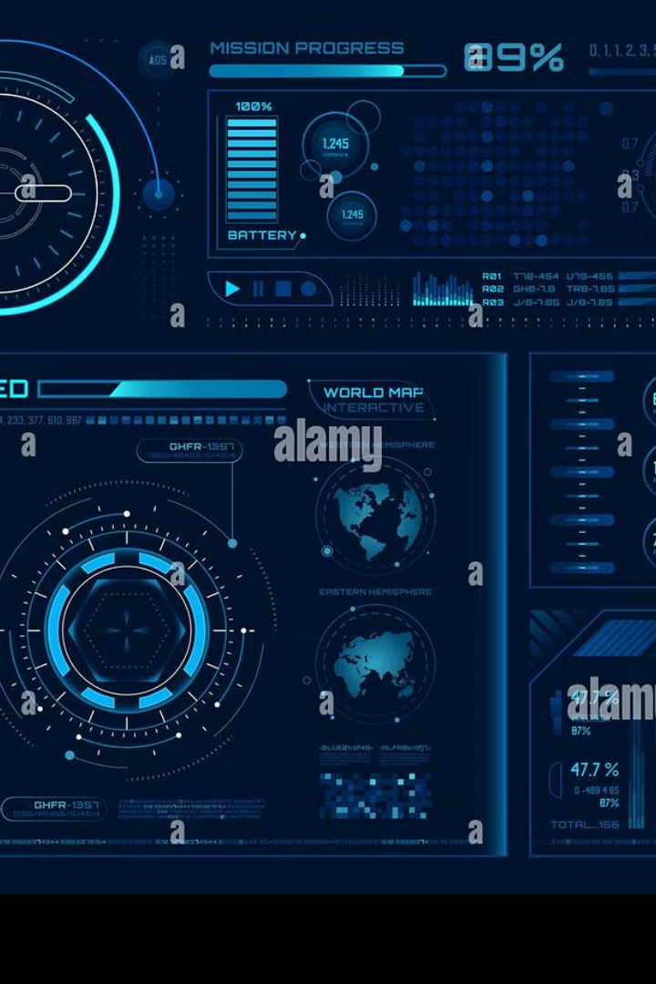
JARVIS: An AI Voice Assistant
Submitted by: Yashika Jindal (12261006)
Mentor: Dr. Nirvair Neeru
This project presents a multi-interface AI voice assistant built using Python and Streamlit. JARVIS (Just A Rather Very Intelligent System) combines desktop and web interfaces to create a versatile assistant that responds to both voice and text commands, enhancing user productivity through intelligent automation.

Slide 2
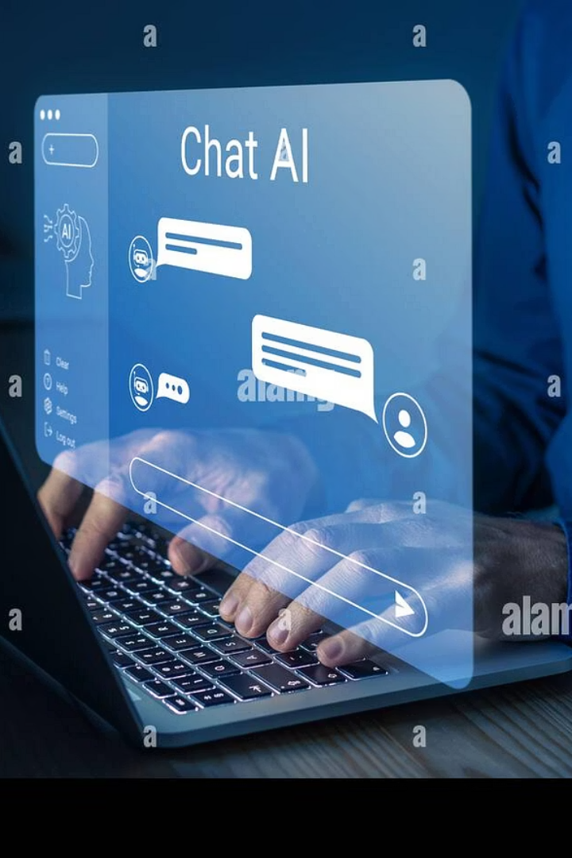



Project Introduction
Voice-Controlled Desktop Assistant
Enables hands-free control of your computer through natural voice commands, allowing you to open applications, search the web, and perform tasks without touching your keyboard.
Interactive Web Interface
A Streamlit-based web application that supports both text and voice input, making the assistant accessible across different platforms and user preferences.
Intelligent Command Processing
Processes natural language to perform various tasks like opening websites, playing music, providing time updates, and answering general queries using AI capabilities.

Slide 3




System Architecture
Voice Input Capture (jarvis_listener.pyw)
Continuously monitors the microphone for voice commands using SpeechRecognition library, converting speech to text for processing.
Command Processing Engine (main.py)
The brain of the assistant that interprets commands and decides which action to take, whether from voice or text input.
Action Execution
Performs system-level actions like opening applications, searching the web, or playing music based on the processed command.
Response Generation
Provides feedback through text-to-speech using pyttsx3 and displays responses on the Streamlit interface.

Slide 4








Core Technologies
Python
The foundation programming language
Key Libraries
SpeechRecognition, pyttsx3, Streamlit
System Integration
OS, webbrowser, datetime modules
Modular Architecture
Separate components for listening, processing, and UI
Python was chosen for this project due to its simplicity, extensive library support, and cross-platform compatibility. The modular architecture ensures clean separation of concerns, making the system maintainable and extensible.

Slide 5








Voice Recognition Capabilities
Listen
Recognize
Captures audio input from the microphone using PyAudio and SpeechRecognition
Converts speech to text using Google's speech recognition API
Respond
Process
Provides audible feedback using text-to-speech conversion
Analyzes the text to identify commands and intentions
The voice recognition system is designed to work in real-time, providing a natural interaction experience. It can handle various accents and speaking styles, making it accessible to a wide range of users.

Slide 6
JARVIS Web Interface
Streamlit Integration
Real-time Feedback
The web interface is built using Streamlit, a Python framework for creating interactive web applications. This allows users to interact with JARVIS through a browser, making it accessible from any device.
All responses from JARVIS are displayed in real-time on the web interface, creating a chat-like experience. This visual feedback complements the voice responses, making the assistant accessible to users with different preferences.
The interface supports both text input through a typing field and voice input through microphone access, providing flexibility in how users communicate with the assistant.
The web interface also provides a history of interactions, allowing users to review previous commands and responses.

Slide 7

Key Features & Capabilities
Application Control
Open applications and files with commands like "open Chrome" or "open Downloads folder" using OS integration.
Web Navigation
Search the web, open specific websites, or play videos on YouTube with natural language commands.
Information Retrieval
Get current time, date, weather updates, and answers to general knowledge questions.
Media Control
Play music on Spotify or YouTube, set reminders, and send emails through voice commands.

Slide 8
Project Results
Successful integration of voice recognition, natural language processing, and web technologies to build a versatile AI assistant.
User testing demonstrated high accuracy in command recognition and execution.
Dual interface with voice and text input provided flexibility for different usage scenarios.
The project theory centers on combining advanced speech processing with interactive web platforms to provide seamless and natural user interactions. This integration enables broad accessibility and enhances user experience by adapting to varied interaction preferences.

Slide 9




Challenges & Solutions
Voice Recognition Accuracy
1
Challenge: Inconsistent speech recognition in noisy environments. Solution: Implemented noise filtering and context-aware command processing to improve accuracy.
Synchronization Between Interfaces
Challenge: Maintaining consistent state between desktop and web interfaces. Solution: Developed a shared command processing engine in main.py that handles inputs from both sources.
Cross-Platform Compatibility
Challenge: Ensuring the assistant works across different operating systems. Solution: Used platform-agnostic libraries and implemented OS-specific fallbacks where needed.
User Experience Design
Challenge: Creating an intuitive interface for both voice and text interaction. Solution: Implemented clear feedback mechanisms and consistent command patterns.

Slide 10
Future Scope & Conclusion
Personalized Learning
Mobile Application
Implement user profiles and preference learning to make JARVIS more intelligent and adaptive to individual needs over time.
Multilingual Support
Develop a mobile app version using Flutter or React Native to allow users to interact with JARVIS on-the-go.
IoT Integration
Incorporate NLP models to understand and respond in multiple regional languages, making the assistant more inclusive and accessible.
Extend JARVIS to control smart home devices like lights, fans, and security systems using platforms like Home Assistant or Arduino.
JARVIS demonstrates the potential of combining AI, voice recognition, and web technologies to create versatile digital assistants. The project successfully bridges the gap between traditional desktop assistants and modern web-based AI systems, offering a more accessible and user-friendly experience.

