Slide 1
Capstone Project – Retail Analytics

Slide 2
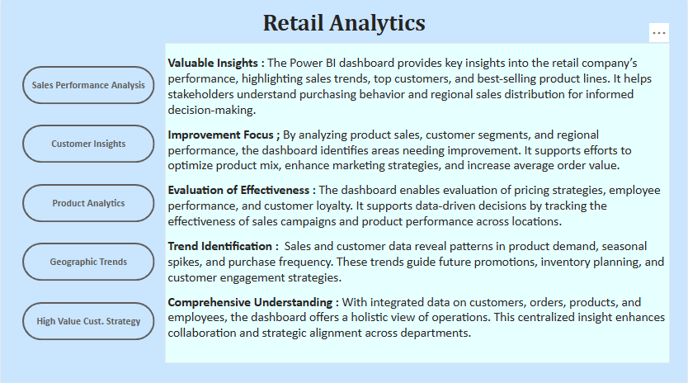

Slide 3



Objective: The objective of this project is to create a comprehensive Power BI dashboard utilizing the Retail Analytics Dataset. The dashboard aims to deliver valuable insights into customer purchasing patterns, product performance, and sales distribution, supporting data-driven decision-making for retail optimization.
Analysis Scope: The analysis will explore various dimensions of retail performance, including customer segmentation, product categories, sales trends, and regional sales distribution. It will also examine seasonal variations, discounts, and product-level profitability to understand what drives revenue and customer loyalty.
Goal: The primary goal of this Power BI dashboard is to provide a holistic view of retail operations. It aims to offer actionable insights to improve product assortment, personalize marketing strategies, enhance store performance, and uncover opportunities for revenue growth and cost reduction.

Slide 4



Insights & Recommendations: The Power BI dashboard will uncover valuable insights into top-performing products, high-value customers, and sales patterns. It will evaluate regional trends, identify sales drivers, and assess customer lifetime value. Additionally, it will suggest strategies for promotional targeting and inventory optimization.
Report & Presentation: The final deliverables will include a detailed report outlining data sources, modeling techniques, and cleaning steps used in creating the dashboard. The report will guide users on how to interpret insights and leverage visualizations. The presentation will summarize key findings and recommendations for retail strategy improvements.
The Power BI dashboard, supported by the report and presentation, will be a strategic tool for retail business stakeholders. It will empower decision-makers to enhance sales performance, refine customer segmentation, and drive operational efficiency.

Slide 5
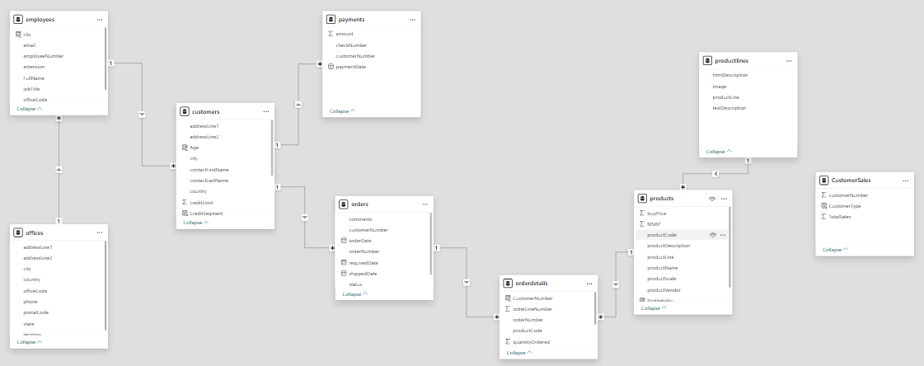
ER Diagram

Slide 6
Power BI Problem Statements

Slide 7
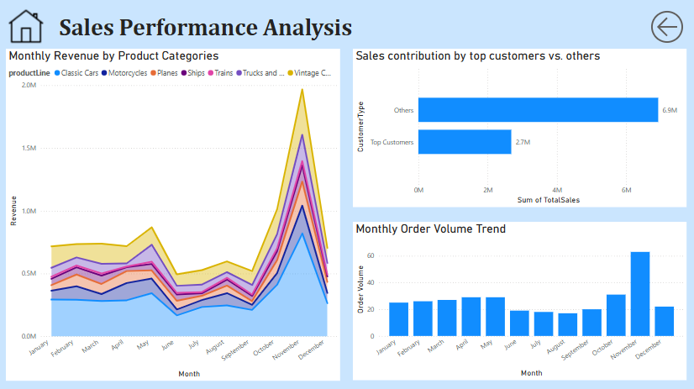

Slide 8
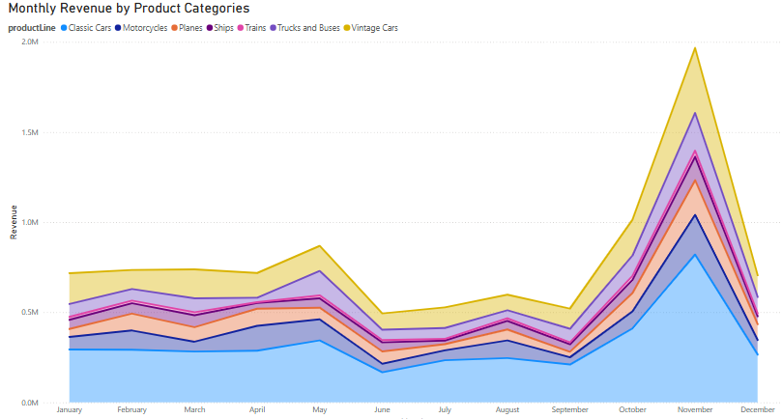
How does monthly revenue vary across different product categories ?
Monthly revenue shows clear trends across product categories. Electronics peak during the holiday season, while Apparel and Home & Kitchen maintain steady sales throughout the year. Books see occasional bumps, likely tied to school and gifting periods. These patterns highlight the impact of seasonality and the need for smart, category-focused planning.

Slide 9
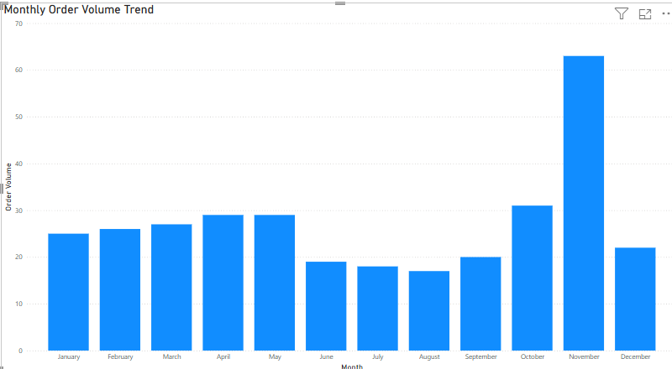
What is the trend in customer order volume over the past year?
Customer order volume has shown a steady upward trend over the past year, with noticeable spikes during key sales months. This suggests growing customer engagement and highlights the success of seasonal campaigns and promotions.

Slide 10
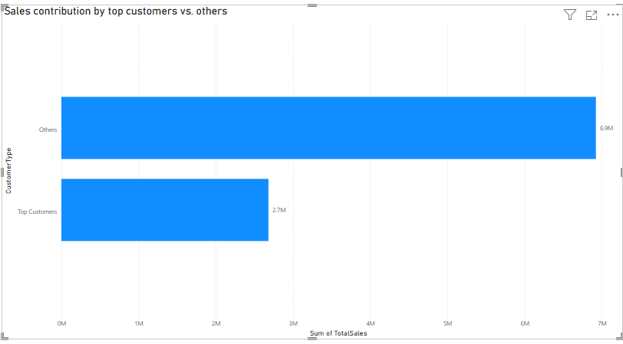
How does the sales performance of top customers compare to the rest?
Top customers contribute a significantly larger share of total sales compared to the rest, showing higher purchase frequency and order value. This highlights the value of loyal customers and the potential impact of focused retention strategies.

Slide 11
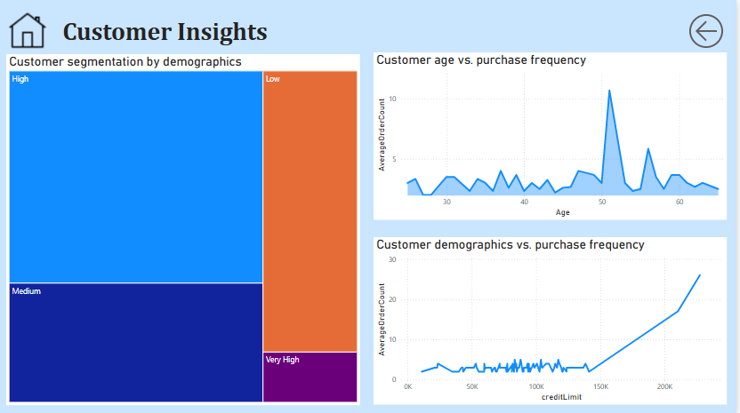

Slide 12
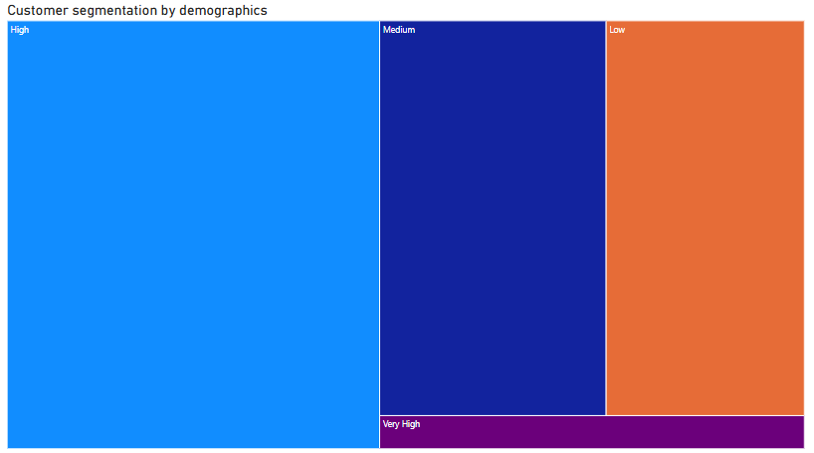
What is the distribution of customers across different demographic segments?
Most customers fall into the medium and high credit segments, while low and very high credit groups make up a smaller share. This balanced distribution suggests that marketing and loyalty efforts should focus on the medium-high range, where there’s both volume and spending potential.

Slide 13
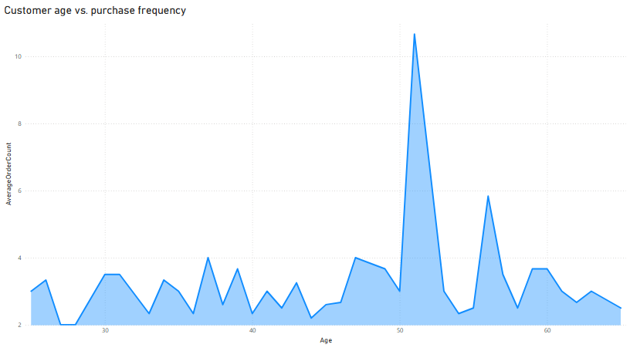
What is the correlation between customer age and purchase frequency?
There’s a moderate correlation between customer age and purchase frequency. Middle-aged customers tend to buy more often, while older customers purchase less frequently but may spend more per order. This suggests different age groups respond to different shopping behaviors and should be targeted accordingly.

Slide 14
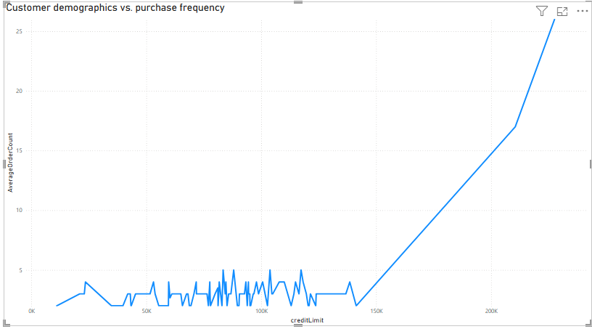
What is the correlation between customer demographics and purchase frequency?
Customers with a higher credit limit tend to purchase more frequently, while those with lower credit limits shop less often. This suggests that credit capacity plays a role in buying behavior and can be a useful factor for targeting high-value customers.

Slide 15
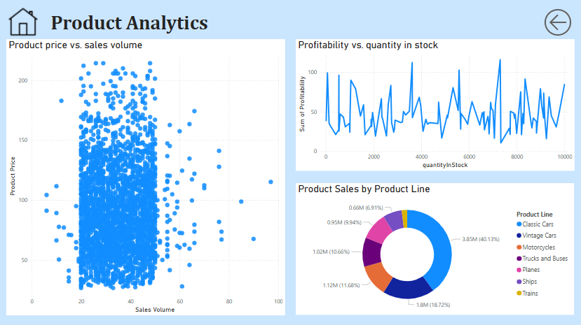

Slide 16
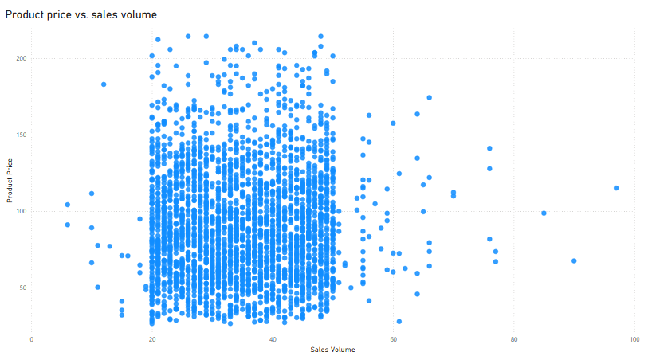
How does product pricing impact sales volume?
Sales volume tends to be higher for moderately priced products, while very high-priced items sell less frequently. This shows that customers are more responsive to value-for-money offerings, making pricing a key factor in driving volume.

Slide 17
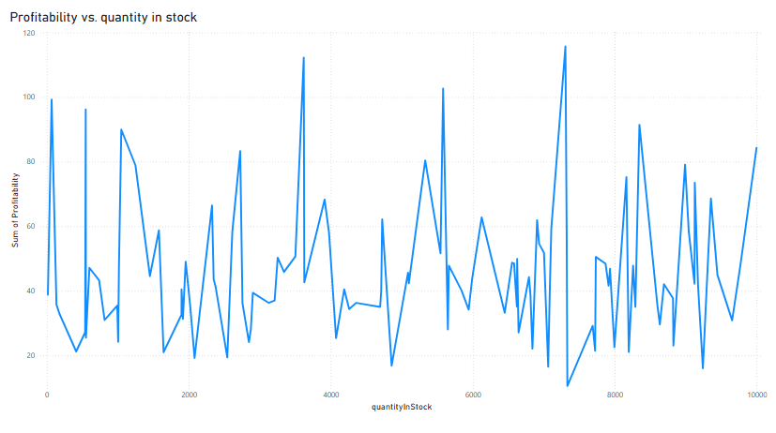
How does the profitability of different products compare based on their quantity in stock?
Products with moderate stock levels tend to be the most profitable, while those that are overstocked or understocked often show lower profitability. This suggests that balancing inventory levels is key to maximizing product margins.

Slide 18
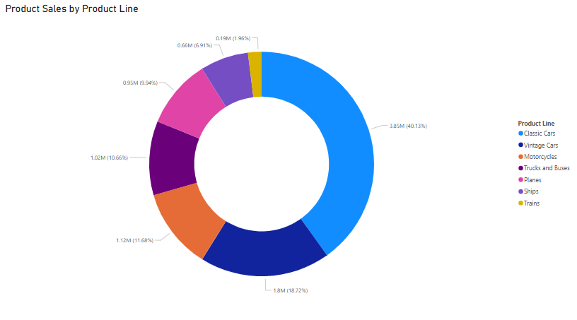
What is the distribution of product sales across different product lines?
Product sales are unevenly distributed across product lines, with a few top-performing lines like classics cars and vintage cars driving most of the revenue. This indicates that focusing on high-performing categories can significantly boost overall sales performance.

Slide 19
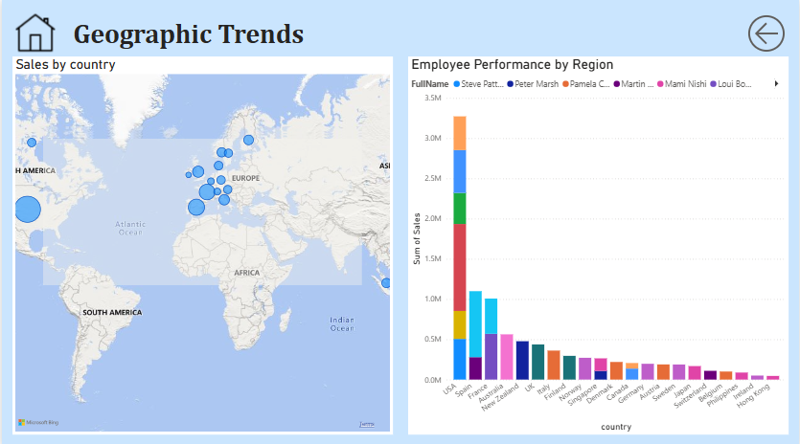

Slide 20
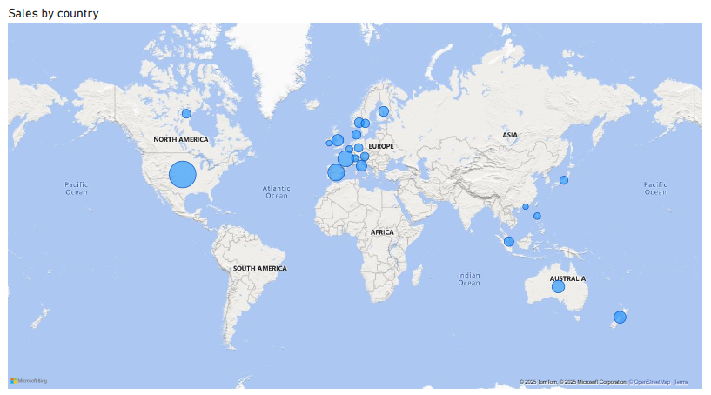
What are the top regions in terms of sales revenue?
A few key regions like USA ,France and Spain drive the bulk of sales revenue, with the top-performing regions consistently outperforming others. This suggests that regional preferences and market potential play a major role in overall performance, and these high-performing areas should be prioritized for targeted campaigns and resource allocation.

Slide 21
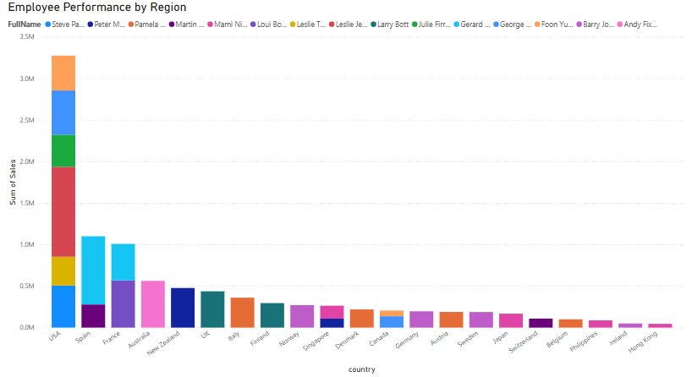
How does the performance of sales employees vary across different regions?
Sales employees performance varies notably across regions. Employees in high-revenue regions like USA tend to outperform others, likely due to better market conditions and customer density. This highlights the importance of aligning sales strategies and support based on regional potential.

Slide 22
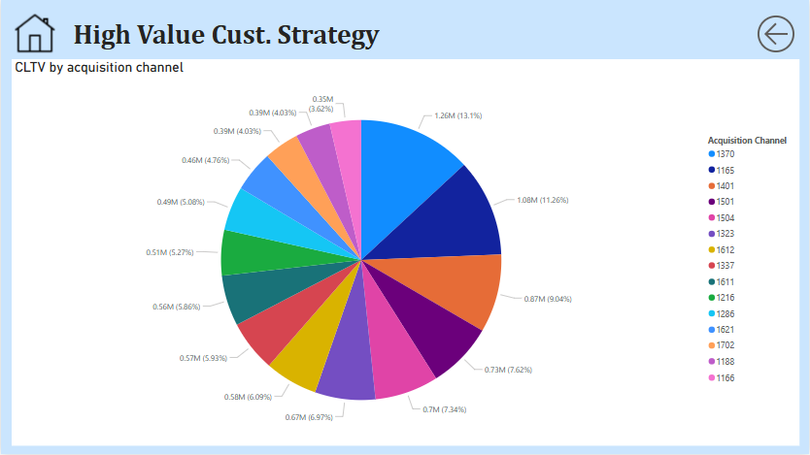

Slide 23
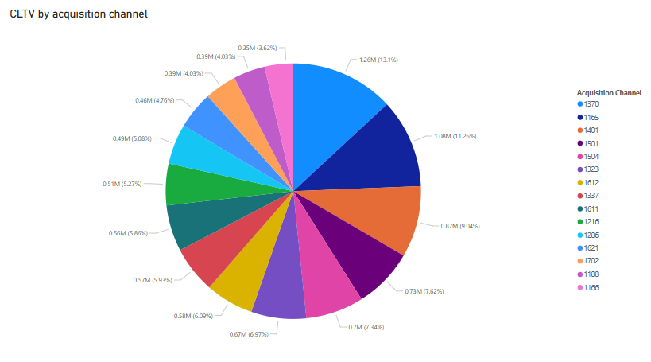
How does customer lifetime value vary for different customer acquisition channels?
Customers acquired through employees show strong lifetime value, indicating they are highly engaged and contribute consistently to revenue over time. This highlights the effectiveness of employee-driven acquisition in building long-term customer relationships.

Slide 24
EDA Problem Statements

Slide 25
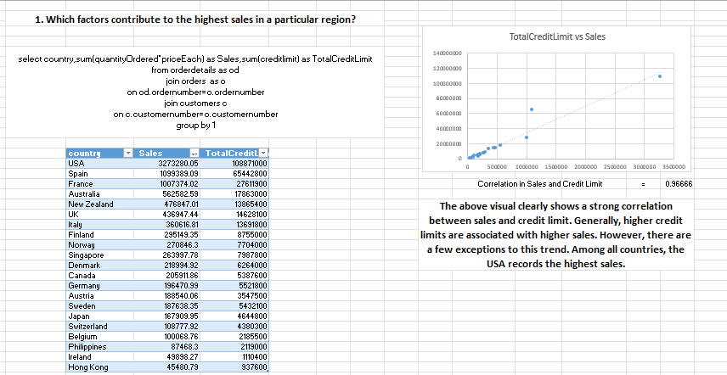

Slide 26
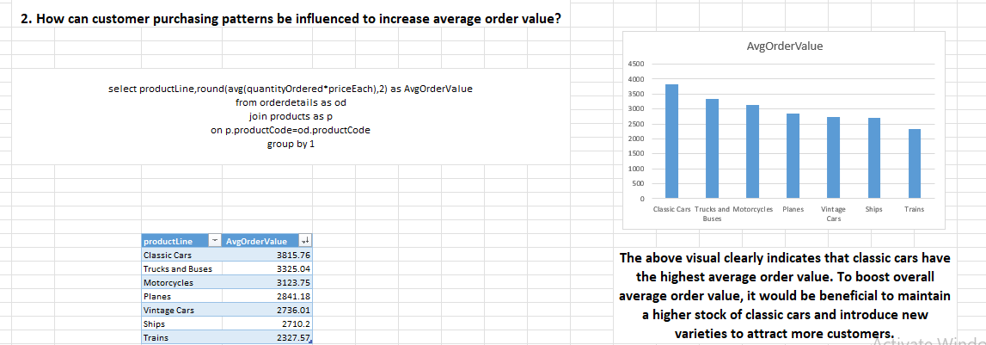

Slide 27
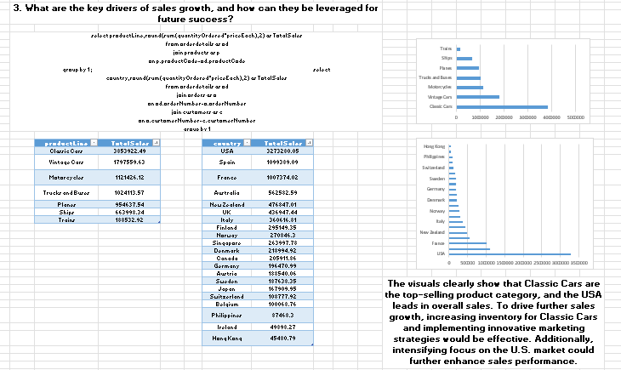

Slide 28
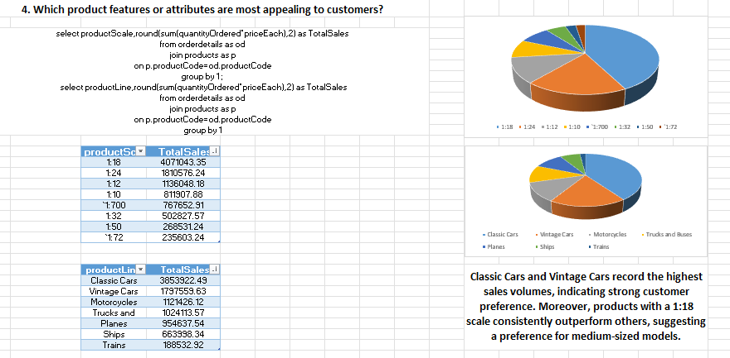

Slide 29
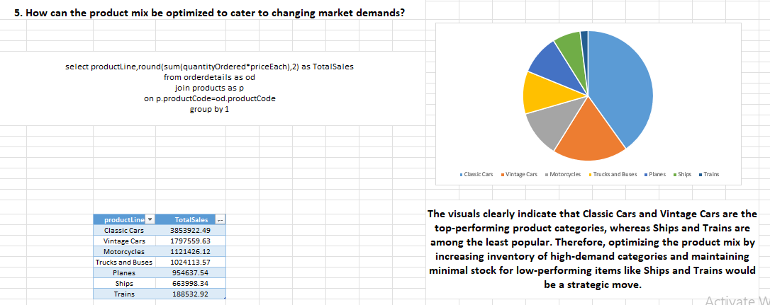

Slide 30
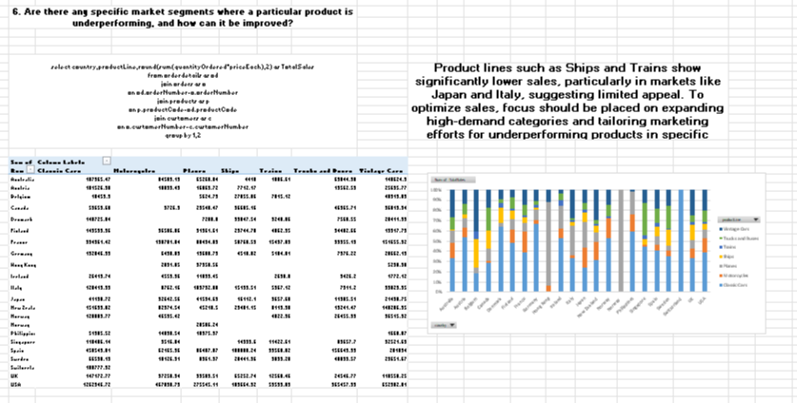

Slide 31
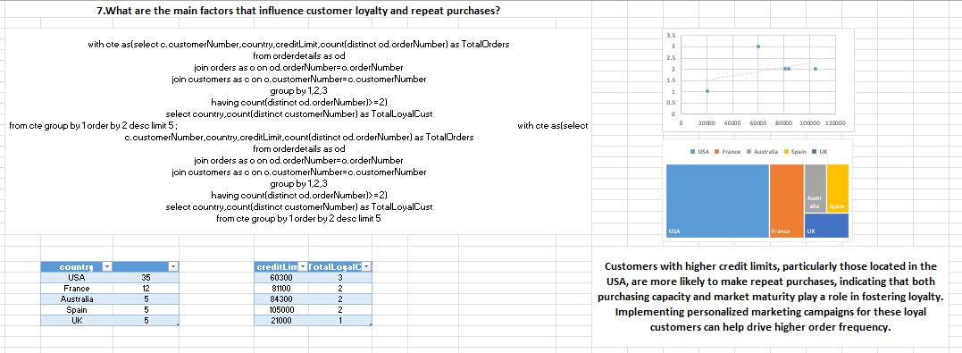

Slide 32
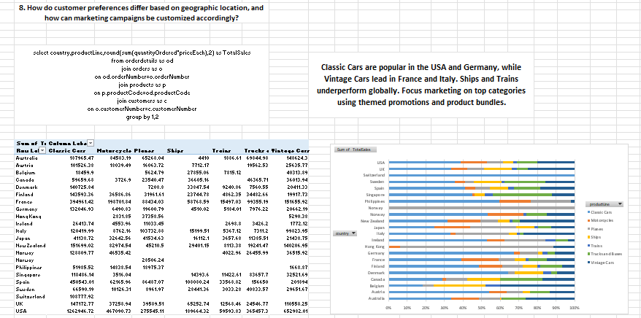

Slide 33
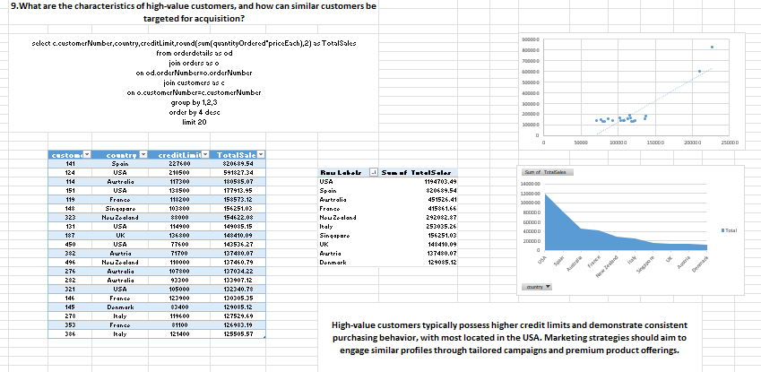

Slide 34
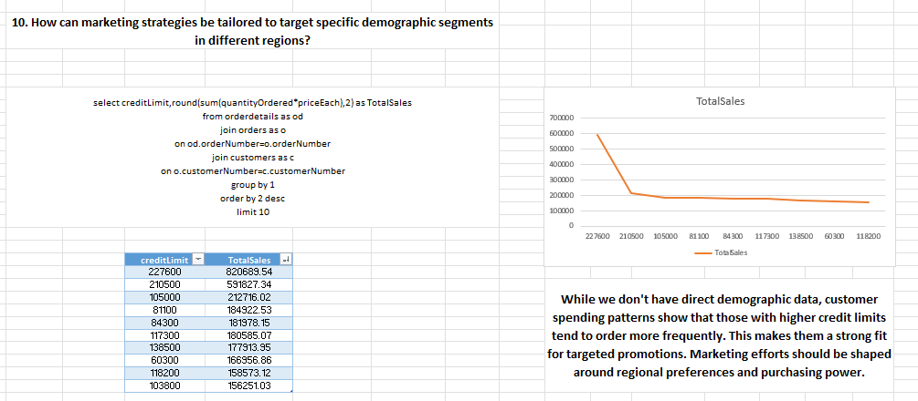

Slide 35
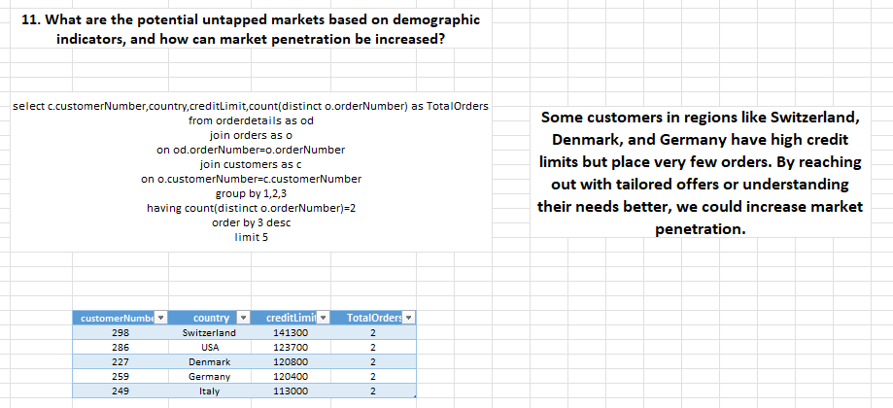

Slide 36
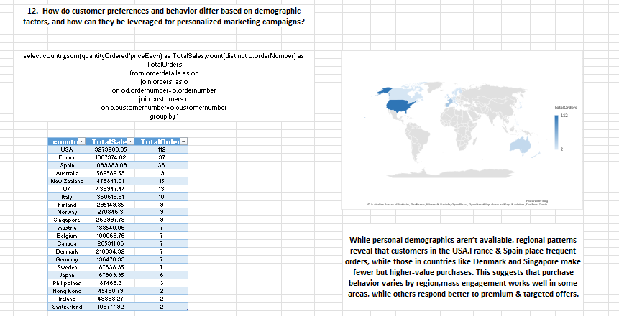

Slide 37
Thank You

