Slide 1
Algorithm & Their Application - Final Project
Counting Triangles in a graph
Presenter:
Computational Science & Engineering
2020314303 Jinduk park

Slide 2
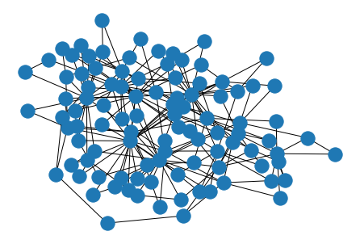
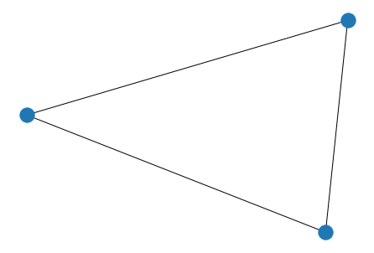
Counting Triangles in a graph
Introduction : what we want to solve
Counting triangles in graph plays an important role in complex network analysis.
a graph with 100 nodes
It is difficult to catch the graph’s property at a glance.
Total number of triangles in a graph is used to compute clustering coefficient or transitivity [1] which is used for graph evaluation metric.
What is triangle in a graph?
Triangle pattern in a graph
3 nodes are connected to each other.
node
edge
[1] Newman, Mark EJ. "The structure and function of complex networks." SIAM review 45.2 (2003): 167-256.

Slide 3
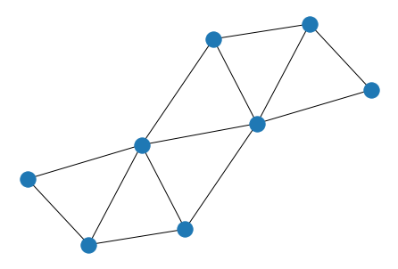
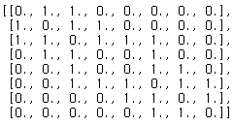




Counting Triangles in a graph
Problem definition
adjacency matrix
a square matrix used to represent a finite graph
The elements of the matrix indicate whether pairs of vertices are adjacent or not in the graph
G
$A$
G : undirected, unweighted graph
Count total # of triangular pattern in a graph
$A$ : adjacency matrix of a graph G
1. DFS strategy with stack data structure
$A^{n}$: n-th power of adjacency matrix
2. Using power of adjacency matrix - simple matrix multiplication
- Divide & conquer algorithm – Strassen’s formula
$a_{ij}$: i,j-th element of matrix A

Slide 4
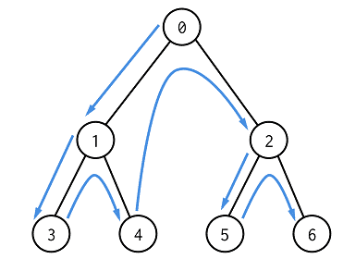


Counting Triangles in a graph
Algorithm#1. Depth Frist Search with stack
Triangular pattern:
DFS strategy:
a
c
[ a b c a]
b
Stack
Triangle trace list
+insert
push
push
c
c
b
b
b
Time complexity
$$O(dmax^{2}∗n)$$
a
a
a
a
$dmax$: maximum degree in G

Slide 5
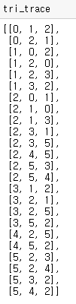
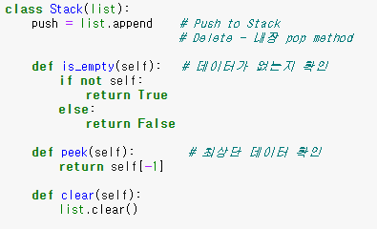
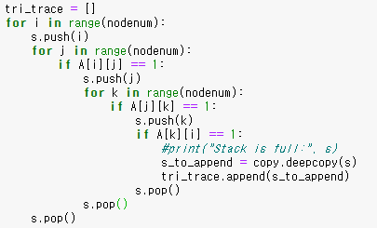
Counting Triangles in a graph
Algorithm#1. Depth Frist Search with stack
Implementation
Stack
DFS strategy
Triangle trace list
+insert
push
push
c
c
b
b
b
a
a
a
a

Slide 6
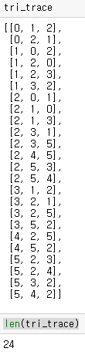
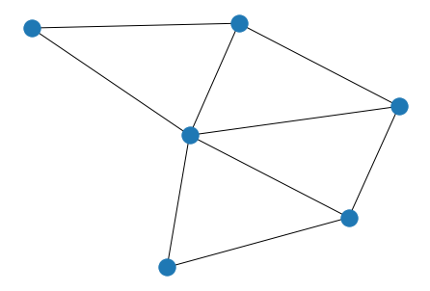


Counting Triangles in a graph
Algorithm#1. Depth Frist Search with stack
Implementation
a
c
* 1 triangle has 6 trace each.
b
Input graph: 4 triangle lattice graph
$$\frac{24}{6}=\frac{24}{3∗2∗1}$$
Permutation order

Slide 7








Counting Triangles in a graph
Algorithm#2. Using power of adjacency matrix
G : undirected, unweighted graph
$A$ : adjacency matrix of a graph G
$a_{ij}^{n}$: total # of walks from node i to j of length n
$a_{ij}^{n}$: i,j-th element of matrix $A^{n}$
It can be proved in an inductive way.
=
$$A$$
X
$$A$$
$$A^{2}$$

Slide 8
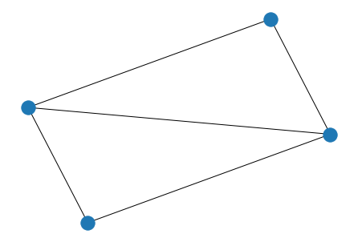





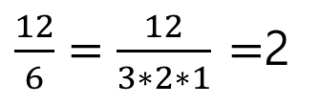
Counting Triangles in a graph
Algorithm#2. Using power of adjacency matrix
Sum of ${diagonal elements of A}^{3}$ represent total number of 3time walks from node ‘x’ to node ‘x’
e.g)
Sum(diag($A^{3}$)) = 2+4+4+2 =12
Total triangle number:
$\frac{12}{6}=\frac{12}{3∗2∗1}$ $=$2
Time complexity
$$O(n^{3})$$
$$A$$
$$A^{3}$$

Slide 9
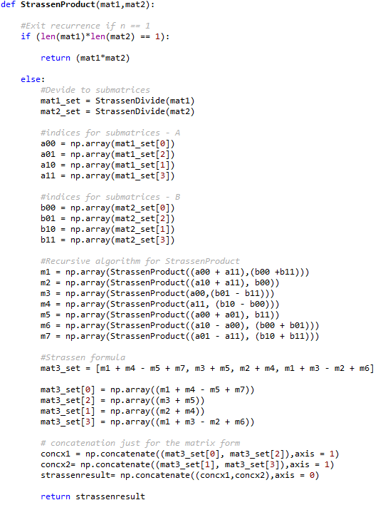
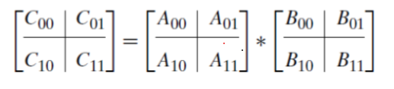
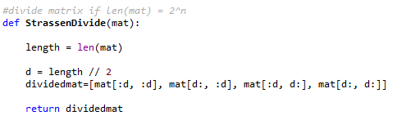
Counting Triangles in a graph
Algorithm#2. Using power of adjacency matrix –Strassen’s formula
Divide & Conquer matrix multiplication algorithm – Strassen’s formula

Slide 10
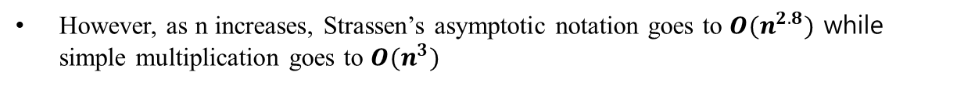
Counting Triangles in a graph
Algorithm#2. Using power of adjacency matrix –Strassen’s formula
Divide & Conquer matrix multiplication algorithm – Strassen’s formula
In small size graph, Strassen’s formula has more computational cost compared to simple multiplication method
However, as n increases, Strassen’s asymptotic notation goes to $O(n^{2.8})$ while simple multiplication goes to $O(n^{3})$
I plan to check from which size the performance of Strassen will be better.

Slide 11
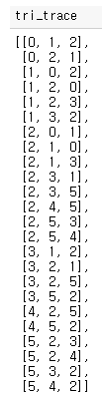



Counting Triangles in a graph
Summary
Using matrix multiplication
DFS with stack
normal
Strassen’s formula
characteristic
We can track triangles
We cannot track triangles (only know triangle count)
Time complexity
$$O(dmax^{2}∗n)$$
$$O(n^{3})$$
$$O(n^{2.8})$$

