Slide 1
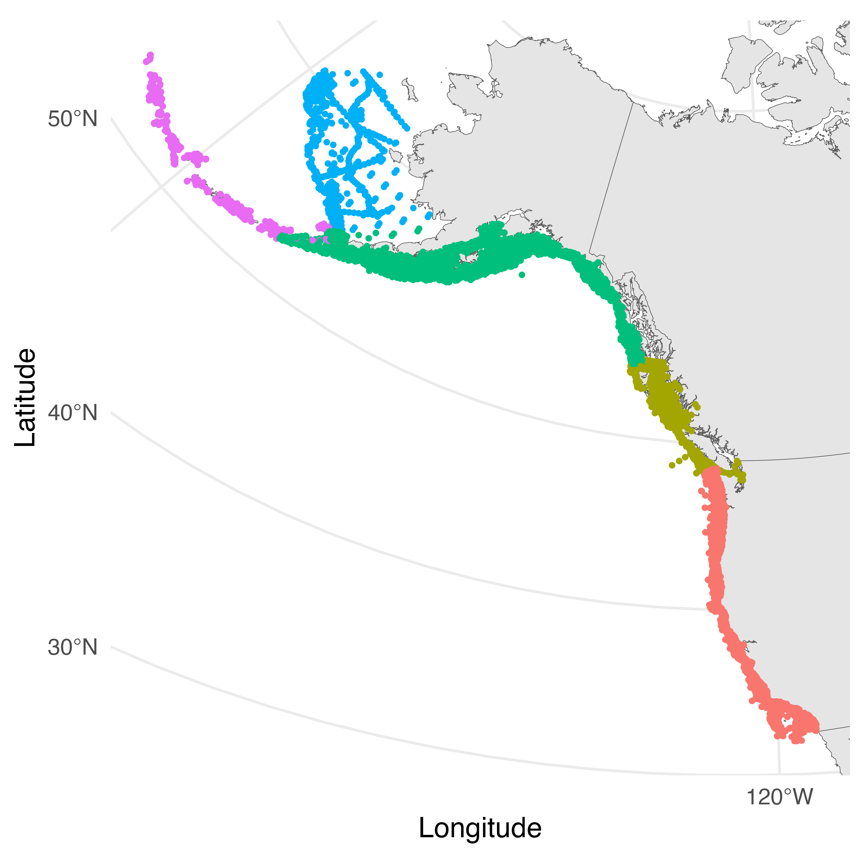
Eastern Bering Sea
Aleutian Islands
Gulf of Alaska
British Columbia
California Current

