Slide 1
3.4 Testing Bipartiteness

Slide 2
Bipartite Graphs
Def. An undirected graph G = (V, E) is bipartite if the nodes can be colored red or blue such that every edge has one red and one blue end.
Applications.
  Stable marriage: men = red, women = blue.
  Scheduling: machines = red, jobs = blue.
a bipartite graph

Slide 3
Testing Bipartiteness
Testing bipartiteness. Given a graph G, is it bipartite?
  Many graph problems become:
    easier if the underlying graph is bipartite (matching)
    tractable if the underlying graph is bipartite (independent set)
  Before attempting to design an algorithm, we need to understand structure of bipartite graphs.
v₂
v₂
v₃
v₁
v₄
v₆
v₅
v₄
v₃
v₅
v₆
v₇
v₁
v₇
a bipartite graph G
another drawing of G

Slide 4
An Obstruction to Bipartiteness
Lemma. If a graph G is bipartite, it cannot contain an odd length cycle.
Pf. Not possible to 2-color the odd cycle, let alone G.
bipartite
(2-colorable)
not bipartite
(not 2-colorable)

Slide 5
Bipartite Graphs
Lemma. Let G be a connected graph, and let L₀, …, L_{k} be the layers produced by BFS starting at node s. Exactly one of the following holds.
  (i) No edge of G joins two nodes of the same layer, and G is bipartite.
  (ii) An edge of G joins two nodes of the same layer, and G contains an
  odd-length cycle (and hence is not bipartite).
L₁
L₂
L₃
L₁
L₂
L₃
Case (i)
Case (ii)

Slide 6
Bipartite Graphs
Lemma. Let G be a connected graph, and let L₀, …, L_{k} be the layers produced by BFS starting at node s. Exactly one of the following holds.
  (i) No edge of G joins two nodes of the same layer, and G is bipartite.
  (ii) An edge of G joins two nodes of the same layer, and G contains an
  odd-length cycle (and hence is not bipartite).
Pf. (i)
  Suppose no edge joins two nodes in the same layer.
  By previous lemma, this implies all edges join nodes on same level.
  Bipartition: red = nodes on odd levels, blue = nodes on even levels.
L₁
L₂
L₃
Case (i)

Slide 7
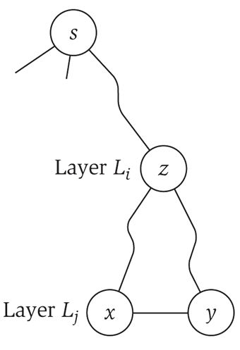
Bipartite Graphs
Lemma. Let G be a connected graph, and let L₀, …, L_{k} be the layers produced by BFS starting at node s. Exactly one of the following holds.
  (i) No edge of G joins two nodes of the same layer, and G is bipartite.
  (ii) An edge of G joins two nodes of the same layer, and G contains an
  odd-length cycle (and hence is not bipartite).
Pf. (ii)
  Suppose (x, y) is an edge with x, y in same level L_{j}.
  Let z = lca(x, y) = lowest common ancestor.
  Let L_{i} be level containing z.
  Consider cycle that takes edge from x to y,
  then path from y to z, then path from z to x.
  Its length is 1 + (j-i) + (j-i), which is odd. ▪
z = lca(x, y)
(x, y)
path from
y to z
path from
z to x

Slide 8
Obstruction to Bipartiteness
Corollary. A graph G is bipartite iff it contain no odd length cycle.
5-cycle C
bipartite
(2-colorable)
not bipartite
(not 2-colorable)

