Slide 1
Strain adaptation in diseases

Slide 2
SGB
MAGs
StrainPhlAn

Slide 3
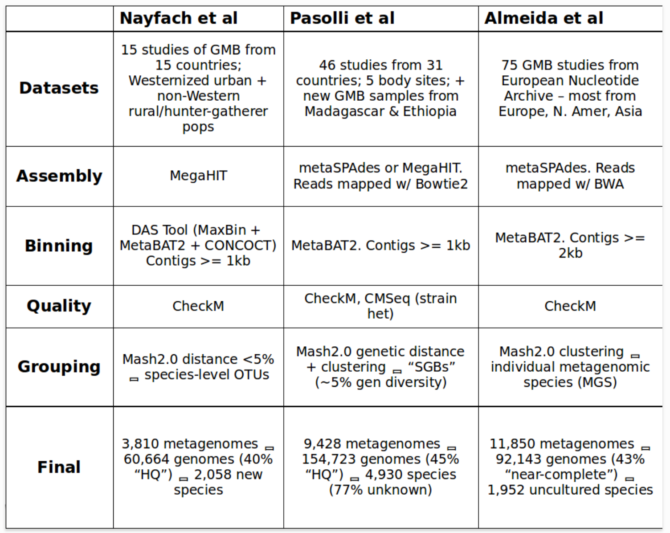
Nayfach et al. Nature, 2019
Pasolli et al. Cell, 2019
Almeida et al. Nature, 2019
Comparing the datasets, methods, and results from the three Metagenome Assembled Genomes (MAG) studies.
https://www.bsiranosian.com/
Notes:
New insights from uncultivated genomes of the global human gut microbiome
Extensive Unexplored Human Microbiome Diversity Revealed by Over 150,000 Genomes from Metagenomes Spanning Age, Geography, and Lifestyle
A new genomic blueprint of the human gut microbiota

Slide 4
workflow
MetaBAT2:
binning
Raw Fastq
bam
output_bins
samtools:
Sort sam file
CheckM:
evaluate completeness
fastp: QC
Trimmed raw Fastq
sam
checkm_out
bowtie2:
Remove Human reads
bowtie2:
map reads into scaffolds
Mash2.0: grouping
delHum
Fastq
scaffolds.fasta
MAG
metaSPAdes:
Assembly
Notes:
https://github.com/CUMoellerLab/sn-mg-pipeline
Snakemake pipeline for basic processing of metagenomic data from the lab. It accepts raw fastq files of metagenomic data, quality filters it, removes reads that map to the host genome, then builds assemblies of each sample and generates a sourmash profile. The current version also generates a taxonomic profile of each sample using MetaPhlAn3. Modules that are currently underdevelopment will handle automated binning procedures, as well as strain-level profiling.

Slide 5
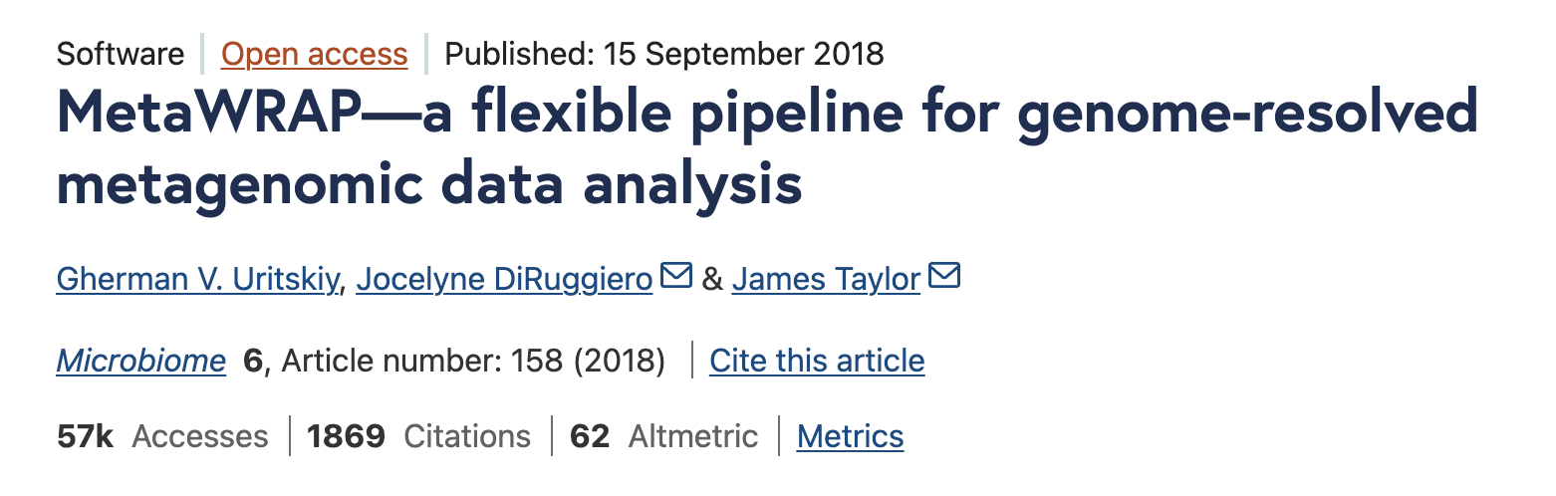
https://github.com/CUMoellerLab/sn-mg-pipeline
It accepts raw fastq files of metagenomic data, quality filters it, removes reads that map to the host genome, then builds assemblies of each sample and generates a sourmash profile. The current version also generates a taxonomic profile of each sample using MetaPhlAn3. Modules that are currently underdevelopment will handle automated binning procedures, as well as strain-level profiling.
ATLAS: https://github.com/metagenome-atlas/atlas
MetaWRAP
Notes:
# Step-by-step: Using UHGG as Reference for AlleleFlux
# ----------------------------------------
# STEP 1: Prepare UHGG Reference MAGs
# ----------------------------------------
# 1.1 Download representative genomes from UHGG
# e.g., download all .fna files into UHGG_MAGs/
# https://www.ebi.ac.uk/metagenomics/genomes/UHGG/
# 1.2 Concatenate all MAGs into a single FASTA
mkdir -p reference
cat UHGG_MAGs/*.fna > reference/all_uhgg.fasta
# 1.3 Reformat FASTA headers (optional but recommended)
# Use awk or a Python script to ensure format >MAG_ID.fa_contigID
# Example:
sed -i 's/^>/>MAG_/' reference/all_uhgg.fasta
# ----------------------------------------
# STEP 2: Generate Prodigal ORFs from UHGG FASTA
# ----------------------------------------
# 2.1 Run Prodigal
prodigal -i reference/all_uhgg.fasta \
-d reference/all_uhgg.genes.fna \
-a reference/all_uhgg.proteins.faa \
-p meta
# ----------------------------------------
# STEP 3: Align Your Reads to UHGG Reference
# ----------------------------------------
# 3.1 Build index
bowtie2-build reference/all_uhgg.fasta reference/uhgg_index
# 3.2 Align paired-end reads (repeat for each sample)
mkdir -p bam
bowtie2 -x reference/uhgg_index \
-1 sample_R1.fastq.gz -2 sample_R2.fastq.gz \
| samtools sort -o bam/sample.sorted.bam
# 3.3 Index the BAM file
samtools index bam/sample.sorted.bam
# ----------------------------------------
# STEP 4: Configure AlleleFlux
# ----------------------------------------
# 4.1 Edit smk_workflow/config.yml:
# config.yml
# ------------------------
fasta: ../reference/all_uhgg.fasta
prodigal: ../reference/all_uhgg.genes.fna
bamDir: ../bam/
metadata_file: ../metadata.tsv
gtdb_file: ../gtdbtk.bac120.summary.tsv
# ------------------------
# 4.2 Check sample IDs in BAM and metadata match
# ----------------------------------------
# STEP 5: Run AlleleFlux Workflow
# ----------------------------------------
# 5.1 Activate conda environment
mamba activate AlleleFlux
# 5.2 Run Step 1 (profiling, eligibility)
cd smk_workflow
snakemake -s step1.smk --profile cornell_profile/
# 5.3 Run Step 2 (allele frequency analysis)
snakemake -s step2.smk --profile cornell_profile/
# ✅ Output will include allele profiles, frequencies, scores, etc.

Slide 6
Notes:
Pan S, Zhu C, Zhao X-M. et al. SemiBin: incorporating infor-
mation from reference genomes with semi-supervised deep
learning leads to better metagenomic assembled genomes
(MAGs). Nat Commun 2022;13:2326. https://doi.org/10.1038/
s41467-022-29843-y
Pan S, Zhao X-M, Coelho LP. SemiBin2: self-supervised
contrastive learning leads to better MAGs for short-and
long-read sequencing. Bioinformatics 2023;39:21–29. https://doi.
org/10.1093/bioinformatics/btad209
Kang DD, Froula J, Egan R. et al. Metabat, an efficient tool
for accurately reconstructing single genomes from com-
plex microbial communities. PeerJ 2015;3:e1165. https://doi.
org/10.7717/peerj.1165

Slide 7
vamb

Slide 8
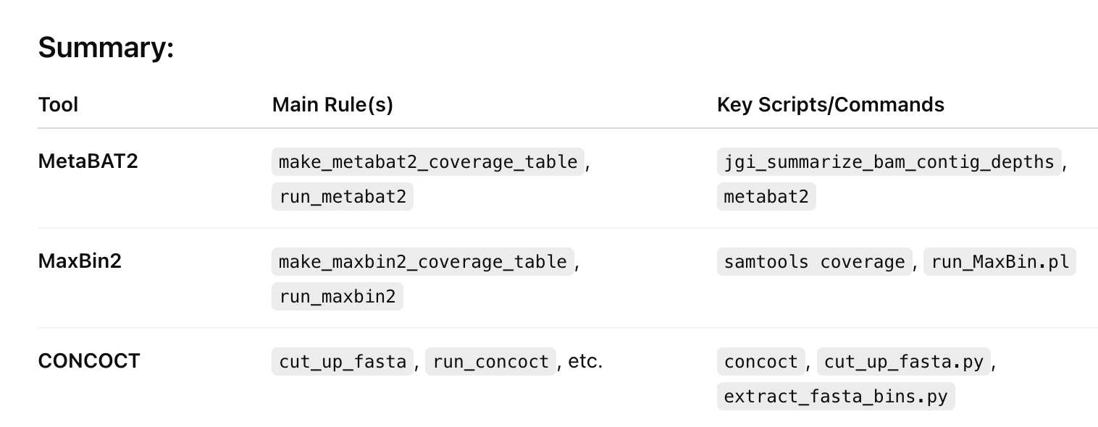
binning tools

Slide 9
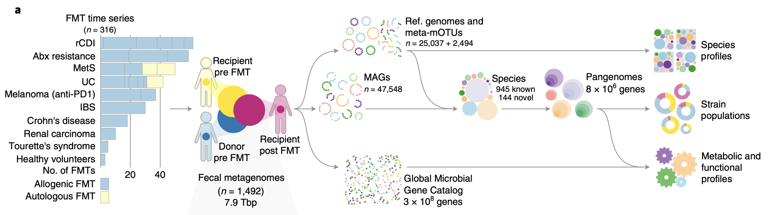
Schmidt2022_Nat_Med
Notes:
rCDI
UC
CD
Healthy volunteer
有无pre/post for control and diseased

Slide 10
PRJEB46777
Rossen NG et al., "Findings From a Randomized Controlled Trial of Fecal Transplantation for Patients With Ulcerative Colitis.", Gastroenterology, 2015 Jul;149(1):110-118.e4
Notes:
PRJEB46777

Slide 11
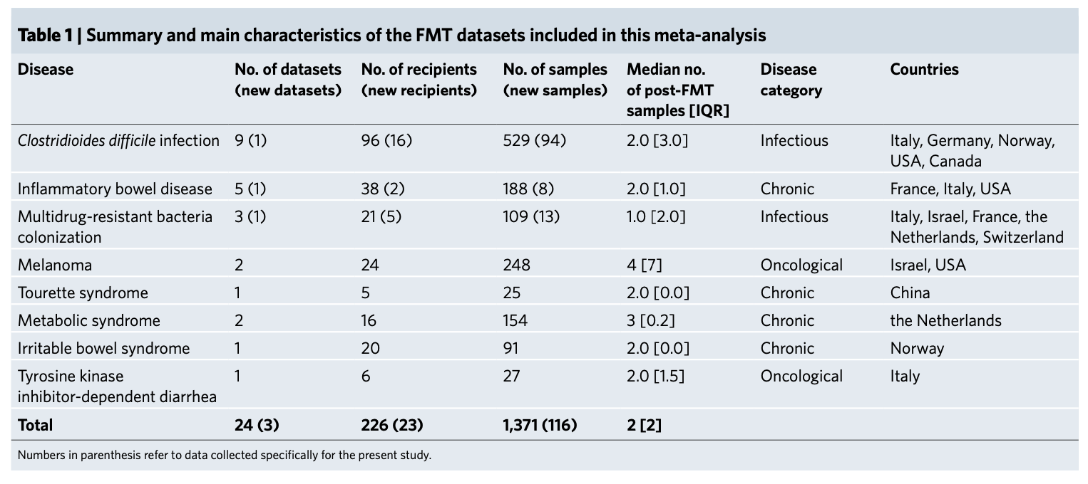
Ianiro2022_Nat_Med

Slide 12
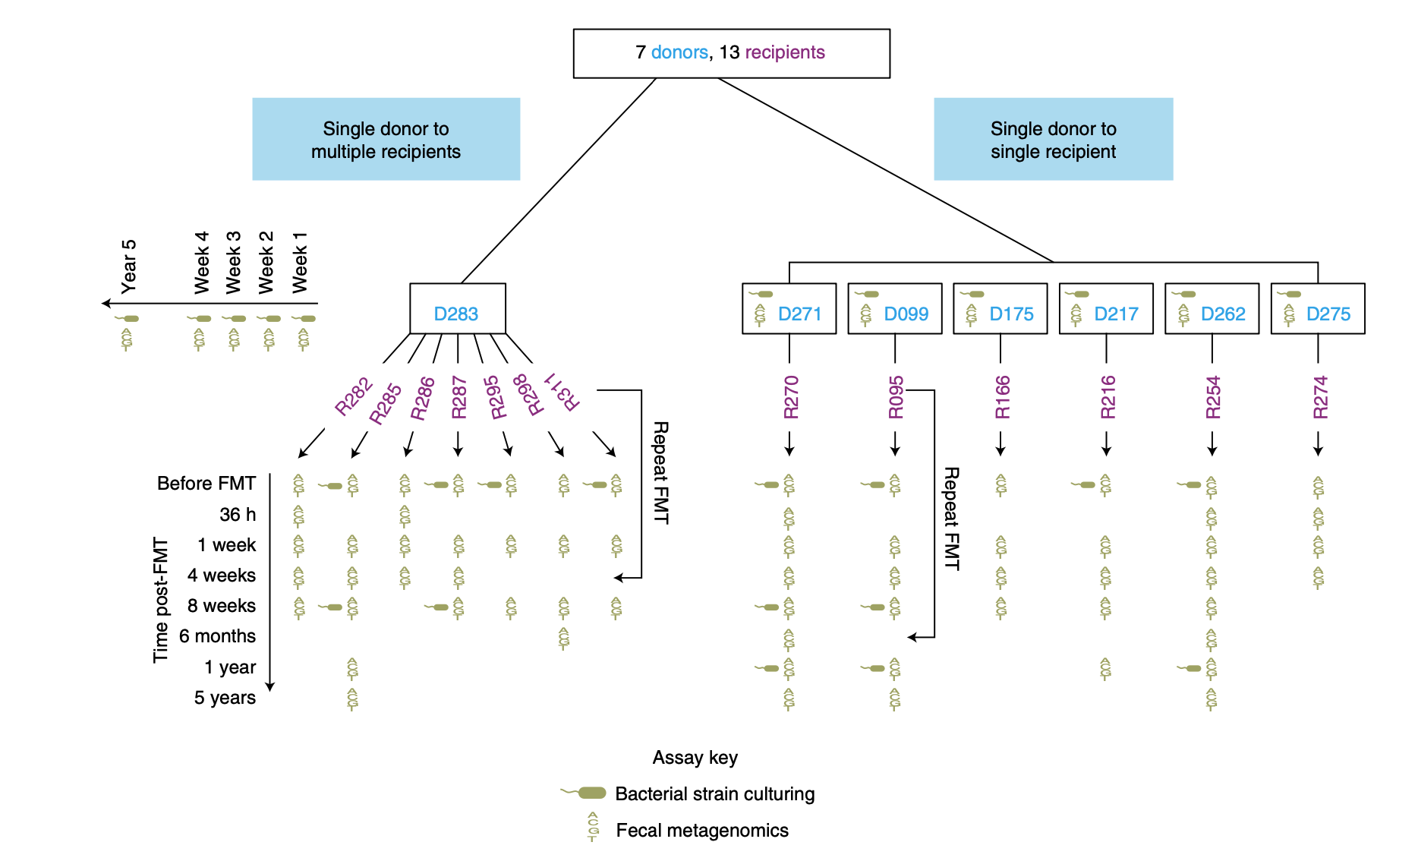
Aggarwala2021_Nat_Microb
applied a statistical approach named Strainer to evaluate clinical interventions and detected stable engraftment of 71% of donor microbiota strains in recipients up to 5 years post-FMT
80% of recipient gut bacterial strains pre-FMT were eliminated by FMT and that post-FMT the strains present persisted up to 5 years later
Notes:
Fig. 1
Metadata available in Supplementary Table 8. All metagenomics samples and their accession numbers.

Slide 13
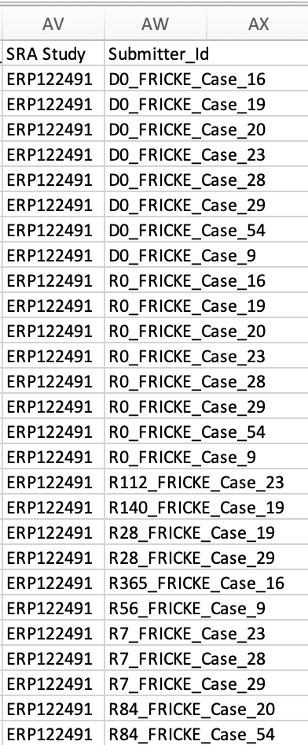
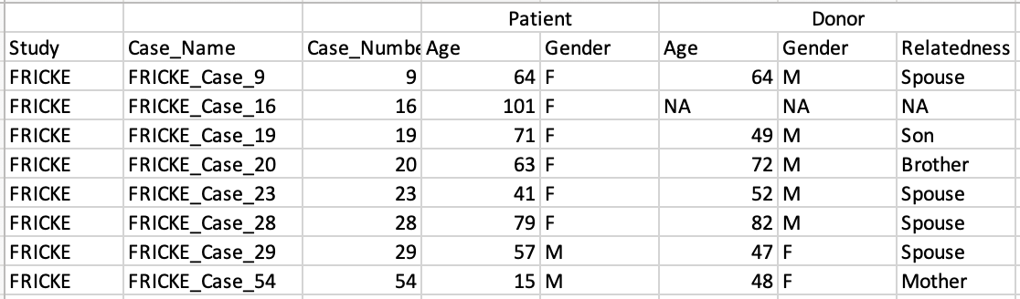
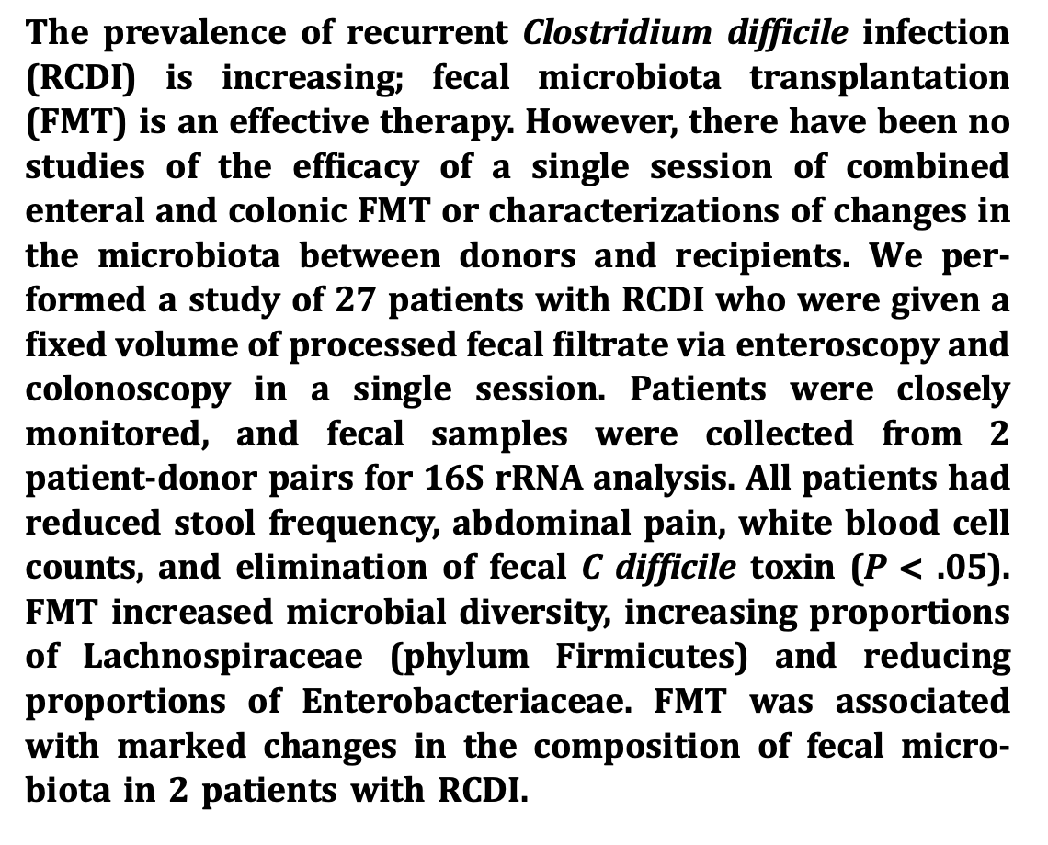
Podlesny_2022
Cohort: FMT-treated rCDI patients
The sample set included eight rCDI patient samples, collected 1–2 days before treatment, and eleven patient samples, collected between 1 week and up to 1 year after FMT.
FMT design in: Dutta SK, Girotra M, Garg S, Dutta A, von Rosenvinge EC, Maddox C, et al. Efficacy of combined jejunal and colonic fecal microbiota transplantation for recurrent Clostridium difficile Infection. Clin Gastroenterol Hepatol. 2014;12:1572–6.

Slide 14
Watson_2023
2 donor, 5 recipients per donor
All recipients had recurrent C. difficile infection before FMT, and two DA recipients and one DB recipient were also diagnosed with ulcerative colitis (UC).
24 stool samples were collected from the DA donor over a period of 636 days,
15 stool samples were collected from the DB donor over a period of 532 days.
5 and 9 stool samples were collected from each recipi- ent over periods of 187 to 404 days
109 samples in total.
FMT serves as an environmental filter that favors populations with higher metabolic independence, the genomes of which encode complete metabolic mod- ules to synthesize critical metabolites

Slide 15
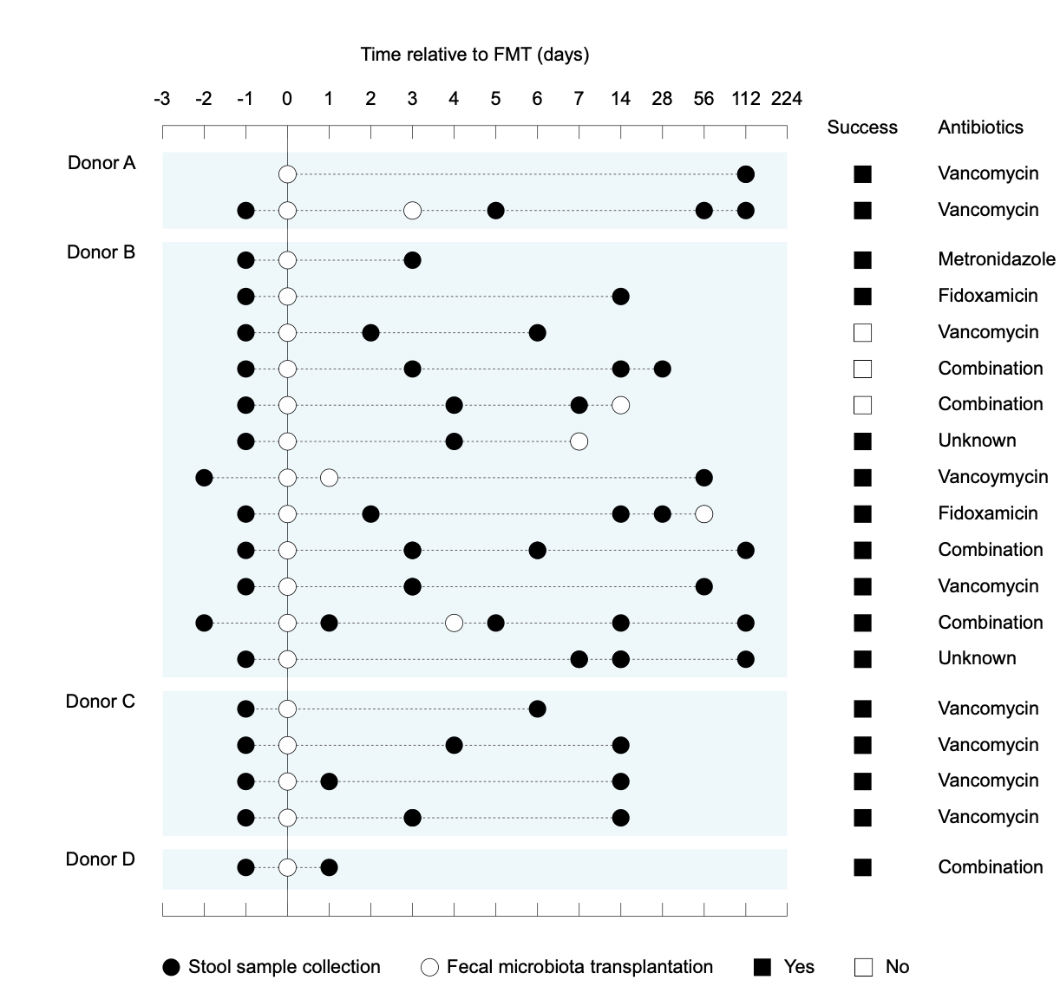
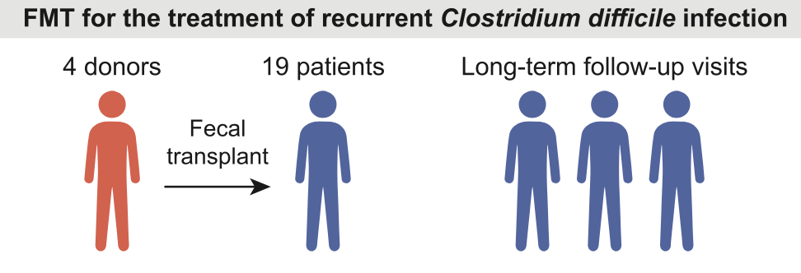
Smillie 2018
79 stool samples
built a statistical model that predicts which bacterial species will engraft in a given host, and developed Strain Finder, a method to infer strain genotypes and track them over time.
engraftment can be predicted largely from the abundance and phylogeny of bacteria in the donor and the pre-FMT patient
donor strains within a species engraft in an all-or-nothing manner and previously undetected strains frequently colonize patients receiving FMT
Notes:
Metadata available in Schmidt2022

Slide 16
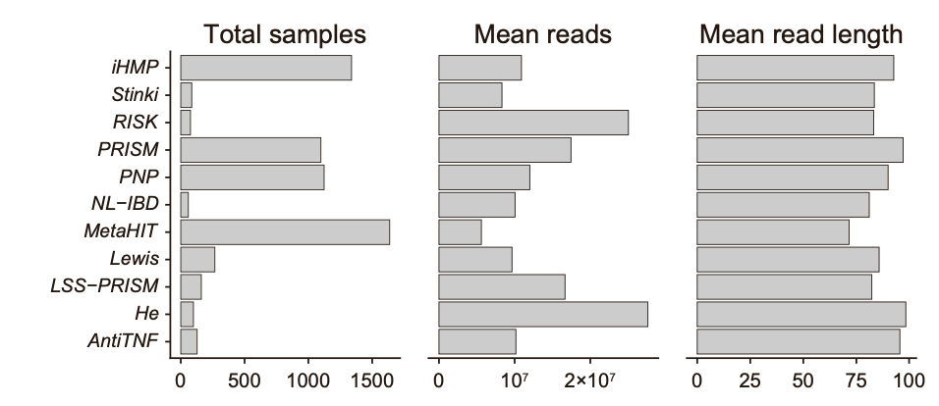
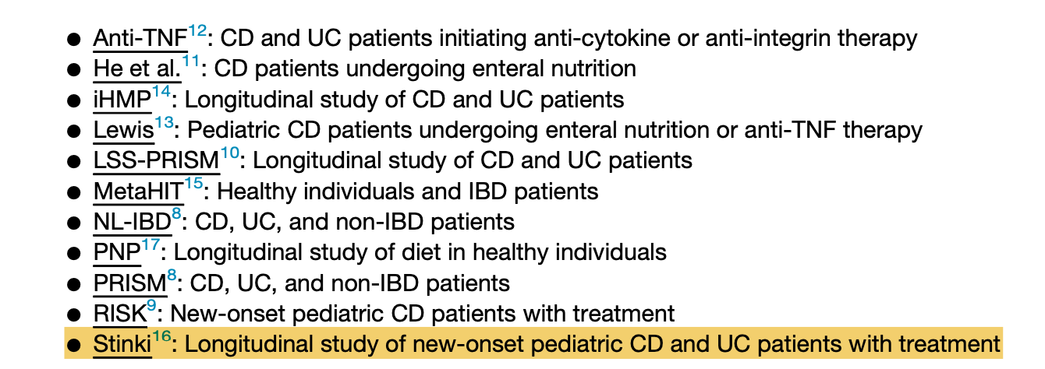
Smillie 2024
Notes:
Lee,J.W.J.,Plichta,D.,Hogstrom,L.,Borren,N.Z.,Lau,H.,Gregory,S.M., Tan, W., Khalili, H., Clish, C., Vlamakis, H., et al. (2021). Multi-omics reveal microbial determinants impacting responses to biologic therapies in in- flammatory bowel disease. Cell Host Microbe 29, 1294–1304.e4. https:// doi.org/10.1016/j.chom.2021.06.019. – only baseline samples ref12

Slide 17
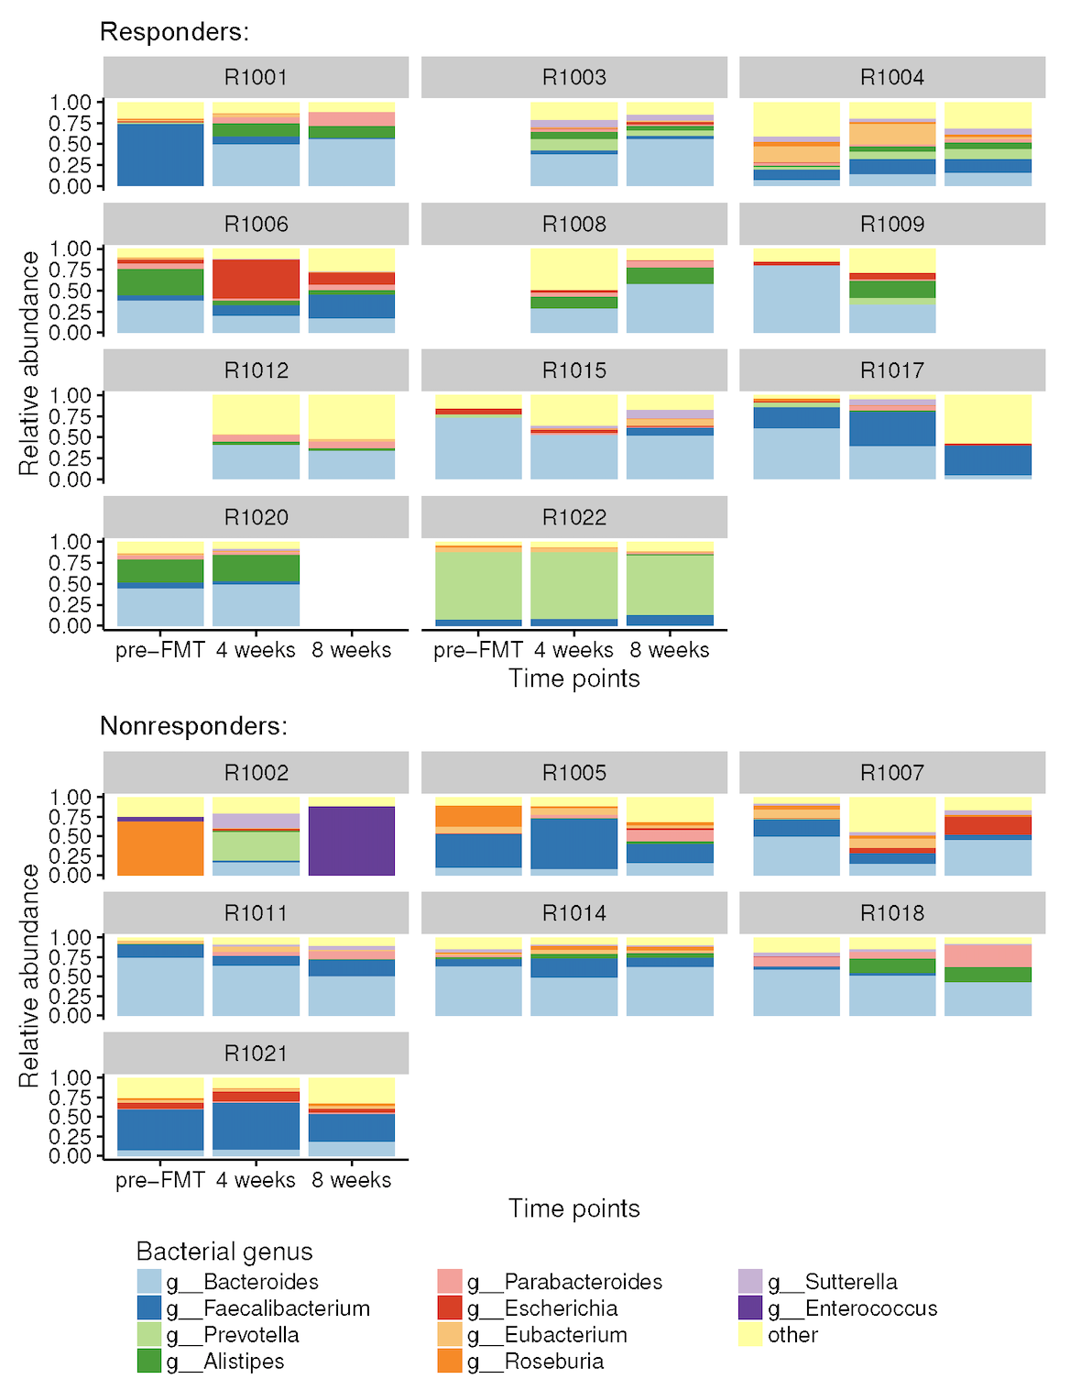
Vaughn_2016
Of the 19 subjects, 15 had sufficient pre-FMT and post-FMT fecal samples for further exploratory analysis.
FMT led to an expansion in microbial bacterial diversity in patients with active CD.
Donors were healthy men without any relation to the patient.
No antibiotics were administered before FMT.
4 donors: D9001, D9002, D9004, D9005.
Time points: pre_FMT, 4 weeks after FMT, 8 weeks after FMT.
Recipients: R1001 – R1022. No data for R1010, R1013, R1016, R1019; No pre_FMT for R1003, R1008, R1012; No 8weeks after FMT for R1009, R1020.
22-4-3-2=13 13 recipients has data from 3 time points.
Did not disclose the specific donor–recipient matches (1 donor : 5 recipients pairing)
Responder: A patient who had a decrease of more than 3 points in the Harvey–Bradshaw Index (HBI) at 4 weeks after FMT without any escalation of Crohn’s disease-related medications.
Nonresponder: A patient who did not meet the above criteria—i.e., they either did not achieve an HBI reduction >3 or required an increase in medications during the follow-up.
11 responders
Notes:
Vaughn_2016
13 individuals pre-FMT + 8weeks later

Slide 18
Nielsen 2015
Identification and assembly of genomes and genetic
elements in complex metagenomic samples without
using reference genomes
Seventy-seven of the Spanish individuals were sampled twice, with an average of 6 months between the samplings.
Healthy Spanish sampled twice, 12 individuals, around 70 days in between
UC sampled twice, 58 individuals around 90 days in between
CD, 8, 300 days.
Notes:
UC 48 individuals sampled twice ~50,70 days in between
CD 8 individuals sampled twice
UC 22 individuals sampled twice ~300 days in between
Healthy Danish people single time samples

Slide 19
He 2017
EEN-treated CD patients after 2 weeks of treatment + baseline samples (n = 14)
Exclusive Enteral Nutrition
Based on signature taxa, CD microbiotas clustered into 2 distinct metacommunities, indicating individual variability in CD microbiome structure. Metacommunity-specific functional shifts in CD showed enrichment in producers of the pro-inflammatory hexa-acylated lipopolysaccharide variant and a reduction in the potential to synthesize short-chain fatty acids. Disruption of ecological networks was evident in CD, coupled with reduction in growth rates of many bacterial species. Short-term exclusive enteral nutrition elicited limited impact on the overall composition of the CD microbiota, although functional changes occurred following treatment. The microbiotas in CD patients can be stratified into 2 distinct metacommunities, with the most severely perturbed metacommunity exhibiting functional potentials that deviate markedly from that of the healthy individuals, with possible implication in relation to CD pathogenesis.

Slide 20
rCDI, or IBD, healthy overtime
MAGs
Allel flux

Slide 21
Hall2017
Ruminococcus gnavus
PRJNA385949

Slide 22
MAGs
demarcated

