Slide 1
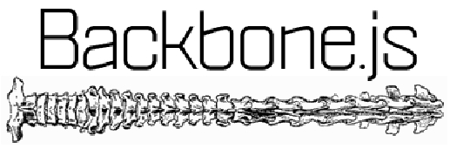
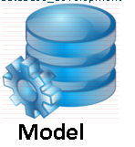



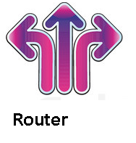
Agenda
SBR Department

Slide 2
Lightweight
< 1200 Lines of code
No UI Widgets
Pre-requisites ( HTML , Css and Basic JavaScript)
Use Jquery and underscorejs Internally

Slide 3
Backbone.Model
What do they do?
Store Data
Fire Events when data is changed
Provide get/set Accessors
Does the data persistance ( save method )

Slide 4
eg:Model
GridModel = Backbone.Model.extend();
Or
GridModel = Backbone.Model.extend({
defaults:{
}
});
var gridModel = new GridModel();
gridModel.get(“key”); // only one level
gridModel.set({“key”:”value”}); //does the writing

Slide 5
Backbone.View
What do they do?
Display data
Render data with template
Respond to model data changes
Act on user input entries

Slide 6
eg:View
GridView = Backbone.View.extend({
initialize:function(){
_.bindAll(this, 'render','remove');
this.template = _.template( $(“#grid-template”).html());
},
render:function(){
var rc = this.template( this.model.toJSON());
$(this.el).html( rc );
return this;
}
});
var gridView = new GridView( {model:gridModel});

Slide 7
Backbone.Collection
What do they do?
Listen to"add" and "remove" events
Fetch data model from server
Act on user input entries

Slide 8
Eg: Collection
var GridModels = Backbone.Collection.extend({
model:gridModel
});

Slide 9
Extras
Jasmine is a behavior driven development framework for testing.

Slide 10
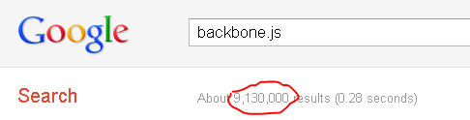
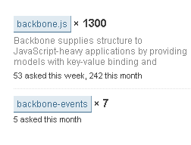
Trends
Support

Slide 11

Any questions?

