Slide 1




INCOMING FREIGHT COST MODELING
JILLIAN NEMEC

Slide 2
A PROBLEM WORTH SOLVING
Automate the tracking of incoming freight costs while identifying outliers
Set up linear regressions to track the current and future freight cost patterns

Slide 3
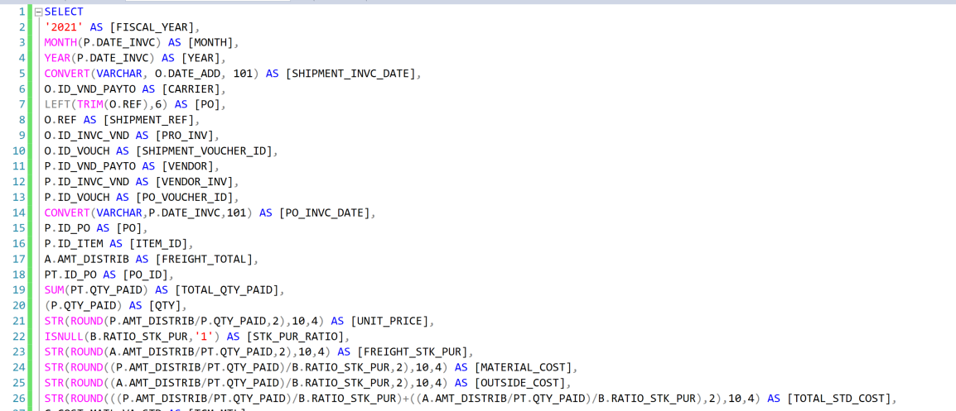
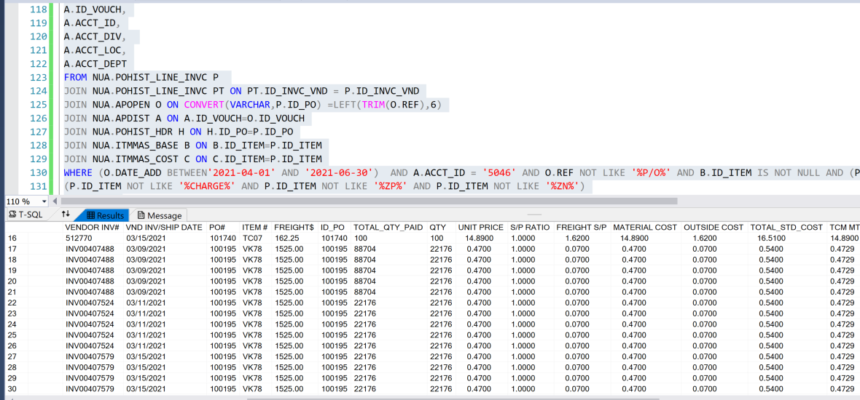
ETL PROCESS
SQL queries to identify and join the necessary data from several tables including:
Accounts Payable Distribution
PO Line Invoice History
Item Base data for stock to purchase ratios
Cost table for current standard costs
Data cleaning to get the intended results

Slide 4
AFTER GATHERING MY DATA
Saved data into csv files
Pushed data files to Postgres
Connected to Postgres database to analyze the data and push to machine learning models
Set up linear regressions to analyze data

Slide 5
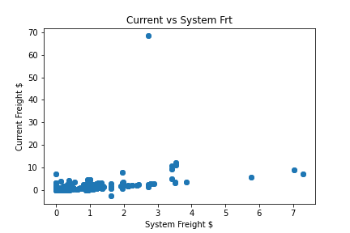
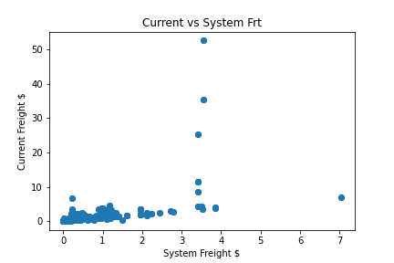
Comparison of Current vs System Freight
2020
2021

Slide 6
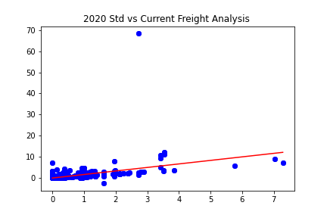
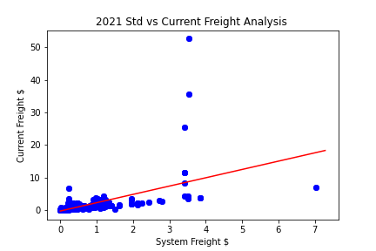
Linear Regressions

Slide 7
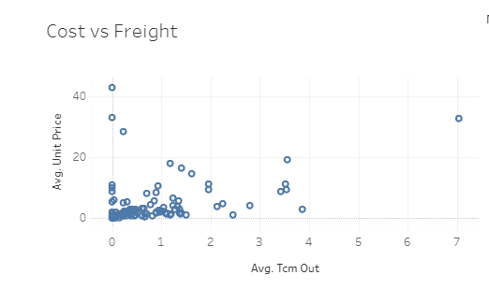
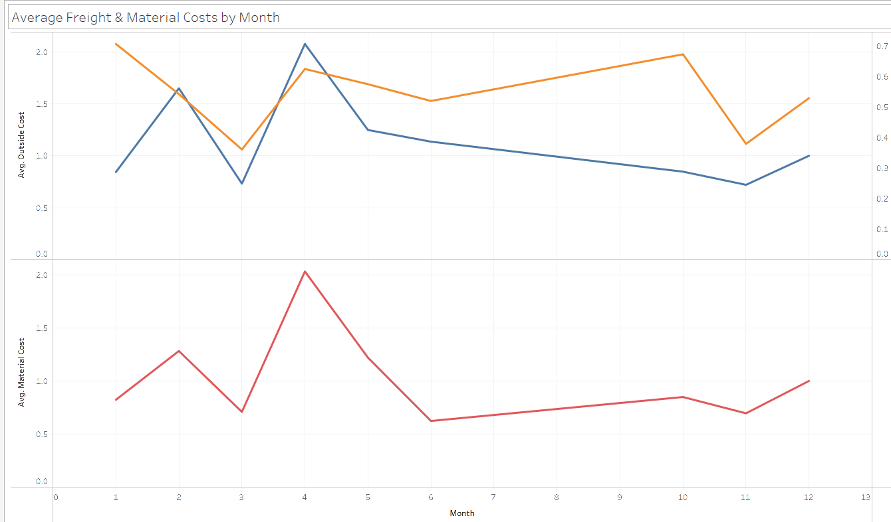
TABLEAU

Slide 8

Challenges
It was a lot more difficult to use the data I needed to analyze in real life for the project than I thought would be. I was able to produce a few linear regressions with Machine Learning but didn’t get to the point of a Heroku app because I spent too much time trying to clean the data from our SQL database.

