Slide 1
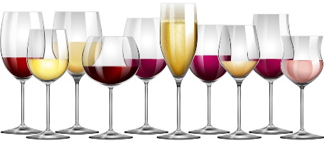
Wine Not
Kayla M, Jillian N, Koustav B.
Project 2
Northwestern University Boot Camp

Slide 2
Purpose of project
As wine connoisseurs, we love tasting new varietals, blends, and products from established and up-an-coming estates. So, where are these emerging estates???
What constitutes “great” wine? (Reputation of vineyard? Rating? Vintage? Region (AOC)?
Do individual parameters such as where a grape grows, or how long its been aged have any impact on its overall popularity?

Slide 3
Choropleth MAP – Wine/LOcation

Slide 4
Stack Chart : Wine/Age/Rating/Country

Slide 5
Interactive User-Experience

Slide 6
TECHNIQUES USED
CSV files did not include lat/long data. This needed to be merged to data-frame.
Non-English proper nouns needed to be cleaned of apostrophes and accent marks. Pandas was used to clean raw CSV file prior to visualization
<anything else ya’ll wanna add?>

Slide 7
FUTURE DEEP DIVES
As trends change, can it be possible that next year’s data set will show changes on the heat map of top rated wines?
Can we use this as a starting point to gauge evolution in preferences of wine? (ie., can we see a shift in preference in white to red (or vice-versa) over time?
How strong of a determining factor will cost be when it comes to a taster’s preference for the perfect bottle?

Slide 8
REFERENCES
Data Source : Wine Varieties, Rating, and Price by Region & Country
https://data.world/markpowell/global-wine-points

Slide 9
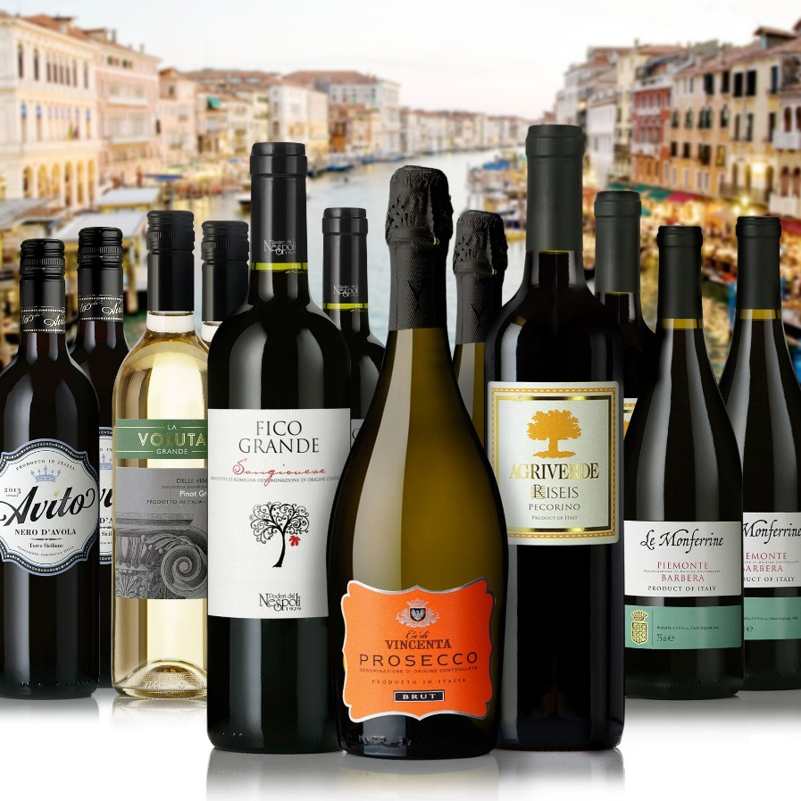
Q&A
Make it interesting and BYOB!

