Slide 1
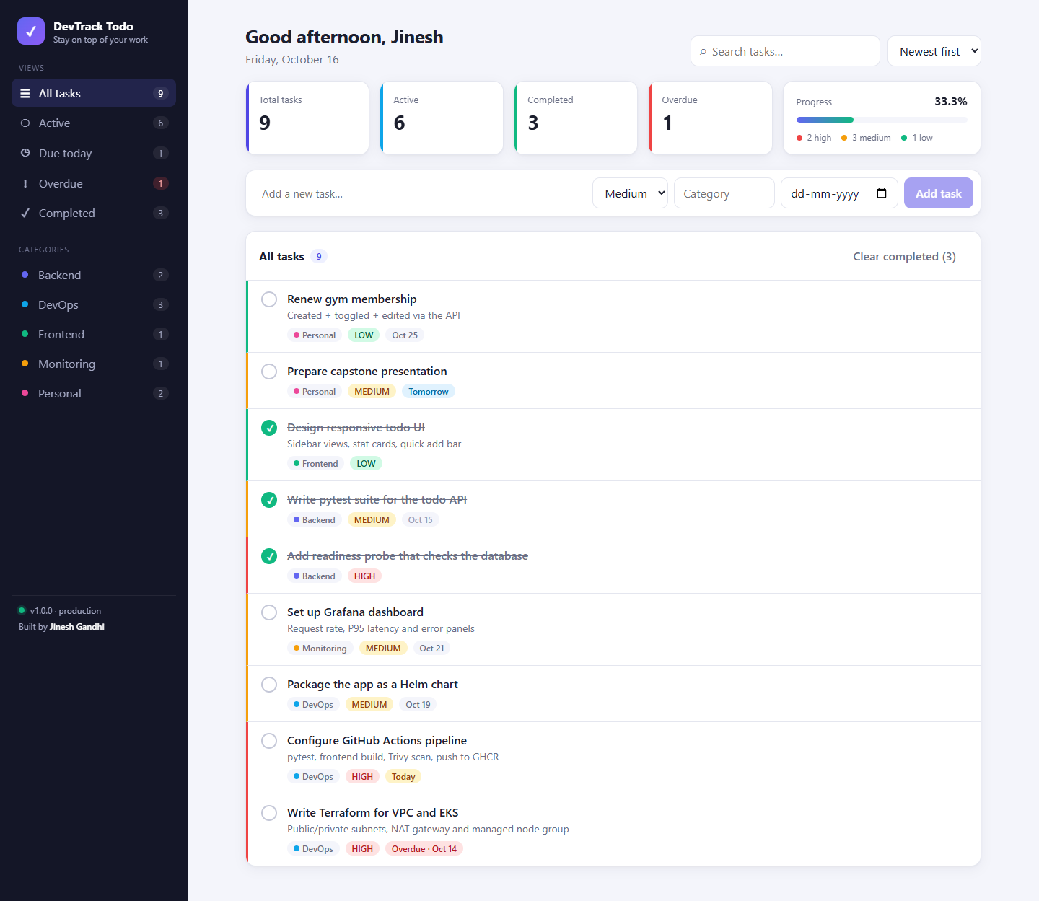
✓
DevTrack Todo
Final DevOps Capstone Presentation
From commit
to running
to observed.
TEST
BUILD
SCAN
DEPLOY
OBSERVE
Jinesh Gandhi
github.com/jineshgandhi79/Devops-capstone

Slide 2
01 • PROBLEM & MOTIVATION
Organise the work. Ship it reliably.
DevTrack Todo pairs a useful everyday product with a production-style delivery path.
The product problem
The delivery problem
Tasks live in heads, chats and sticky notes. People need one place to capture todos, set priorities and due dates, group them by category and see what is overdue.
Manual releases are hard to reproduce. Untested code, unscanned images and missing metrics turn every deployment into a risk.
Project goals
Working product
Quality gates
Reproducible infra
Observable runtime
Full CRUD todo app with filters, stats and a responsive UI
Automated tests and image scanning before anything ships
AWS network and EKS cluster described as code
Health probes, metrics and dashboards in production
DevTrack Todo • Jinesh Gandhi • DevOps Capstone
2 / 17

Slide 3
02 • PRODUCT
A focused todo dashboard
Screenshots captured from the running Docker Compose stack.
✓
Smart views
All · Active · Due today · Overdue · Completed
✓
Organise
Priorities, categories and due dates
✓
Find fast
Search, category filter and 4 sort orders
✓
Track progress
Live stat cards and completion bar
✓
Edit in place
Modal editor, one-click complete, safe delete
✓
Responsive
Desktop sidebar → mobile scrolling tabs
DevTrack Todo • Jinesh Gandhi • DevOps Capstone
3 / 17

Slide 4
03 • ARCHITECTURE
Four paths through one system
Request path, delivery path, GitOps path and infrastructure / observability path.
REQUEST PATH
Browser
Ingress NGINX
React SPA (Nginx)
FastAPI /api
PostgreSQL
DELIVERY PATH
git push
pytest + build
Docker build
Trivy scan
GHCR :sha
GITOPS PATH
CI pins SHA
values.yaml commit
ArgoCD sync
Helm release
Rolling update
PLATFORM PATH
Terraform
VPC + subnets
EKS + nodes
Prometheus
Grafana
Rule: the cluster only changes through Git, so every running image traces back to a commit SHA.
DevTrack Todo • Jinesh Gandhi • DevOps Capstone
4 / 17

Slide 5
04 • TECHNOLOGY STACK
Every layer has one clear responsibility
Frontend
Backend
Data & tests
React 19
Vite 8
FastAPI
Pydantic v2
PostgreSQL 16
Pytest (28 tests)
Oxlint
Nginx unprivileged
SQLAlchemy 2
Alembic
SQLite test DB
Delivery
Platform
Observability
Docker / Compose
GitHub Actions
Terraform
AWS VPC + EKS
Prometheus
Grafana
Trivy
GHCR
Helm 3
ArgoCD
Health / ready probes
DevTrack Todo • Jinesh Gandhi • DevOps Capstone
5 / 17

Slide 6
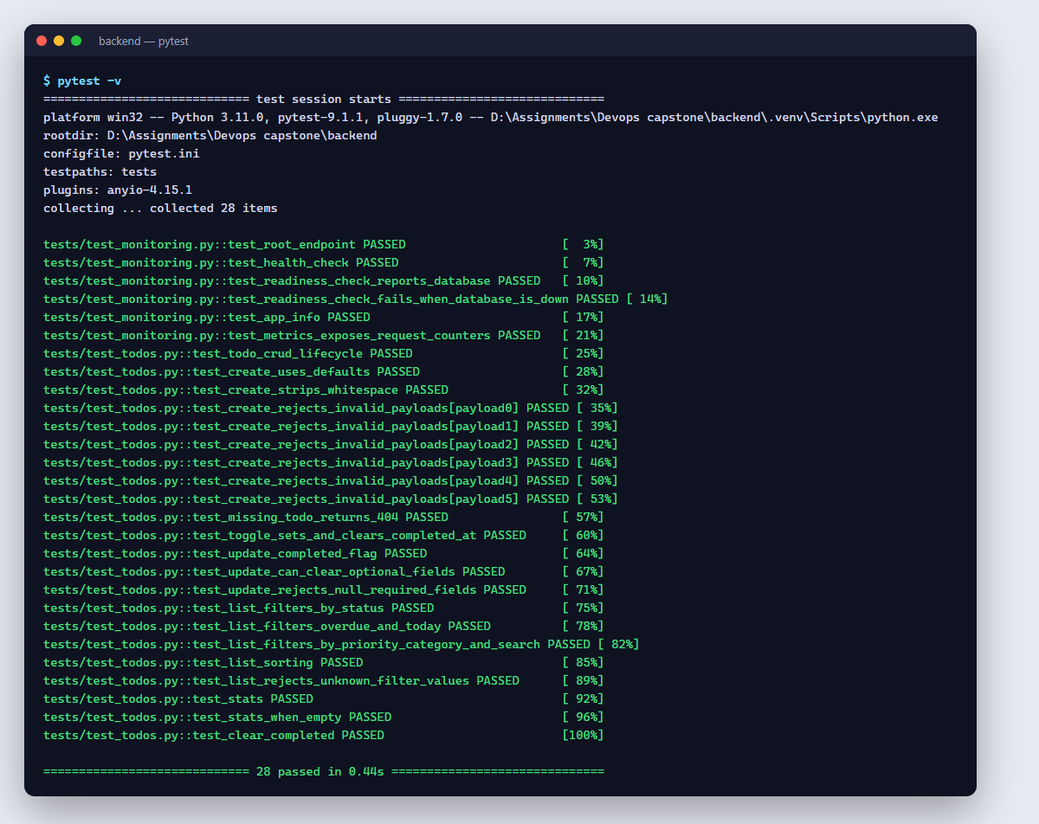
05 • BACKEND, DATA & TESTS
A validated REST API with isolated tests
28 pytest tests pass locally; CI also applies the migrations to a real PostgreSQL service.
GET
/api/todos
list · filter · search · sort
GET
/api/todos/stats
dashboard counters
GET
/api/todos/{id}
read one
POST
/api/todos
create
PUT
/api/todos/{id}
partial update
PATCH
/api/todos/{id}/toggle
complete / reopen
DELETE
/api/todos/{id}
delete
DELETE
/api/todos/completed
clear completed
GET
/health · /ready · /metrics
operations
DevTrack Todo • Jinesh Gandhi • DevOps Capstone
6 / 17

Slide 7
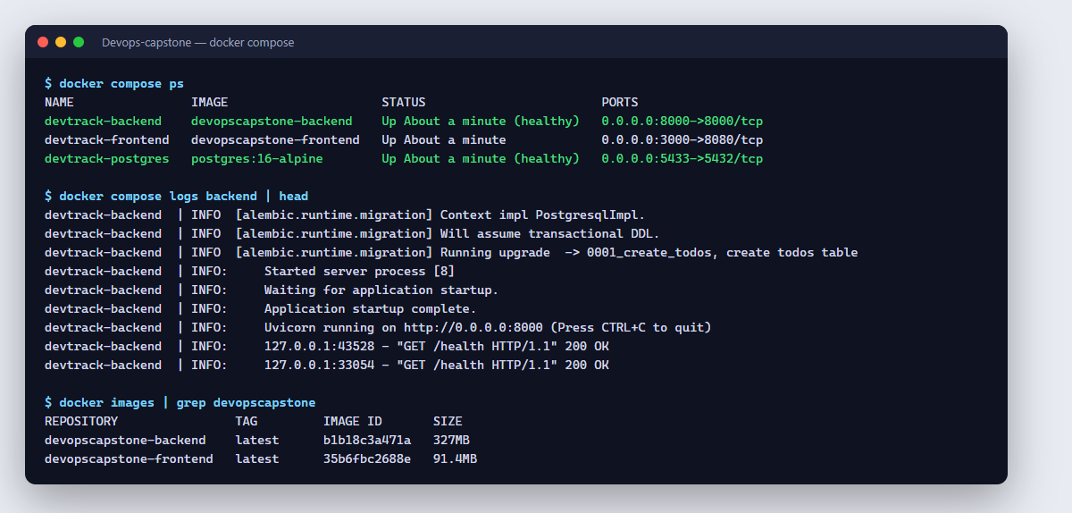
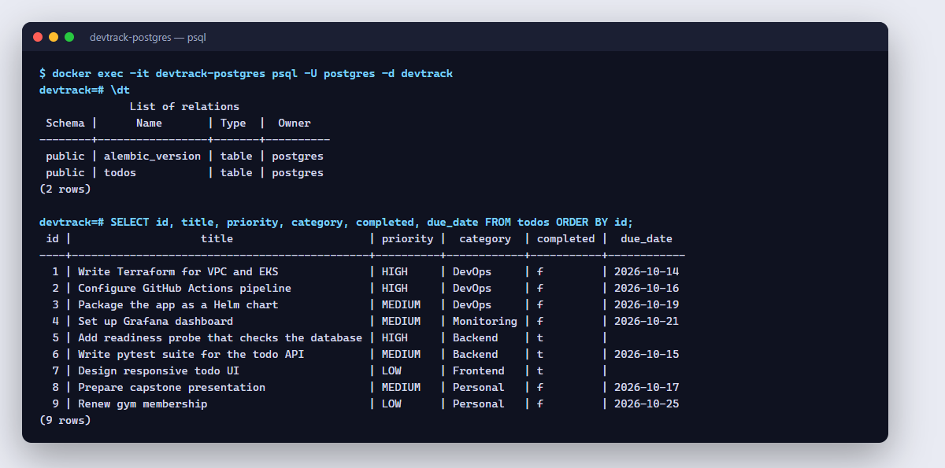
06 • CONTAINERS
A reproducible local stack in dependency order
docker compose up --build starts PostgreSQL, then the API (after migrations), then the frontend.
PostgreSQL
Backend
Frontend
postgres:16-alpine
Named data volume
pg_isready health check
python:3.12-slim, non-root UID 1000
alembic upgrade head → uvicorn
/health check
Multi-stage: node:20 → nginx
Unprivileged, port 8080
Proxies /api to backend
DevTrack Todo • Jinesh Gandhi • DevOps Capstone
7 / 17

Slide 8
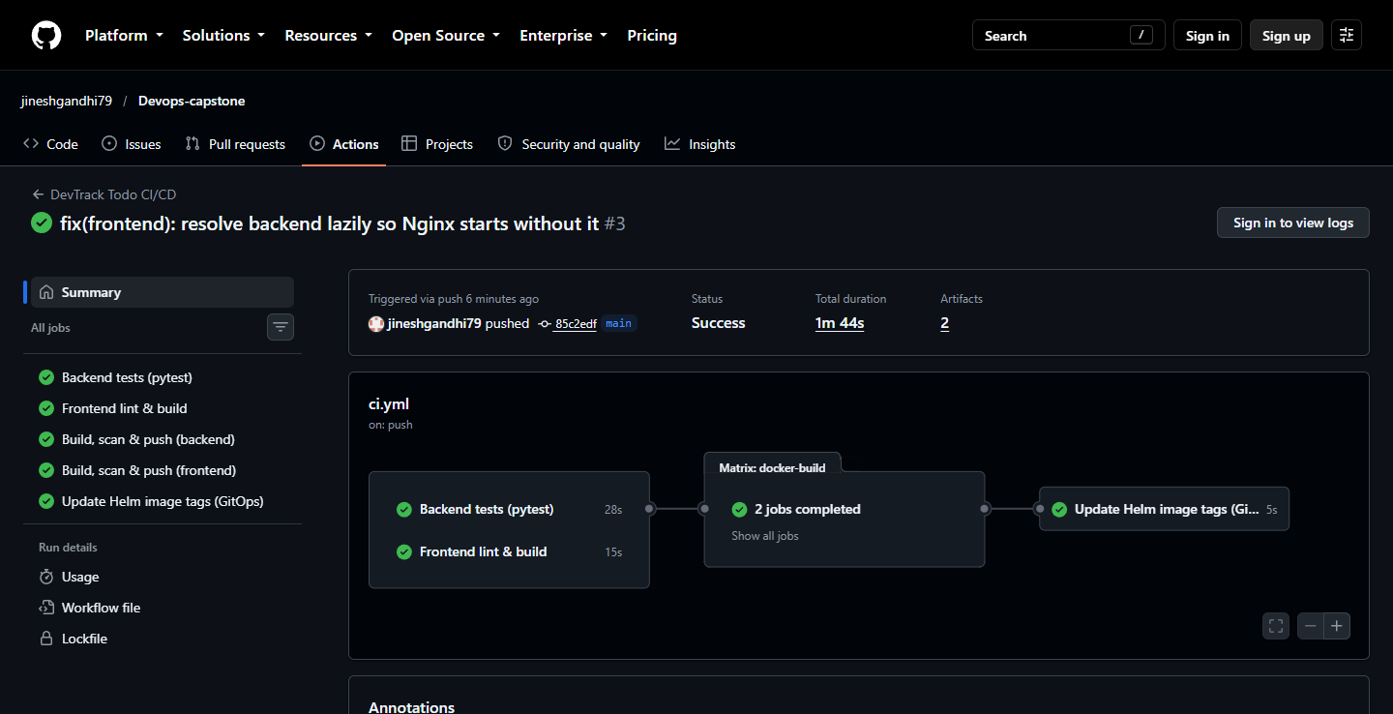
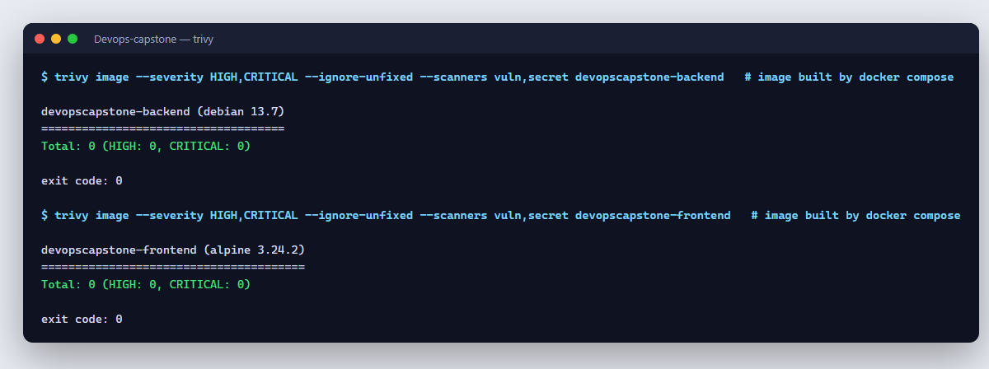
07 • CI/CD & DEVSECOPS
Quality gates before a SHA-tagged deployment
.github/workflows/ci.yml — run #3 on commit 85c2edf: all five jobs green in 1 m 44 s.
01
02
03
04
05
06
Push / PR
Test
Build
Scan
Publish
Deploy
main branch
pytest + alembic
on PostgreSQL
lint + vite build
docker images
Trivy HIGH/CRITICAL
vuln + secrets
GHCR
:sha and :latest
pin SHA in Helm
values (GitOps)
DevTrack Todo • Jinesh Gandhi • DevOps Capstone
8 / 17

Slide 9
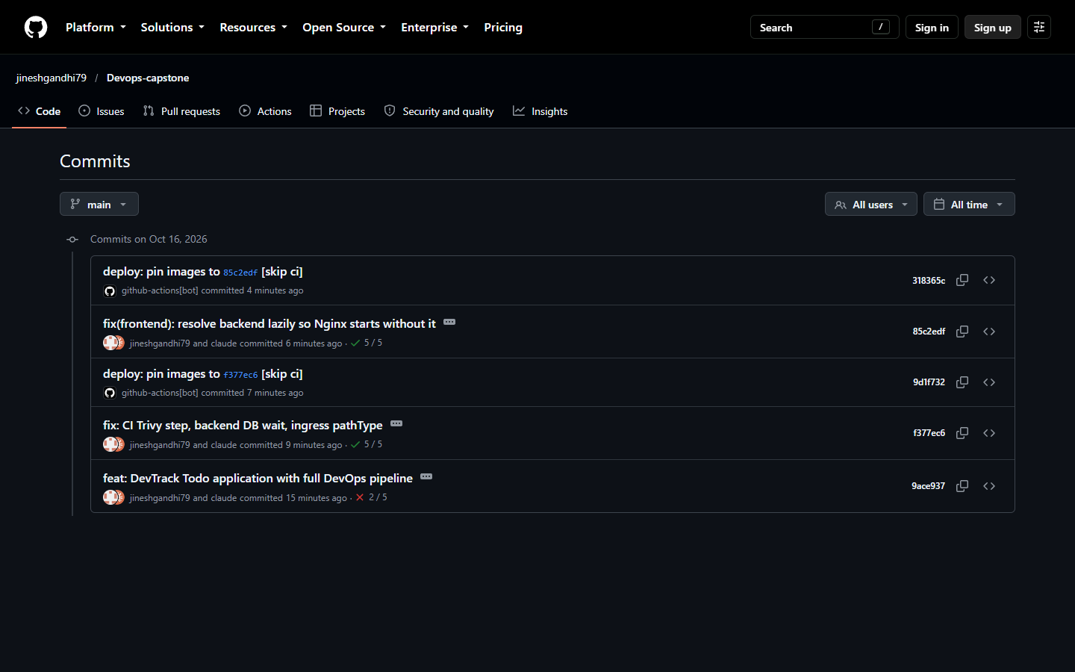
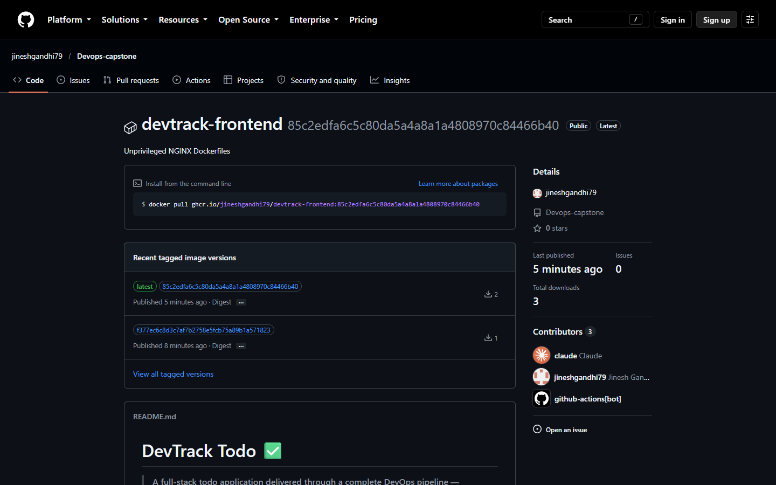
08 • REGISTRY & GITOPS
Every green run publishes and pins an immutable image
CI pushes ghcr.io/jineshgandhi79/devtrack-*:<sha>, then github-actions[bot] commits that SHA to helm/devtrack/values.yaml.
DevTrack Todo • Jinesh Gandhi • DevOps Capstone
9 / 17

Slide 10
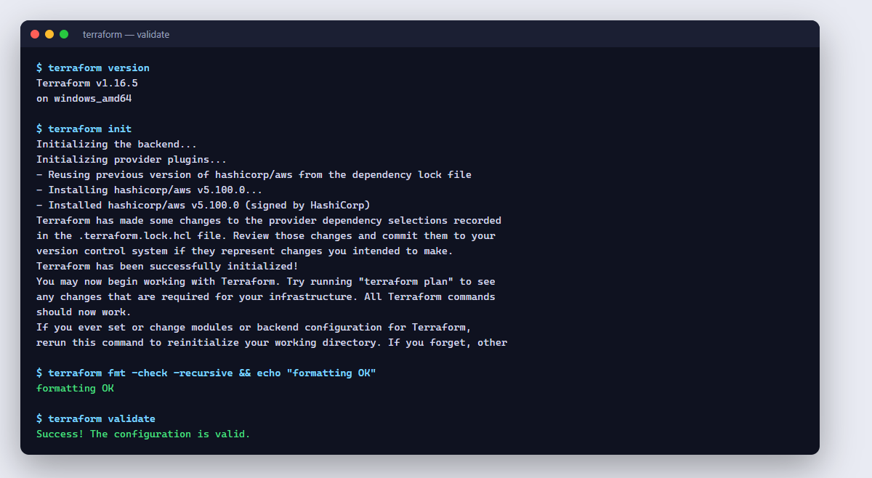
09 • INFRASTRUCTURE AS CODE
Terraform describes the AWS foundation
Region ap-southeast-2 (Sydney) • terraform init → validate → plan → apply → destroy
VPC • 10.0.0.0/16
AZ a
AZ b
Public subnet
10.0.1.0/24
IGW + NAT gateway
Public subnet
10.0.2.0/24
IGW
Private subnet
10.0.10.0/24
EKS worker nodes
t3.medium (AL2023)
Private subnet
10.0.11.0/24
EKS worker nodes
t3.medium (AL2023)
📷 Add your screenshot
EKS cluster & VPC in the AWS console
terraform plan / apply
(needs AWS credentials)
DevTrack Todo • Jinesh Gandhi • DevOps Capstone
10 / 17

Slide 11
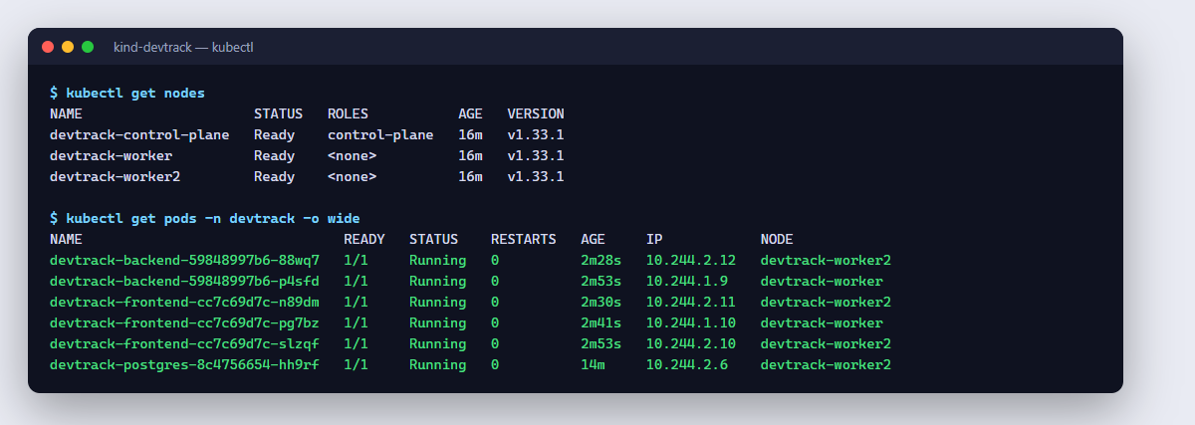
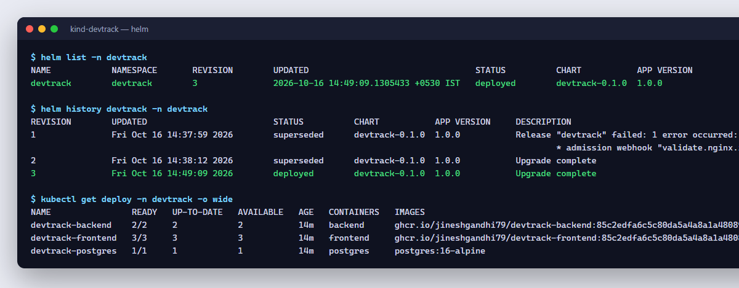
10 • KUBERNETES & HELM
Declarative delivery with probes and self-healing
Shown on a local 3-node kind cluster running the CI-built GHCR images; the same chart targets EKS.
Cluster • namespace: devtrack
Ingress NGINX ( / · /api · /docs )
Frontend
3 replicas
Service :80 → :8080
Backend
2 replicas
/health · /ready probes
Service :8000
PostgreSQL
1 replica + PVC
Service :5432
Rolling update to the new SHA completed with 0 restarts • backend waits for PostgreSQL before migrating • non-root containers • requests and limits on every container
DevTrack Todo • Jinesh Gandhi • DevOps Capstone
11 / 17

Slide 12
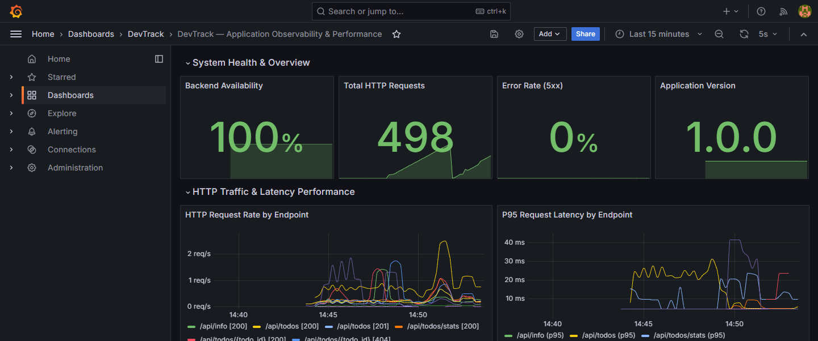
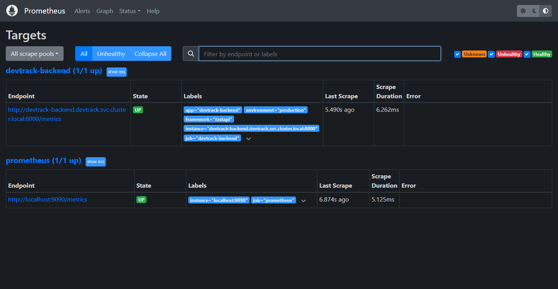
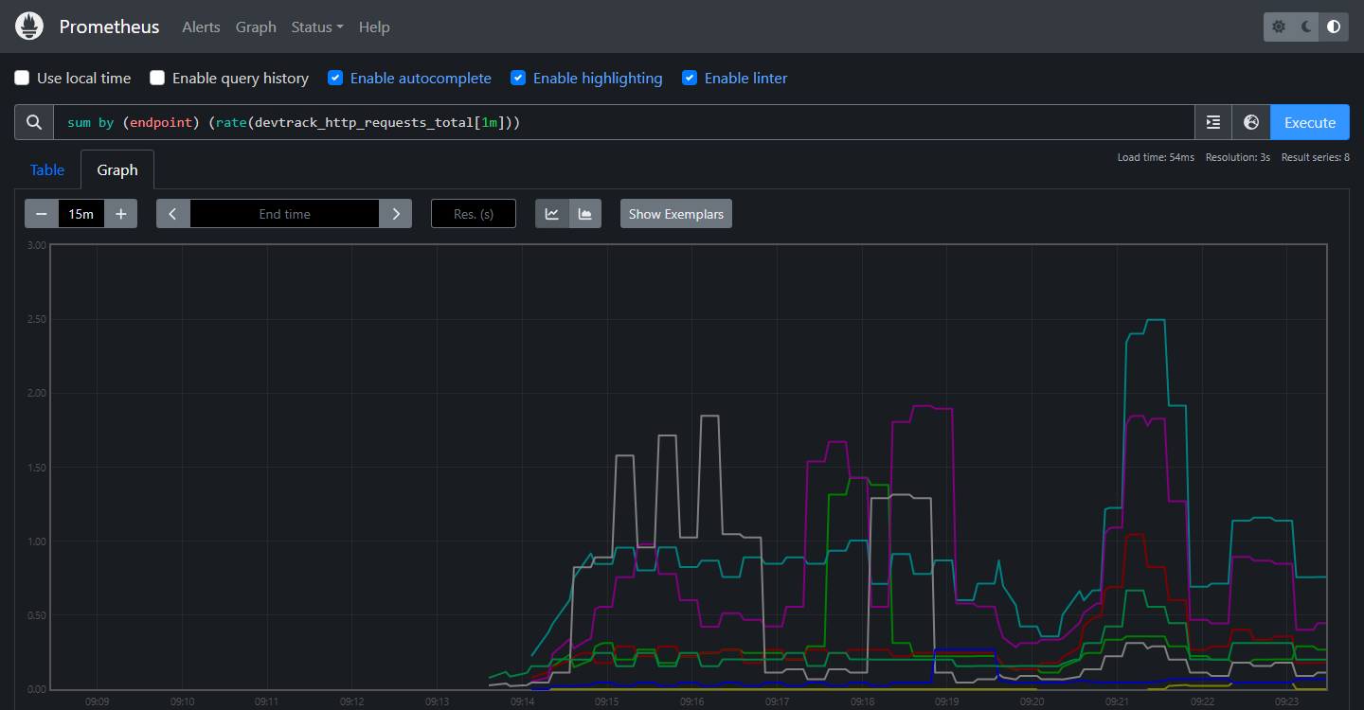
11 • OBSERVABILITY
Instrumented in code, scraped by Prometheus, shown in Grafana
Instrument
FastAPI middleware records devtrack_http_requests_total and a latency histogram per route template.
Collect
Prometheus scrapes devtrack-backend:8000/metrics every 15 seconds — target UP (1/1).
Visualise
Grafana dashboard: availability, request rate, P95 latency, 5xx errors, memory and CPU.
DevTrack Todo • Jinesh Gandhi • DevOps Capstone
12 / 17

Slide 13
12 • TROUBLESHOOTING & RESILIENCE
Diagnose from evidence, then fix the cause
Both drills were executed on the cluster — the terminal evidence is on the next slide.
Drill 1 • ImagePullBackOff
Drill 2 • Service with no endpoints
Inject
Start a pod whose image tag does not exist in GHCR.
Inject
Service selector typo: app=lab-wbe instead of lab-web.
Observe
kubectl get pod → ErrImagePull / ImagePullBackOff
Observe
curl http://lab-web fails; endpoints show <none>
Diagnose
kubectl describe pod → 'Failed to pull image … NotFound'
Diagnose
Compare the Service selector with pod --show-labels
Fix
Recreate it with a real commit-SHA tag published by CI
Fix
kubectl patch the selector → endpoints appear, HTTP 200
Found while drilling: Nginx crashed when the backend name was unresolvable — fixed by resolving it per request.
DevTrack Todo • Jinesh Gandhi • DevOps Capstone
13 / 17

Slide 14
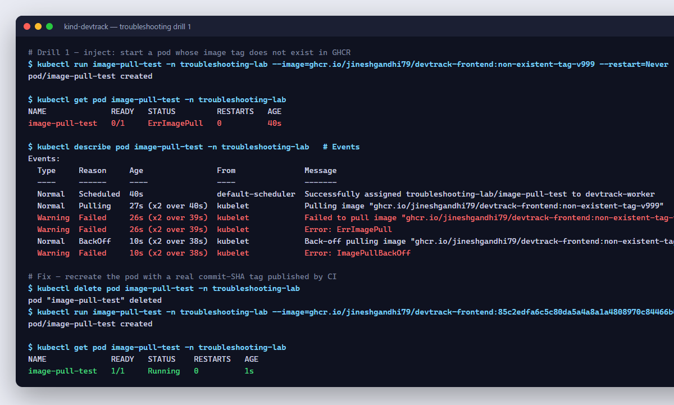
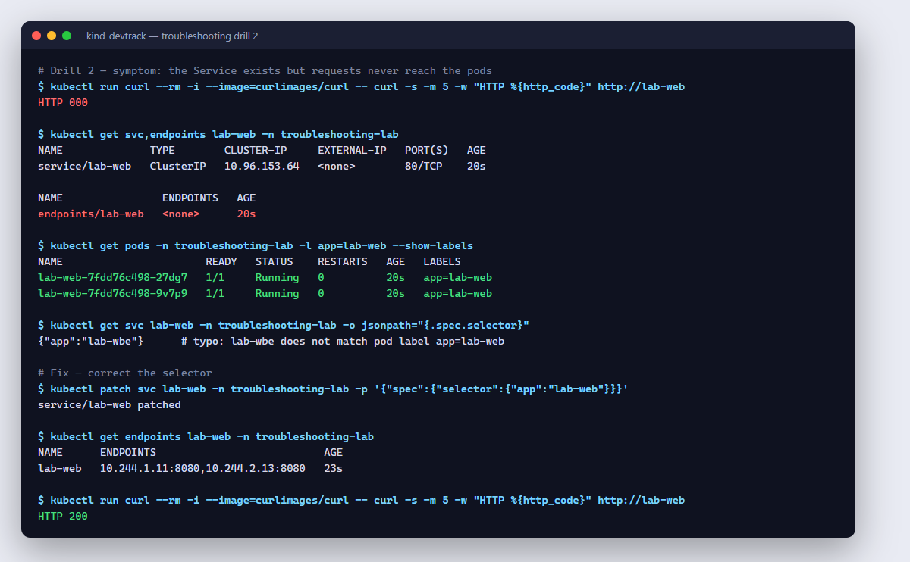
13 • DRILLS, EXECUTED
Real output from the troubleshooting-lab namespace
DevTrack Todo • Jinesh Gandhi • DevOps Capstone
14 / 17

Slide 15
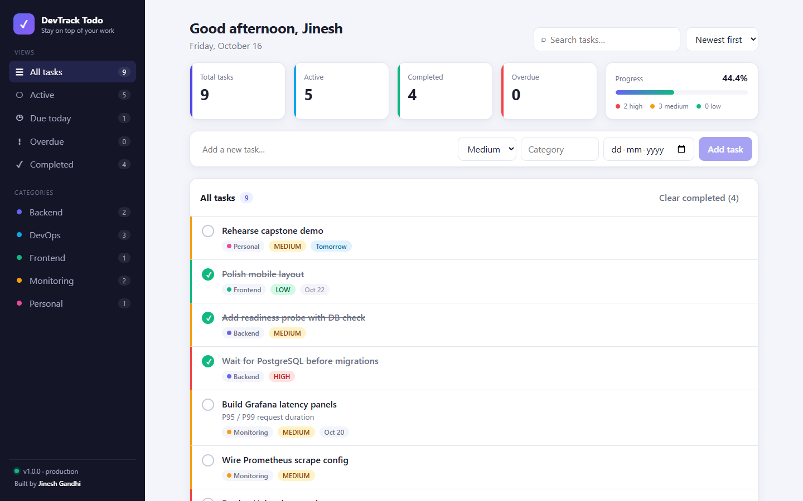
14 • VERIFICATION
Evidence captured on 16 October 2026
Everything below was run for real; only the AWS EKS deployment still needs cloud credentials.
✓
Application
Todo CRUD, filters and stats through Nginx and the Ingress
✓
Tests
28 / 28 pytest; migration matches models; CI on PostgreSQL
✓
Security
Trivy 0 HIGH / 0 CRITICAL locally and as a CI gate
✓
CI/CD & registry
All 5 jobs green; SHA-tagged images public in GHCR
✓
GitOps
Bot commits pin each new SHA in the Helm values
✓
Kubernetes
Helm release on 3-node cluster pulling GHCR images, 0 restarts
✓
Observability
Prometheus target UP; Grafana panels populated
App served through the Ingress (localhost:8081 on the local cluster)
✓
Terraform
init, fmt -check and validate pass
Pending: AWS EKS
terraform plan / apply needs AWS credentials; then the same Helm chart deploys with storageClass gp2.
DevTrack Todo • Jinesh Gandhi • DevOps Capstone
15 / 17

Slide 16
15 • CONCLUSION & NEXT STEPS
From commit to observed workload
Built
Automated
Operated
Todo app with React UI, FastAPI REST API, PostgreSQL and Alembic migrations.
Tests, lint, image builds, Trivy scanning, GHCR publishing and GitOps image pinning.
Helm release on Kubernetes with Ingress, probes, Prometheus and Grafana; EKS defined in Terraform.
Next steps
Horizontal Pod Autoscaler on backend CPU
Amazon RDS instead of in-cluster PostgreSQL
User accounts and per-user todo lists
TLS with cert-manager + a custom domain
Alerting rules (error rate, latency) to Slack
Remote Terraform state in S3 with locking
Lesson: a feature is not finished until it is tested, scanned, deployed and observable.
DevTrack Todo • Jinesh Gandhi • DevOps Capstone
16 / 17

Slide 17
Thank you
Questions & live demo
Jinesh Gandhi
github.com/jineshgandhi79/Devops-capstone
App
Git
CI
Docker
Trivy
Terraform
Helm
Grafana

