Slide 1
单元测试
费永军
2019-3

Slide 2
01
什么是单元测试
02
单元测试步骤
03
单元测试度量
04
demo

Slide 3
01
什么是单元测试
单元测试（unit testing），是指对软件中的最小可测试单元进行检查和验证。
对于单元测试中单元的含义，一般来说，要根据实际情况去判定其具体含义，如C语言中单元指一个函数，Java里单元指一个类，图形化的软件中可以指一个窗口或一个菜单等。总的来说，单元就是人为规定的最小的被测功能模块。
单元测试是在软件开发过程中要进行的最低级别的测试活动，软件的独立单元将在与程序的其他部分相隔离的情况下进行测试。

Slide 4
02
单元测试步骤
准备测试数据
调用测试方法
判断测试是否通过

Slide 5
03
单元测试度量
覆盖率（ Coverage ）
It is a mix of Line coverage and Condition coverage. Its goal is to provide an even more accurate answer to the following question: How much of the source code has been covered by the unit tests?
Coverage = (CT + CF + LC)/(2*B + EL)
CT = conditions that have been evaluated to 'true' at least once
CF = conditions that have been evaluated to 'false' at least once
LC = covered lines = linestocover - uncovered_lines
B = total number of conditions
EL = total number of executable lines (lines_to_cover)

Slide 6
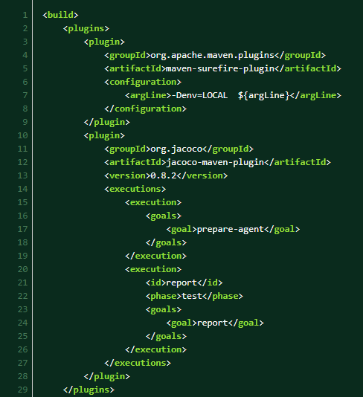
04
Demo-添加加Jacoco 配置

Slide 7
04
Demo-添加sonar配置

Slide 8
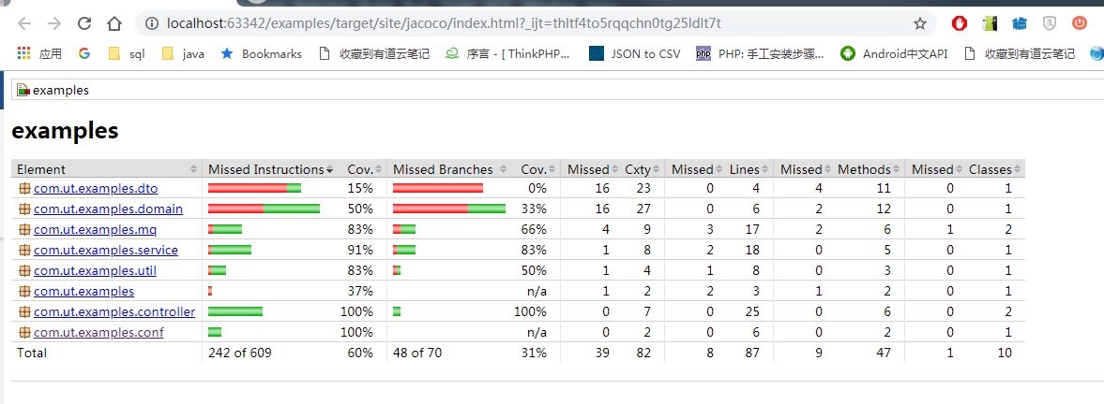
04
Demo-执行mvn test sonar:sonar

Slide 9
参考
https://www.jianshu.com/p/f6e3ab9719b9

