Slide 1
A Metadata Platform of the Experimental Datasets for Computer Science
Jinfeng Rao, Xing Niu
@CMSC724

Slide 2
Objective – Extracting Matadata
CS literatures
Matadata of Datasets
Training Invariant Support Vector Machines
A fast learning algorithm for deep belief nets
Geoffrey E. Hinton and Simon Osindero
University of Toronto
osindero@cs.toronto.edu
Abstract
We show how to use “complementary priors” to eliminate the explaining away effects that make
inference difficult in densely-connected belief
nets that have many hidden layers.
Keywords
Belief nets, Deep learning, Digit classification
……
6. Experiments
The MNIST database of handwritten digits contains 60,000 training images and 10,000 test images. Results for many different pattern recognition techniques are already published for this publicly available database so it is ideal for evaluating new pattern recognition methods.
……
Properties | Valus
name | MNIST
appears_in | [“A fast learning algorithm for deep belief nets”, “Training Invariant Support Vector Machines”]
topic | [Belief nets, Deep learning, Digit classification, Support Vector Machines]
keyword | [handwritten digits, images]

Slide 3
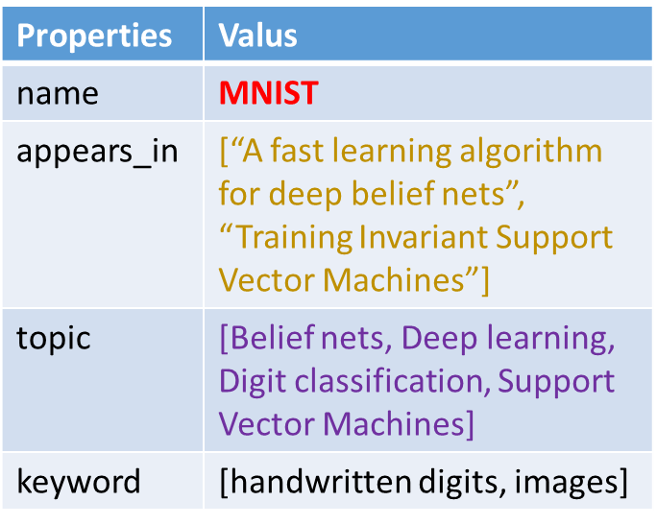
Objective – Matadata Platform
Storage & Query
Applications
dataset recommendation
Matadata DB
I want to evaluate my method on some handwritten digits datasets, can you recommend one?
Try MNIST

Slide 4
Objective – Matadata Platform
Storage & Query
Applications
dataset recommendation
Matadata DB
Is there any datasets similar to MNIST?
Try USPS

Slide 5
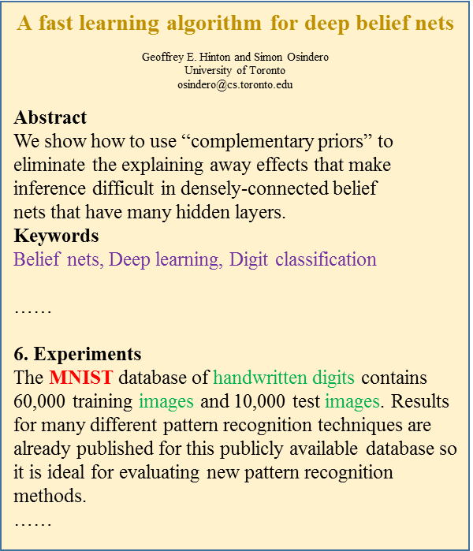


Workflow
Matadata DB
Challenge
Dataset name recognition (DNR)
Context analysis

Slide 6
Dataset Name Recognition
Concrete Example
The DBLP dataset consists of 123m authors and 200m papers .
Five of the sets in this subsection are from the UCI repository #REF# ( iris , wine , pendigits , waveform , segmentation )

Slide 7
Dataset Name Recognition(DNR)
Candidate Generation
Heuristic rules, e.g, regular expression.
Candidate Window [-3,3]
Candidate Validation
Build a classifier seems like a good idea.
Um…but what’s the features?
Heuristic Features
Context Features

Slide 8
DNR (Heuristic Features)
Capital Form, e.g, Movielens
Has-Dash, e.g, DBLP-1
Mixed-Case, e.g, NewsGroup20
Length
Words Count
In Figure
Reference Followed
Number Followed
Position in Sentence
Contain co-occurrence word ‘the’, ‘dataset | data set’
Distance to word ‘the’, ‘dataset | data set’

Slide 9
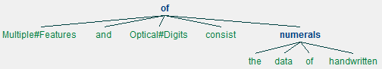
DNR (Context Features)
The distances between candidates and keywords
Improvement: using dependency tree
3
6
Multiple#Features and Optical#Digits consist of the data of handwritten numerals
1
4
level distance = 0
level distance = 3

Slide 10
DNR (Conditional Random Fields)
Drawbacks of Classifier Methodology
Features are often too noisy to get a good prediction
Could not utilize structural information
CRF is often used in Structural Prediction tasks.
An Hidden Markov Model example:
The(DT) DBLP(DATASET) dataset(NN) contains(VB) 100m(NUMER) images(NN) .(PT)

Slide 11
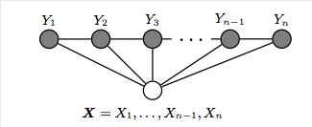


Conditional Random Fields
Unlike EM algorithm using joint probability Pr(S,O), based on Pr(S|O),S is State Seq, O is Word Seq
Given training set D = {(o¹,l¹),(o²,l²)…,(o^{n},l^{n})}

Slide 12
Conditional Random Fields
Features: the same as Heuristic Features
Labels:
DATASET_B, DATASET_I, DATASET_O
NUMERIAL
THE
DATA
OTHER
PUNCTUATION

Slide 13
DNR (Bootstrap)
Context Features
Seeds
dataset names
New dataset names
Learn discriminative context:
e.g. “The XXX dataset…”

Slide 14

Preliminary Results
Methods
Classifier: Heuristic Rules features
Conditional Random Fields
Dataset: 51 KDD 2012 Paper
Cross-Validation,Fold = 5
Method | Precision | Recall | F-Score
SVM | 58.2% | 27.1% | 36.8%
Naïve Bayes | 79% | 20.1% | 31.9%
Decision Tree | 52.7% | 13.3% | 20.8%
CRF | 67.8% | 40.4% | 50.7%

Slide 15
Todo List
Conducting experiments on dependency tree, further optimize CRF
Find a bootstrap way to adapt conditional random field in incremental.
Not only extracting dataset name, also getting the dataset metadata.

