Slide 1
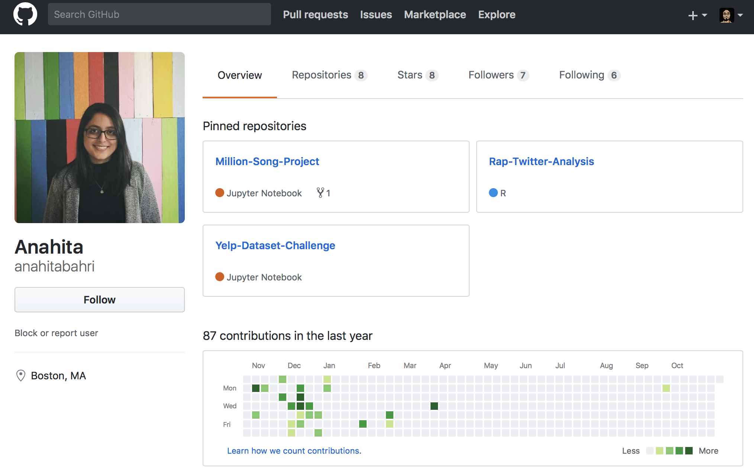

Slide 2
Midterm Project

Slide 3
Midterm Project
Data Analysis Project: Choose a dataset that is relevant to your career goals or your personal interest and propose an analysis that includes fitting at least a multilevel model.
Simulation based project: Choose a phenomenon of interest that you can quantify, devise a simulation scheme to quantify the uncertainty in the process and validate your result.

Slide 4
Data Analysis Project
Example data:
Tech:
Yelp Data challenge: https://www.yelp.com/dataset/challenge
AirBnB: http://tomslee.net/airbnb-data-collection-get-the-data
Consumer:
Customer Revenue prediction: https://www.kaggle.com/c/ga-customer-revenue-prediction
Medical:
Medicare, CDC: https://data.medicare.gov/data/. https://wonder.cdc.gov
Financial:
IMF: http://data.imf.org/?sk=388DFA60-1D26-4ADE-B505-A05A558D9A42
Lending club: https://www.lendingclub.com/info/download-data.action
Music:
Million Songs: https://labrosa.ee.columbia.edu/millionsong/
etc. + extra bonus if you can combine different datasets.
Criteria: A “LARGE” dataset with at least 10 groups that’s “Interesting”.

Slide 5
Simulation Project
Criteria: you need to be able to quantify the outcome of interest and validate it using a real data that you can collect from various sources.
Analyze Boston: https://data.boston.gov/
MBTA API: https://www.mbta.com/developers/v3-api
Weather API: https://openweathermap.org/api

Slide 6
Timeline
Nov 13th: Proposal Due
You are to chose from the two options below and propose a project that will help you showcase your skills to your future employee.
Nov 30th: Recommended submission date
Dec 6th : Final submission date (Mid
Recommended Submission 11/30
Partner Projects
Consulting Projects
Recommended Timeline
MA615 Projects
Proposal
11/13
Work
Hard
Thanks Giving
Work
Polish
Deadline
12/6

Slide 7
Grading Rubric for the project
(10) Overall Format: Can you confidently show it to a recruiter?
(10) Novelty: New in some ways and interesting?
(40) Accuracy: Model choice reasonable? Interpretations correct?
(30) Validation: Detailed model checking to justify the result?
(10) Discussions: Assessment of the result. Limitations? Future directions?
(+10) Technical:
How did you deal with the big data challenge?
Did you integrate data from multiple sources?
(∞) Passion

Slide 8
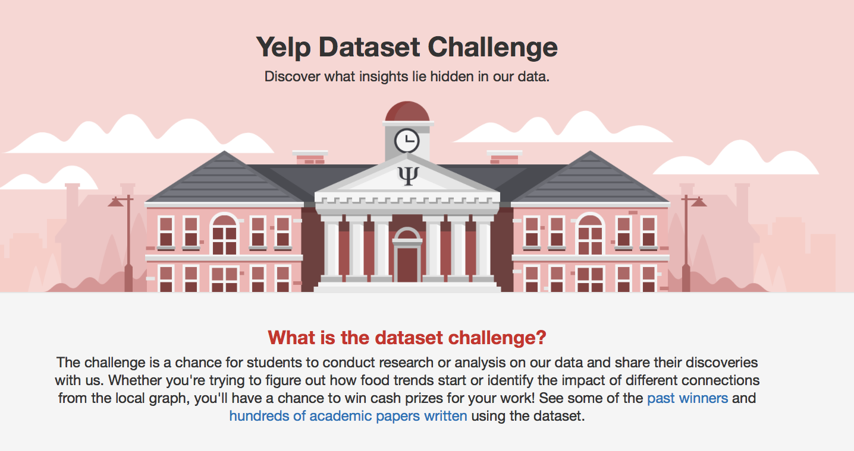
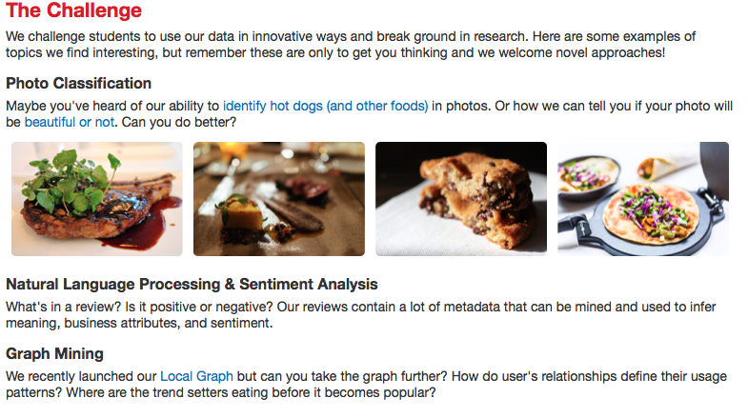
Yelp Data Challenge
The 12th installment
https://www.yelp.com/dataset/challenge

Slide 9
For Yelp data
You can find JSON file as well as SQL file.
You can install the data on your local database.
Alternatively, Iris has kindly put the data on a database in the cloud.
Please go to her discussion section if you want to use it.
mysql -h 45.63.90.29 -u mssp

