Slide 1
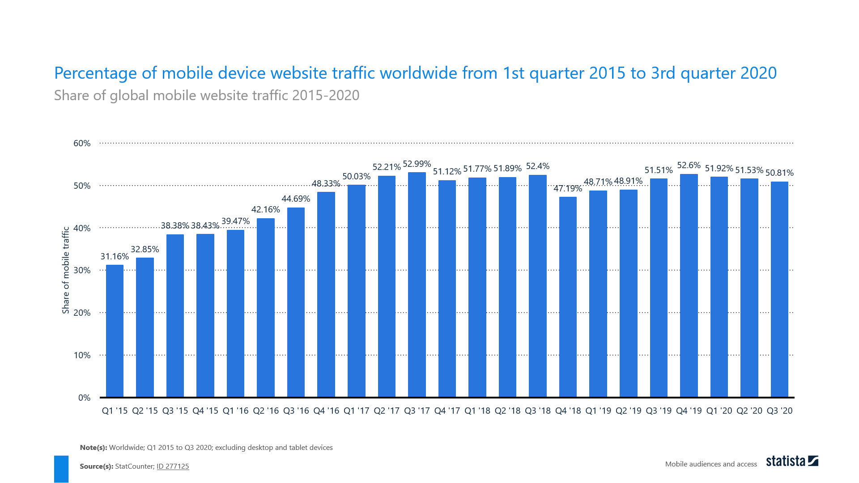
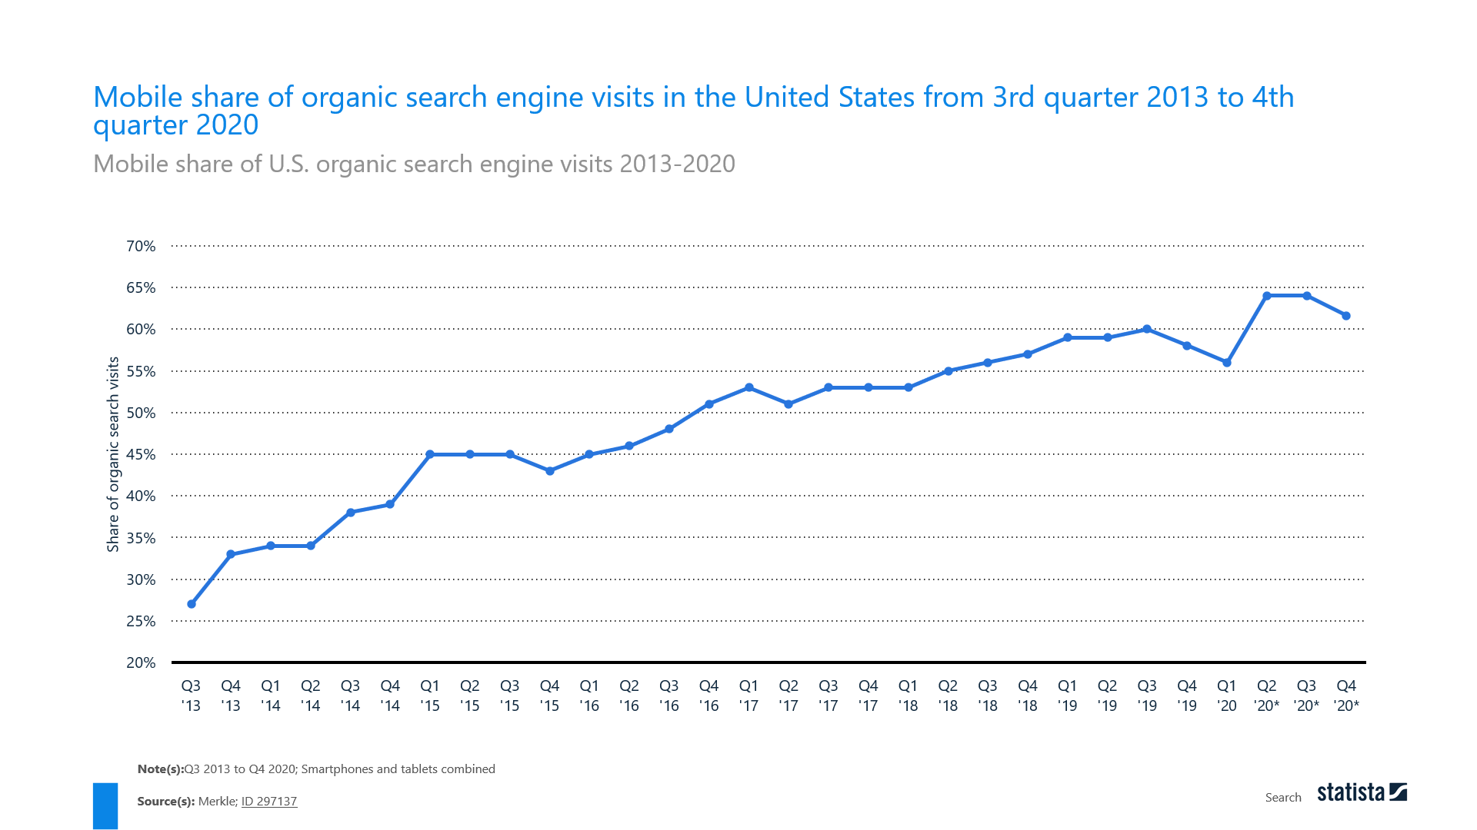
Diagram: Percentage of mobile traffic and mobile share of organic search engine (source: Statista, 2020b)

Slide 2
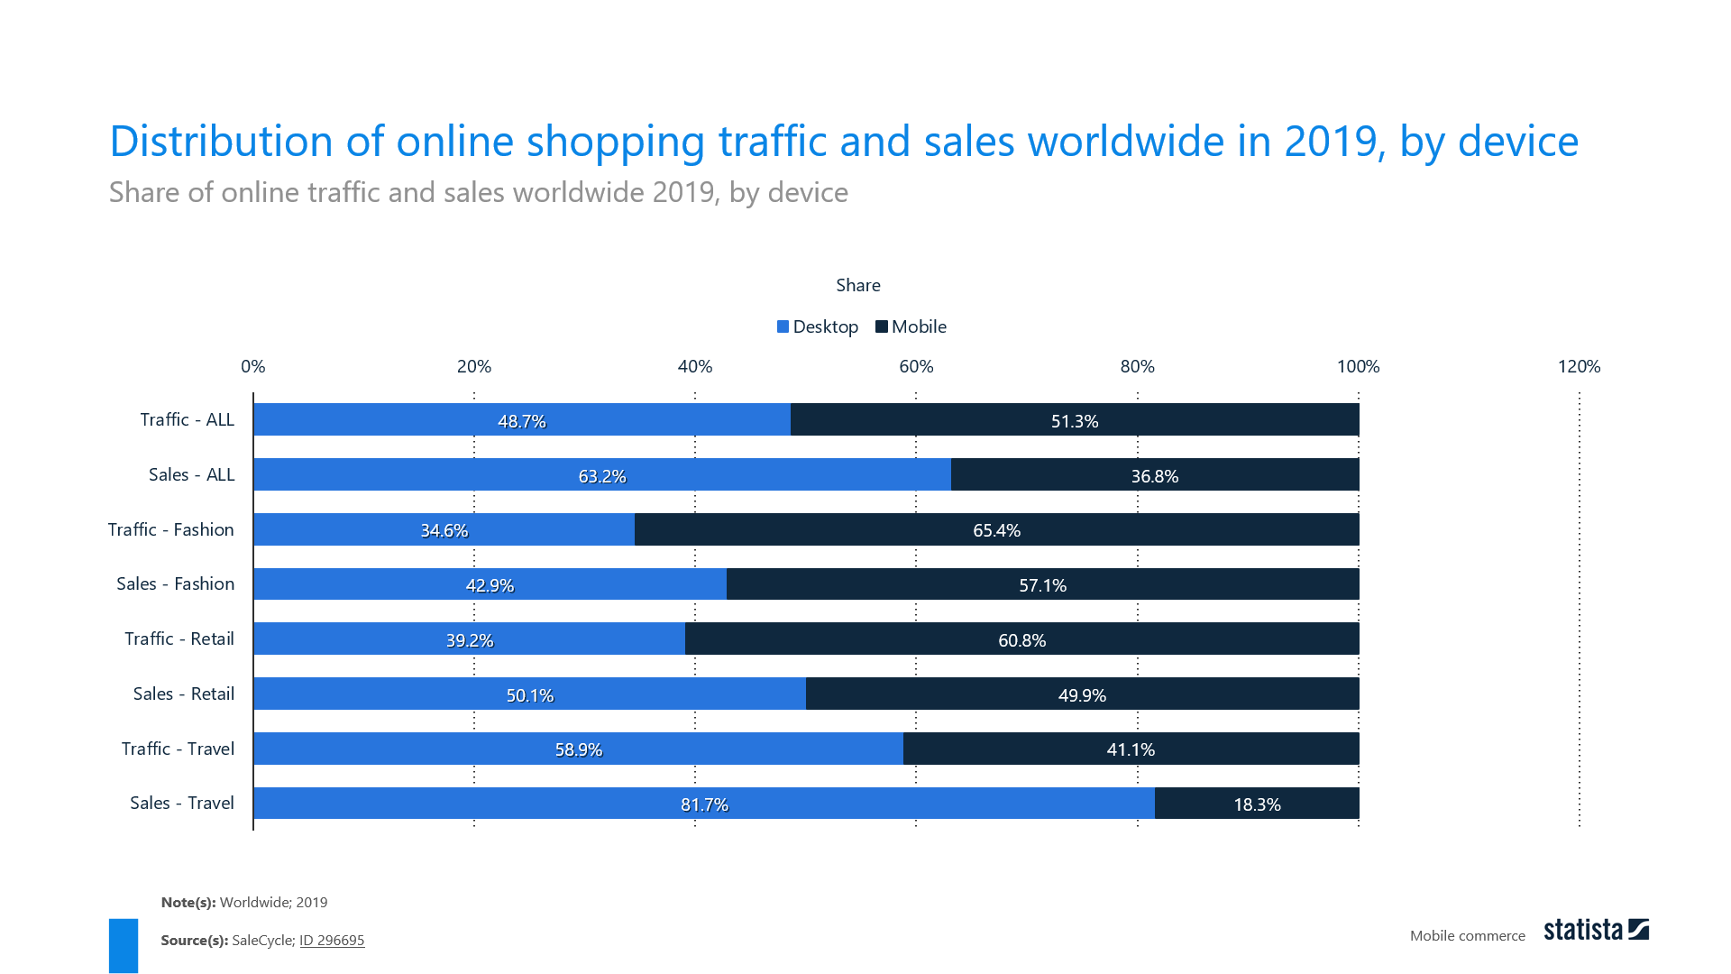
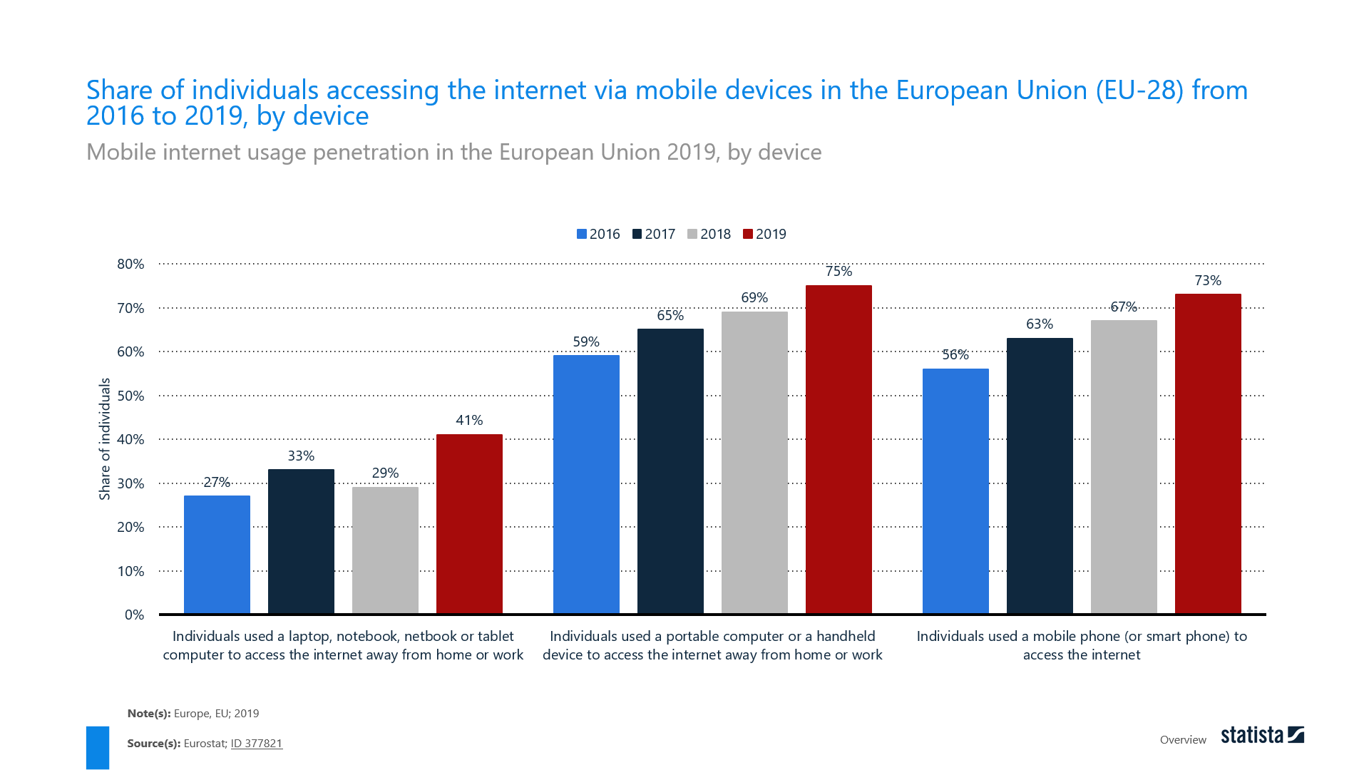
Diagram: Distribution of online shopping traffic and share of internet access through mobile devices (source: Statista, 2020c)

Slide 3
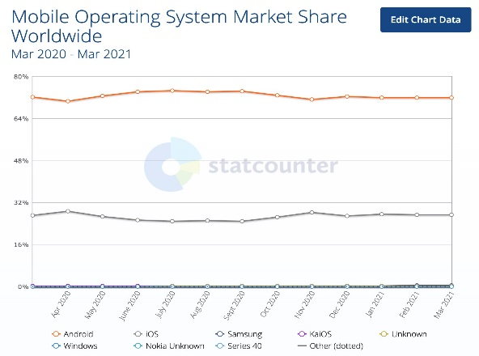
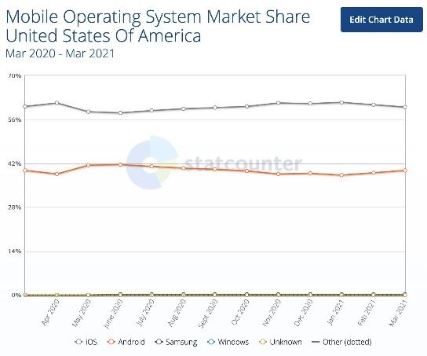
Diagram: Mobile operating system market share worldwide and in U.S. (source: Statcounter, 2021)

Slide 4
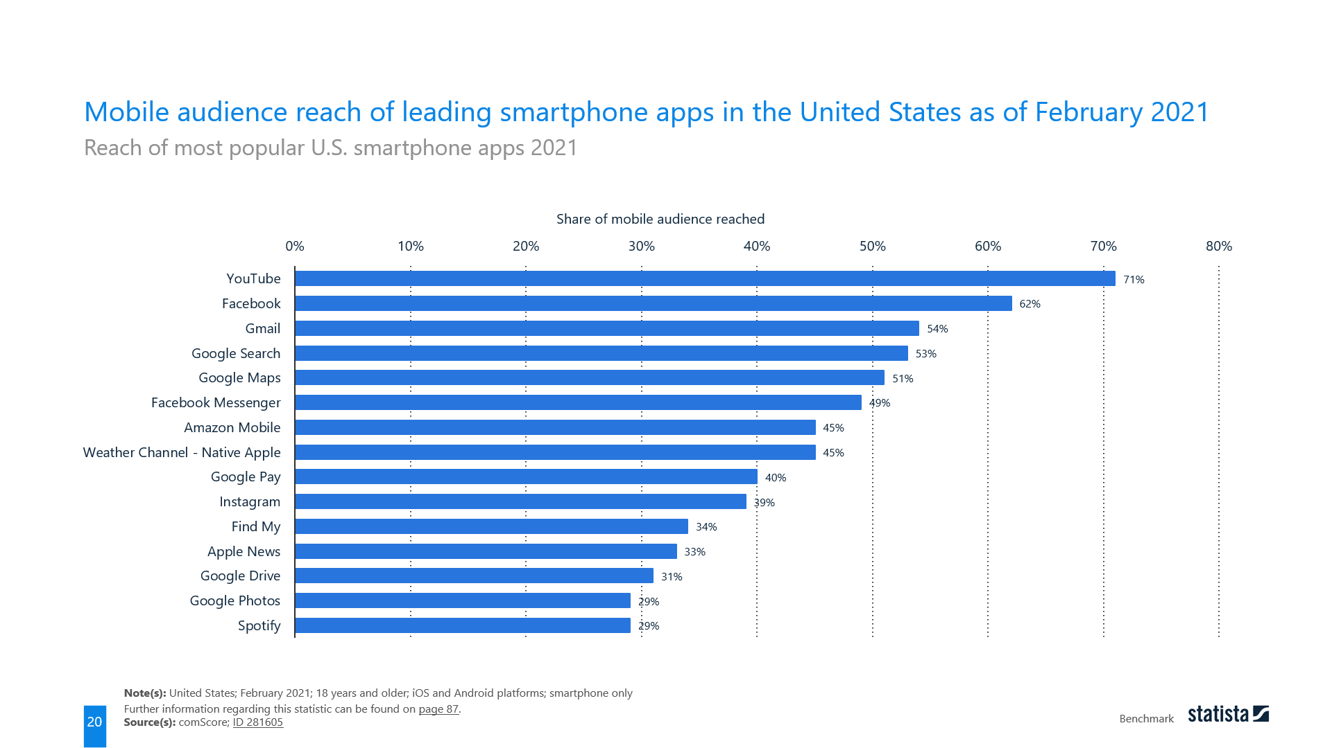
Diagram: Mobile audience reach in the U.S. (source: Statista, 2020b)

Slide 5
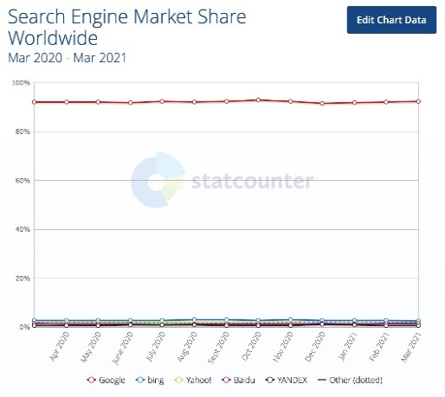
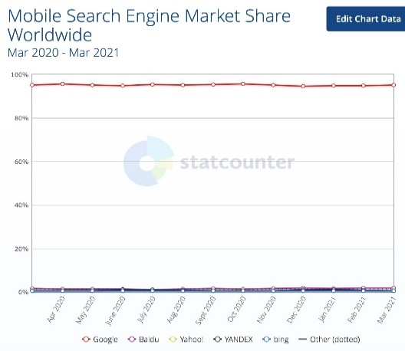
Diagram: Search engine market share worldwide and mobile search engine market share worldwide (source: Statcounter, 2021)

Slide 6
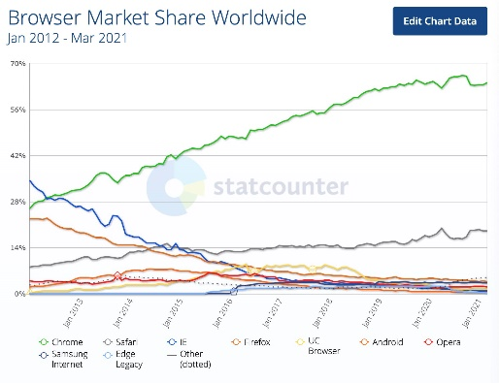
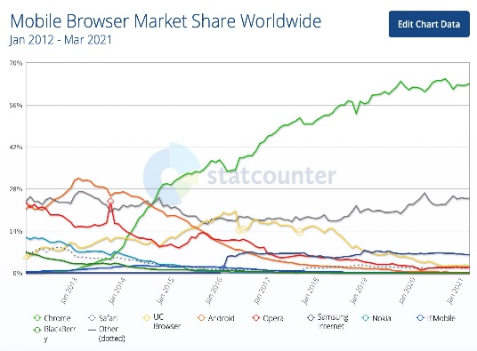

Slide 7
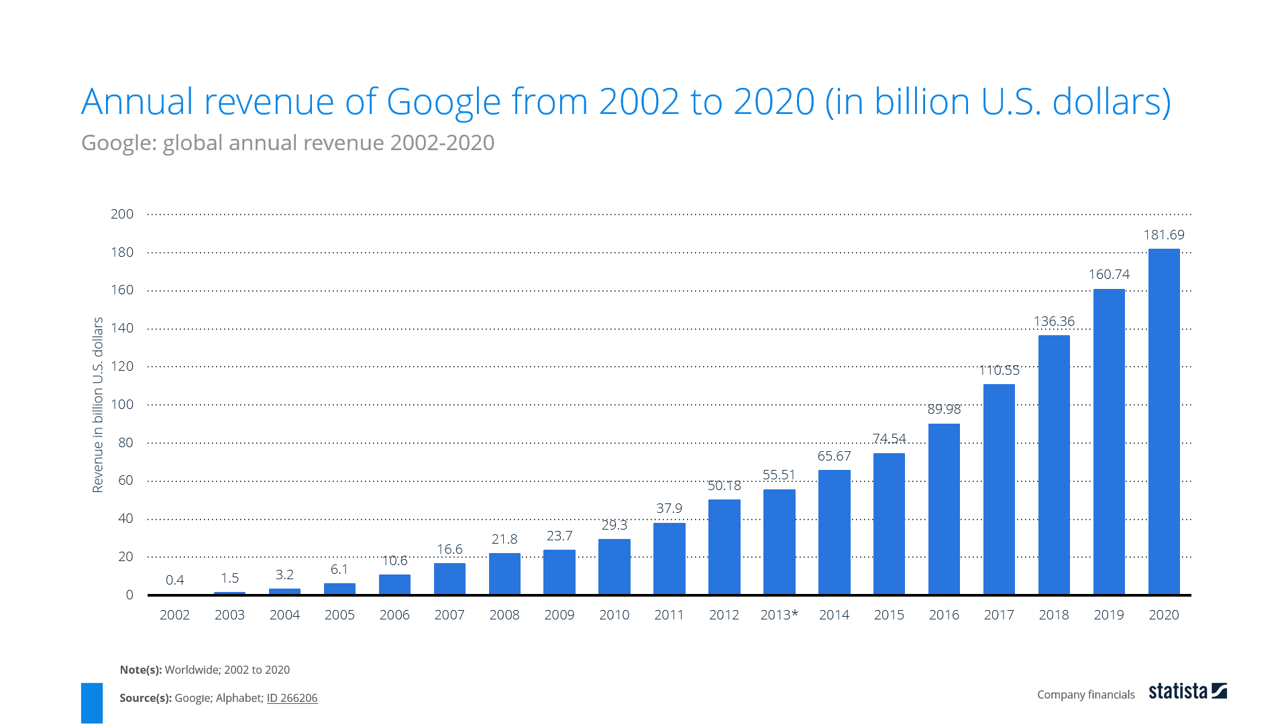
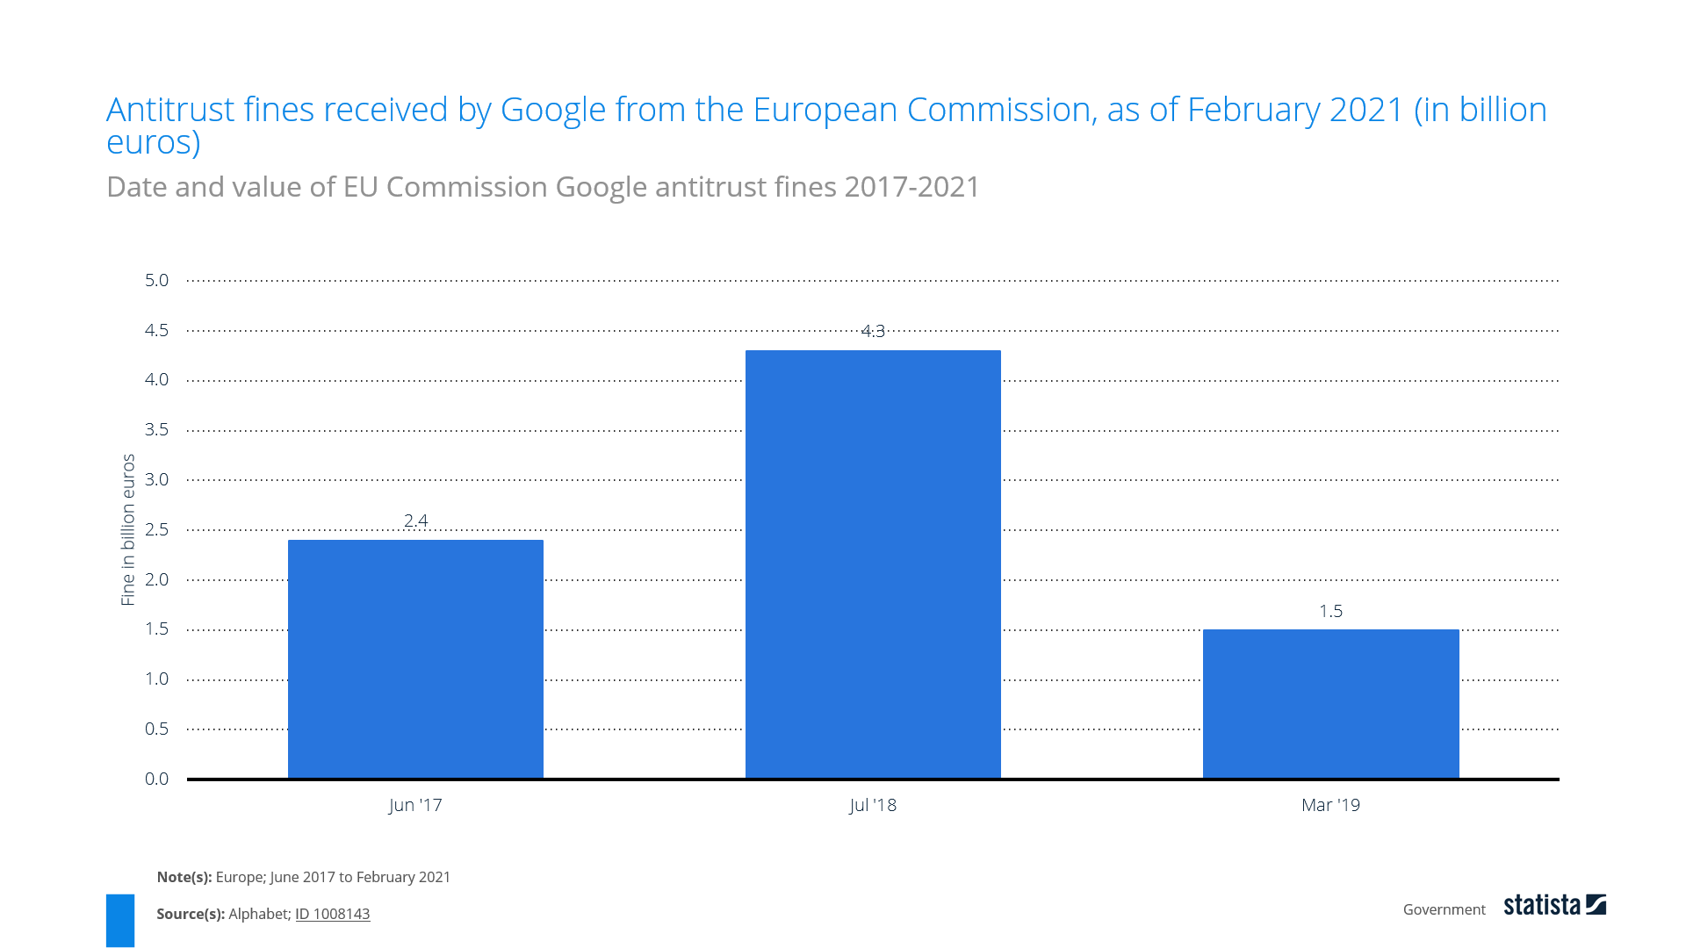
Diagram: Annual revenue of Google and fines from EU (source: Statista, 2020a)

Slide 8
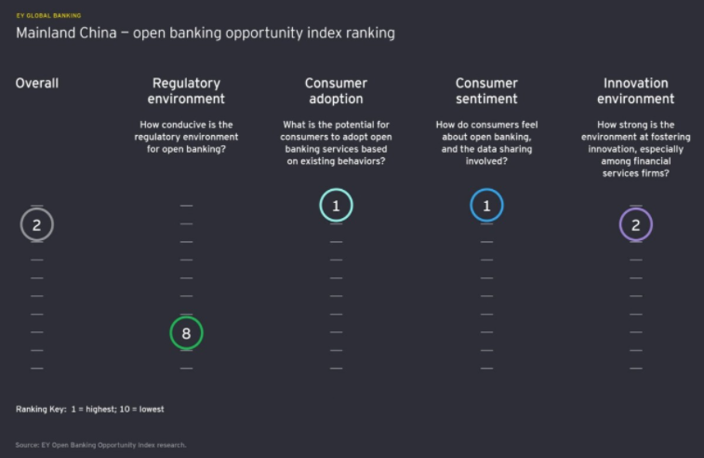
Diagram: Open bank scored highly in consumer adoption & sentiment while encouraging innovation at the same time in China, Source: EY, 2018.

