Slide 1






Consumer Path To Purchase
Cognitive Stage
Affective Stage
Behavioral Stage
Awareness & Interest
Evaluation &
Trial
Decision &
Confirmation

Slide 2



Customer: making tour plans and searching for travel information/tips
Headline 1 | Tourscurator4u (This is for people to know and remember our company name)
Headline 2 | Customized Travel Planner (This is for indicating our main service which matched to customers’ needs)
Headline 3 | Adventure, City and Cultural Tour (This is for people to quickly understand our specific services)
Description 1 | We offer great traveling ideas, travel tips, and customized travel planning. (We try to introduce our main services in a simple and clear way.)
Description 2 | Relax, enjoy your vacation, and leave the tour itinerary planning to us. Contact us today! (We try to attract and motivate people to click on our ad.)

Slide 3
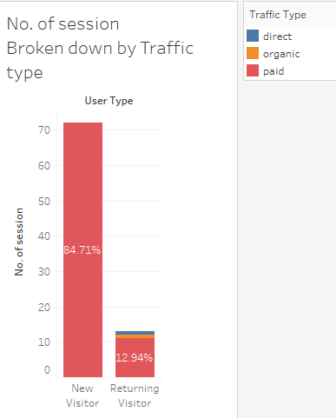
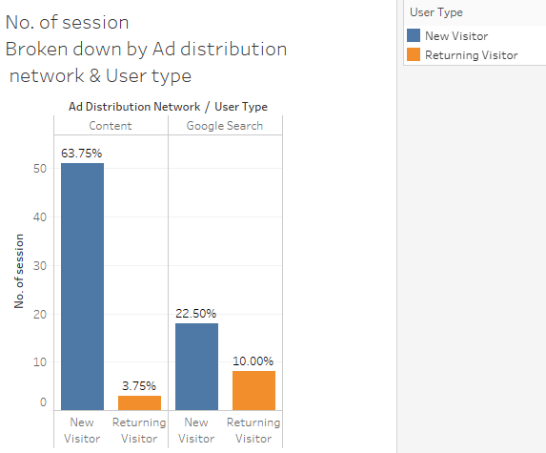

Slide 4
Consumer Path To Purchase
Cognitive Stage
Affective Stage
Behavioral Stage
Awareness & Interest
Evaluation &
Trial
Decision &
Confirmation
Advertising Objectives
Create Awareness
Generate Interest
Catch Attention
Visit &
Navigate our website
Like our content
Join us
Measurement Metrics
No. of ‘Learn more’ event per session
Average session duration
Average page view per session
Bounce rate
No. of ‘Like’ event per session
% return customer
No. of ‘Join us’ event per session

Slide 5
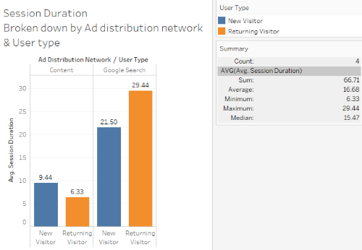
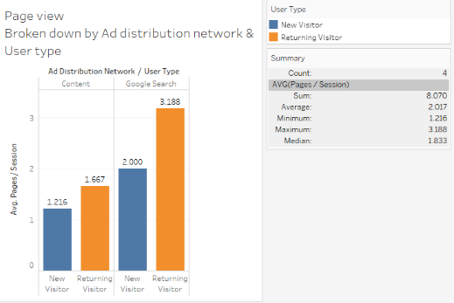
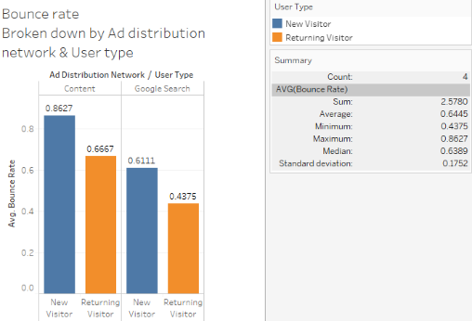
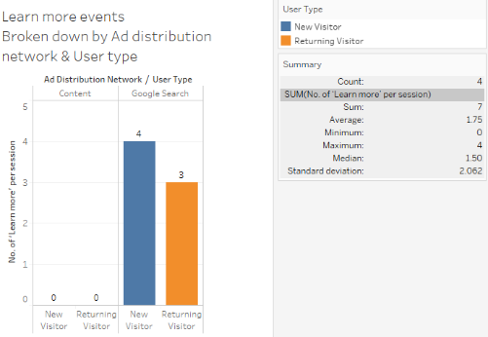

Slide 6
