Slide 1
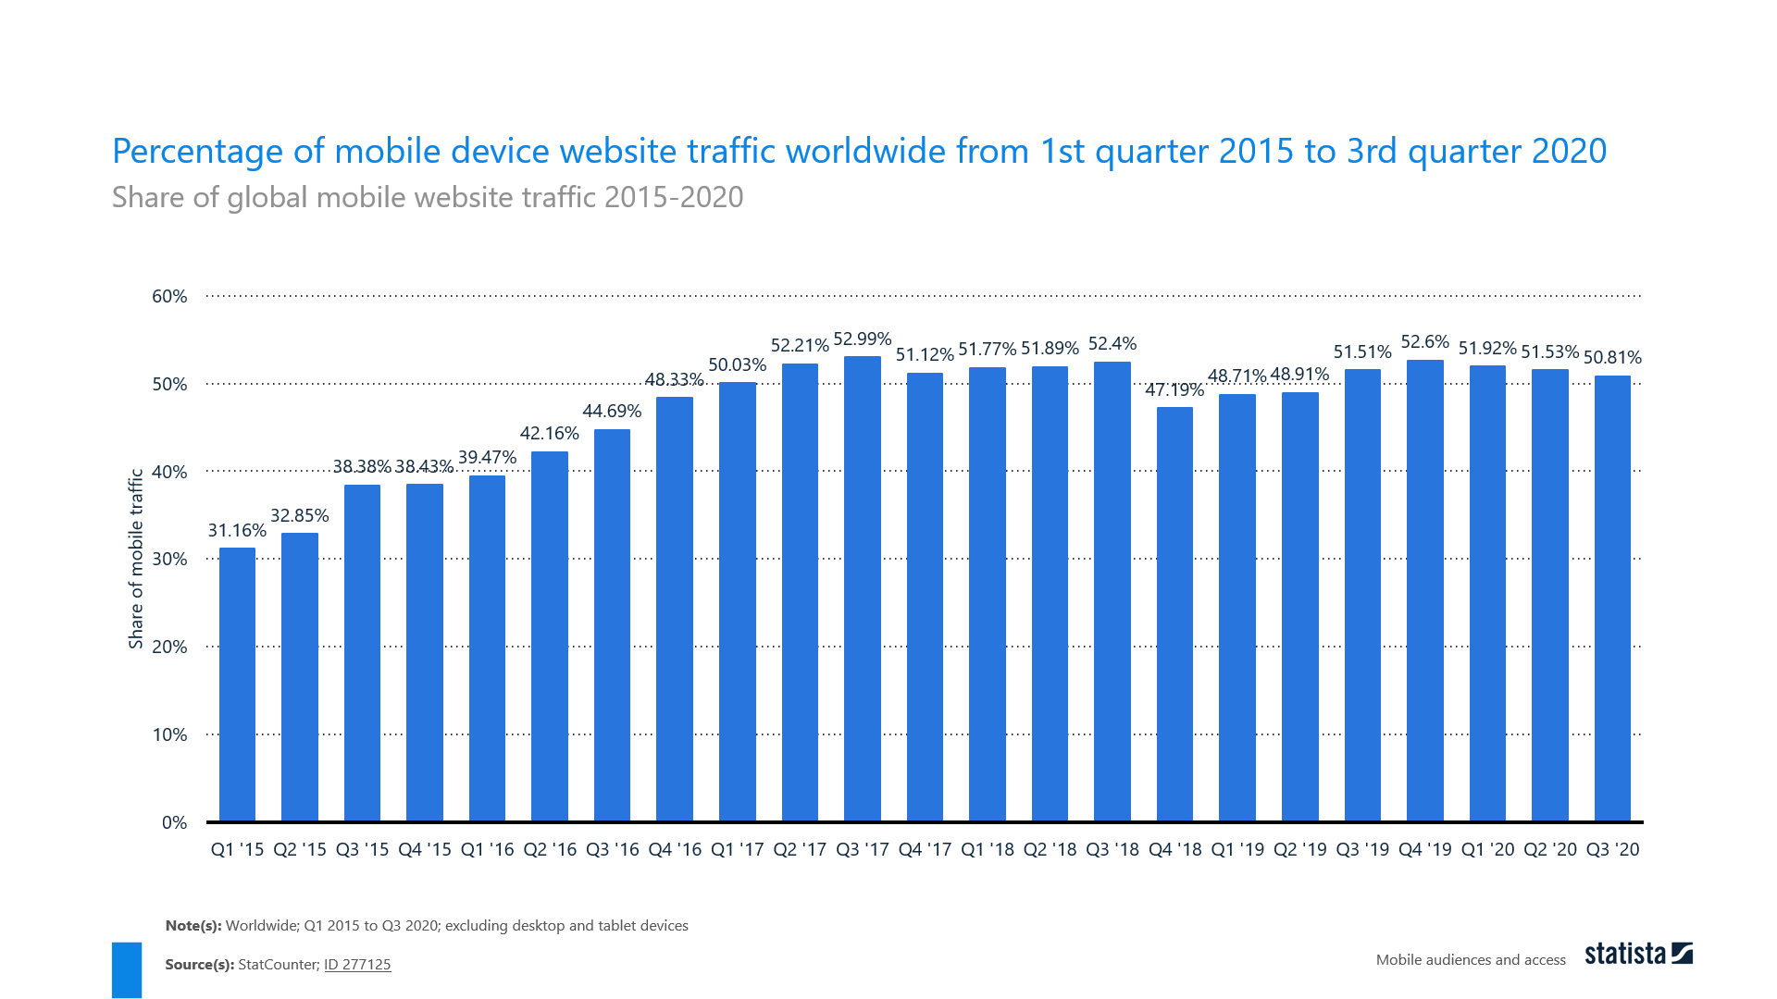
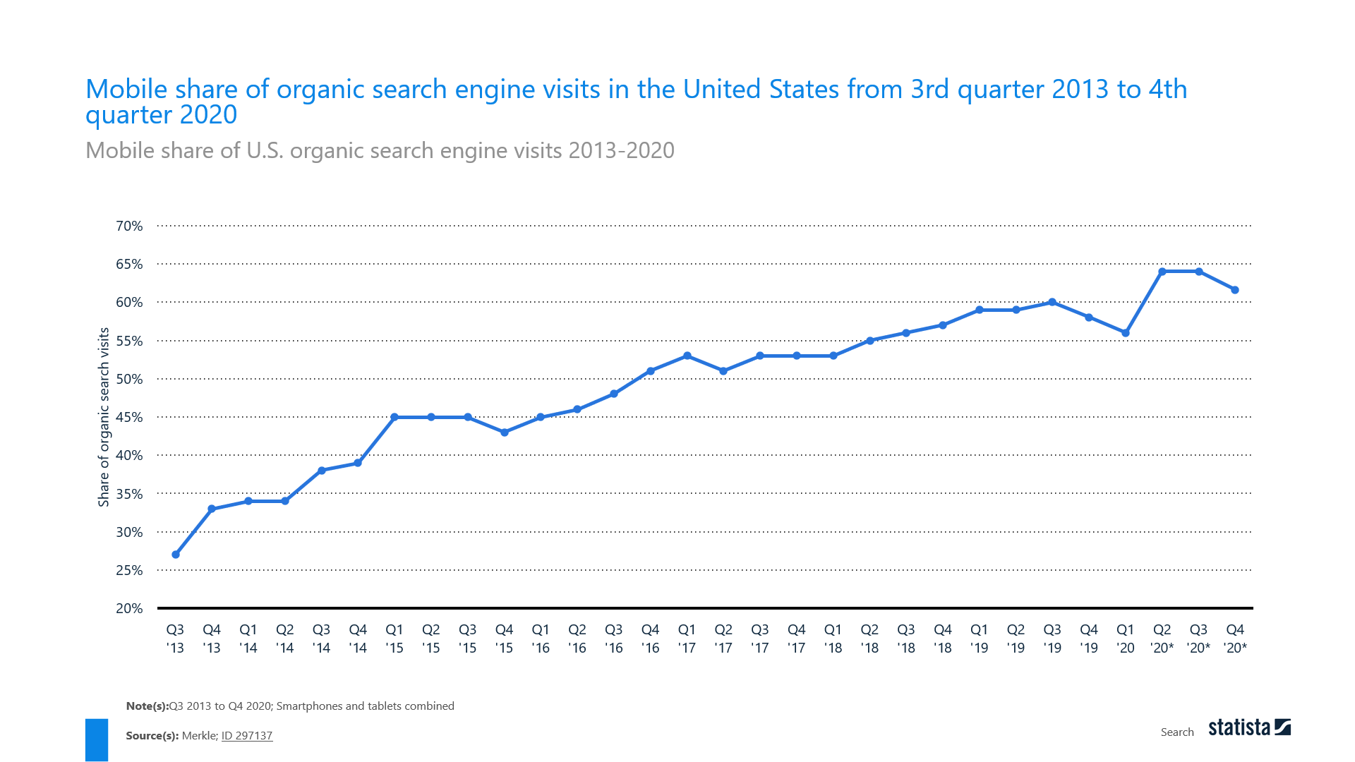
Diagram: Percentage of mobile traffic and mobile share of organic search engine (source: Statista, 2020b)

Slide 2
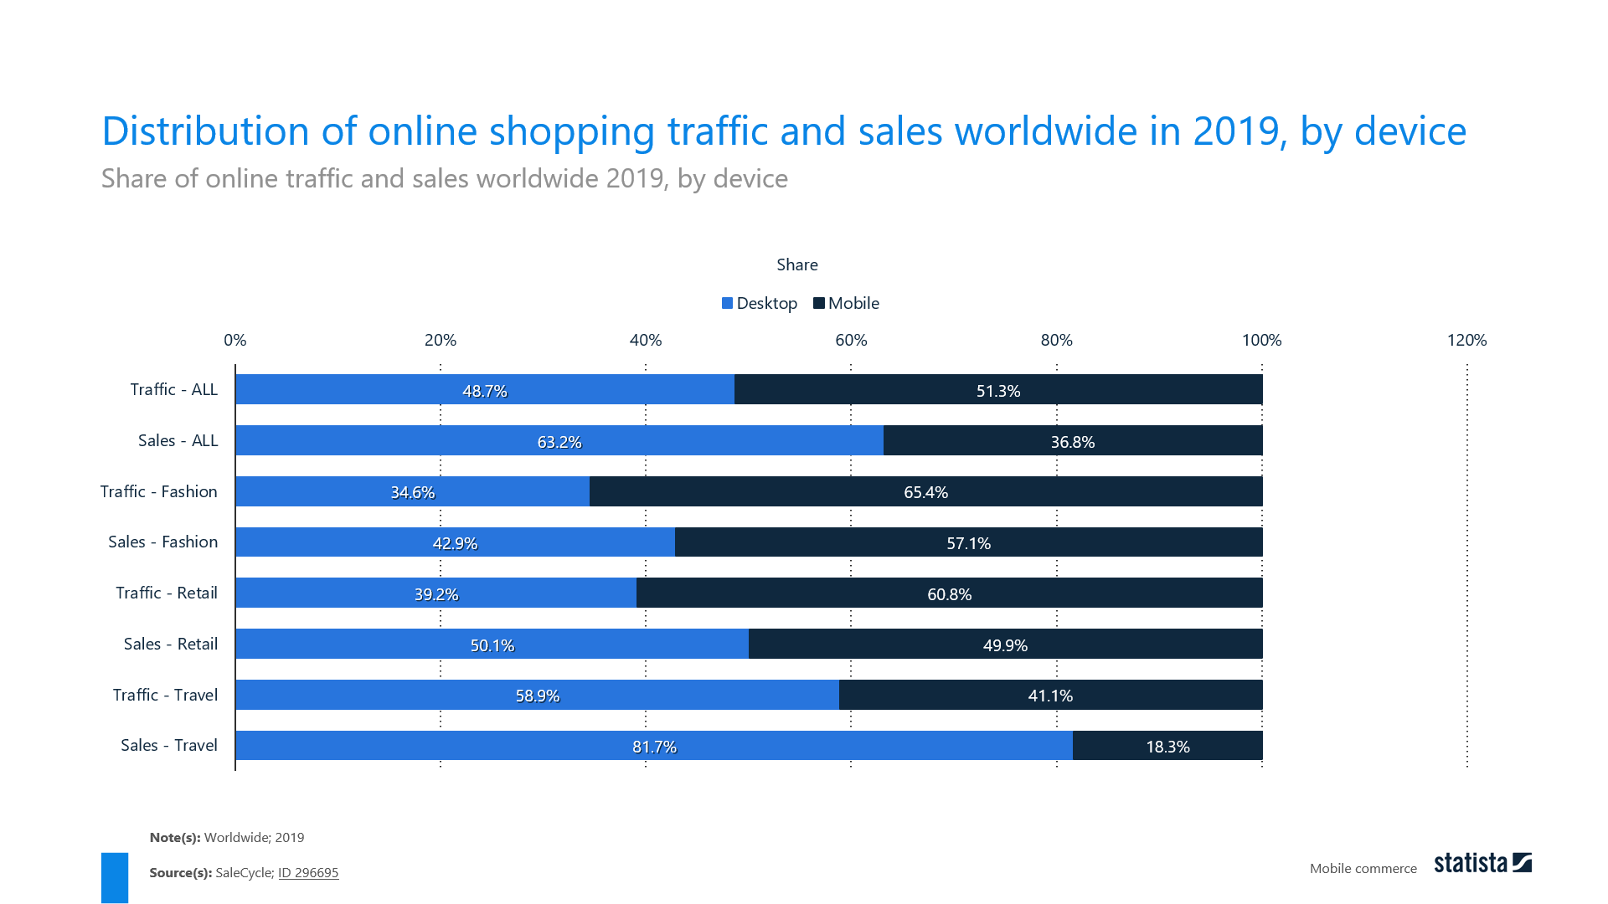
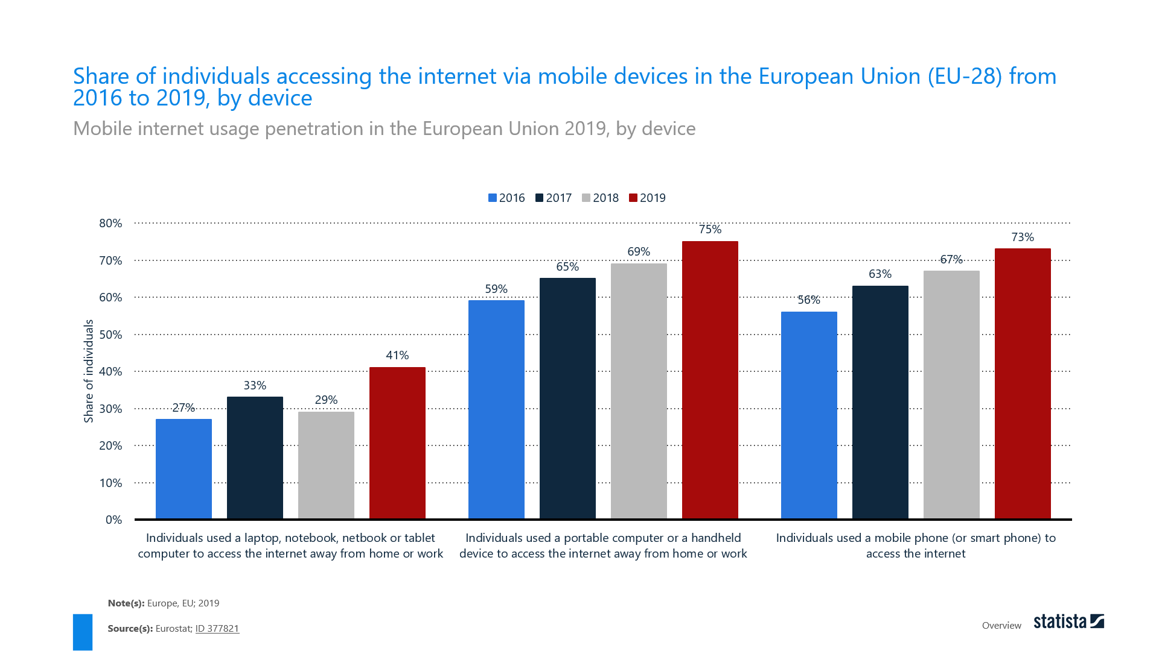
Diagram: Distribution of online shopping traffic and share of internet access through mobile devices (source: Statista, 2020c)

