Slide 1
Machine Learning Project: Predicting Tic-Tac-Toe
Group 4
Yang Jie – Hanyaqian Yuan -Jenny Shah
Elaine Lee – Ganesh Kumar – Kaushik Nerusupalli

Slide 2
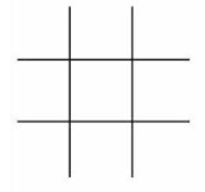
About Tic-Tac-Toe
2-player game
X and O
X typically goes first
players take turns marking the spaces in a 3×3 grid
three X’s or O’s in a horizontal, vertical, or diagonal row wins the game.

Slide 3
Data Set
The data are collected from the UCI Machine Learning Repository
Tic-Tac-Toe Endgame database
Created by David W. Aha (aha@cs.jhu.edu) August 19, 1991
Contains the complete set of possible board configurations at the end of tic-tac-toe games, where "x" is assumed to have played first. The target concept is "win for x" (i.e., true when "x" has one of 8 possible ways to create a "three-in-a-row").
Number of Instances: 958 (legal tic-tac-toe endgame boards)
Number of Attributes: 9, each corresponding to one tic-tac-toe square
No missing values

Slide 4
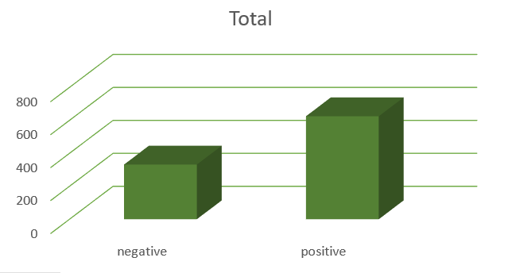
Approximately 65.3% are positive (i.e., wins for "x")

Slide 5
Objective
Apply machine learning concepts to predict whether X’s will win
Address class imbalance if applicable

Slide 6
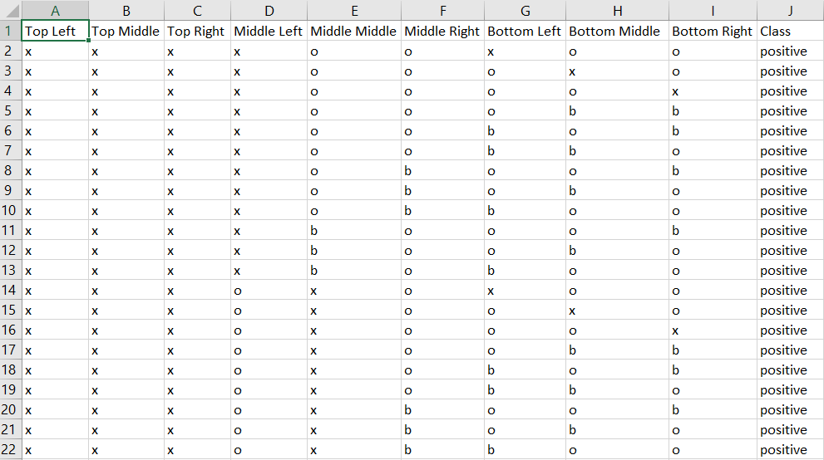
Data set : Input Variables

Slide 7
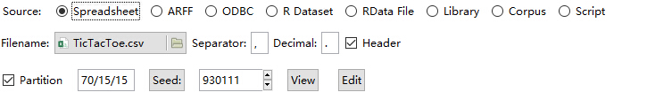
Data Filtering and Partitioning
Filtering:
No missing Values
No replacement of data required
Partitioning:
Train: 70 %
Validate: 15 %
Test: 15 %

Slide 8
Approach followed
Naïve Bayes
Single Decision Tree
Random Forest
Boosting

Slide 9
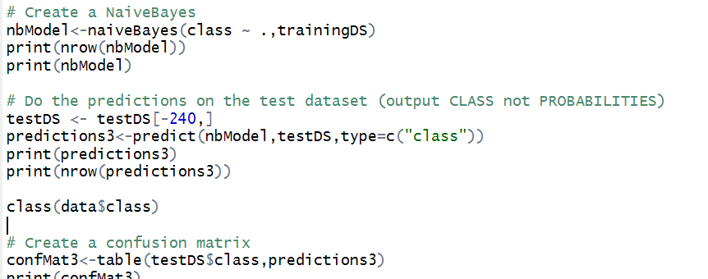
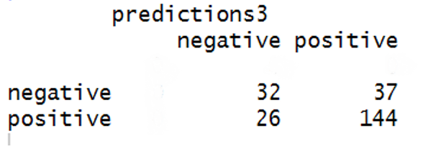
Naïve Bayes
Assumes that the data is independent
Use other techniques such as Single Decision Tree, Random Forest, Boosting

Slide 10
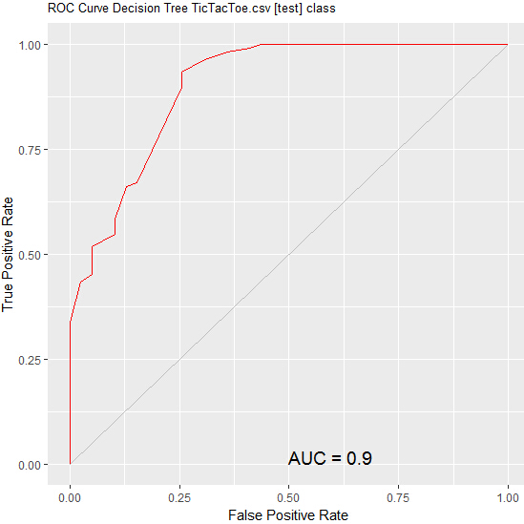
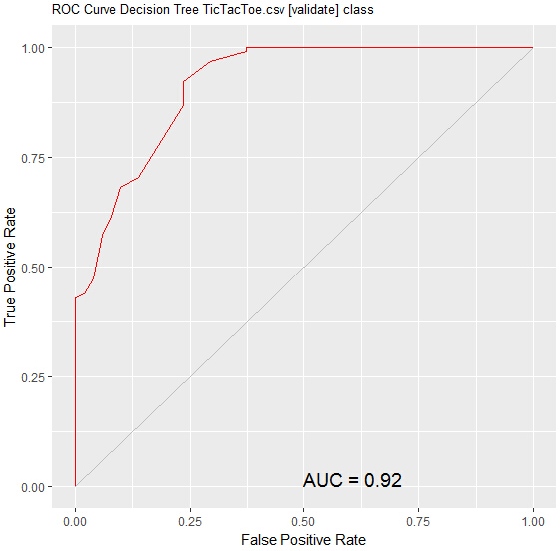
Decision tree ROC

Slide 11
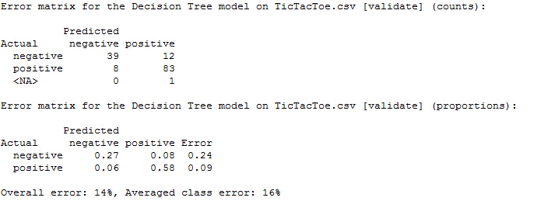
Decision tree validation

Slide 12
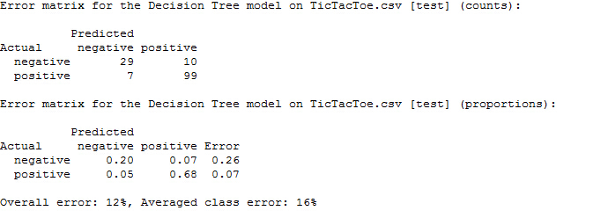
Decision tree test

Slide 13
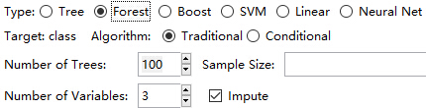
Random Forest Info

Slide 14
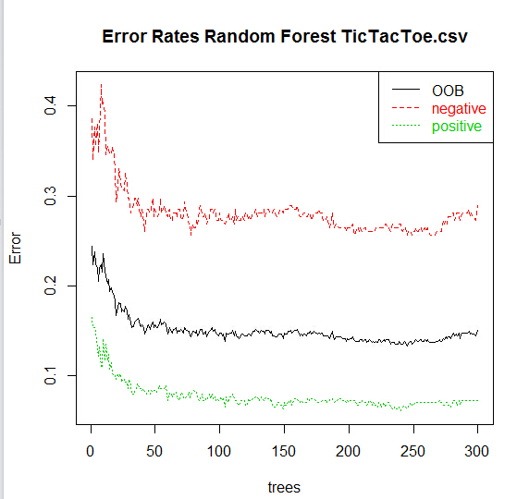
Random Forest Error Rates

Slide 15
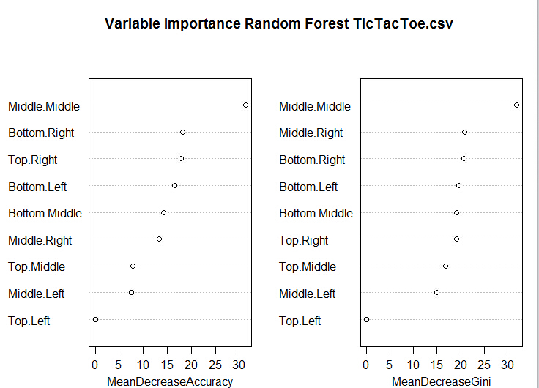
Random Forest IMPORTANCE OF INPUTS

Slide 16
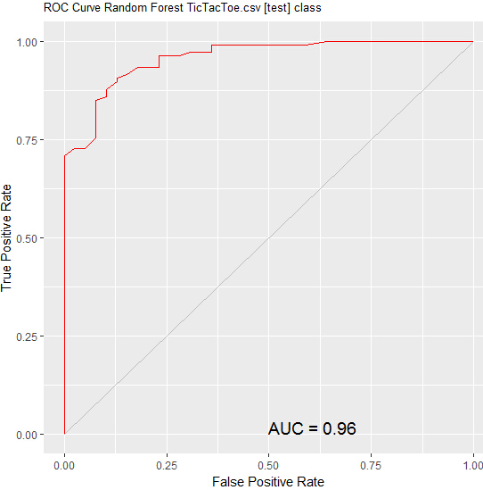

Random Forest ROC Curves

Slide 17
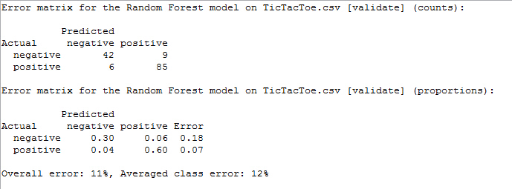
Random Forest Validation

Slide 18
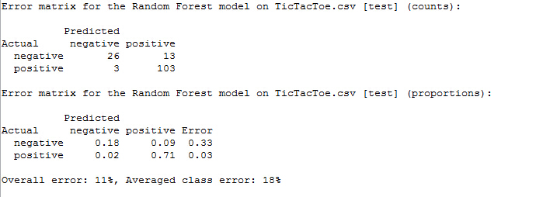
Random Forest test

Slide 19
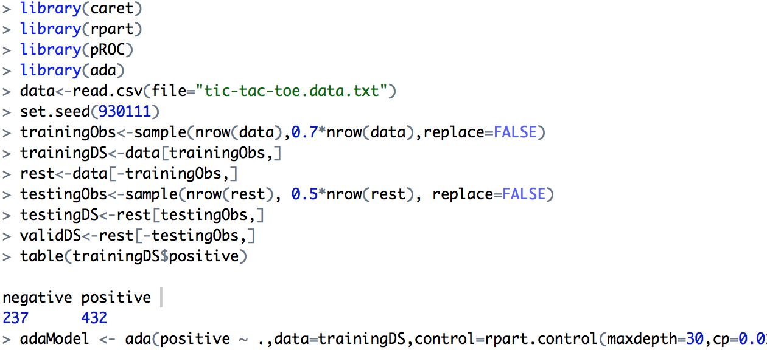
Boosting

Slide 20
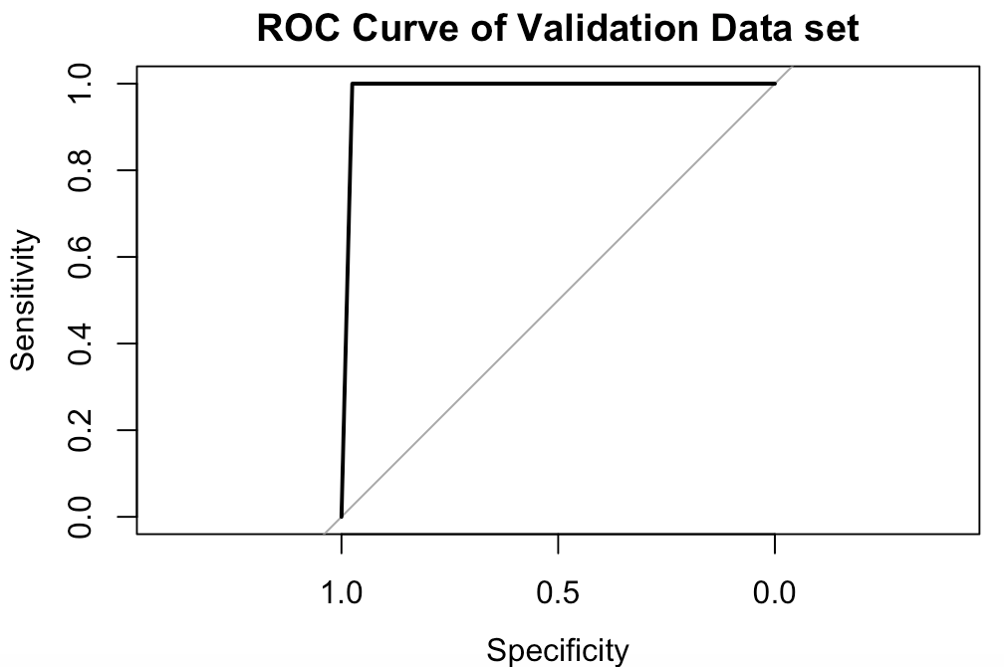
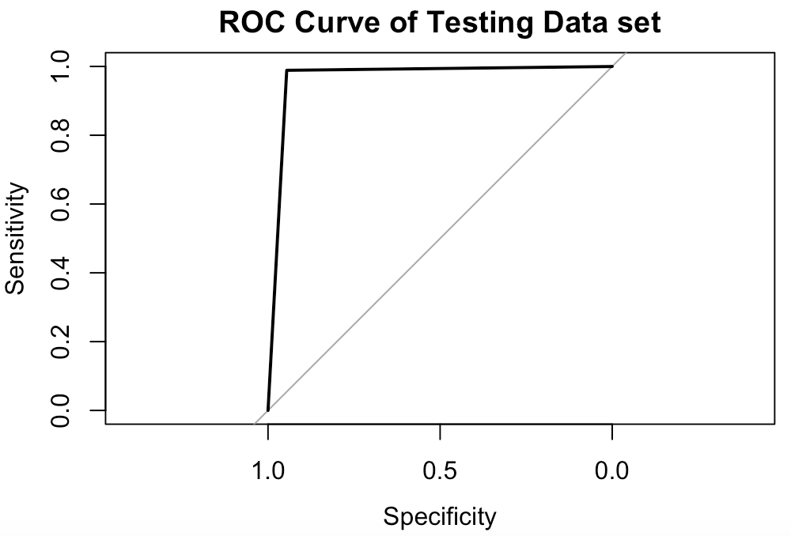
Boosting ROC and corresponding AUC

Slide 21
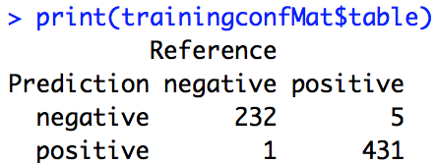
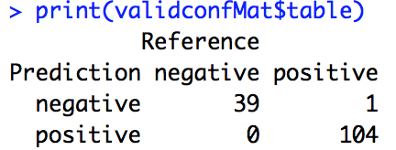
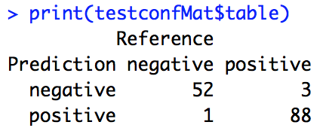
Boosting Error Matrice
Overall error rate: 0.89%
Minority case error rate: 2.11%
Training:
Validation:
Overall error rate: 0.69%
Minority case error rate: 2.5%
Overall error rate: 2.78%
Minority case error rate: 5.45%
Testing:

Slide 22
Boosting Precision/Recall and F1 score
Negative case
Precision=52/(52+1)=0.967
Recall=52/(52+3)=0.945
F1 score=2rp/(r+p)=0.956
Positive case
Precision=88/(88+3)=0.967
Recall=88/(88+1)=0.989
F1 score=2rp/(r+p)=0.978

Slide 23
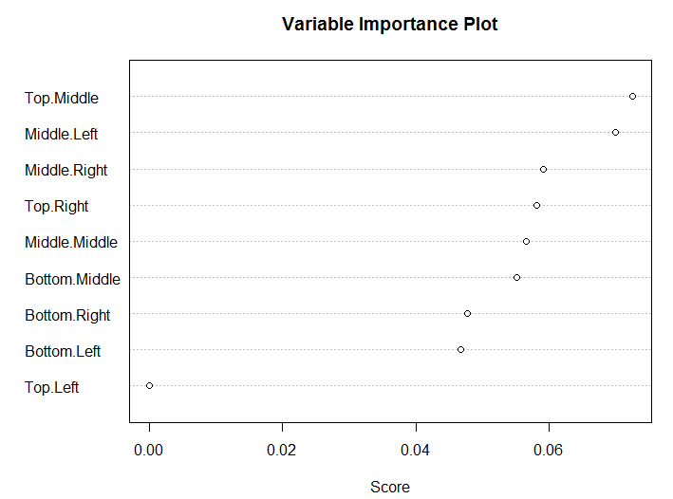
Boosting IMPORTANCE OF INPUTS

Slide 24
Imbalanced Data
Is our data imbalanced?

Slide 25
QUESTIONS?

Slide 26
Reference
https://archive.ics.uci.edu/ml/datasets/Tic-Tac-Toe+Endgame

Slide 27
tHANK YOU!

