Slide 1
Navigation of Mobile Robot
Jing Liang
Zamora, I., Lopez, N.G., Vilches, V.M. and Cordero, A.H., 2016. Extending the openai gym for robotics: a toolkit for reinforcement learning using ros and gazebo. arXiv preprint arXiv:1608.05742.

Slide 2
Contents
Software Architecture
Q-Learning
Training
Result
Reference

Slide 3
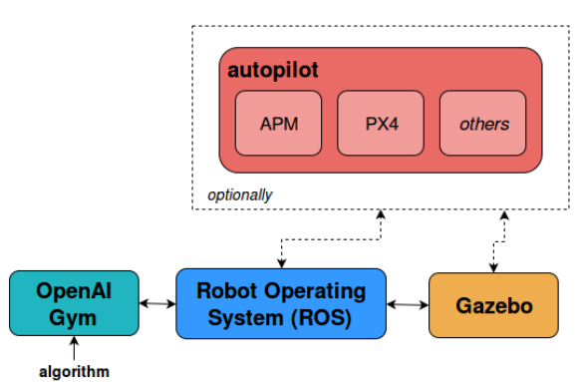
Software Architecture
Main Blocks:
ROS,
Gazebo,
Open-AI Gym

Slide 4
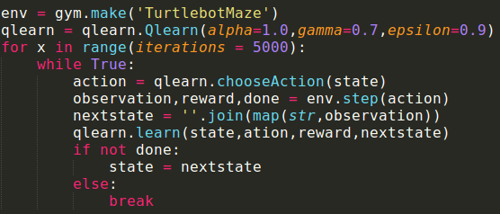
Q-Learning
Basic description:

Slide 5
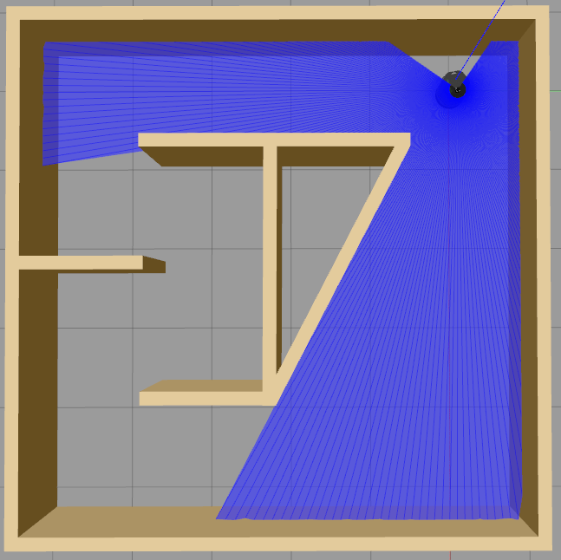
Q-Learning Parameters
States:
10 sectors of Lidar data
Range:
0; 1; 2; 3
[0,0.3]; [0.3,1]; [1,1.5],[1.5,inf]
Reward:
Turn: 1
Forward: 5
Collision: -200
Action:
0: Left turn
1: Right turn
2: Forward
Speed:
Forward: 0.3 m/s
Turn: Angular: 0.3 r/s
Linear: 0.1 m/s

Slide 6
Training

Slide 7
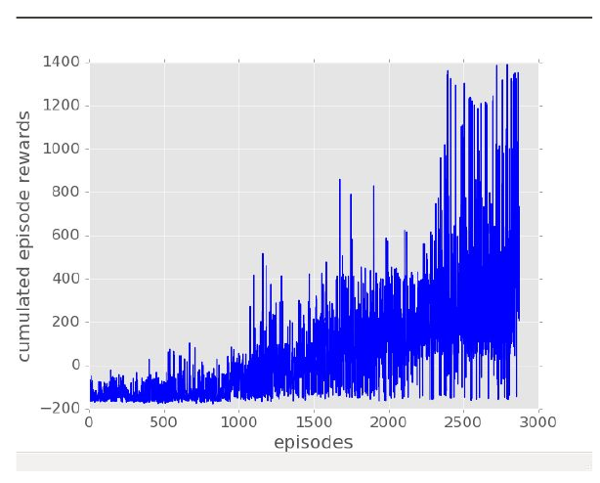
Result

Slide 8
Future Work
Add dynamic obstacles
Use other algorithms like PPO(policy proximal optimization)
Add target position to system

Slide 9
Reference
Zamora, I., Lopez, N.G., Vilches, V.M. and Cordero, A.H., 2016. Extending the openai gym for robotics: a toolkit for reinforcement learning using ros and gazebo. arXiv preprint arXiv:1608.05742.

Slide 10
Questions

