Slide 1
HANDS-ON MACHINE LEARNING | EXPERIMENT REPORT
Workshop 2.4
Visualizing Neural Networks
A visual report based on five experiments in TensorFlow Neural Network Playground
Name: Jingbin Wang Date: 11/05/2026
01

Slide 2
Study Overview
What was tested and how the experiments were compared.
The goal was to observe how data noise, input features, network depth, and dataset type affect a neural network’s learned decision boundary and loss.
Five recorded experiments
What was observed
Fair interpretation
1. Baseline XOR model
2. Increased noise
3. Added x₁x₂ feature
4. Added a second hidden layer
5. Switched to Circle dataset
Dataset pattern, selected features, hidden-layer count, neuron count, epoch counter, Training Loss and Test Loss.
The recordings show the displayed state at capture. Epoch counts are not wall-clock training times; runs may have been stopped at different points.
All five recordings used Classification, learning rate 0.03, Tanh activation, no regularization, 50% training data and batch size 10.
Source of evidence: the five screen recordings supplied for this presentation.
02

Slide 3
Neural Network Architecture & Data Flow
A simplified feed-forward network similar to the one explored in the Playground.
INPUT
HIDDEN LAYER(S)
OUTPUT
h₁
x₁
h₅
ŷ₁
h₂
x₂
h₃
ŷ₂
h₆
h₄
Input layer
Hidden layers
Output layer
Receives feature values.
Learn intermediate patterns.
Produces class predictions.
03

Slide 4
Core Components I: Layers, Neurons & Weights
These components define the network’s structure and the strength of information flow.
Layers
Neurons
Weights
Groups of neurons arranged by processing stage. The input layer receives features, hidden layers learn patterns, and the output layer produces predictions.
Small computational units. Each neuron combines incoming values, weights and a bias, then applies an activation function.
Learned numbers on connections. They scale incoming signals and are adjusted during training to improve predictions.
A neuron’s basic computation
z = w₁x₁ + w₂x₂ + … + b output = activation(z)
The input values are multiplied by weights, combined with a bias, and passed through an activation function. Repeating this operation across layers enables the network to learn patterns.
04

Slide 5
Core Components II: Activation, Loss & Optimization
The learning process turns a network prediction into parameter updates.
Activation functions
Loss functions
Optimization algorithms
Transform a neuron’s weighted sum. Tanh was used in all five recordings. It maps values into the range −1 to +1 and introduces non-linearity.
Measure prediction error. Training Loss measures error on training examples; Test Loss measures performance on held-out examples.
Use gradients from the loss to update weights and biases. The Playground’s training process iteratively adjusts parameters to reduce loss.
1
2
3
4
Prediction
Calculate loss
Compute gradients
Update weights
This cycle repeats across training steps. Lower loss generally indicates a closer fit to the target labels, but test loss is especially useful for judging generalization.
05

Slide 6
Experimental Setup: What Stayed the Same?
The recordings show a mostly controlled comparison, with one main change in each experiment.
Setting
Observed value
Scope
Problem type
Classification
All five
Learning rate
0.03
All five
Activation
Tanh
All five
Regularization
None (rate 0)
All five
Training / test split
50% / 50%
All five
Batch size
10
All five
Input features
Varied in Experiment 3 and 5
Changed where noted
Hidden layers
1 or 2
Changed in Experiment 4 and 5
Dataset / noise
XOR or Circle; noise 0 or 30
Changed where noted
Note: Experiment 3 adds x₁x₂; Experiment 4 uses two hidden layers; Experiment 5 changes the dataset to Circle and uses x₁ and x₂.
06

Slide 7
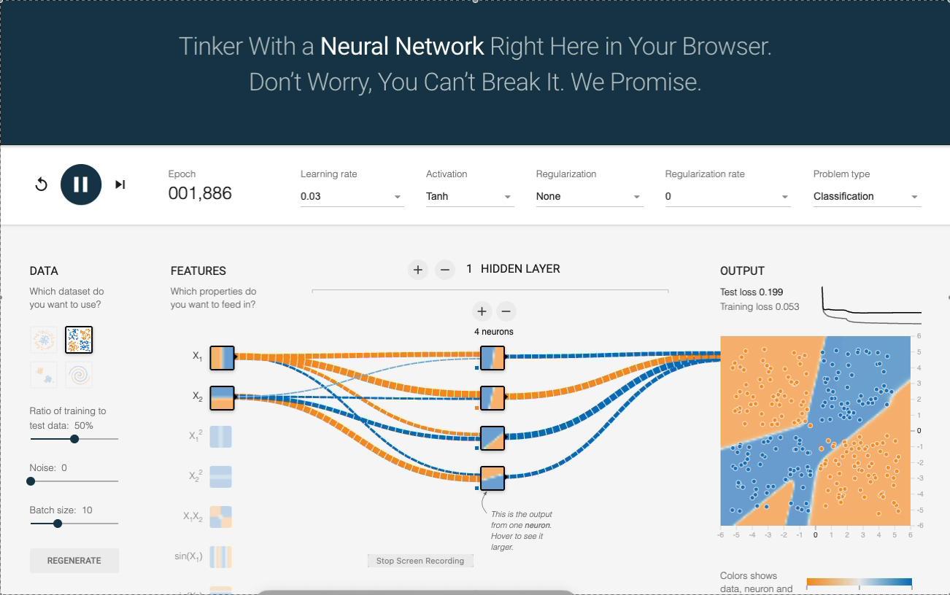
Experiment 1: Baseline XOR Model
Starting point: one hidden layer with four neurons and the original two input features.
Recorded settings
Dataset: XOR (classification)
Noise: 0
Features: x₁, x₂
Hidden layers: 1 × 4 neurons
Learning rate: 0.03 | Activation: Tanh
Observed metrics
Epoch shown: 1,868
Training Loss: 0.064
Test Loss: 0.190
What the result suggests
Key takeaway
The baseline model learned part of the XOR pattern, but the displayed test loss remained relatively high. The output map still showed imperfect class separation at the moment captured.
This provides the comparison point for later experiments. XOR requires a non-linear decision boundary; the basic setup did not yet achieve a very low test loss.
07

Slide 8
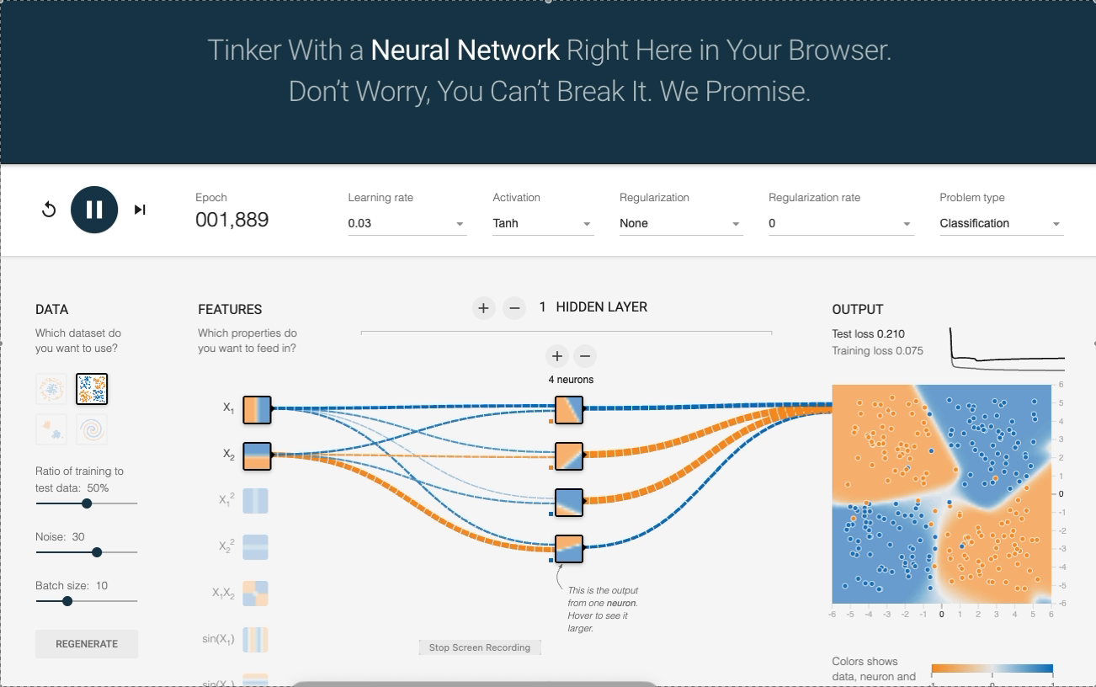
Experiment 2: Increasing Noise
The main change was increasing the dataset noise from 0 to 30.
Recorded settings
Dataset: XOR (classification)
Noise: 30
Features: x₁, x₂
Hidden layers: 1 × 4 neurons
Learning rate: 0.03 | Activation: Tanh
Observed metrics
Epoch shown: 1,870
Training Loss: 0.075
Test Loss: 0.210
What the result suggests
Key takeaway
Compared with the baseline, both displayed losses were higher: Training Loss rose from 0.064 to 0.075, and Test Loss rose from 0.190 to 0.210. The output regions also appear less cleanly separated.
Adding noise makes the underlying pattern harder to identify. In this recorded run, the model’s measured error increased.
08

Slide 9
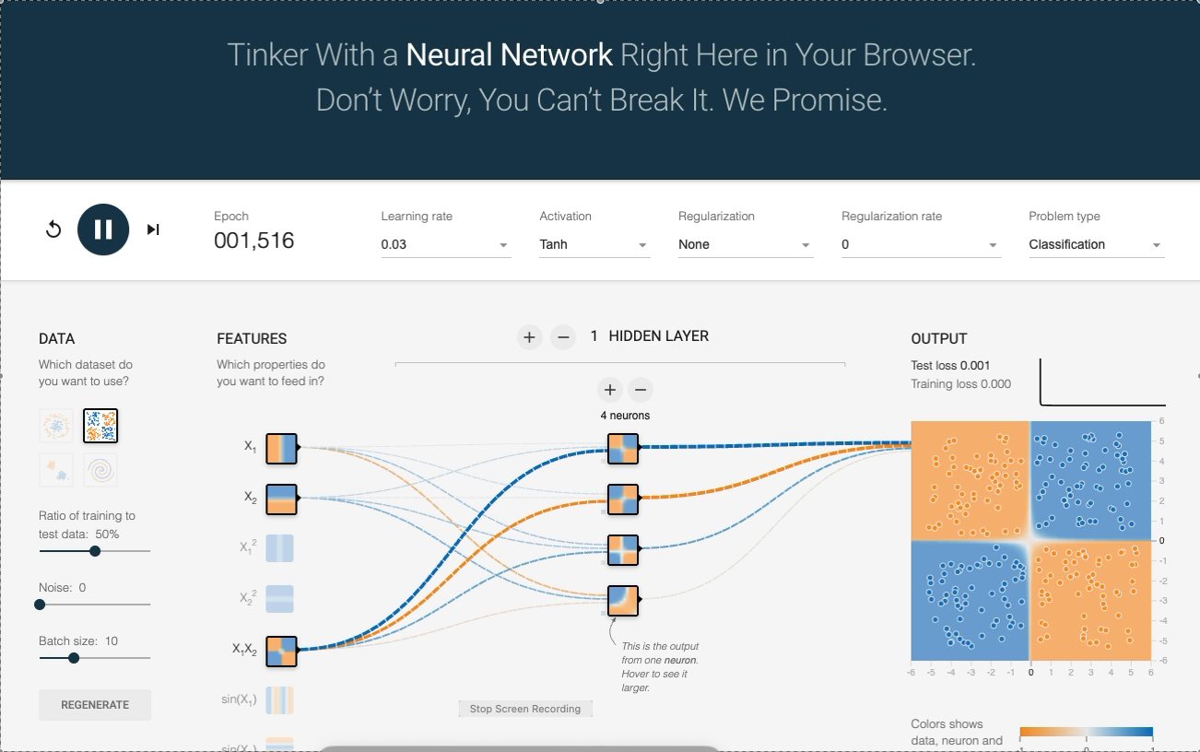
Experiment 3: Adding an Input Feature
The main change was enabling the interaction feature x₁x₂ while keeping the XOR task and one hidden layer.
Recorded settings
Dataset: XOR (classification)
Noise: 0
Features: x₁, x₂, and x₁x₂
Hidden layers: 1 × 4 neurons
Learning rate: 0.03 | Activation: Tanh
Observed metrics
Epoch shown: 1,497
Training Loss: 0.000
Test Loss: 0.001
What the result suggests
Key takeaway
The displayed loss dropped substantially compared with the baseline. The output map shows a clear four-quadrant pattern, closely matching the XOR labels.
A useful engineered feature can make a difficult relationship easier to represent. The x₁x₂ interaction feature gave the model direct information about the interaction between the two inputs.
09

Slide 10
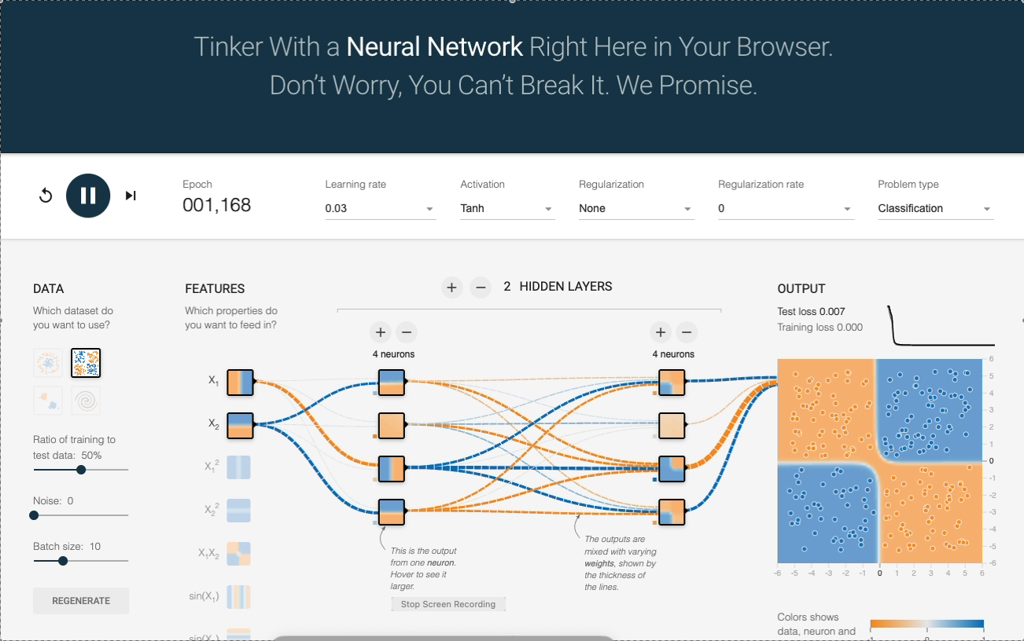
Experiment 4: Increasing Network Depth
The network was expanded from one hidden layer to two hidden layers, with four neurons in each layer.
Recorded settings
Dataset: XOR (classification)
Noise: 0
Features: x₁, x₂, and x₁x₂
Hidden layers: 2 × 4 neurons each
Learning rate: 0.03 | Activation: Tanh
Observed metrics
Epoch shown: 1,149
Training Loss: 0.000
Test Loss: 0.007
What the result suggests
Key takeaway
The two-hidden-layer model also achieved very low loss. Test Loss was 0.007, slightly higher than the 0.001 recorded in Experiment 3, while Training Loss remained displayed as 0.000.
Adding depth increases the network’s capacity, but more layers do not automatically improve test performance. Here, the simpler feature-augmented model had the lower displayed Test Loss.
10

Slide 11
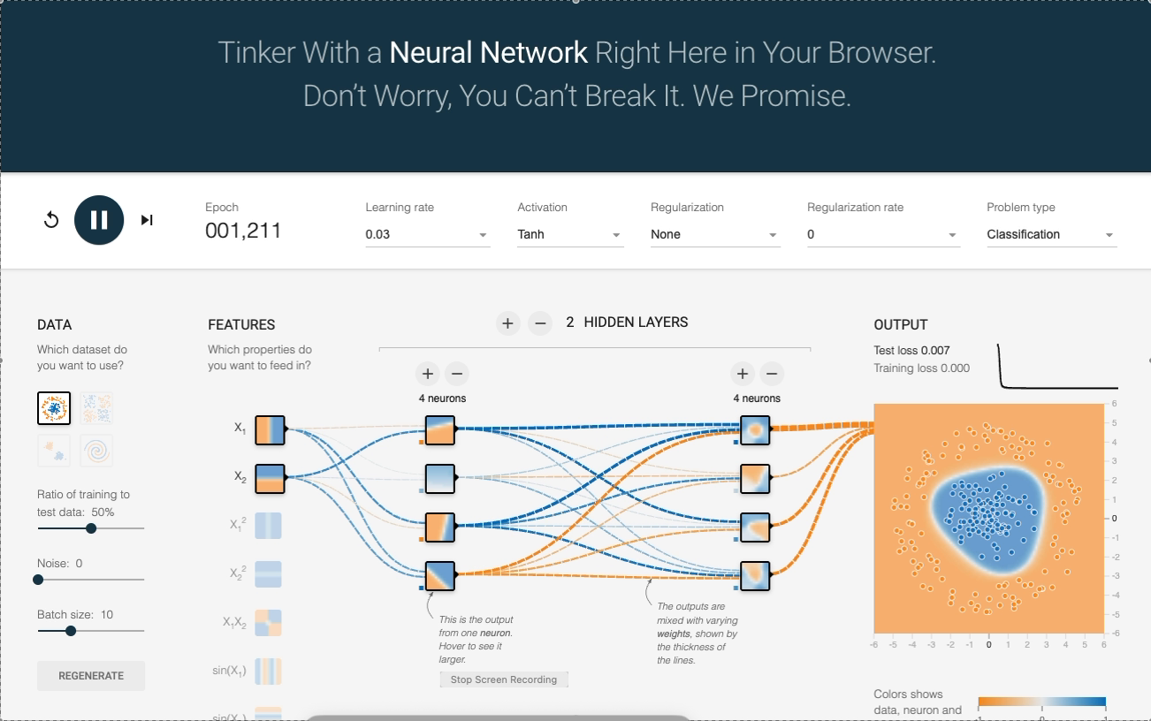
Experiment 5: Switching to the Circle Dataset
The dataset was changed from XOR to Circle; the network retained two hidden layers with four neurons each.
Recorded settings
Dataset: Circle (classification)
Noise: 0
Features: x₁, x₂
Hidden layers: 2 × 4 neurons each
Learning rate: 0.03 | Activation: Tanh
Observed metrics
Epoch shown: 1,192
Training Loss: 0.000
Test Loss: 0.007
What the result suggests
Key takeaway
The output visualization shows a circular decision region: one class is concentrated near the center and the other surrounds it. The displayed losses were both low.
A different dataset requires a different decision-boundary shape. The two-hidden-layer network represented the circular pattern successfully in this recorded run.
11

Slide 12
Results Comparison: All Five Experiments
Values are transcribed from the final visible state in each supplied recording.
Experiment
Main change
Epoch shown
Training Loss
Test Loss
1. Baseline
XOR, 1 layer × 4
1,868
0.064
0.190
2. Noise
Noise = 30
1,870
0.075
0.210
3. Feature
Add x₁x₂
1,497
0.000
0.001
4. Depth
2 layers × 4
1,149
0.000
0.007
5. Circle
Circle dataset
1,192
0.000
0.007
Lowest displayed Test Loss: Experiment 3 (0.001). Highest displayed Test Loss: Experiment 2 (0.210). Experiments 4 and 5 both showed Test Loss = 0.007.
12

Slide 13
What the Five Experiments Tell Us
The results connect model settings to decision boundaries and generalization.
Noise matters
Features matter
Depth is not always better
Experiment 2 had higher Training and Test Loss than the baseline. Noise can obscure the pattern and make classification harder.
Adding x₁x₂ in Experiment 3 coincided with a large improvement in the displayed loss. Feature representation can be as important as network size.
Experiment 4 used more layers but its Test Loss (0.007) was higher than Experiment 3 (0.001). Greater complexity is not a guarantee of better generalization.
Decision-boundary observations
• Baseline XOR: the output boundary was still imperfect at the captured point.
• Noisy XOR: class regions were less clean and the recorded losses were higher.
• Feature-augmented XOR: the output formed a clear four-quadrant pattern.
• Circle: the model learned a central region surrounded by the other class.
Interpretation is limited to the settings and moments visible in the recordings; repeated trials may produce slightly different values.
13

Slide 14
How to Interpret the Results Carefully
A good experiment report distinguishes what the recording shows from what it does not show.
What the recordings directly show
What cannot be concluded exactly
• Dataset and selected features
• Noise slider setting
• Hidden-layer and neuron counts
• Epoch counter at capture
• Training Loss and Test Loss at capture
• Actual wall-clock training duration
• That one run proves a universal rule
• That lower training loss always means better generalization
• Exact causality when multiple settings differ
Important note about epoch counts
The displayed epoch counters differ (1,149–1,870), but the videos may have been stopped at different times. Therefore, this presentation reports the visible epoch values rather than claiming that one configuration trained faster in real time.
For a strict speed comparison, run each configuration for the same number of epochs and measure elapsed time under the same conditions.
14

Slide 15
SUMMARY | KEY TAKEAWAYS
Visualizing a neural network makes learning easier to understand.
Structure
Learning
Experiment insight
Layers organize processing. Neurons compute values, and weights control the strength of connections.
Tanh adds non-linearity. Loss measures error, and optimization updates the network’s parameters.
Useful features can improve learning. Noise can make it harder. More layers do not always improve test results.
The most important lesson from these experiments is that model performance depends on the relationship between the data, its features, and the network architecture—not simply on making a network larger.
A neural network is not a black box: its behavior can be explored by changing one component at a time and observing the result.
15

Slide 16
Evidence & Reflection Notes
The five supplied recordings are the primary evidence for this report.
Evidence included
Reference
One captured Playground screen from each recording is embedded on its corresponding experiment slide. The screenshots show settings, network structure, output map and loss values.
TensorFlow Neural Network Playground
https://playground.tensorflow.org/
Interactive tool used to conduct the five experiments.
Personal Reflection
Using TensorFlow Neural Network Playground helped me understand how a neural network learns patterns from data. By changing noise, input features, hidden layers and dataset type, I could see how the decision boundary and loss values changed. The most surprising result was that adding the x₁x₂ feature greatly reduced the loss in the XOR experiment, while adding another hidden layer did not improve the test loss further. This activity showed me that choosing meaningful features and matching the model to the data are important parts of machine learning.
16

