Slide 1
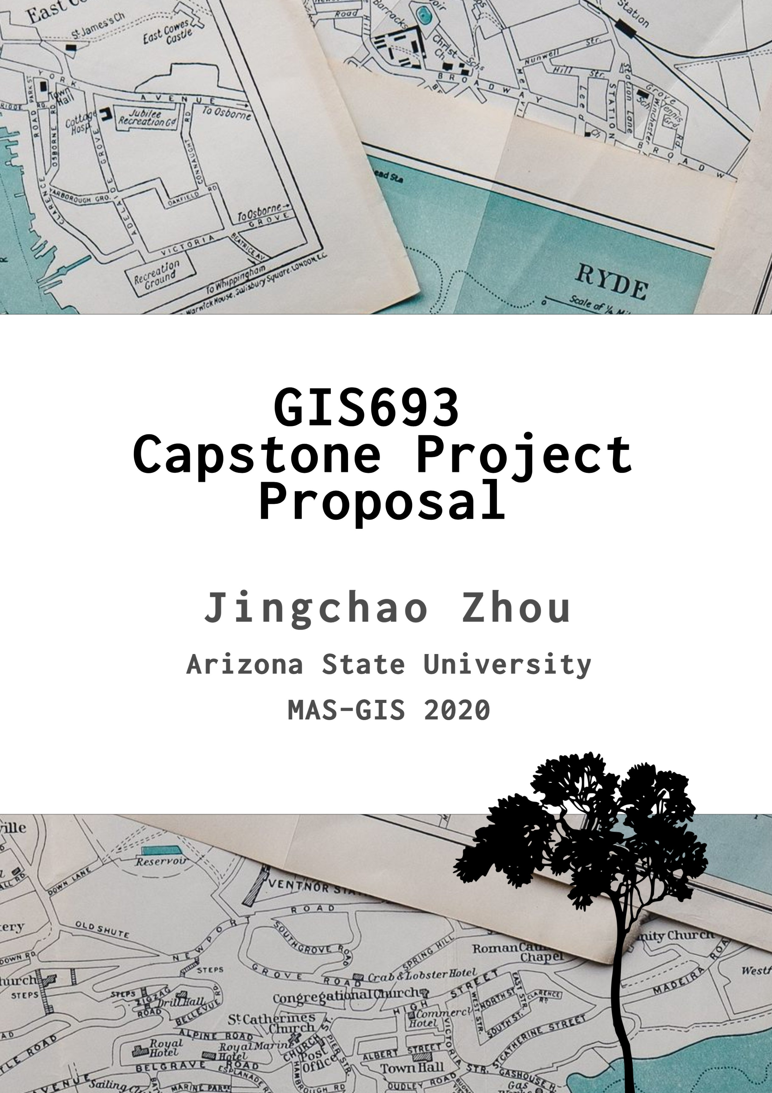
Data Update and Manipulation on a Web Application for finding the shortest feasible route for Alternative Fueling Vehicles

Slide 2
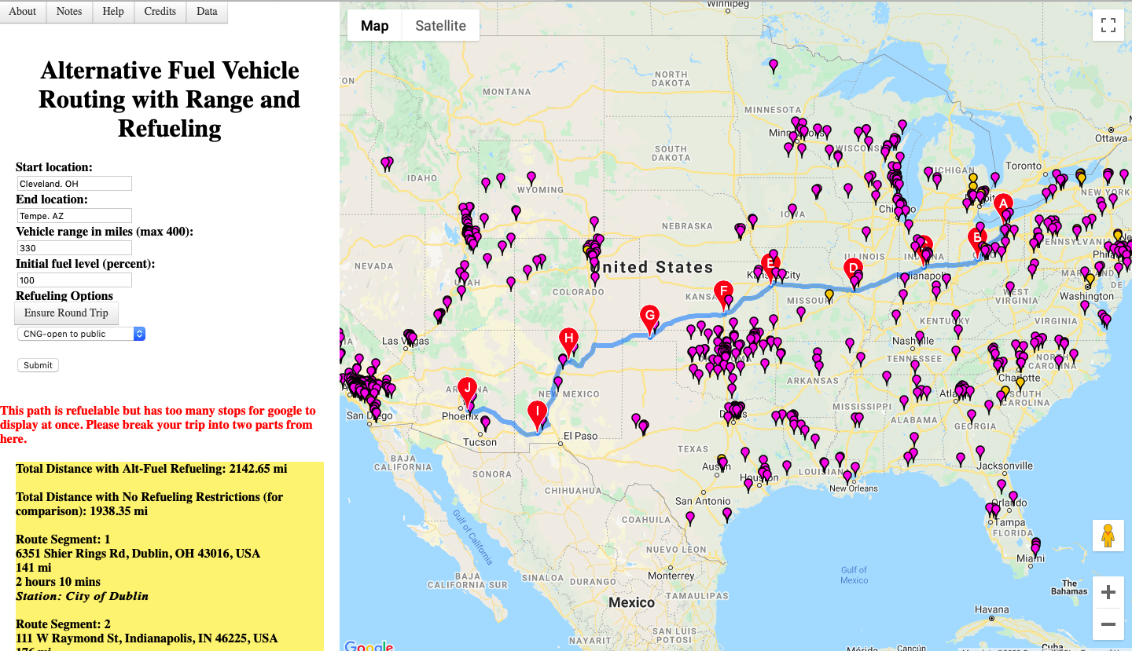
Background

Slide 3
Purpose
Update the data from 2014-2020
Learning more about programming and RDBMS
Apply a new programming language and SQL in a Real-world project

Slide 4
Challenges
Google API needs certain credits and it is not free.
Understanding the previous work in the project.

Slide 5
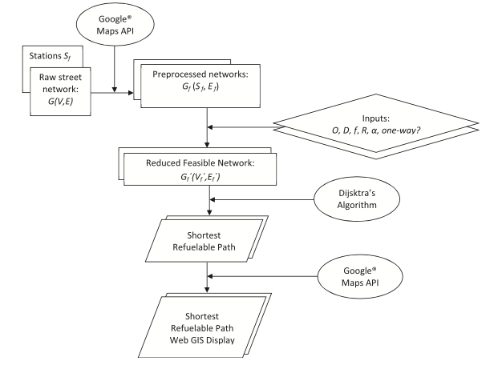
Methodology
Data Collection and Analysis
Data Manipulation
User Interface Improvement
Optional Works

Slide 6
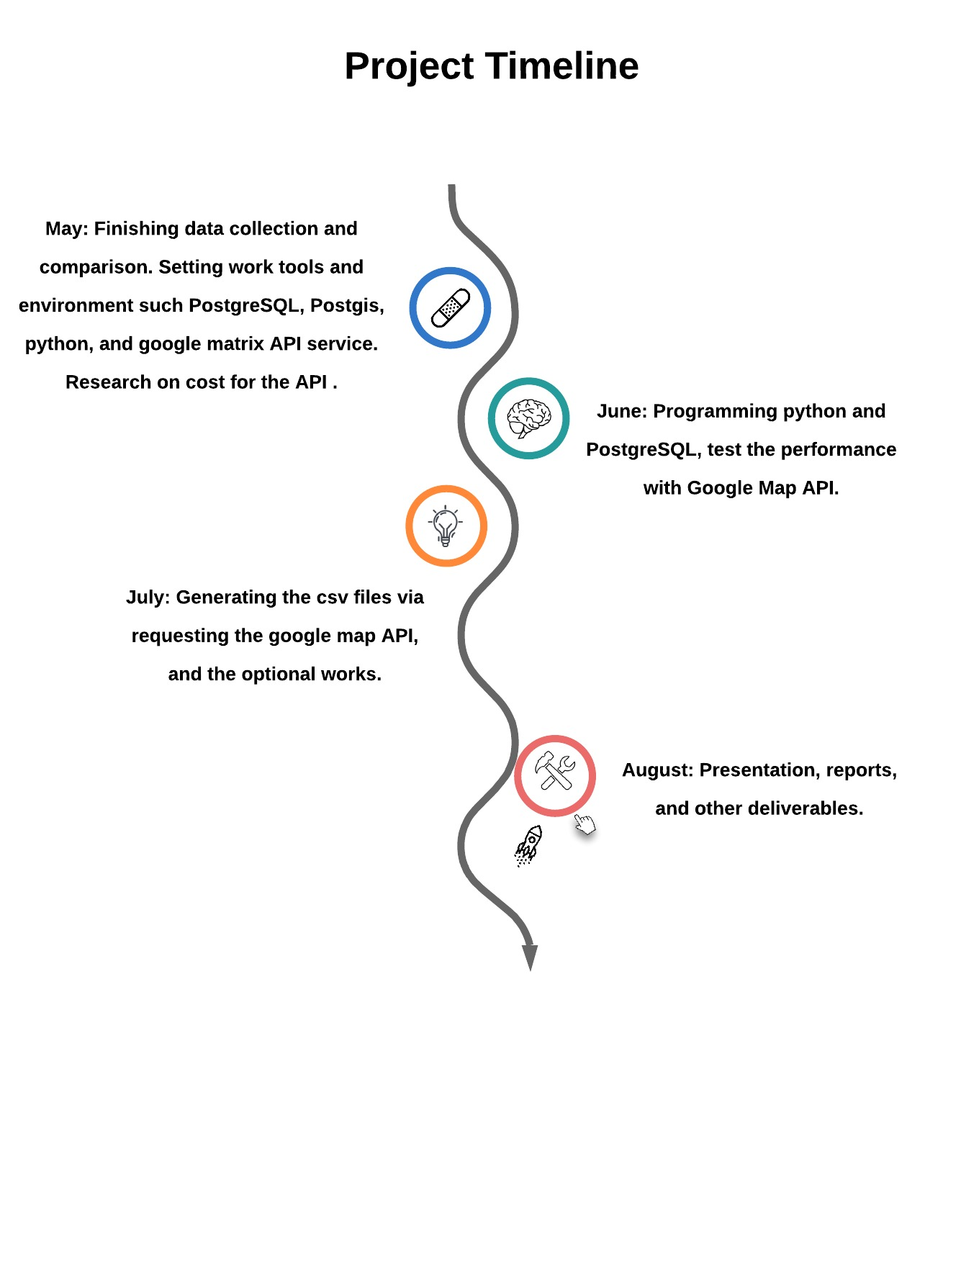
Timeline

Slide 7
Deliverables
Content | Memo
Collection of current Updated data of the CNG and Hydrogen Station in 2020 | From the website https://afdc.energy.gov
Using google map API to pre-generate the shortest distance between all pairs of the nodes of the stations. | .csv file
Python code and SQL query documents. | .py and .txt files
A repository on GitHub. | Potential future collaborative work
Screen shot of test results. | Two tests for long and short distances.
Web Application. | Prototype for finding shortest feasible route. www.afvrouting.com Tweak the web user interface to be responsive and mobile friendly using Bootstrap.
Report | In MLA format, with instructions and test results for each distance tool.
Presentation | August before graduation

