Slide 1
J
W
studio

Slide 2
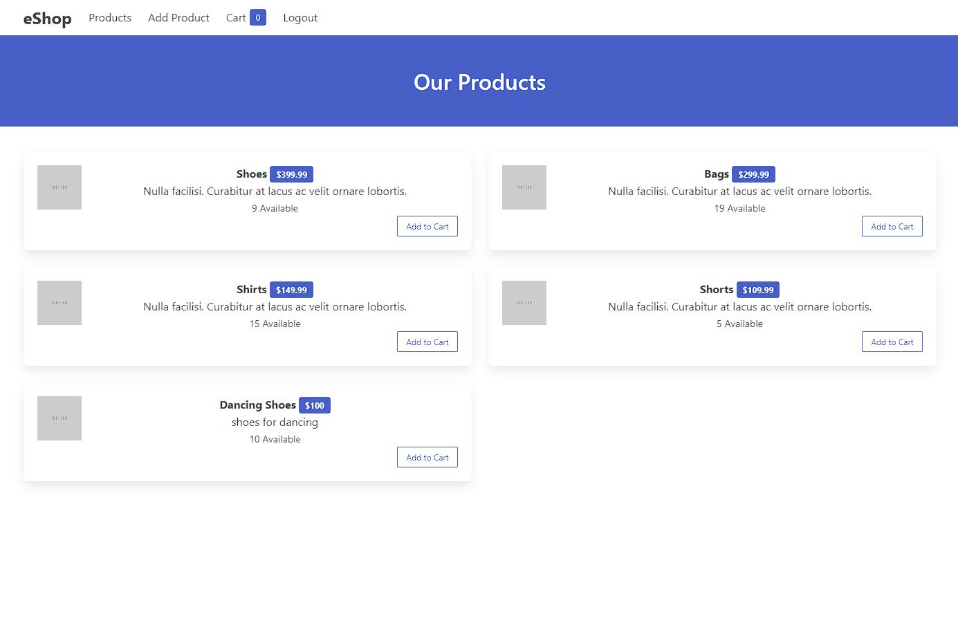

Slide 3
