Slide 1
CS513 Homework 2 Presentation
Probe Data Analysis for Road Slope
Mengzhao Cai A20405372
Jingcheng Deng A20411512
Tianran Chen A20396751

Slide 2
1. Introduction
We are given two .csv files, with one of them contains probe points that collected by devices and another contains data of road links.
Our goal is to match those probe points to road links to correct errors from probe data, derive road slope for each link, and evaluate the derived road slope with the surveyed road slope in the link data.

Slide 3
2. Implement Details
Part 1. Map Matching
In this part we need to correct the errors that probe data might have by matching probe point to the apposite link.
In order to reach the goal we first need to clean up the data, and filter out the data that we don’t need.

Slide 4
2. Implement Details
For ProbePoints we need:
Sample ID
Latitude
Longitude
Altitude
For LinkData we need:
LinkPVID
ShapeInfo
SlopeInfo
Reference node
Non reference node

Slide 5
2. Implement Details
We project each probe point to every link, and calculate the distance between probe and projection point. For points cannot project on link (projection is outside from link), we use either reference or non reference point as projection point whichever is closer to probe point.
We noticed that since our Earth is a sphere, we shouldn’t ignore the radian of it when calculating the distance, so we roughly regard it as a ball with a radius of 6373km, and calculate the distance with Euclidean approach.

Slide 6
2. Implement Details
We record all candidate probe point and link pairs which the distance is less than 20 meters. After that we calculate the weight of matched links by average the weight from previous and post 5 probe points. If the previous and post probes are matched in same link, but the weight suggest a different link for this single node, we consider this as an error in probe data, so that we add a dummy value to weight of correct link in order to force the probe match the correct link.

Slide 7
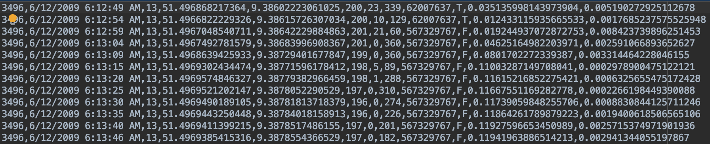
2. Implement Details
We format our output file matchedpoint follow the structure mentioned in read me file.
To calculate directions, we filter out data by link number and then calculate whether post points leaving or approaching reference point.
Part of result of matched point:

Slide 8
2. Implement Details
Part 2. Calculate Slope
We first filter our data by matched linkID number. We notice that every link should have altitude and we should not ignore it when calculating slope. But most of the slope info in linkData is missing, so that we decide to use the difference of altitude from two neighboring probe point divide difference of distance to reference point, to get the sine value of slope. After that we calculate the radiance of slope and convert it to degrees. We shape our output data same way as the linkData (dist/slope|dist/slope)

Slide 9
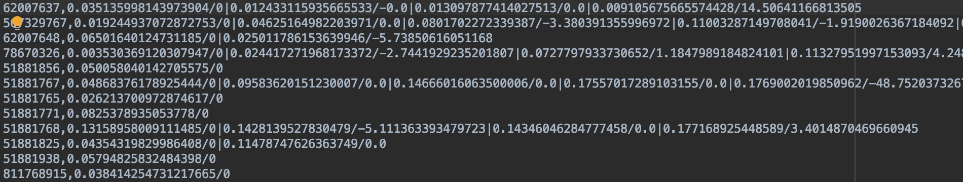
2. Implement Details
Part of output data in slope.csv
We noticed that some of data have extreme sine value (greater than 1 or less than -1), and cannot be calculate into degrees. We believe it is due to high altitude change in very small distance change. We conclude these data cause by error of probe device or high curvature of link(circle entrance of an bridge).

Slide 10
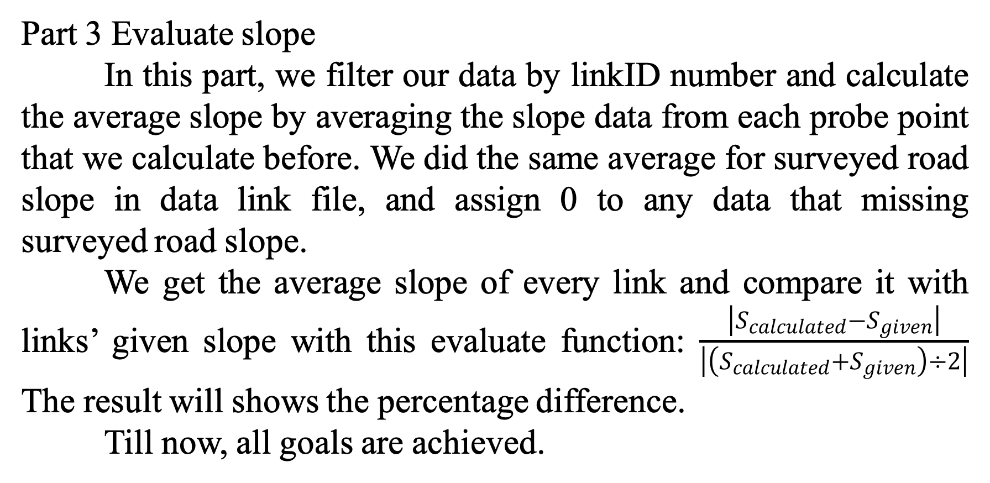
2. Implement Details
Part 3 Evaluate slope
In this part, we filter our data by linkID number and calculate the average slope by averaging the slope data from each probe point that we calculate before. We did the same average for surveyed road slope in data link file, and assign 0 to any data that missing surveyed road slope.
We get the average slope of every link and compare it with links’ given slope with this evaluate function: $\frac{\left|S_{calculated}−S_{given}\right|}{\left|\left(S_{calculated}+S_{given}\right)÷2\right|}$ The result will shows the percentage difference.
Till now, all goals are achieved.

Slide 11
3. Conclusion and Thoughts
In conclusion, we have all the requirements done with our method. Though there still have many place can be done in a more efficient way, due to the limitation of time, we just stop now.
In fact, we have a more accurate approach to match those points by calculating the weight from all related sequence of points, but it is hard to implement, with more calculations and data to be stored in different data structure. We also don’t have enough compute power to process all 3 millions data, so we process the first 10 thousand and then we stop.

Slide 12
3. Conclusion and
Thoughts
We also met many difficulties while computing slopes. There are many kind of links, some of them are not just a straight way, they might be a circle goes down from highway, with two nodes very close in latitude and longitude but 5 meters away from altitude. This makes it a pretty large sine number. We try to find out a way deal with it, but for now the best we can do is to assign dummy value to those points.
Though our work is not so perfect, we were still very happy to play with these data and achieve every requirements of this homework. Our knowledges that learnt from class were enhanced, and implement experiences are achieved.

Slide 13
That’s all, thank you!

