Slide 1
CS513 Homework 2 Presentation
Probe Data Analysis for Road Slope
Mengzhao Cai A20405372
Jingcheng Deng A20411512
Tianran Chen A20396751

Slide 2
1. Introduction
We are given two .csv files, with one of them contains probe points that collected by devices and another contains data of road links.
Our goal is to match those probe points to road links, derive road slope for each link, and evaluate the derived road slope with the surveyed road slope in the link data.

Slide 3
2. Implement Details
First, we dealed with data reading and preprocessing.
As both input are stored by .csv files, we first read it out, then extract the useful data and store them with proper data structure for further using.
For linkData, we extracted latitude and longitude for both reference node and non reference node of each link. For probeData, we extracted latitude and longitude of each
probe point at first.

Slide 4
2. Implement Details
Second, we used those data that was extracted to calculate and match probe point to links. For each probe point, we simply projected it to all links, and calculated the distance between probe point and links, then matched the point with the closest link.
We noticed that since our Earth is a sphere, we shouldn’t ignore the radian of it when calculating the distance, so we roughly regard it as a ball with a radius of 6373, and calculate the distance with Euclidean approach.

Slide 5
2. Implement Details
Third, we calculate the slope of each link with matched probe points’ data. We use the two furthest probe points’ coordination on each link to calculate it’s overall slope. The angle calculate is simple, done with sin function.
We noticed that there has some links which contains a strange data, such as the side road of the bridge. We added a threshold for ignoring that data since it is hard to process them.

Slide 6
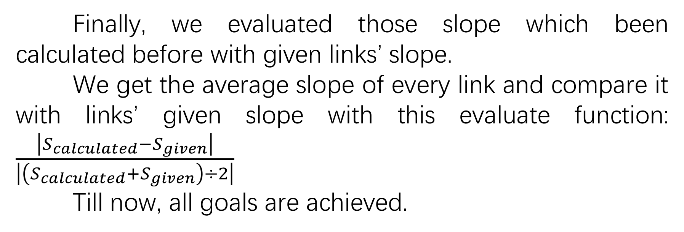
2. Implement Details
Finally, we evaluated those slope which been calculated before with given links’ slope.
We get the average slope of every link and compare it with links’ given slope with this evaluate function: $\frac{\left|S_{calculated}−S_{given}\right|}{\left|\left(S_{calculated}+S_{given}\right)÷2\right|}$
Till now, all goals are achieved.

Slide 7
3. Conclusion and
Thoughts
In conclusion, we have all the requirements done with our method. Though there still have many place can be optimized, due to the limitation of time, we just stop now.
In fact, we have a more accurate approach to match those points, but it is hard to implement, with more calculations and data to be stored in different data structure. It is also hard to compute since that approach has a really high time complexity and thus we give up from it.

Slide 8
3. Conclusion and
Thoughts
We also met many difficulties while computing slopes. There are many kind of links, some of them are not just a straight way, they might be a circle goes down from highway, with two nodes very close in latitude and longitude but 5 meters away from altitude. This makes it a pretty large sin number. We try to find out a way deal with it, but we didn’t get any idea and can only ignore them.
Though our work is not so perfect, we were still very happy to play with these data and this homework. Our knowledges that learnt from class were enhanced, and implement experiences are achieved.

Slide 9
That’s all, thank you!

