Slide 1
CS513 Homework 3 Presentation
Satellite/Aerial Image Retrieval
Mengzhao Cai A20405372
Jingcheng Deng A20411512
Tianran Chen A20396751

Slide 2
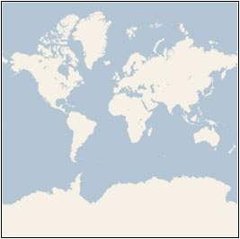
1. Introduction
The purpose of this project is to get aerial imagery (maximum resolution) by using Bing maps tile system with given latitude and longitude.
Bing Maps tile system provides a world map that use the Mercator projection which users can directly manipulate to pan and zoom .

Slide 3
2. Mercator projection
The Mercator projection characteristic：
It’s a conformal projection, which means that it preserves the shape of relatively small objects. This is especially important when showing aerial imagery, because we want to avoid distorting the shape of buildings. Square buildings should appear square, not rectangular.
It’s a cylindrical projection, which means that north and south are always straight up and down, and west and east are always straight left and right.

Slide 4
3. Implement Details
First step:
Since the Bing map tile system only take spherical Mercator projection coordinates instead of latitude and longitude. So we need to use ground resolution equation to convert the input latitude and longitude into Mercator projection.

Slide 5
3. Implement Details
Second Step:
After that we set the origin of a set of tiles, and then calculate the zoom level.
Third Step:
We convert tile XY coordinates into quadkeys, and then request tile from Bing Map Imagery Service.

Slide 6
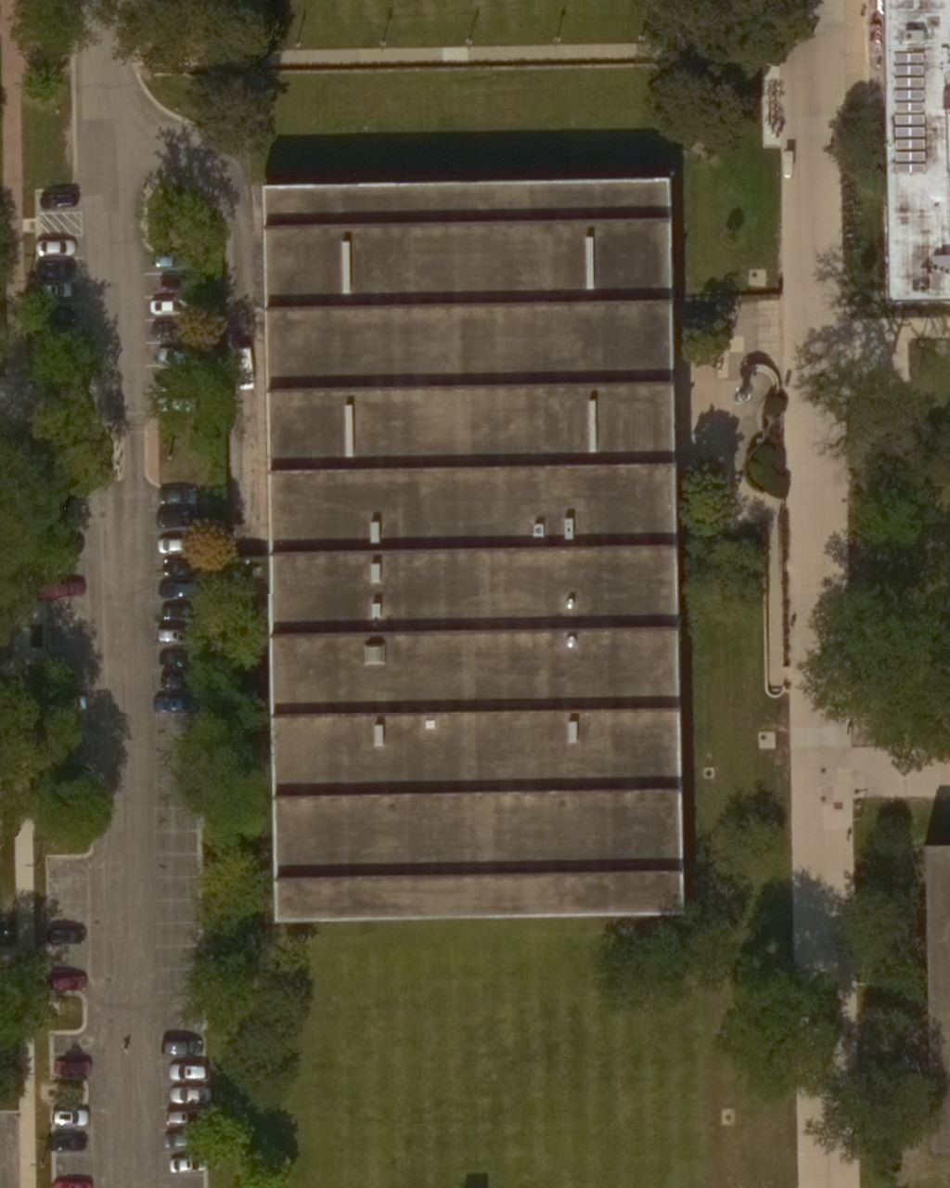
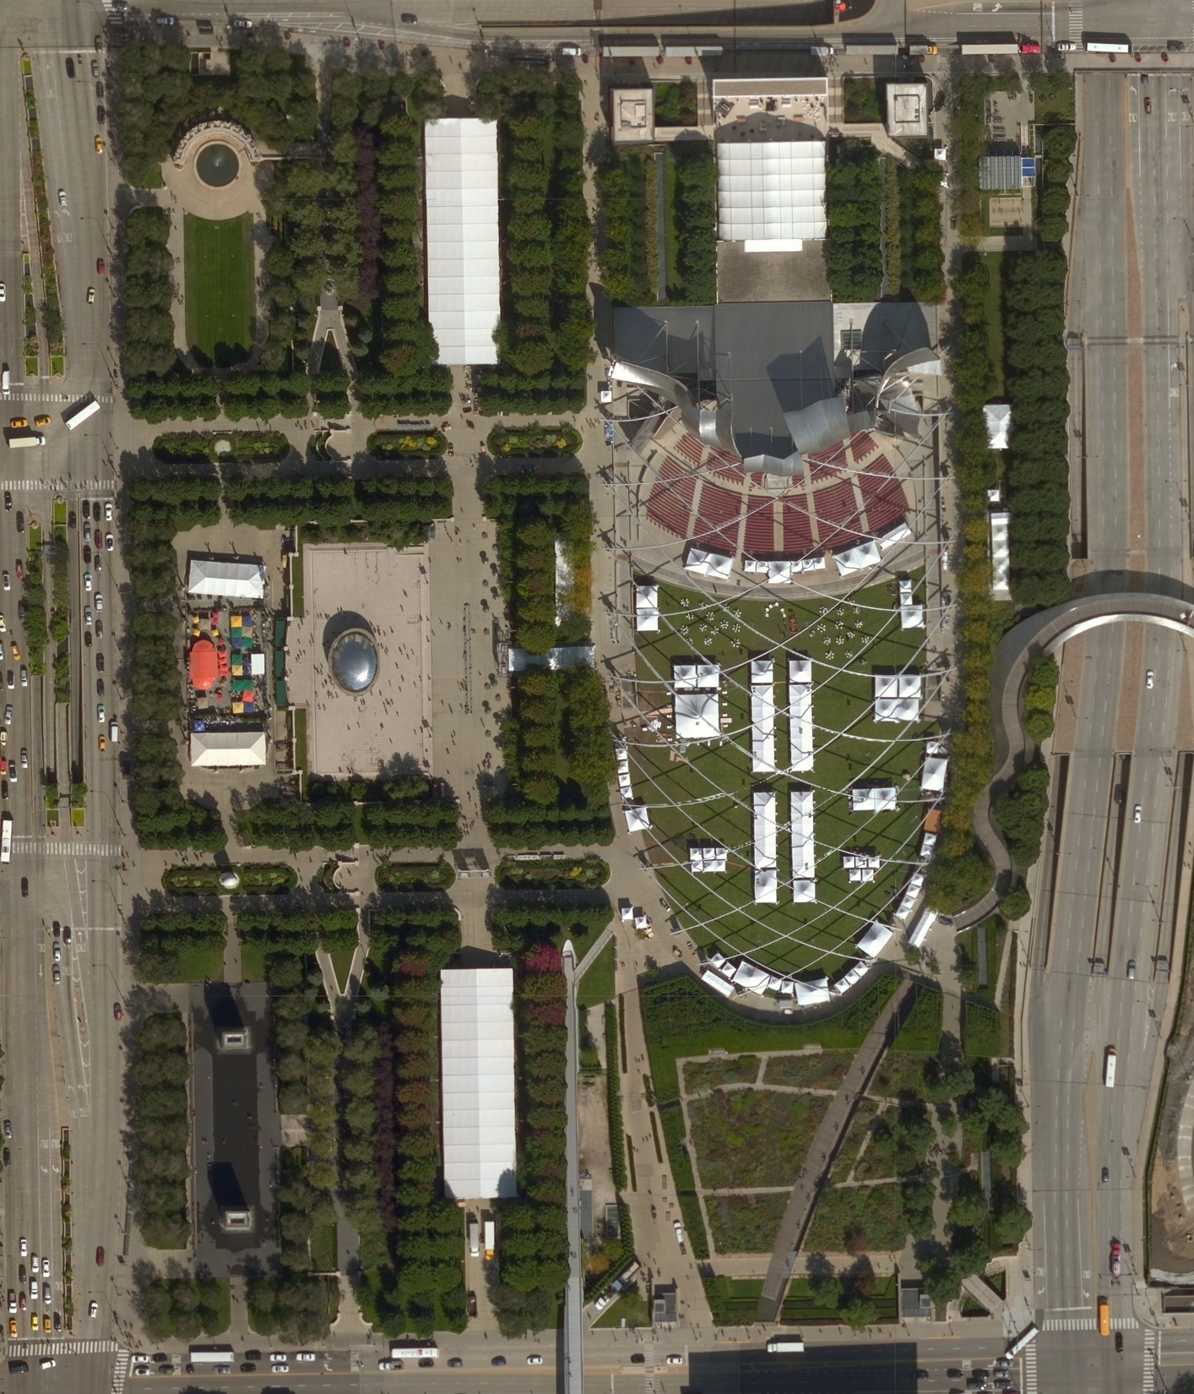
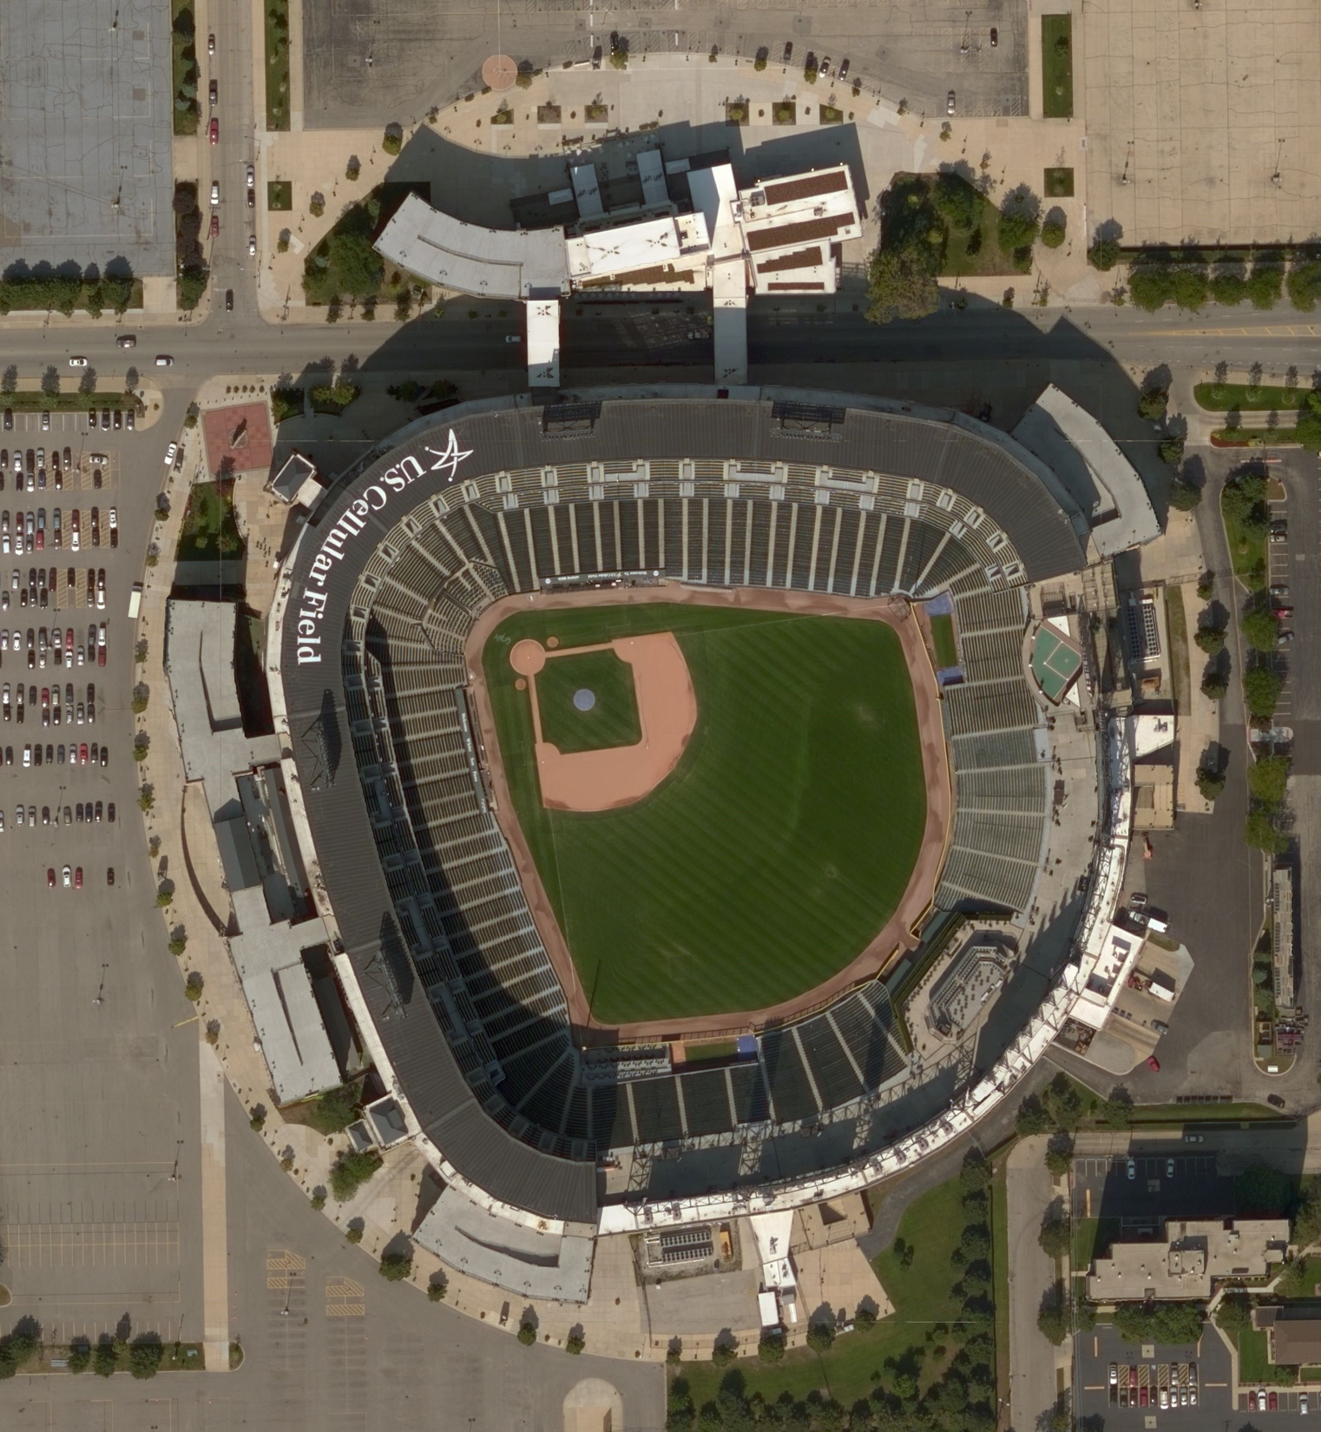
3. Results
We finally merge all tile that we got to generate result image.
Galvin Library
Millennium Park
White Sox

Slide 7
4. Conclusion and Thoughts

Slide 8
That’s all, thank you!

