Slide 1
CS513 Homework 3 Presentation
Satellite/Aerial Image Retrieval
Mengzhao Cai A20405372
Jingcheng Deng A20411512
Tianran Chen A20396751

Slide 2
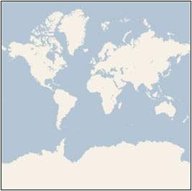
1. Introduction
The purpose of this project is to get aerial imagery (maximum resolution) by using Bing maps tile system with given latitude and longitude.
Bing Maps tile system provides a world map that use the Mercator projection which users can directly manipulate to pan and zoom .

Slide 3
2. Mercator projection
The Mercator projection characteristic：
It’s a conformal projection, which means that it preserves the shape of relatively small objects. This is especially important when showing aerial imagery, because we want to avoid distorting the shape of buildings. Square buildings should appear square, not rectangular.
It’s a cylindrical projection, which means that north and south are always straight up and down, and west and east are always straight left and right.

Slide 4
3. Implement Details
First step:
Since the Bing map tile system only take spherical Mercator projection coordinates instead of latitude and longitude. So we need to use Mercator projection to convert the input latitude and longitude into X Y coordinates.
We first get the center coordinate of the input area and request several times until max zoom is get.
Zoom is like ‘level’, a larger zoom means a higher resolution, so we need to seek for the maximum of the zoom.

Slide 5
3. Implement Details
Second Step:
After that we use the maximum zoom we get from previous step to divide the whole image request into small blocks.
Third Step:
For every block, we calculate their quadKey and request their images one by one.
Final Step:
We merge all the images we get from third step together and get the result image.

Slide 6
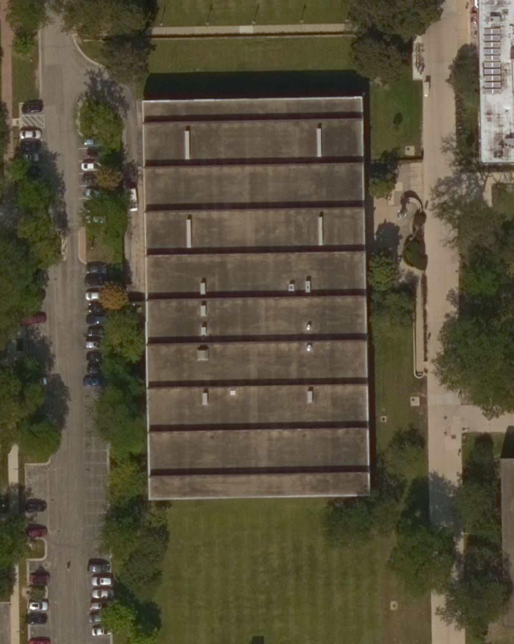
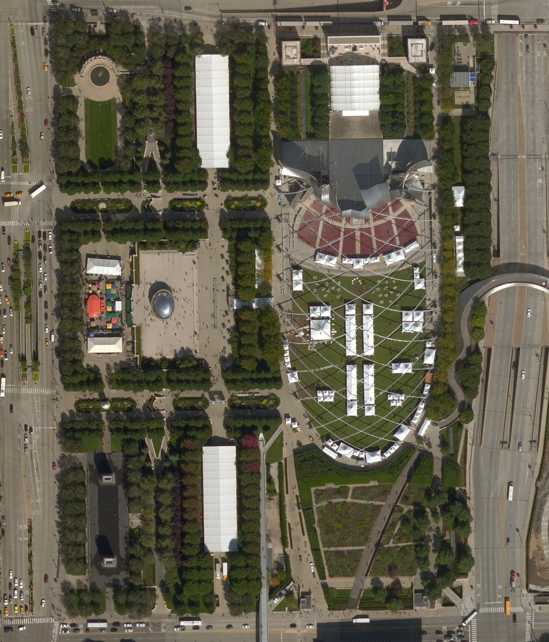
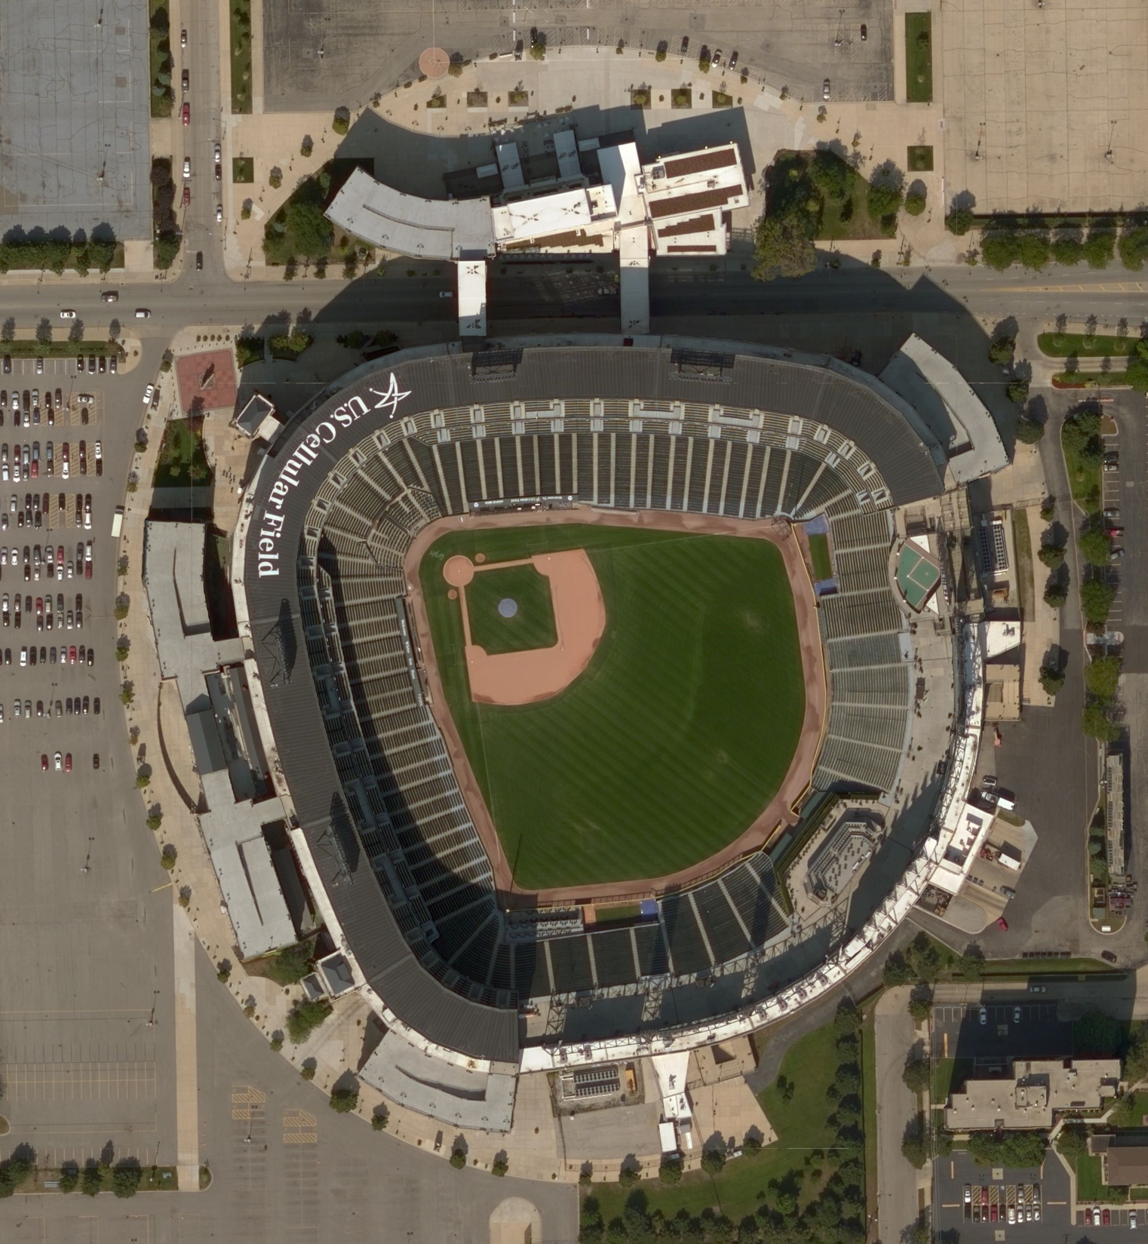
3. Results
We finally merge all tile that we got to generate result image.
Galvin Library
Millennium Park
White Sox

Slide 7
4. Conclusion and Thoughts
In this homework, we learnt a lot about Bing map’s api. We met questions on how to request, how to calculate quadKey, and how to get information from it. It took us long time solving these questions. We also have a greater understanding about the Spherical Mercator projection. This coordinate system is quite useful and interesting that differs from latitude longitude system.
From this homework, we enhanced our knowledges learnt from class, performed a great group work, and improved our coding skills. We believe that we are now prepared for further studying and the final project.

Slide 8
That’s all, thank you!

