Slide 1
CS513 Project Presentation
Point Cloud Lane Marking
Mengzhao Cai A20405372
Jingcheng Deng A20411512
Tianran Chen A20396751

Slide 2
1. Introduction
The purpose of this project is to detect objects by using point cloud data. Our project focusing on detect lane mark on road surface.
We have using data processing technics and a supervised learning model to predict if data belongs to lane mark, our program works with both given data set and other data sets.

Slide 3
2. Point Cloud
Point clouds are usually created by 3D scanners, is a set of data points intended to represent the external surface of an object.
A 3D scanner is a device that analyses a real-world object or environment to collect data on its shape and possibly its appearance (e.g. colour). The collected data can then be used to construct digital three-dimensional models.
3D scanners like LIDAR are used to detect the point cloud data like intensity .
In our case we have a point cloud file with 4,30,736 point defined as
[latitude] [longitude] [altitude] [intensity]
45.90388 11.028413 232.4648 10
45.90368 11.028220 234.4706 5

Slide 4
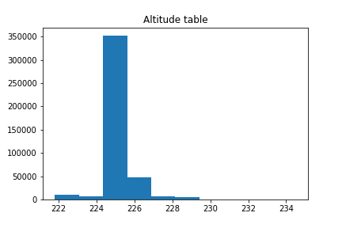
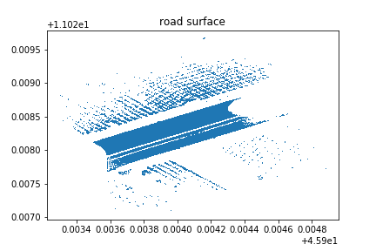
3. Implement Details
The first step is to preprocessing data, the dataset contains points in different altitudes, but the data we need is near road surface. After experience with the data set we found that most of the points are near road surface, so that we set up an altitude filter to get a clear input for our program.

Slide 5
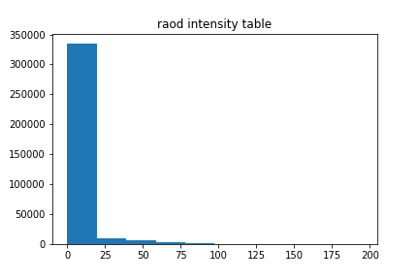
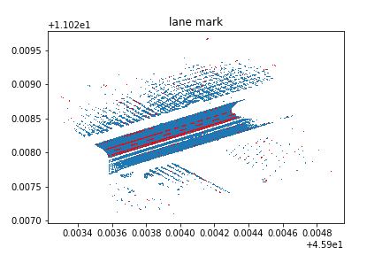
3. Implement Details
The key charterers that separate lane mark from others is the intensity, we found that lane mark has higher intensity than other part of road, so that we filter out points with high intensity and create a first view of the lane marking graph.

Slide 6
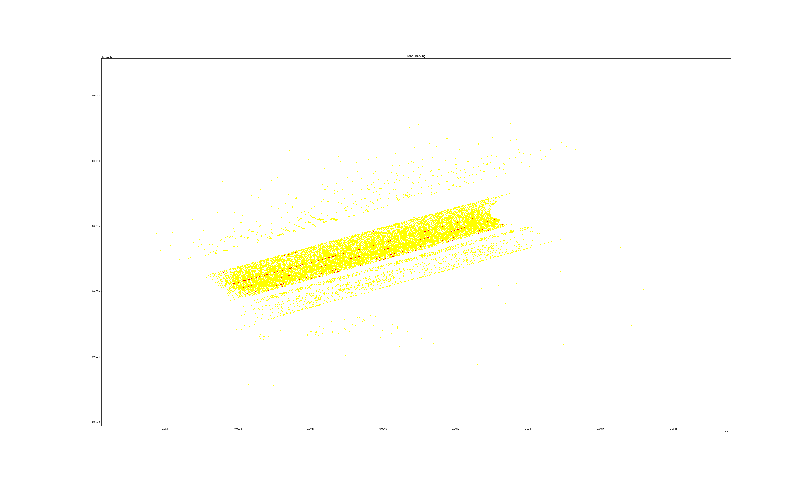
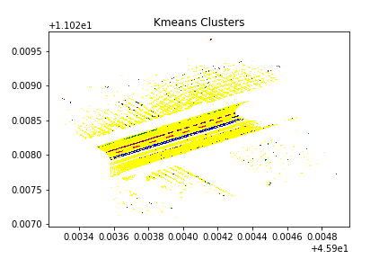
3. Implement Details
We apply Kmeans clustering to our marked lane points, and the model suggest 4 clusters, after apply RANSACR algorithm to each set of clusters, we have filter out outliers and generate a shape of lane on the road. By visualizing the data, the graph shows a clear shape of Lane mark.

Slide 7
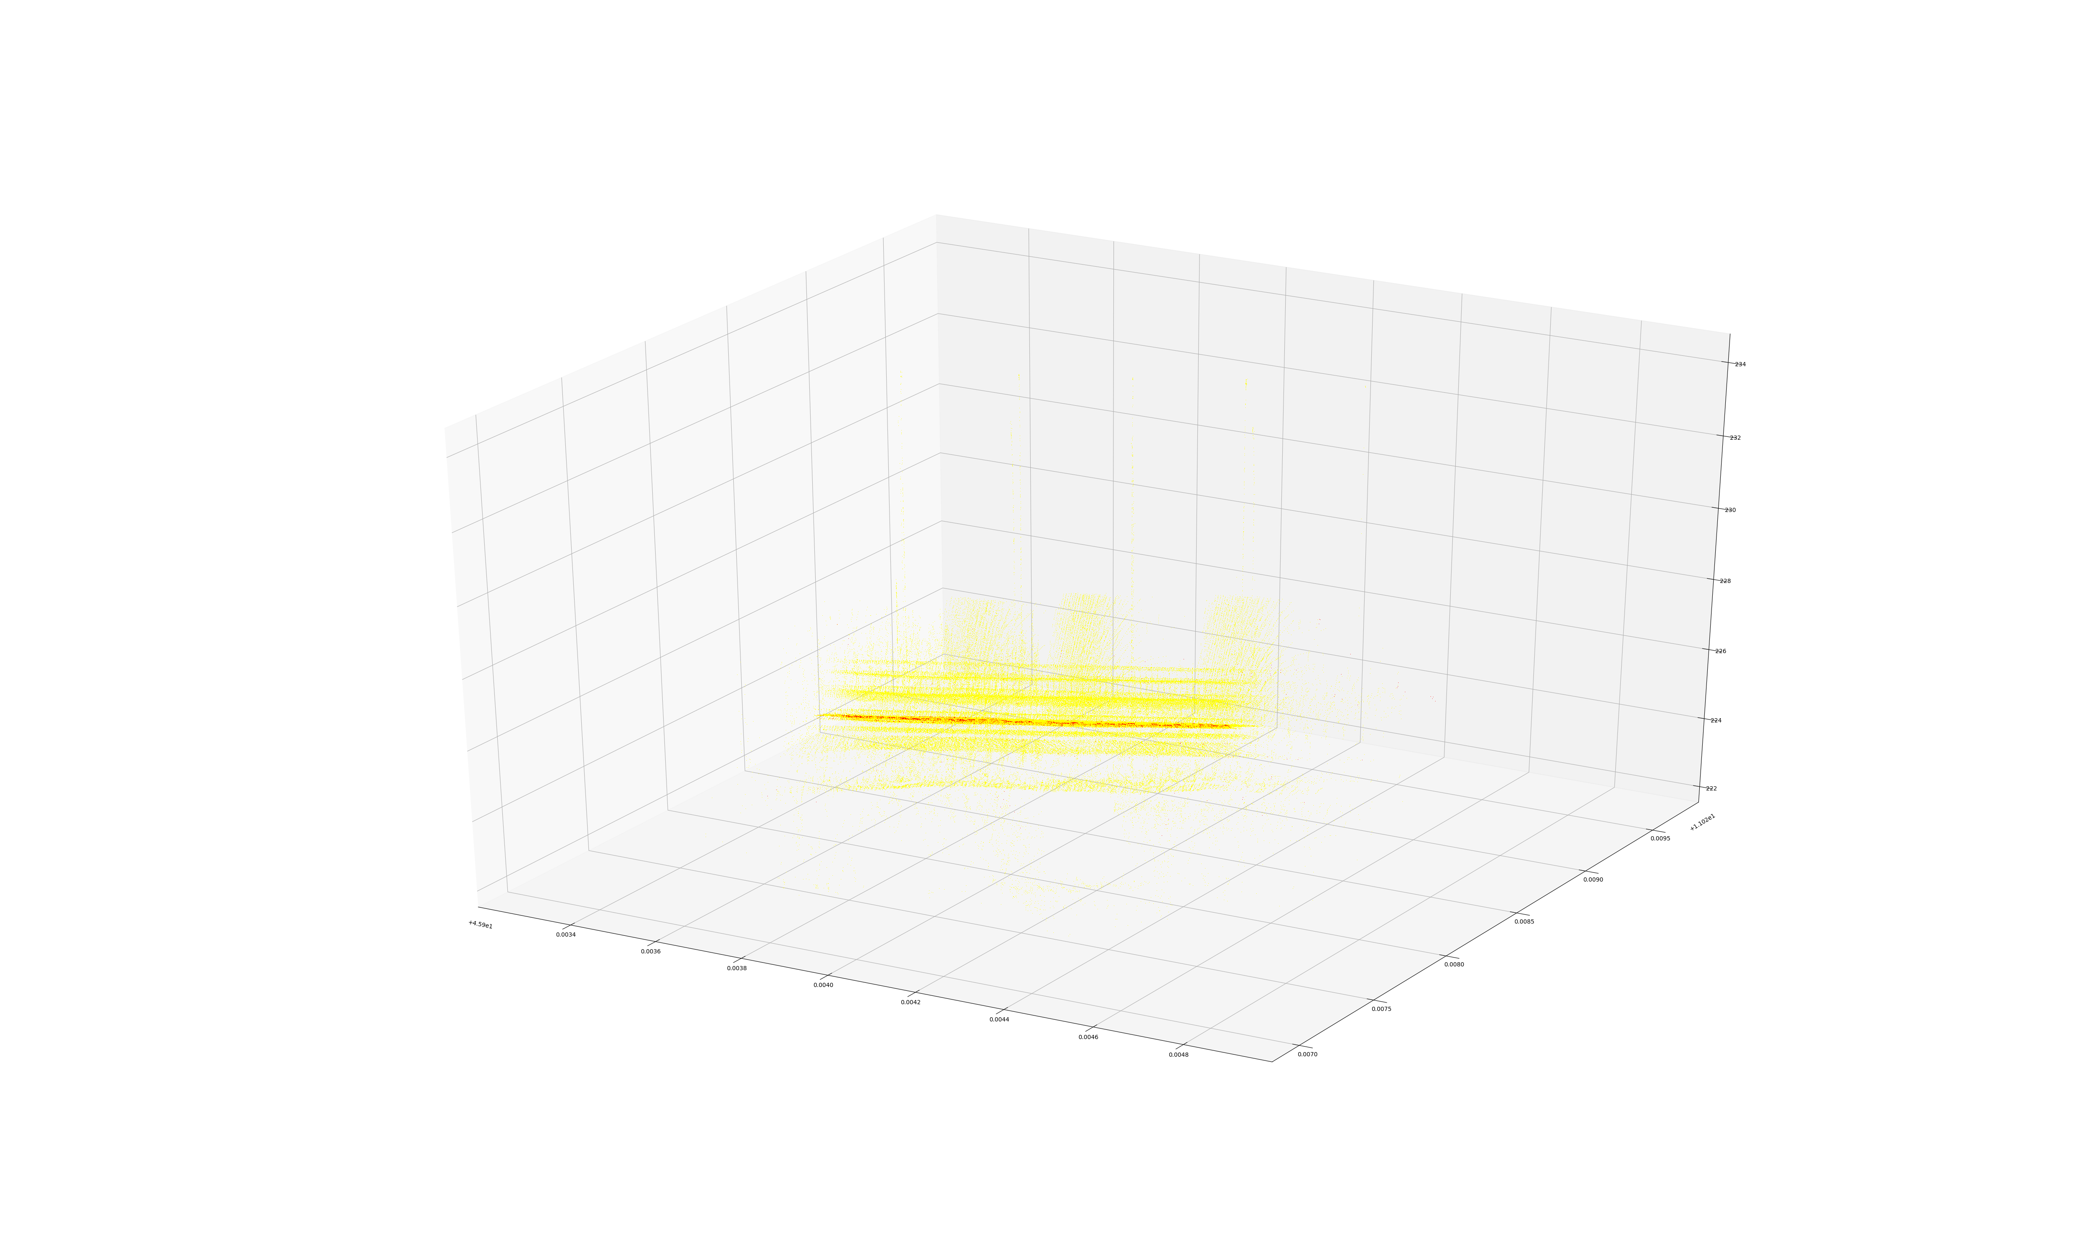
3. Implement Details
2D and 3D intermediate result

Slide 8
3. Implement Details
In order to let our program predict lane mark for any input data, we split our data set into 2/3 training data and 1/3 testing data. We use the training data to train a SVC model, then predict and evaluate the testing set.
F1 = (2* precision *recall) / (precision + recall)
Our model generate the f1 = 0.988476
It proves the performance of our model is very high, as result it can handle any given input data and successfully mark lane on road surface.
0.988476

Slide 9
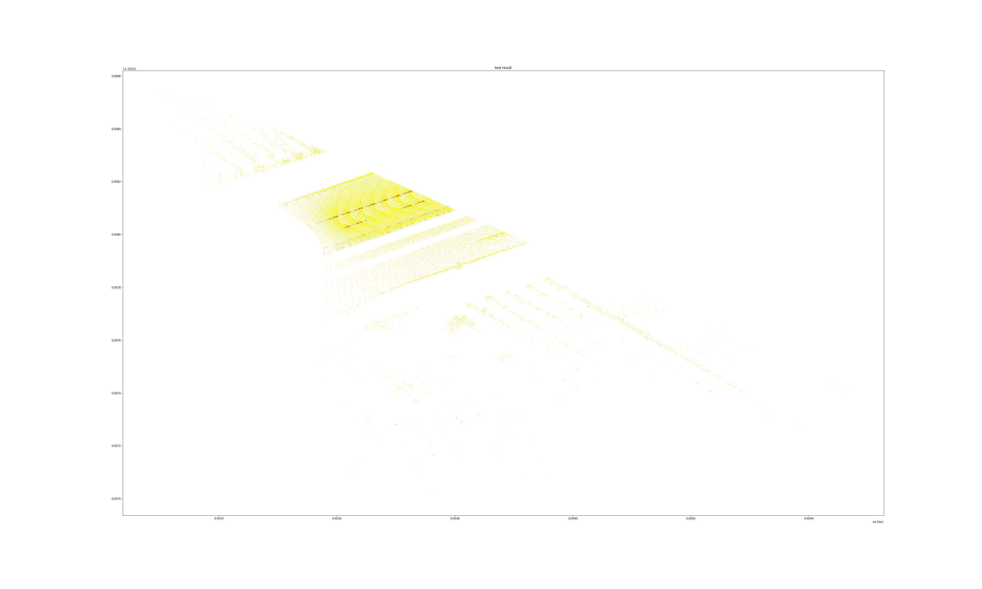
3. Results
The result shows clear and sharp marked lane on testing data.

Slide 10
That’s all, thank you!

