Slide 1
CS513 Project Presentation
Object Detection in Point Cloud: Lane Marking
Mengzhao Cai A20405372
Jingcheng Deng A20411512
Tianran Chen A20396751

Slide 2
1. Introduction
The purpose of this project is to detect objects from point cloud data. Our project focus on detecting lane mark on road surface, and we trained a model that will automatically detect lane mark with other point cloud data input.
Several machine learning technics are used in our project to predict if data belongs to lane mark, such as Kmeans clustering, RANSAC model fitting and Support Vector Machine model, our program can work on both given data set and other data sets.
We first process the data to get those lane mark points, then label all points and use them as training data to train a model for general approach.

Slide 3
2. Point Cloud
Point clouds are usually created by 3D scanners, and are a set of data points intended to represent the external surface of an object.
A 3D scanner is a device that analyses a real-world object or environment to collect data on its shape and possibly its appearance (e.g. color). The collected data can then be used to construct digital three-dimensional models.
3D scanners like LIDAR are used to detect the point cloud data like intensity .
In our case, we have a point cloud file with 430736 point given as
[latitude] [longitude] [altitude] [intensity]
45.90388 11.028413 232.4648 10
45.90368 11.028220 234.4706 5

Slide 4
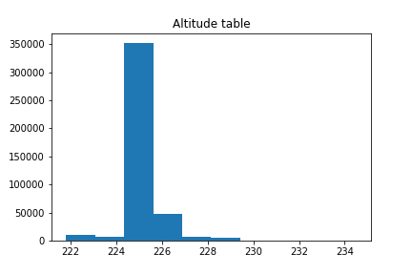
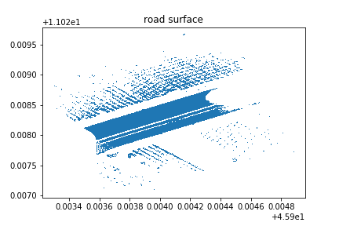
3. Implement Details
The first step is to preprocess the data, the dataset contains points in different altitudes, but the lane mark we need will just appear on those point that near road surface. After checking the histogram we found that most of the points contain a altitude that close to road surface, so that we set up an altitude filter to get a clear input for our program and in order to prevent the influence from unnecessary aspects.

Slide 5
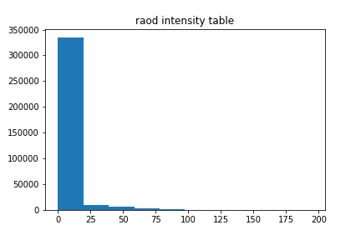
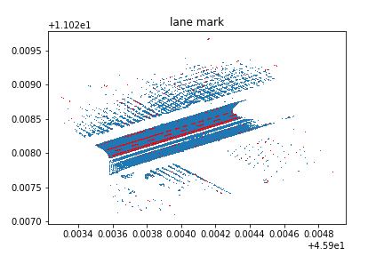
3. Implement Details
The key feature that separate lane mark from others is the intensity. By checking histogram, we found that lane mark always contains higher intensity than other part of road, which because the material of lane mark contains a high reflecting rate, so that we filter out points with high intensity and create a first view of the lane marking graph. We roughly get lane mark point set, but it is easy to see that their still have a lot of outliers, we need to kick them out.

Slide 6
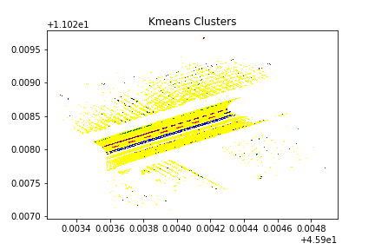
3. Implement Details
We apply Kmeans clustering to our marked lane points. By checking other given image we found that there should have four lines of lane mark(actually it should be 5, but 2 of them are very close to each other and hard to separate) and thus the model suggest 4 clusters. After clustering, we can see that those real lane mark points are clustered very well.
After clustering, we are able to use linear regression to do the line fitting for every lane. We use RANSAC as regressor to fit all 4 clusters that get from previous step, and use inlier approach to find out which point is outlier and need to be kicked away.
The result is in next page, we can see that most of the outliers are cleaned after these steps, we already get labelled data for training model.

Slide 7
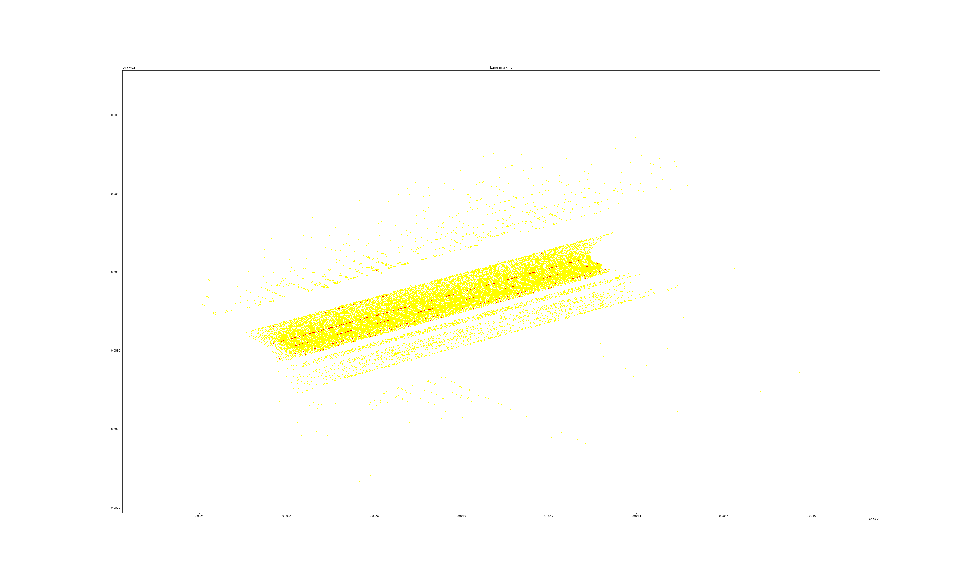
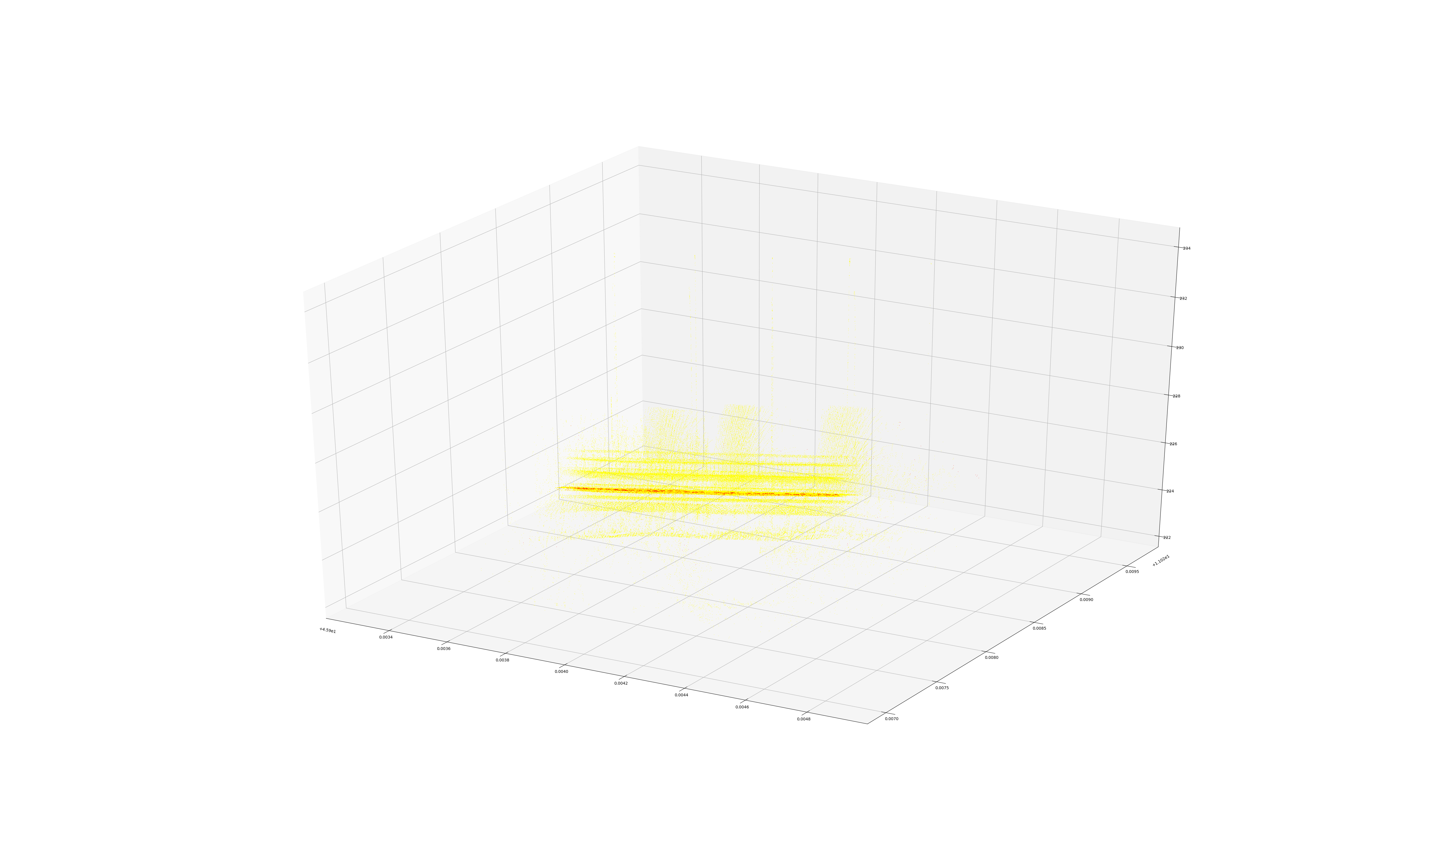
3. Implement Details
2D and 3D intermediate result

Slide 8
3. Implement Details
We just get the label from previous step, but we will not just stop here.
In order to let our program predict lane mark for any input data, we split our data set into roughly 2/3 training data and 1/3 testing data, which split by our own, cut the whole road into two parts, and obviously make sense. We use the training data to train a SVM model, then predict and evaluate the testing set.
It is easy to see that there are more than 99% of data been labelled not lane mark, so accuracy cannot tell us anything about our model. We use
F1 = (2* precision *recall) / (precision + recall)
as our score function, and our model get the score f1 = 0.988476, which is nearly perfect. It proves that the performance of our model is remarkable, as result it can handle any given input data and successfully mark lane on road surface.

Slide 9
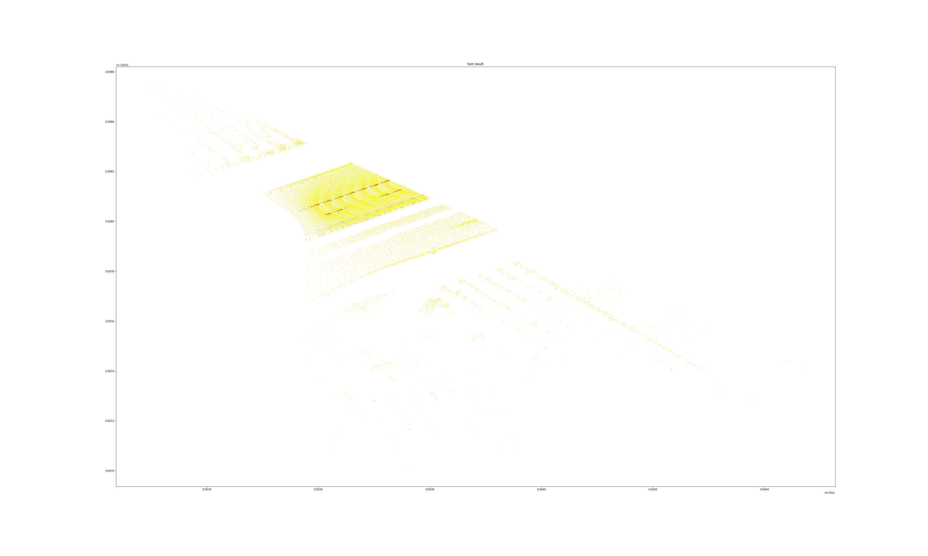
3. Implement Details
The result shows clear and sharp marked lane on testing data.

Slide 10
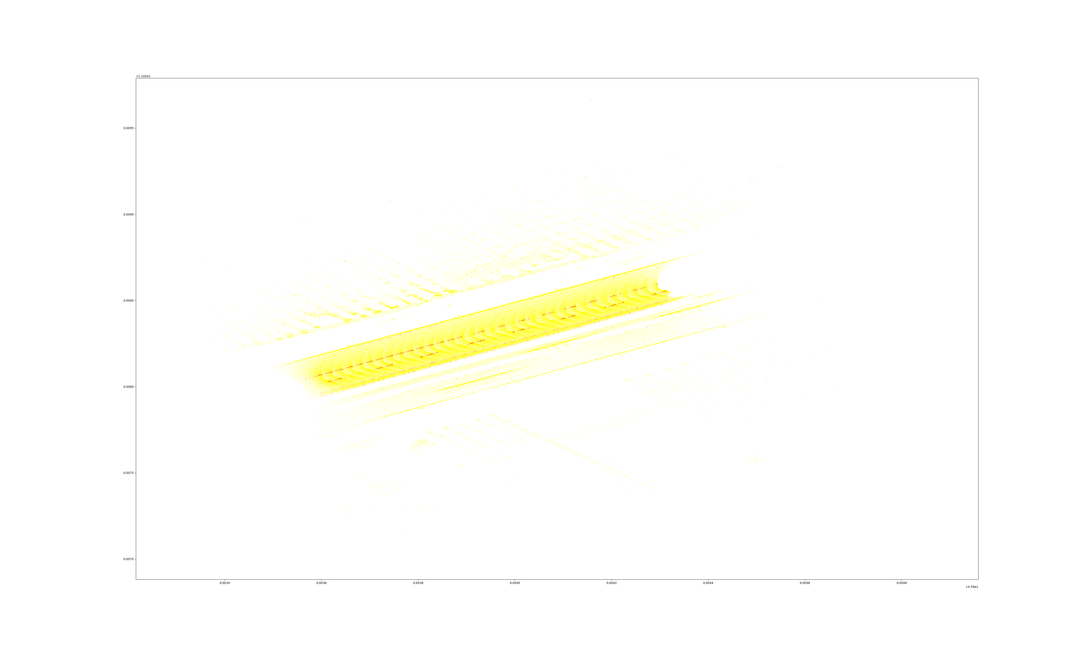
3. Implement Details
Finally, we use this model to predict the whole dataset, and the result we got are pretty good.

Slide 11
4. Conclusion
We get into trouble many times through our implementing. At first it is really hard for us to get any idea from this raw data. We check histogram in many aspect and finally find out that intensity is the key. But the label is still not accurate enough for training model. We come up an idea on kick out the outliers, by using kmeans and RANSAC, the label we get is clear and accurate enough.
We met a big problem choosing the type of model. Decision Tree is obviously not a good choice, even worse than just thresholding. Logistic Regression doesn’t work well through many sets of parameters. We finally find out that SVM with kernel set to ‘rbf’ works really well on this data, that moment should be remembered.

Slide 12
4. Conclusion
It is very happy for us to experience this challenging project. We learnt a lot about point cloud, and use those approaches we learnt from machine learning course. With facing hard problems one by one and solve them step by step, our knowledges are enhanced and skills are trained.
We also find out that it is important to use approaches in right place. As we learnt from class, point cloud data will always huge, may need to apply down sampling by PCA at first. In fact, data what we need is just very small part from whole data (only 1%), that we won’t get any result if we apply down sampling. This also works on model choosing.
We learnt a lot from this project and we got a lot of happiness through this experience. There is no doubt that we did a great job!

Slide 13
That’s all, thank you!

