Slide 2
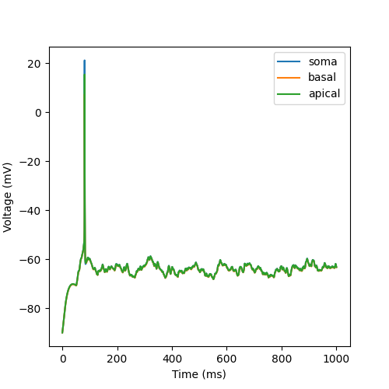
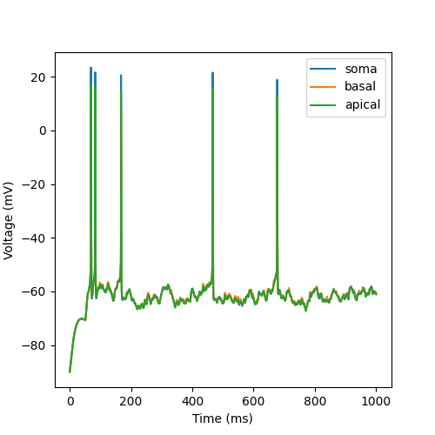
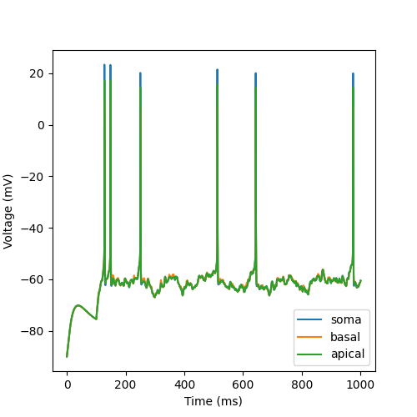
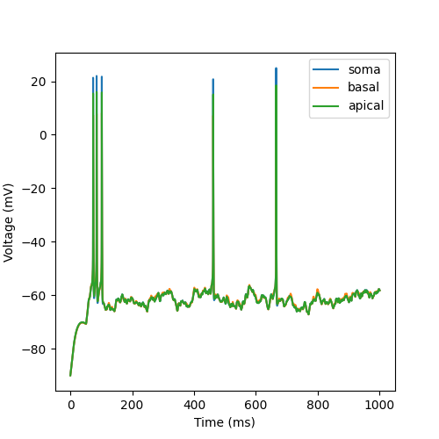
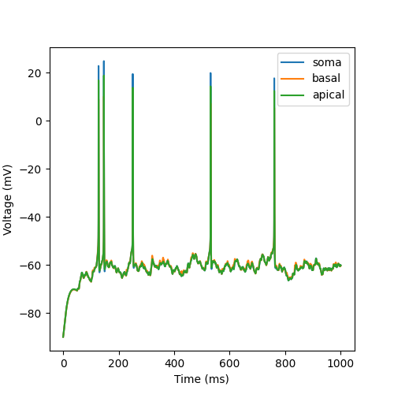
Results of Simulation (clustered by hand)
k=10
k=100
k=1000
k=50
k=500

Slide 3
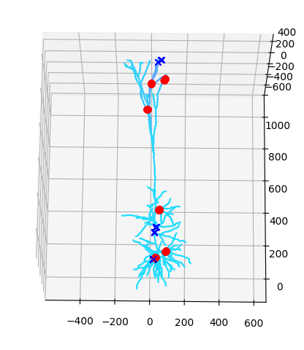
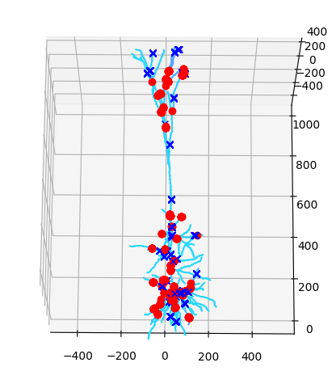
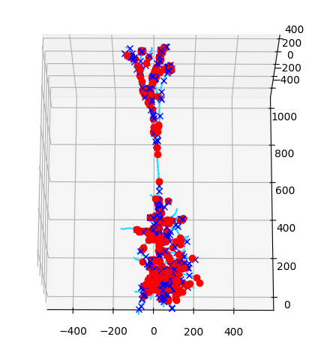
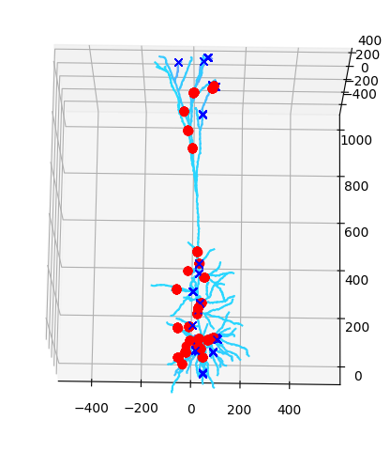
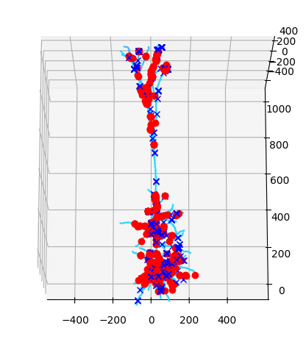
Results of Synapse Distribution (clustered by hand)
k=10
k=100
k=1000
k=50
k=500

Slide 4
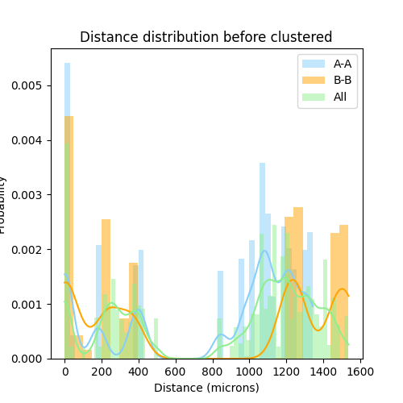
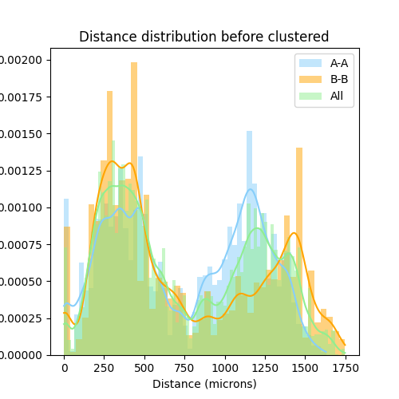
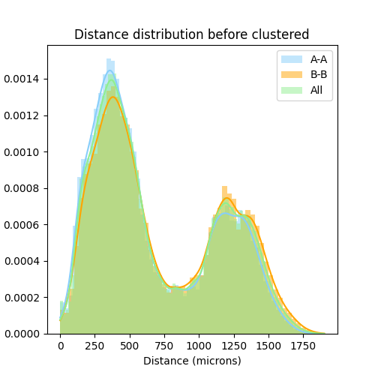
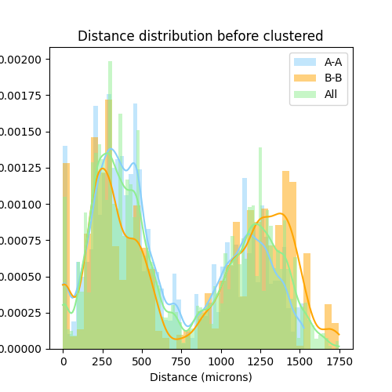

Results of Distance Distribution (clustered by hand)
k=10
k=100
k=1000
k=50
k=500

Slide 5
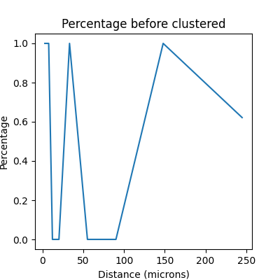
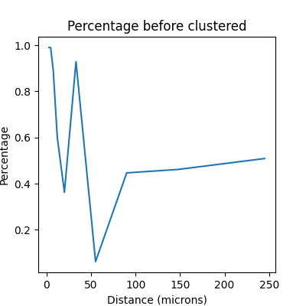
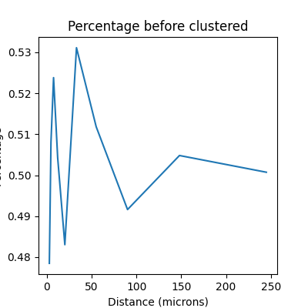
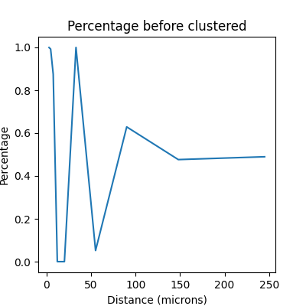
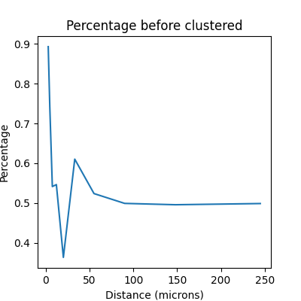
Results of Percentage Curve (clustered by hand)
k=10
k=100
k=1000
k=50
k=500
A least level of cluster numbers
on the dendritic tree is needed

Slide 6
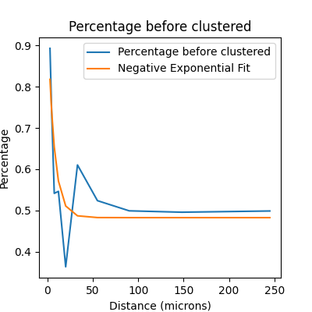
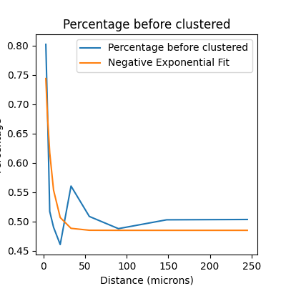
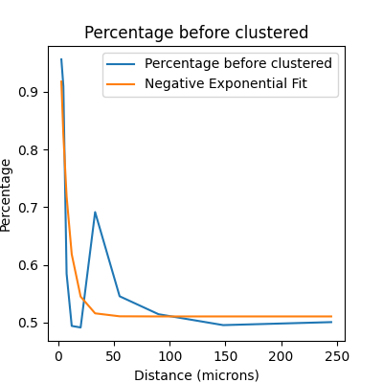
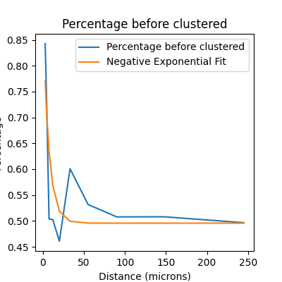
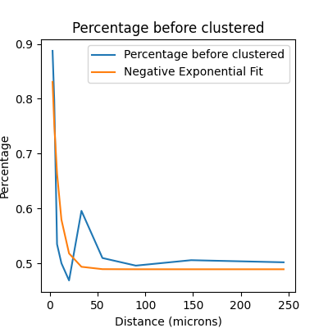
Results of Percentage Curve (clustered by hand)
k=500,num
Syn=1000
k=2000,num
Syn=4000
k=1000,numSyn=6000
k=1000,num
Syn=2000
k=2000,num
Syn=6000
The ratio of numCluster and
numSyn has little effect on fitting

Slide 7
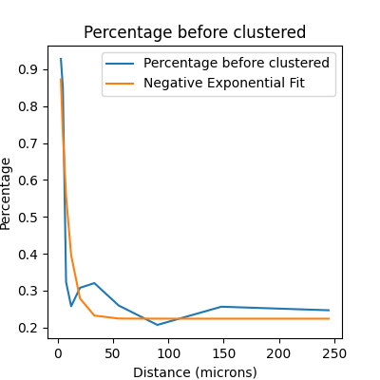
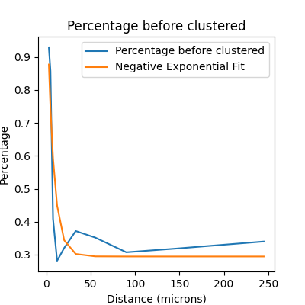
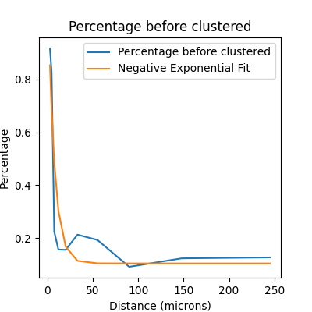
Results of Percentage Curve (clustered by hand)
k=1000,num
Syn=6000,
numType=2
k=1000,num
Syn=6000,
numType=4
k=1000,numSyn=6000
k=1000,num
Syn=6000,
numType=3
k=1000,num
Syn=6000,
numType=8
Considering more types seems to
diminish the unfitted peak

