Slide 1

Project 2
By:
Anna Broomhall Jing Davies Wei (William) Ke James Rydlewski Josh Borschman Kiran Bano

Slide 2
Theme and Goals
Show country statistics in an interesting format.
Making data interactive in a meaningful way.
Allow the user to ‘choose their own adventure’ and tell their own story using the data.
Notes:
Josh - General theme was European country data. We chose to display that information in the form of an interactive website asking the user to plan their very own holiday.

Slide 3
Data Munging
Kaggle datasets.
Web Scraping images.
Transforming data based on required interpretation for visualization.
Notes:
Anna –
Transforming was done for the country statistics chart. The data needed to be transformed in a way that made high scores desirable across all metrics (high crime rate and high trust in police are not both positive for being high scores).
Cleaning data, finding that some areas did not have hotels listed, hitting the storage cap on our server and needing to decide how to proceed.

Slide 4
Flask and The “painful” Server
Understand how Flask, SQL and Heroku works together and deploy the project.
Hard to combine work together due to different html page, style sheet and libraries used.
Database update sometimes created errors for front-end construction.
Communication with each other was limited.
Reduce unnecessary error and duplicated work.

Slide 5
Our Final Product
A website designed to tell the story of a European holiday by allowing the user to interact with the data and decide which data points are the most important to them.
Let’s go to the website!
Notes:
Kiran website skeleton Anna website runthrough

Slide 6
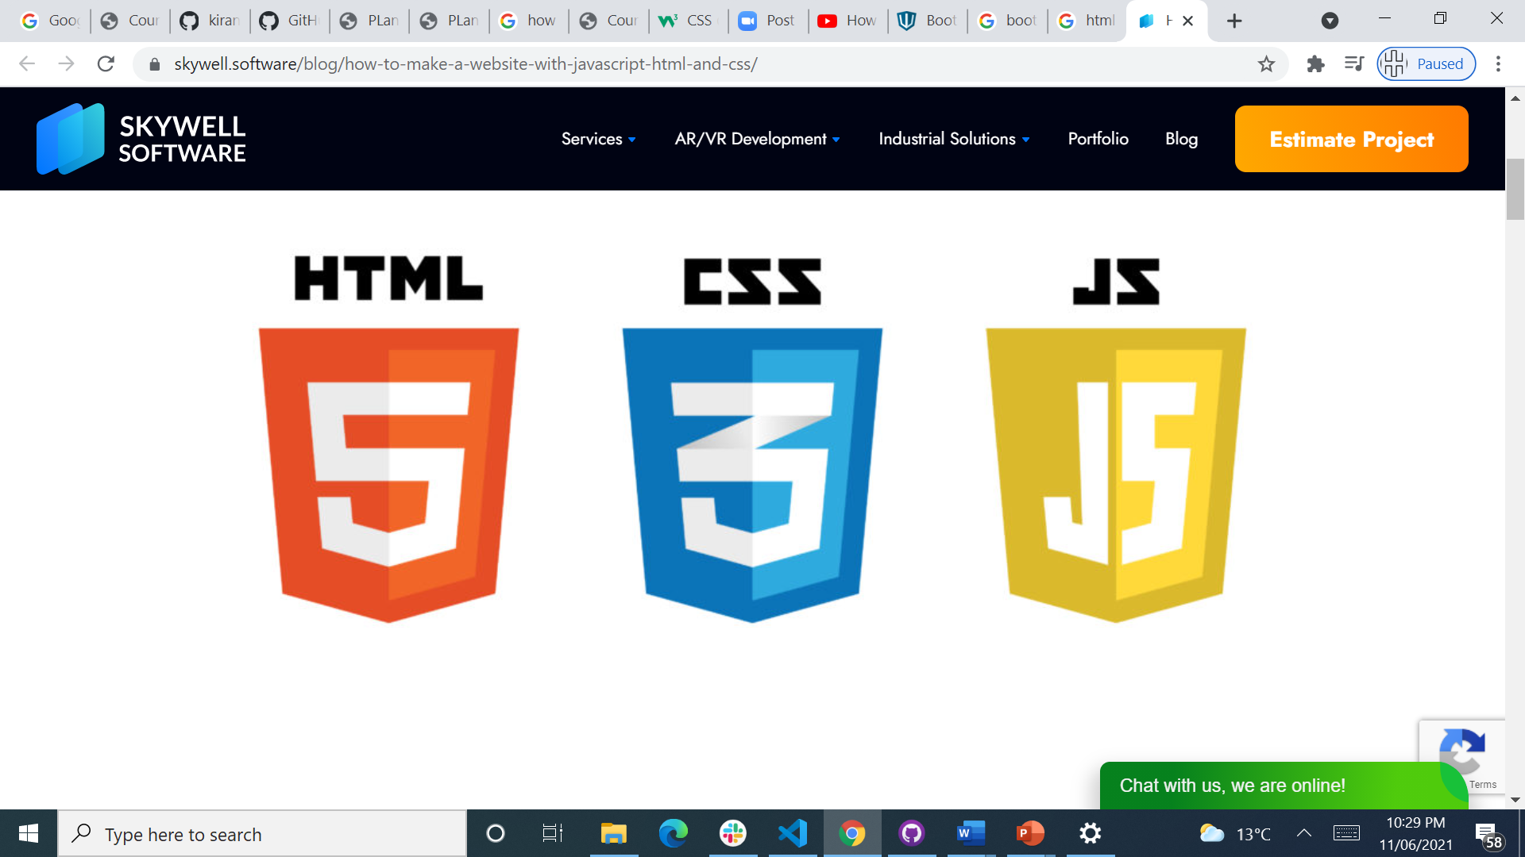
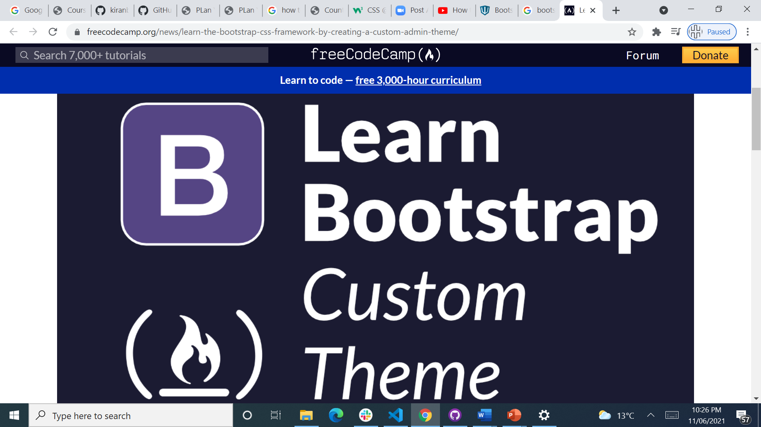
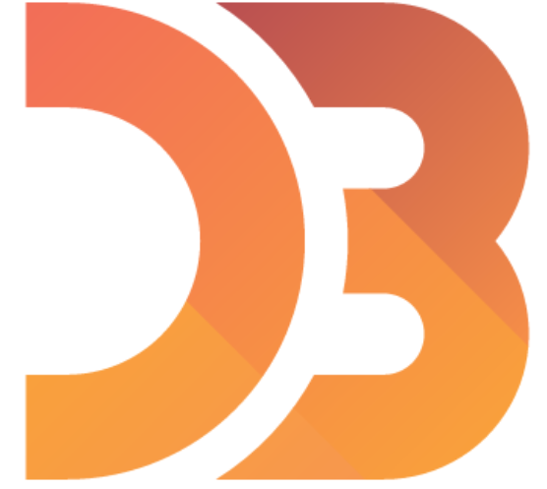
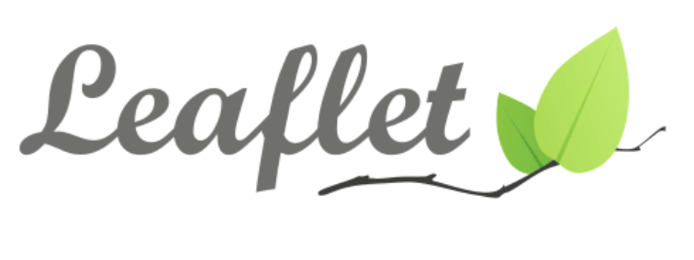
Front End Web Development

Slide 7
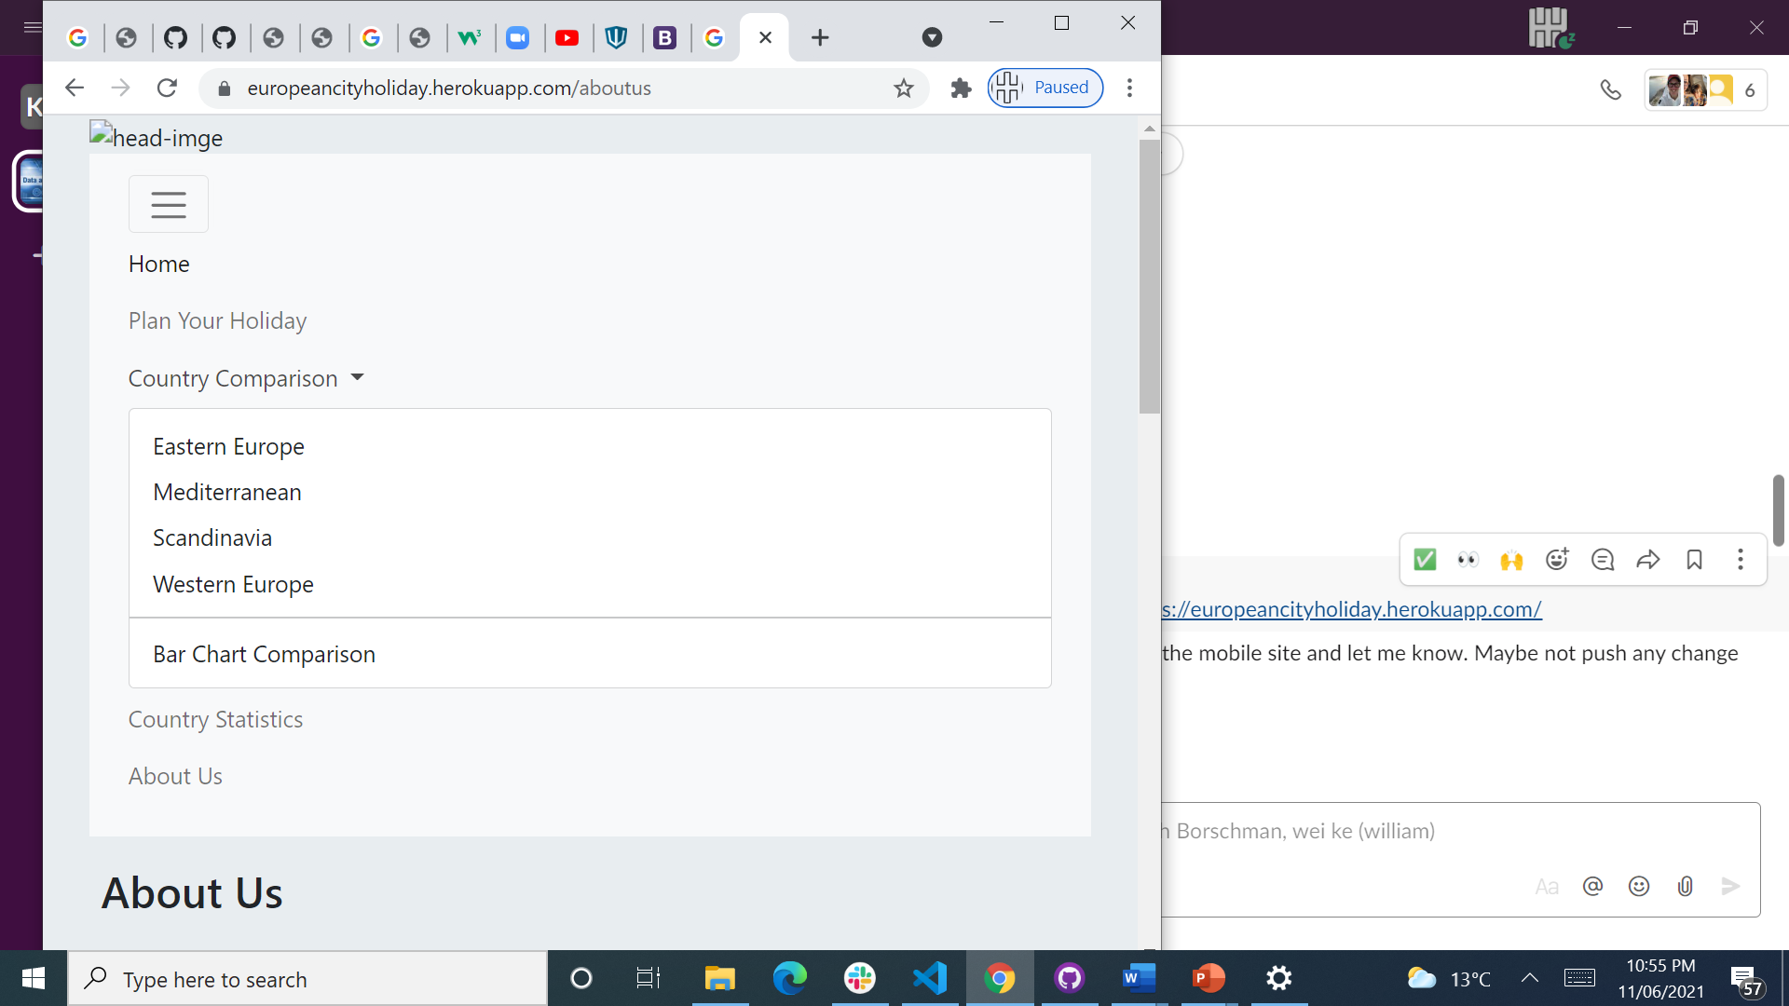
Website Structure

Slide 8
Challenge with navbar
<link rel="stylesheet" href="https://maxcdn.bootstrapcdn.com/bootstrap/3.3.7/css/bootstrap.min.css" integrity="sha384-BVYiiSIFeK1dGmJRAkycuHAHRg32OmUcww7on3RYdg4Va+PmSTsz/K68vbdEjh4u" crossorigin="anonymous">
<!-- Optional theme -->
<link rel="stylesheet" href="https://maxcdn.bootstrapcdn.com/bootstrap/3.3.7/css/bootstrap-theme.min.css" integrity="sha384-rHyoN1iRsVXV4nD0JutlnGaslCJuC7uwjduW9SVrLvRYooPp2bWYgmgJQIXwl/Sp" crossorigin="anonymous">
<!-- jQuery (necessary for Bootstrap's JavaScript plugins) -->
<script src="https://ajax.googleapis.com/ajax/libs/jquery/1.12.4/jquery.min.js"></script>

Slide 9
Challenge with navbar
<link rel="stylesheet" href="https://maxcdn.bootstrapcdn.com/bootstrap/3.3.7/css/bootstrap.min.css" integrity="sha384-BVYiiSIFeK1dGmJRAkycuHAHRg32OmUcww7on3RYdg4Va+PmSTsz/K68vbdEjh4u" crossorigin="anonymous">
<!-- Optional theme -->
<link rel="stylesheet" href="https://maxcdn.bootstrapcdn.com/bootstrap/3.3.7/css/bootstrap-theme.min.css" integrity="sha384-rHyoN1iRsVXV4nD0JutlnGaslCJuC7uwjduW9SVrLvRYooPp2bWYgmgJQIXwl/Sp" crossorigin="anonymous">
<!-- jQuery (necessary for Bootstrap's JavaScript plugins) -->
<script src="https://ajax.googleapis.com/ajax/libs/jquery/1.12.4/jquery.min.js"></script>

Slide 10
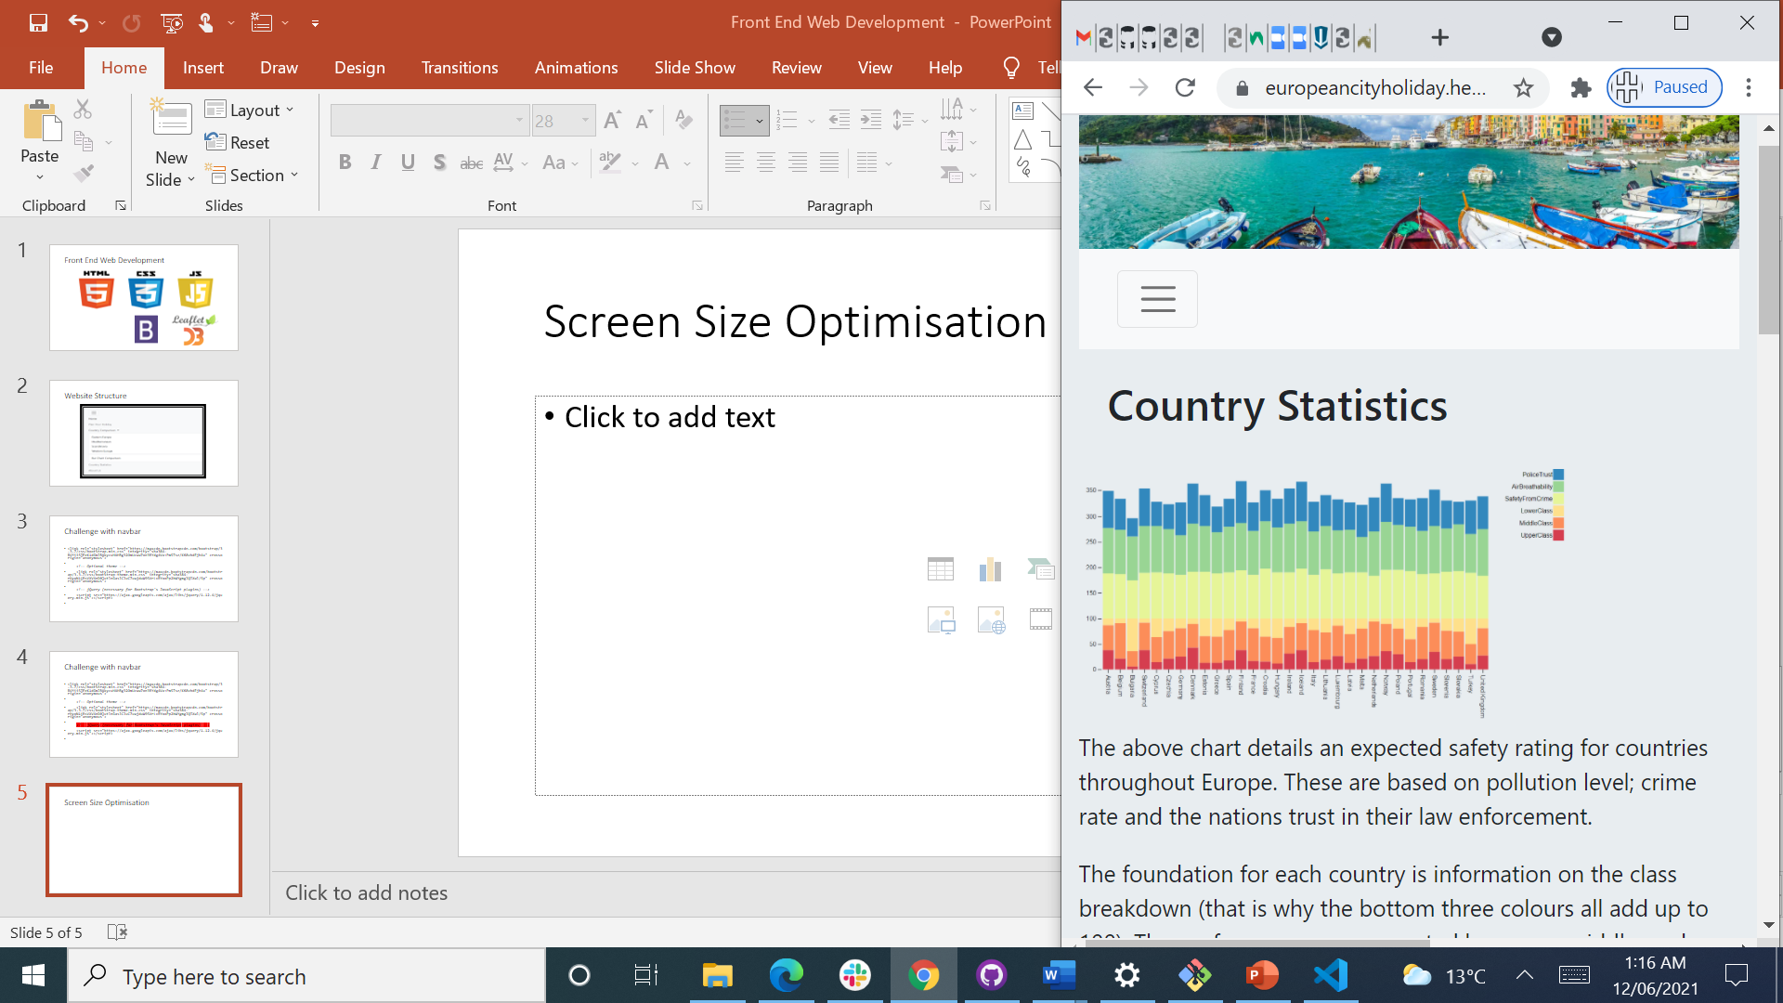
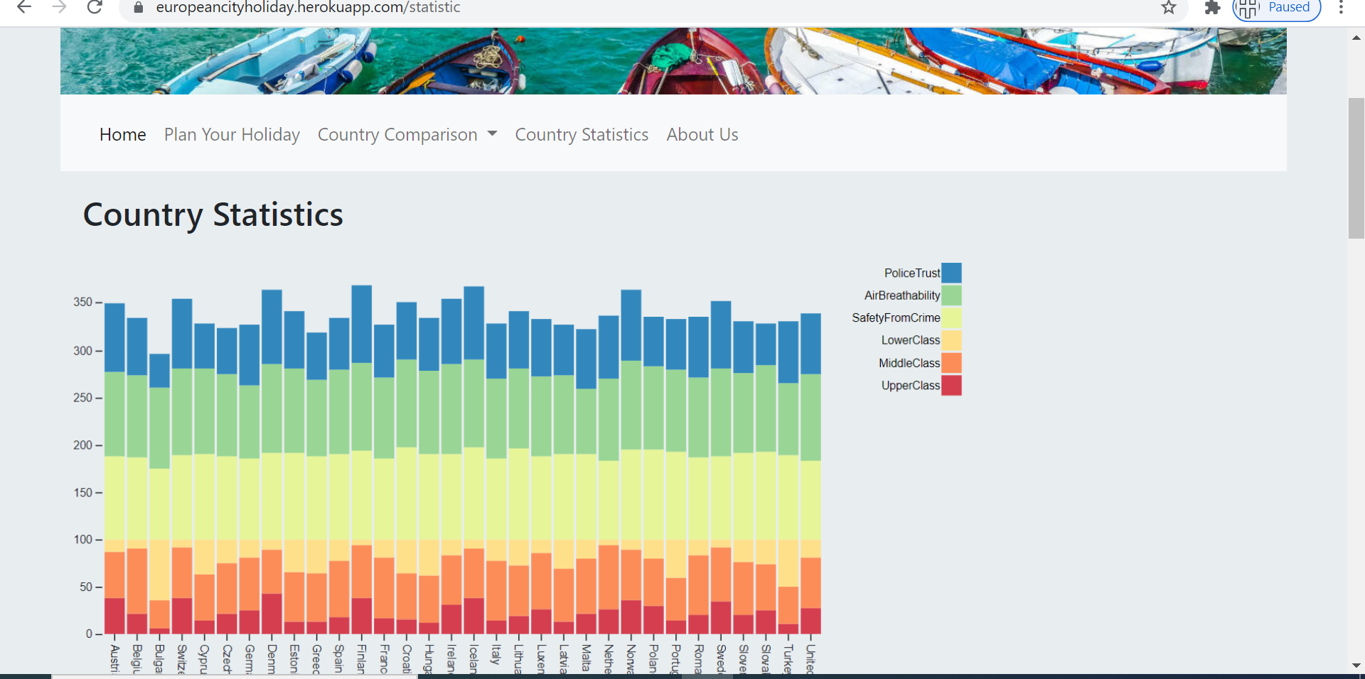
Screen Size Optimisation

