Slide 1
Temporal Imbalance of Positive and Negative Supervision in Class-Incremental Learning
CVPR2026
Jinge Ma Fengqing Zhu
Video and Image Processing Laboratory (VIPER)
Purdue University
West Lafayette, Indiana

Slide 2
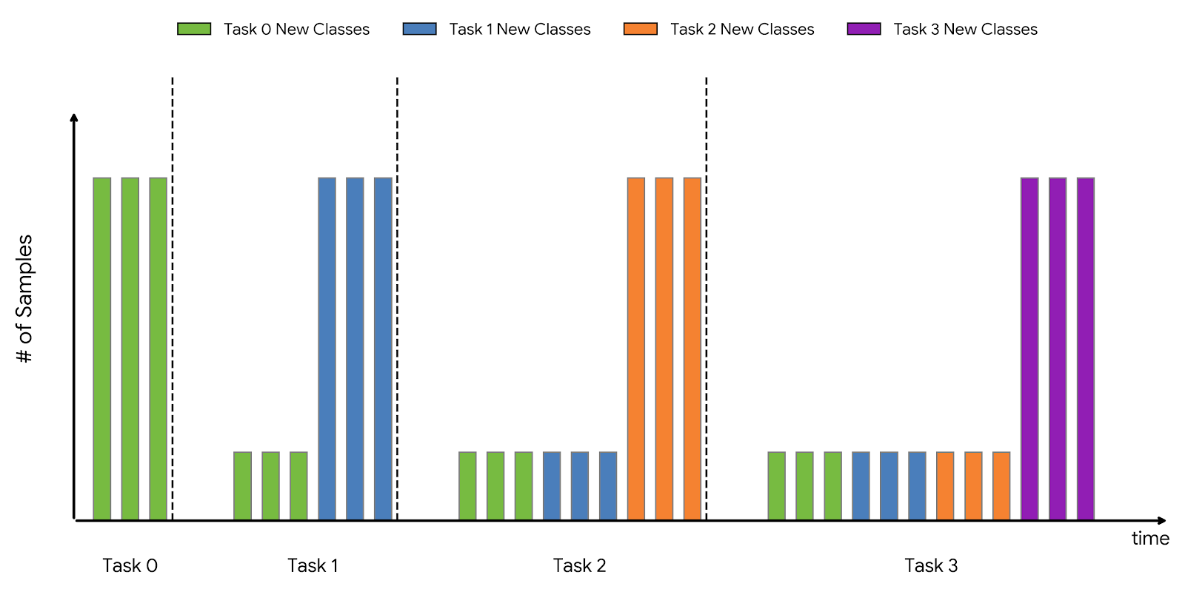
Background: the Set-up of Class-Incremental Learning
Replay Exemplars

Slide 3
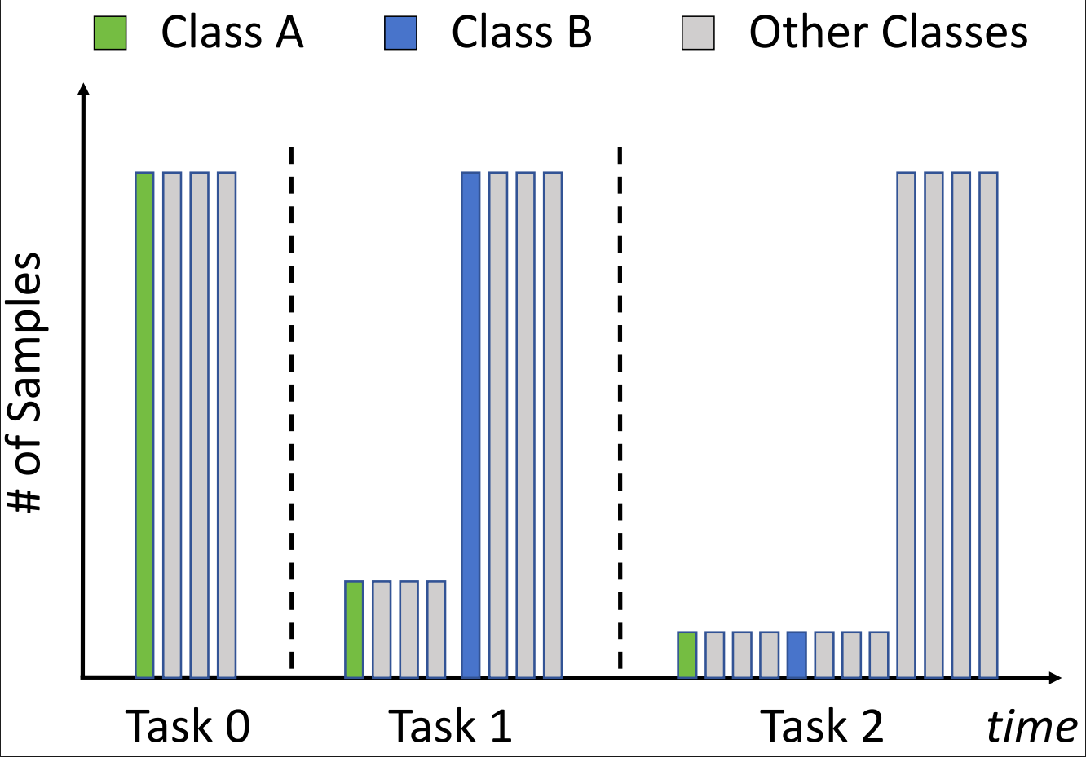
Temporal Imbalance: an Illustration
No class imbalance between old classes in the current task
The moment of evaluation
But with different historical distributions

Slide 4
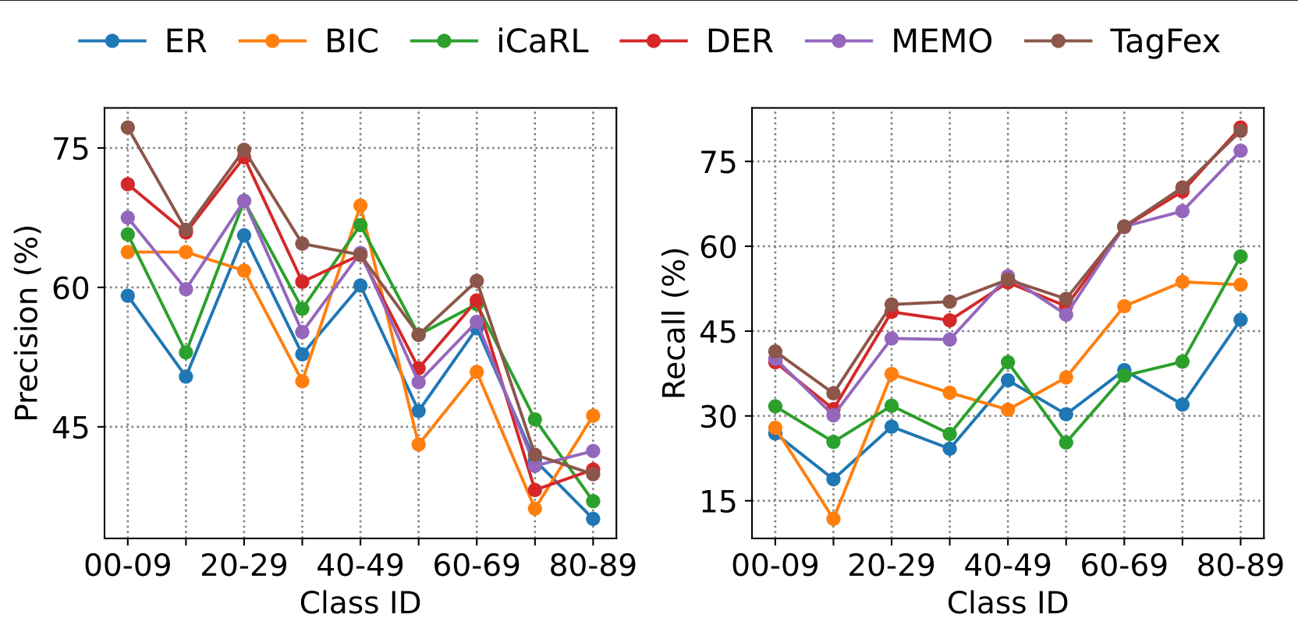
Temporal Imbalance: an Observation
Class A(older old class)
Class B(newer old class)

Slide 5
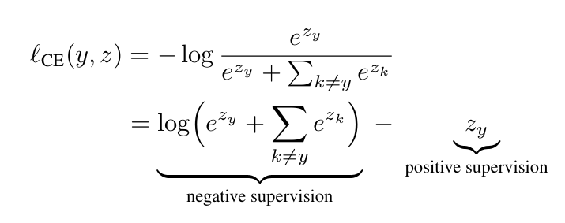
Why is it so?
y: class label
z: [$z_{1}$, $z_{2}$, ..., $z_{n}$], model’s output logits

Slide 6
Why is it so?
Positive Supervision (higher recall)
Negative Supervision (higher precision)
Class A
Class B
Task 0
Task 1
Task 2

Slide 7
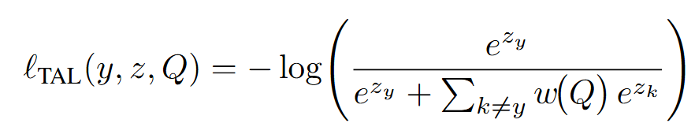
Our Method: Temporal-Ajusted Loss(TAL)
Q: Current Positive Supervision Strength
w(Q): Sensitivity to Negative Supervision
Q↑
w(Q)↑ (Class B)
Q↓
w(Q)↓ (Class A)

Slide 8
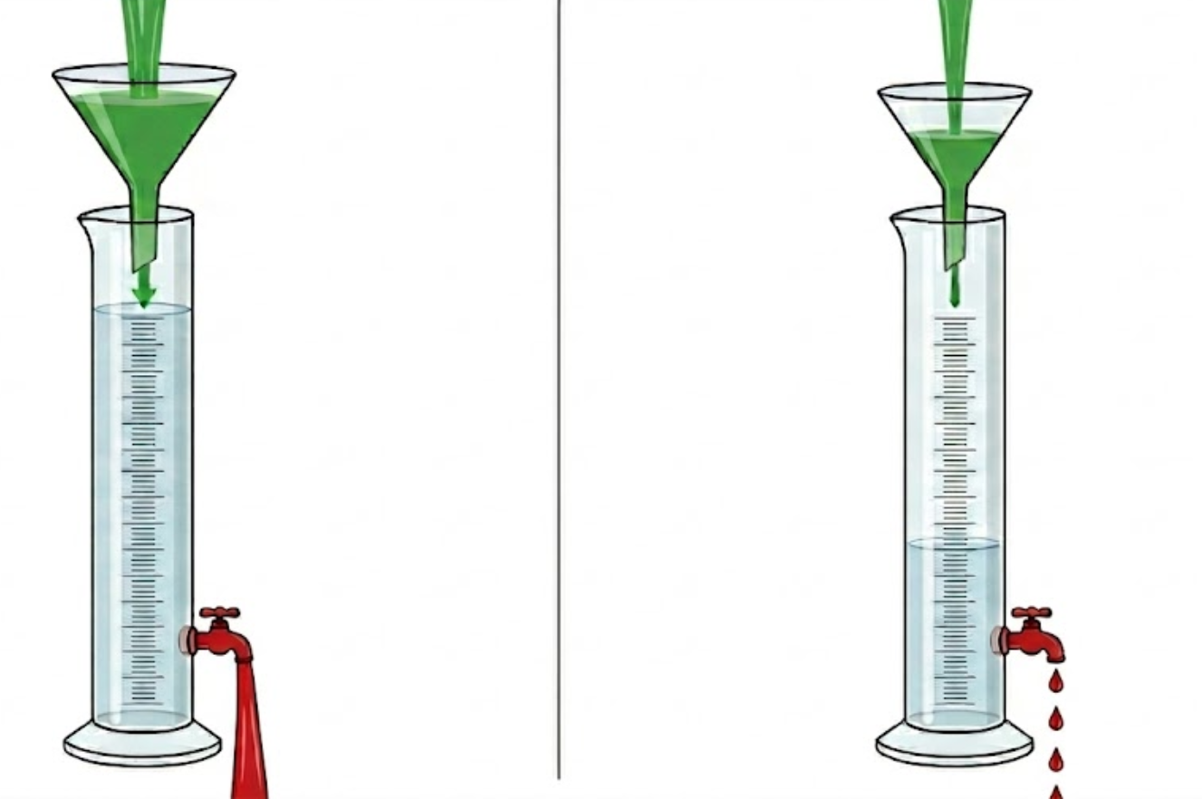
Our Method: Temporal-Ajusted Loss(TAL)
Positive Supervision
Motivation:
Classes with insufficient temporal positive supervision strength should be less sensitive to negative supersivion
Q↑
w(Q)↑
Q↓
w(Q)↓
Negative Supervision

Slide 9
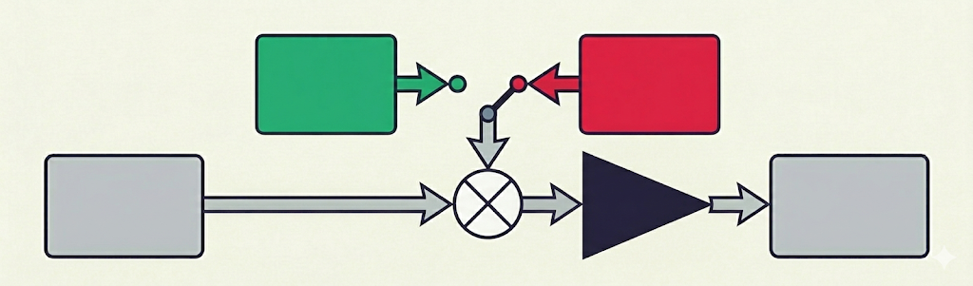
Temporal-Ajusted Loss: Update of Q
Q: Current Positive Supervision Strength
+1 Positive Sample
+1 Negative Sample
Q[N] at step N
Time Decay Factor
Q[N+1] at step N+1

Slide 10
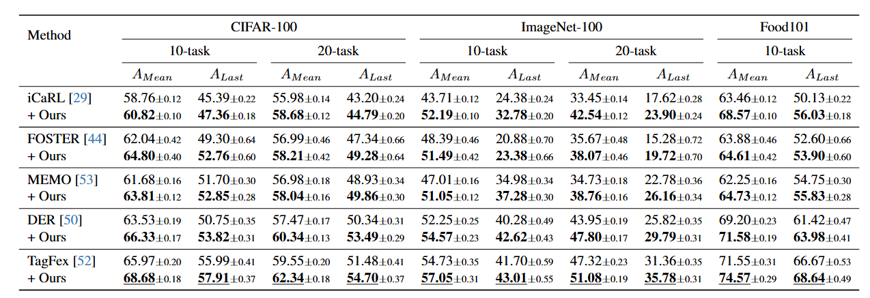
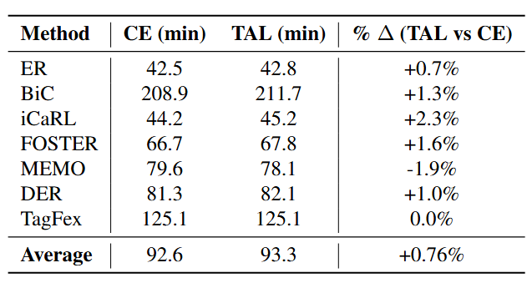
Experiments
Plug&Play

Slide 11
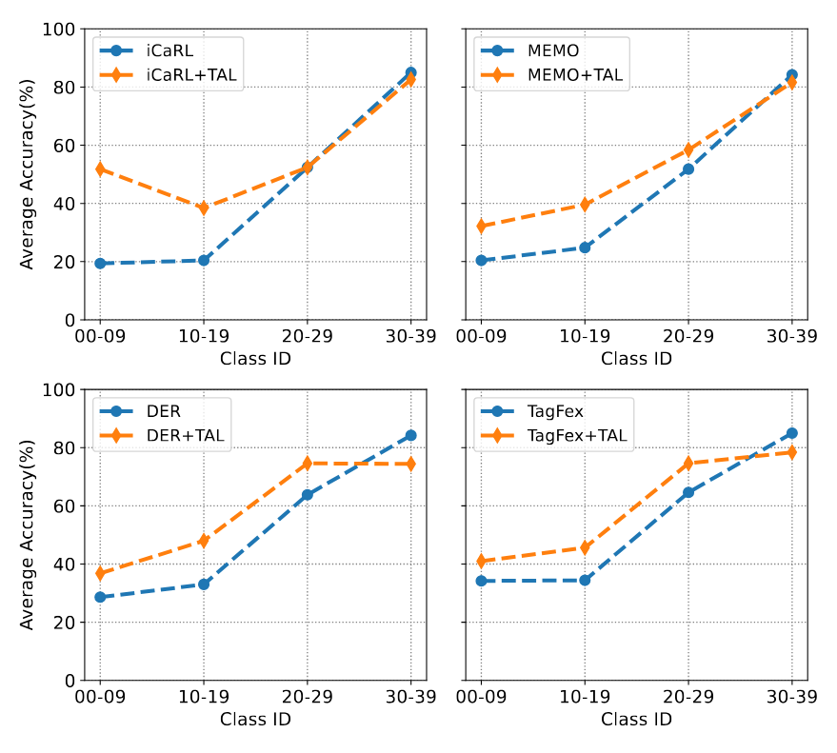
Experiments
High Time Efficiency
Flatten the Asymmetric Curve of Recall

Slide 12
Thank you!

