Slide 1
Machine Learning Techniques for
Automatic Ontology Extraction from Domain Texts
  Janardhana R. Punuru
  Jianhua Chen
  Computer Science Dept.
  Louisiana State University, USA

Slide 2
Presentation Outline
Introduction
Concept extraction
Taxonomical relation learning
Non-taxonomical relation learning
Conclusions and Future Works

Slide 3
Introduction
Ontology An ontology OL of a domain D is a specification of a conceptualisation of D, or simply, a data model describing D. An OL typically consists of:
  A list of concepts important for domain D
  A list of attributes describing the concepts
  A list of taxonomical (hierarchical) relationships among these concepts
  A list of (non-hierarchical) semantical relationships among these concepts

Slide 4
Sample (partial) Ontology – Electronic Voting Domain
Concepts: person, voter, worker, poll watcher, location, county, precinct, vote, ballot, machine, voting machine, manufacturer, etc.
Attributes: name of person, model of machine, etc.
Taxonomical relations:
  Voter is a person; precinct is a location; voting machine is a machine, etc.
Non-hierarchical relations:
  Voter cast ballot; voter trust machine; county adopt machine; equipment miscount ballot, etc.

Slide 5
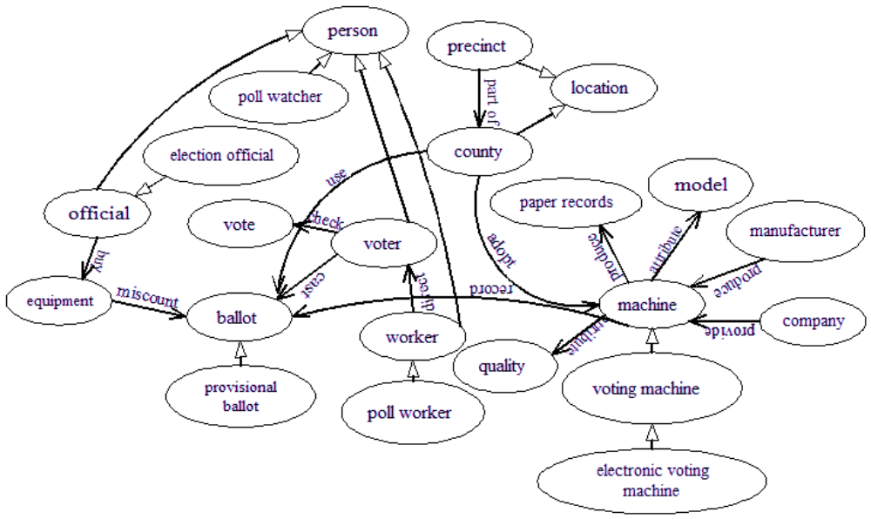
Sample (partial) Ontology – Electronic Voting Domain

Slide 6
Applications of Ontologies
Knowledge representation and knowledge management systems
Intelligent query-answering systems
Information retrieval and extraction
Semantic Web
  Web pages annotated with ontologies
  User queries for Web pages analysed at knowledge level and answered by inferencing on ontological knowledge

Slide 7


Task: automatic ontology extraction from domain texts
texts
Ontology extraction
ontology

Slide 8
Challenges in Text Processing
Unstructured texts
Ambiguity in English text
  Multiple senses of a word
  Multiple parts of speech – e.g., “like” can occur in 8 PoS:
    Verb: “Fruit flies like banana”
    Noun: “We may not see its like again”
    Adjective: “People of like tastes agree”
    Adverb: “The rate is more like 12 percent”
    Preposition: “Time flies like an arrow”
    etc
Lack of closed domain of lexical categories
Noisy texts
Requirement of very large training text sets
Lack of standards in text processing

Slide 9
Challenges in Knowledge Acquisition from Texts
Lack of standards in knowledge representation
Lack of fully automatic techniques for KA
Lack of techniques for coverage of whole texts
Existing techniques typically consider word frequencies, co-occurrence statistics, syntactic patterns, and ignore other useful information from the texts
Full-fledged natural language understanding is still computationally infeasible for large text collections

Slide 10
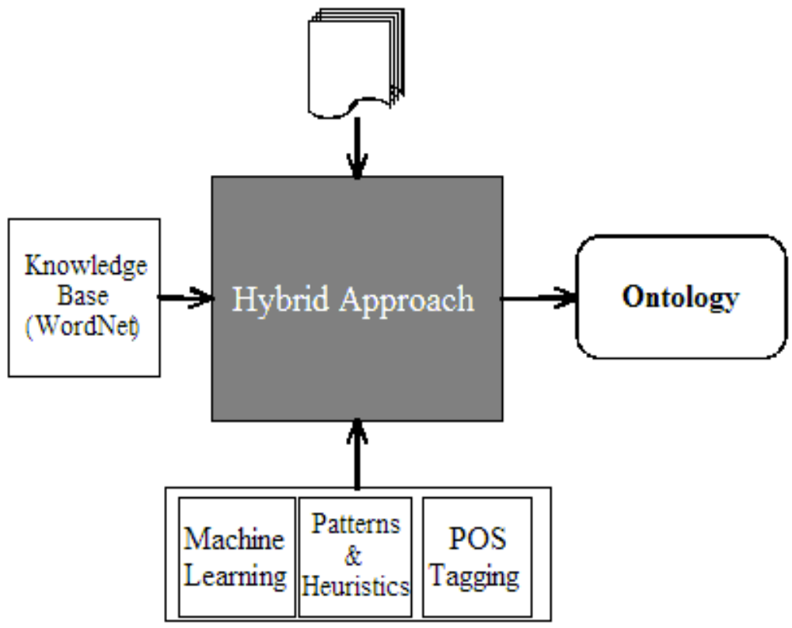
Our Approach

Slide 11
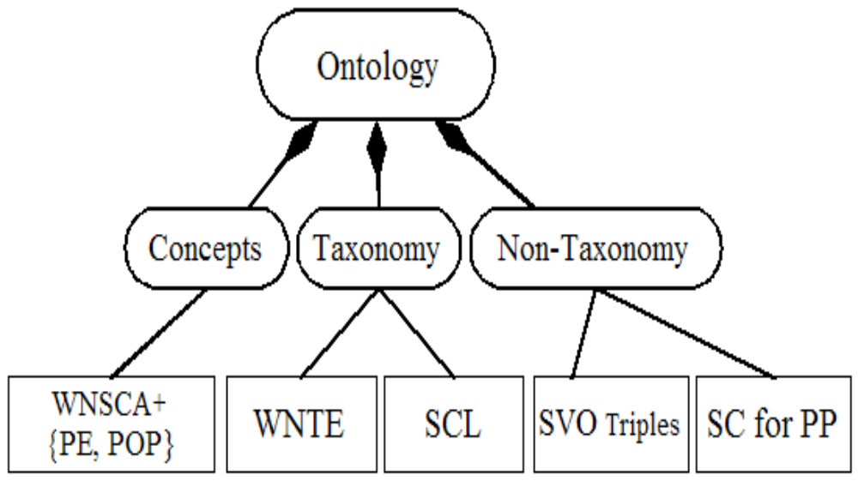
Our Approach

Slide 12
Concept Extraction: Existing Methods
Frequency-based methods
  Text-to-Onto [Maedche & Volz 2001]
Use syntactic patterns and extract concepts matching the patterns
  [Paice, Jones 1993]
Use WordNet
  [Gelfand et. Al. 2004] start from a base word list, for each w in the list, add the hypernyms and hyponyms in WordNet to the list

Slide 13
Concept Extraction: Our Approach
Parts of Speech tagging and NP chunking
Morphological processing – word stemming, converting words to root form
stopword removal
Focus on top % freq. NP
Focus on NP with fewer number of WordNet senses

Slide 14
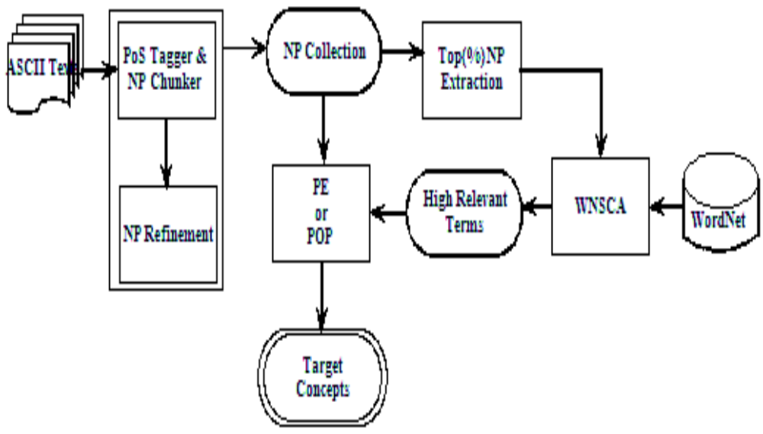
Concept Extraction: WordNet Sense Count Approach

Slide 15
Background: WordNet
General lexical knowledge base
Contains ~ 150,000 words (noun, verb, adj, adv)
A word can have multiple senses: “plant” as a noun has 4 senses
Each concept (under each sense and PoS) is represented by a set of synonyms (a syn-set).
Semantic relations such as hypernym/antonym/meronym of a syn-set are represented
WordNet - Princeton University Cognitive Science Laboratory

Slide 16
Background: Electronic Voting Domain
15 documents from New York Times (www.nytimes.com)
Contains more than 10,000 words
Pre-processing produced 768 distinct noun phrases (concepts)
  329 relevant to electronic voting
  439 irrelevant

Slide 17
Background: Text Processing
Many local election officials and voting machine companies are fighting paper trails, in part
because they will create more work and will raise difficult questions if the paper and electronic
tallies do not match.
POS Tagging: Many/JJ local/JJ election/NN officials/NNS and/CC voting/NN machine/NN companies/NNS are/VBP fighting/VBG paper/NN trails,/NN in/IN part/NN because/IN they/PRP will/MD create/VB more/JJR work/NN and/CC will/MD raise/VB difficult/JJ questions/NNS if/IN the/DT paper/NN and/CC electronic/JJ tallies/NNS do/VBP not/RB match./JJ
NP Chuking: [ Many/JJ local/JJ election/NN officials/NNS ] and/CC [ voting/NN machine/NN companies/NNS ] are/VBP fighting/VBG [ paper/NN trails,/NN ] in/IN [ part/NN ] because/IN [ they/PRP ] will/MD create/VB [ more/JJR work/NN ] and/CC will/MD raise/VB [ difficult/JJ questions/NNS ] if/IN [ the/DT paper/NN ] and/CC [ electronic/JJ tallies/NNS ] do/VBP not/RB [ match./JJ]
Stopword Elimination: local/JJ election/NN officials/NNS, voting/NN machine/NN companies/NNS , paper/NN trails,/NN, part/NN, work/NN, difficult/JJ questions/NNS, paper/NN, electronic/JJ tallies/NNS, match./JJ
Morphological Analysis: local election official, voting machine company, paper trail, part, work, difficult question, paper, electronic tally

Slide 18
WNSCA + {PE, POP}
Take top n% of NP, and select only those with less than 4 senses in WordNet ==> obtain T, a set of noun phrases
Make a base list L of words from T
PE: add to T, any noun phrase np from NP, if the head-word (ending word) in np is in L
POP: add to T, any noun phrase np from NP, if some word in np is in L

Slide 19
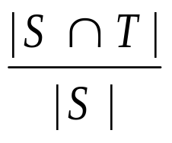
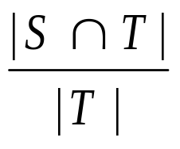
Evaluation: Precision and Recall
S
T
Precision: n
Recall:

Slide 20
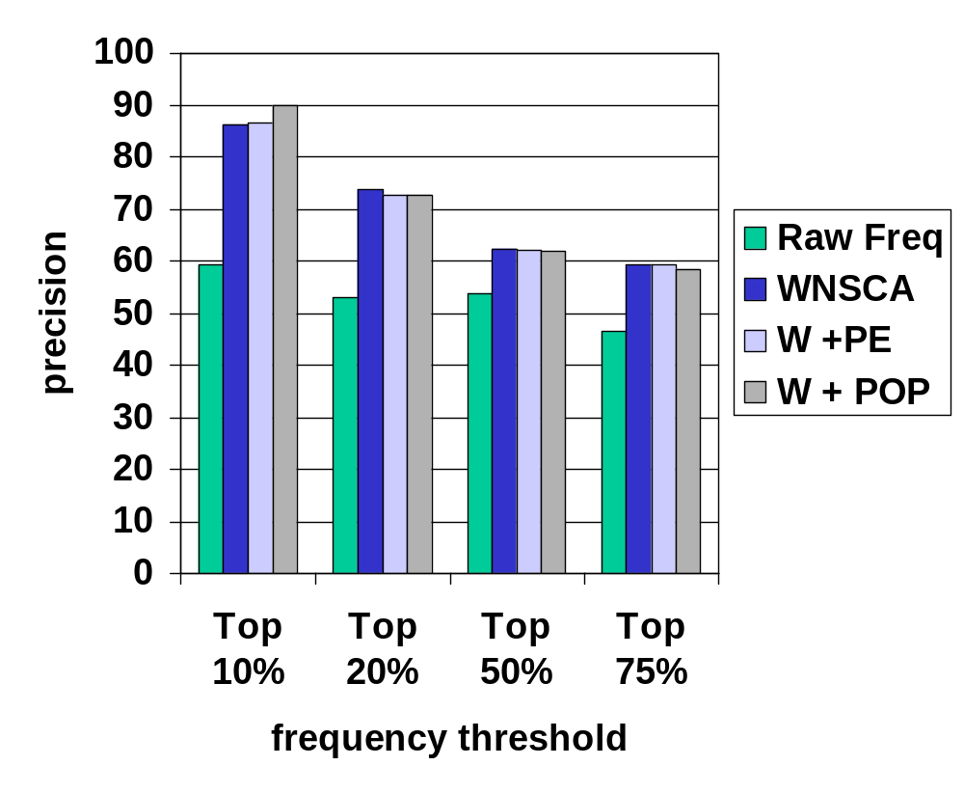
Evaluations on the E-voting Domain

Slide 21
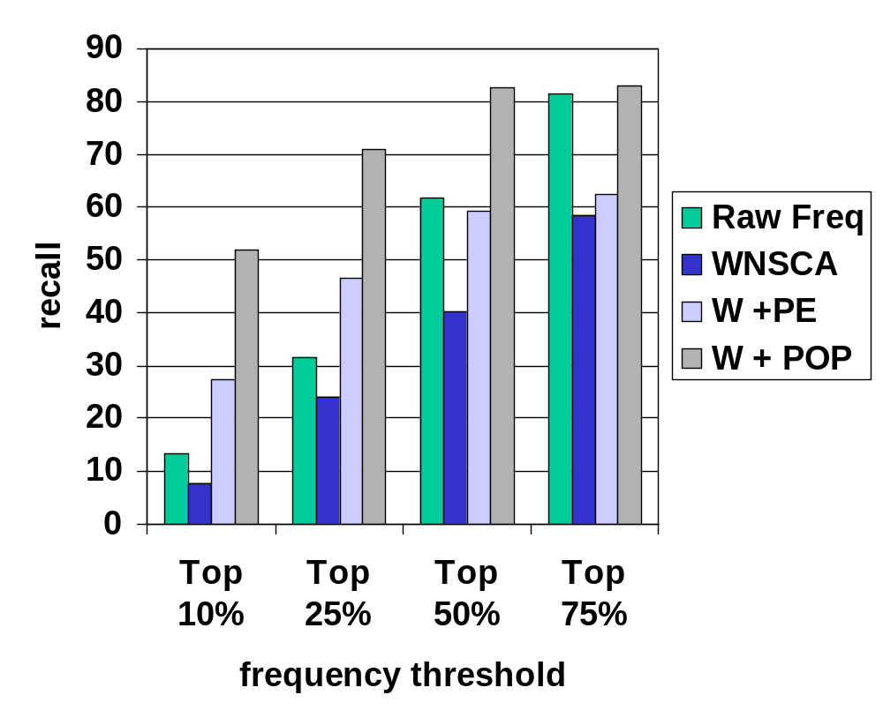
Evaluations on the E-voting Domain

Slide 22
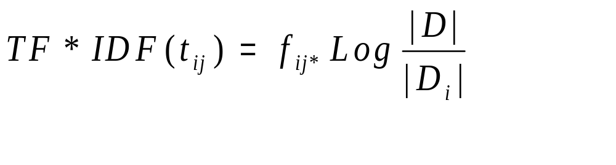
TF*IDF Measure
TF*IDF: Term Frequency Inverted Document Frequency
  |D|: total number of documents
  |D_{i}|: total number of documents containing term t_{i}
  TF*IDF(t_{ij}): TF*IDF measure for term t_{i} in document d_{j}
  f_{ij}: frequency of term t_{i} in document d_{j}

Slide 23
Comparison with the tf.idf method

Slide 24
Evaluations on the TNM Domain
TNM Corpus: 270 texts in the TIPSTER Vol. 1 data from NIST: 3 years (87, 88, 89) news articles from Wall Street Journal, in the category of “Tender offers, Mergers and Acquisitions”
30 MB in size
183, 348 concepts extracted - only used the top 10% frequent ones in the experiments - manually label the 18,334 concepts: only 3,388 concepts are relevant
Use the top 1% frequent concepts as the initial cut

Slide 25
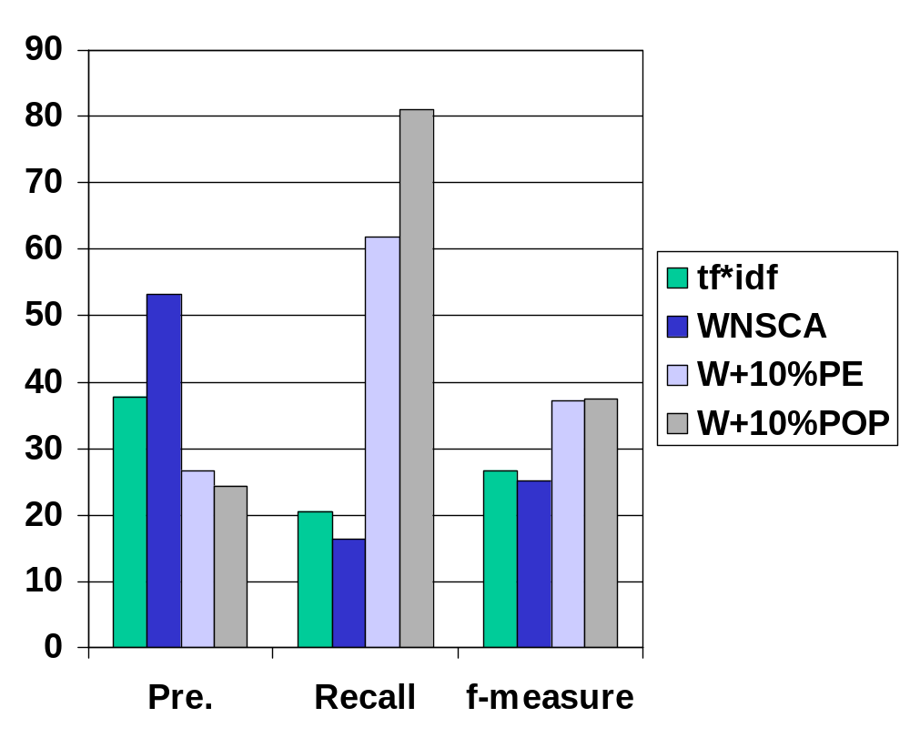
Evaluations on the TNM Domain

Slide 26
Taxonomy Extraction: Existing Methods
A taxonomy: an “is-A” hierarchy on concepts
Existing approaches:
  Hierarchical clustering: Text-To-Onto
  but this needs users to manually label the internal nodes
  Use lexico-syntactic patterns: [Hearst 1992, Iwanska 1999]
  “musical instruments, such as piano and violin … “
  Use seed concepts and semantic variants: [Morin & Jacqumin 2003] “An apple is a fruit” ➔ “Apple juice is fruit juice”

Slide 27
Taxonomy Extraction: Our Method
3 techniques for taxonomy extraction
  Compound term heuristic: “voting machine” is a machine
  WordNet-based method – needs word sense disambiguation (WSD)
  Supervised learning (Naive-Bayes) for semantic class labeling (SCL) of concepts

Slide 28
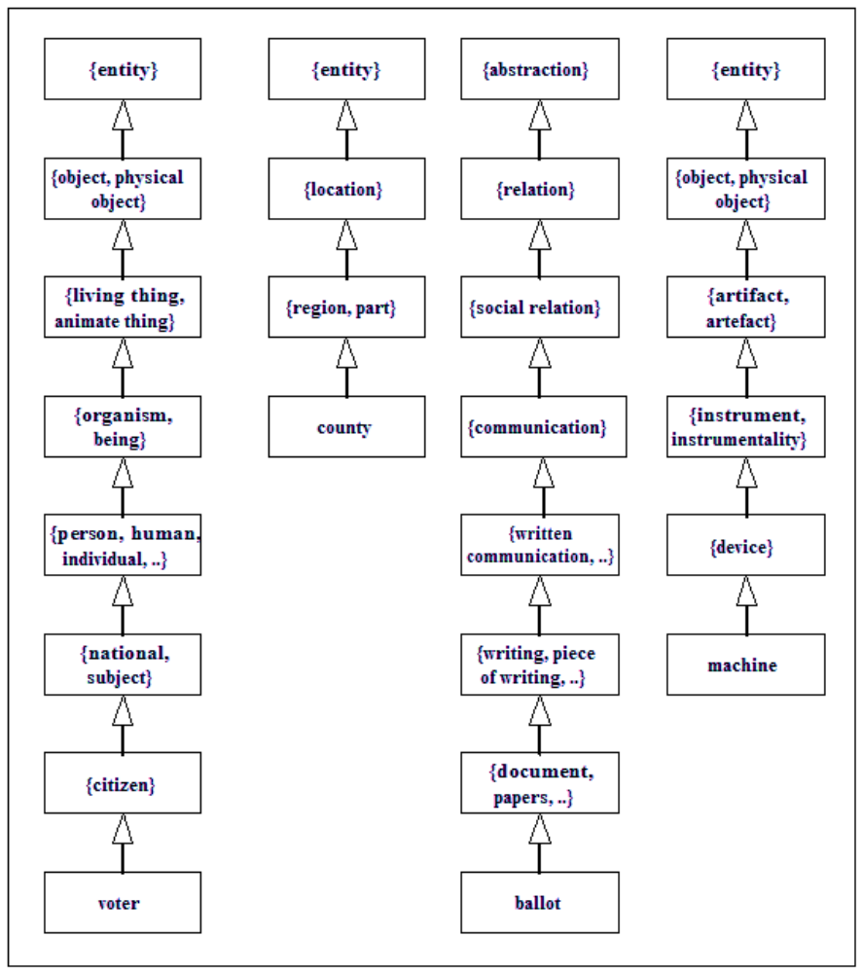

Slide 29
Semantic Class Labeling of Concepts
Given: semantic classes T ={T₁, ..., T_{k} } and concepts C = { C₁, ..., C_{n}}
Find: a labeling L: C --> T, namely, L(c) identifies the semantic class of concept c for each c in C.
For example, C = {voter, poll worker, voting machine} and T = {person, location, artifacts}

Slide 30
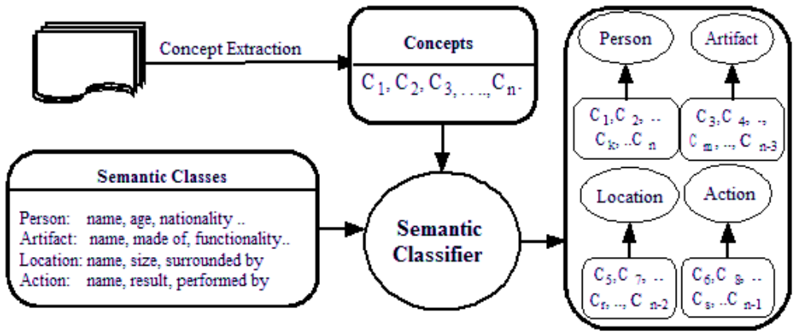
SCL

Slide 31
Naïve Bayes Learning for SCL
Four attributes are used to describe any concept
  The last 2 characters of the concept
  The head word of the concept
  The pronoun following the concept
  The preposition proceeding the concept

Slide 32
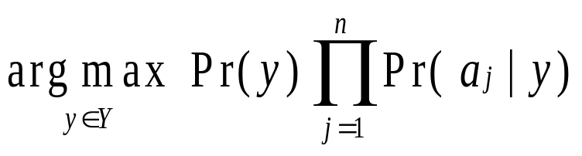
Naïve Bayes Learning for SCL
Naïve Bayes Classifier:
Given an instance x = <a₁, ..., a_{n}>, and
a set of classes Y = {y₁, ..., y_{k}}
NB(x) =

Slide 33
Evaluations
On E-voting domain:
622 instances, 6-fold cross-validation: 93.6% prediction accuracy
Larger experiment: from WordNet
  2326 in the person category
  447 in the artifacts category
  196 in the location category
  223 in the action category
  2624 instances from the Reuters data, 6-fold cross-val.
  produced 91.0% accuracy
  Reuters data: 21578 Reuters news wire articles in 1987

Slide 34
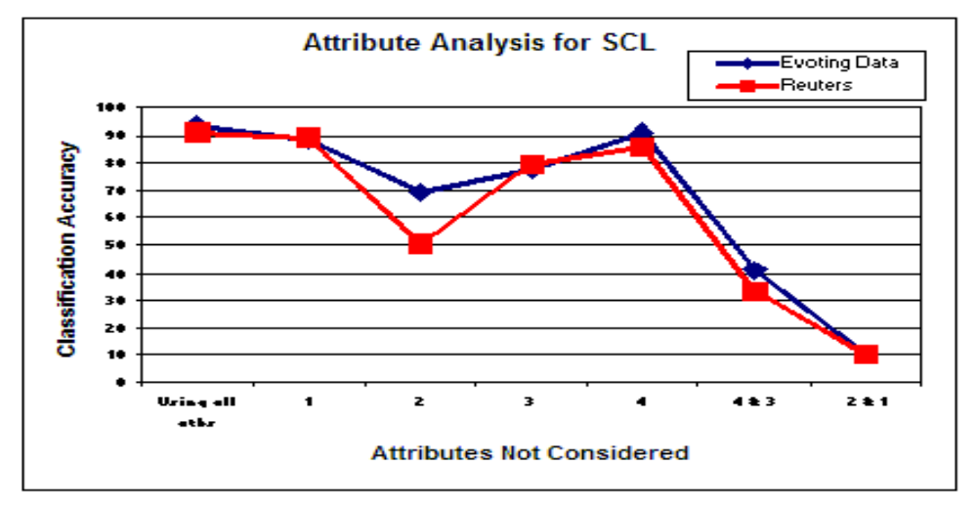
Attribute Analysis for SCL

Slide 35
Non-taxonomical relation learning
We focus on learning non-hierarchical relations of form <C_{i}, R, C_{j}>
Here R is a non-hierarchical relation, and C_{i}, C_{j} are concepts
Example relations: < voter, cast, ballot>
<official, tell, voter>
<machine, record, ballot>

Slide 36
Related Works
Non-hierarchical relation learning is relatively less tackled
Several works on this problem make restrictive assumptions:
  Define a fixed set of concepts, then look for relations among these concepts
  Define a fixed set of non-hierarchical relations, then look for concept pairs satisfying these relations
Syntactical structure of the form (subject, verb, object) is often used

Slide 37
Ciaramita et al(2005):
  Use a pre-defined set of relations
  Extract concept pairs satisfying such a relation
  Use chi-square test to verify the statistical significance
  Experimented with the Molecular Biology domain texts
Schutz and Buitelaar (2004):
  Also use a pre-defined set of relations
  Build triples from concept pairs and relations
  Experimented with the football domain texts

Slide 38
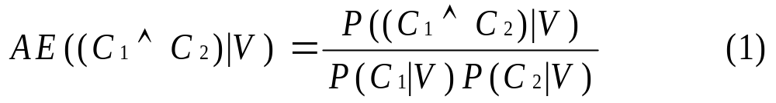
Kavalec et al(2004)
  No pre-defined set of relations
  Use the following AE measure to estimate the strength of the triple:
  Experimented with the tourism domain texts
We have also implemented the AE measure for the purpose of performance comparisons

Slide 39
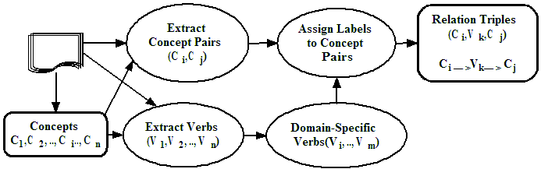
Our Method
The the framework of our method

Slide 40
Extracting concepts and concept pairs
  Domain concepts C are extracted using WNSCA + PE/POP
  Concept pairs are obtained in two ways:
    RCL: Consider pairs (C_{i}, C_{j}), both from C, and occurring together in at least one setence
    SVO: Consider pairs (C_{i}, C_{j}), both from C, and occurring as subject and object in a sentence
    Both use log-likelihood ratio to choose good pairs

Slide 41
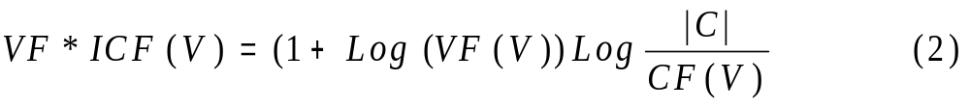
Verb extraction using VF*ICF Measure
Focus on verbs specific to the domain
Filter out overly general ones such as “do”, “is”
  |C|: total number of concepts
  VF(V): number of counts of V in all domain texts
  CF(V): number of concepts in the same sentence as V

Slide 42
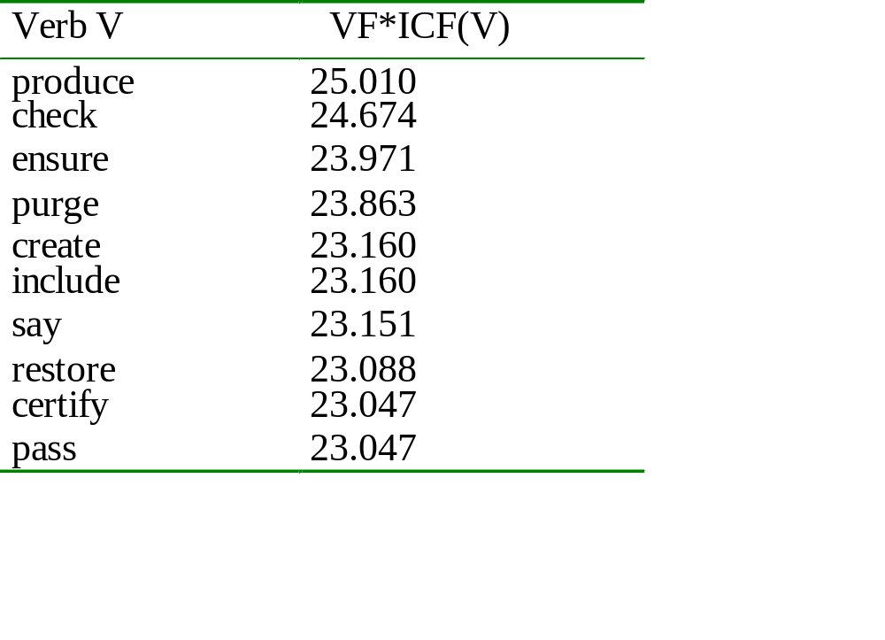
Sample top verbs from the electronic voting domain

Slide 43
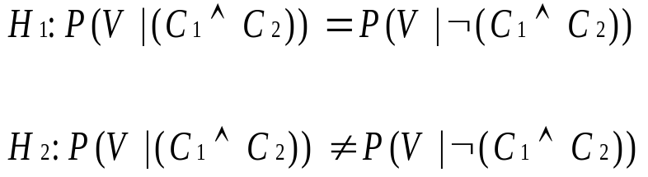
Relation label assignment by
Log-likelihood ratio measure
Candidate triples: (C₁, V, C₂)
  (C₁, C₂) is a candidate concept pair (by log-likelihood measure)
  V is a candidate verb (by VF*ICF measure)
  The triple occurs in a sentence
Question: Is the co-occurrence of V and the pair (C₁, C₂) accidental?
  Consider the following two hypotheses:

Slide 44
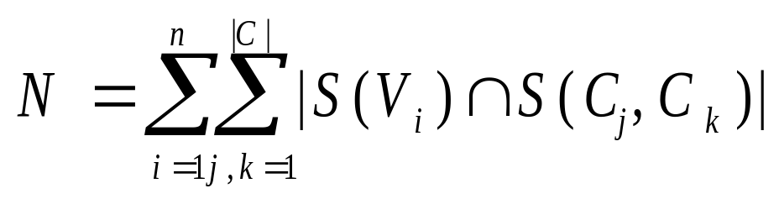
S(C₁, C₂): set of sentences containing both C₁, C₂
S(V): set of sentences containing V

Slide 45
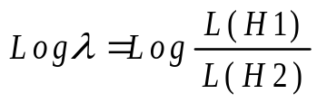
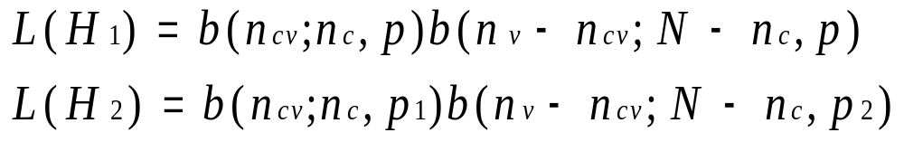
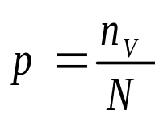
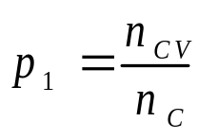
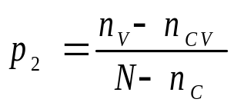
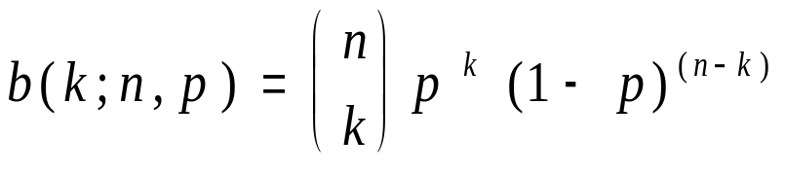

Log-likelihood ratio:
  For concept pair (C₁, C₂), select V with highest value for

Slide 46
Experiments on the E-voting Domain
Recap: E-voting domain
  15 articles from New York Times
  More than 10,000 distinct English words
  164 relevant concepts were used in the experiments
For VF*ICF validation:
  First removed stop words
  Then apply VF*ICF measure to sort the verbs
  Take the top 20% of the sorted list as relevant verbs
  Achieved 57% precision with the top 20%

Slide 47
Experiments -Continued
Criteria for evaluating a triple (C₁, V, C₂)
C₁ and C₂ are related non-hierarchically
V is a semantic label for either C₁ → C₂ or
  C₂ → C₁
V is a semantic label for C₁ → C₂ but not for C₂ → C₁

Slide 48
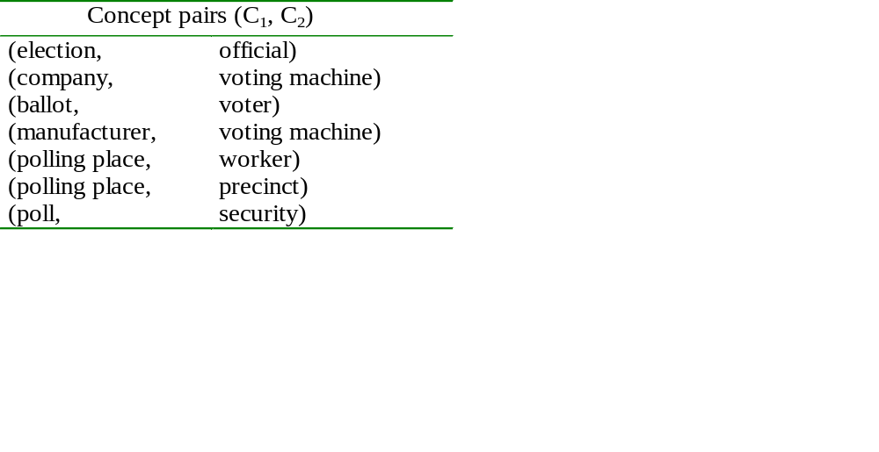
Experiments -Continued
yiuy787878uyuiuuuiuiuiiii
Table II Example concept pairs

Slide 49
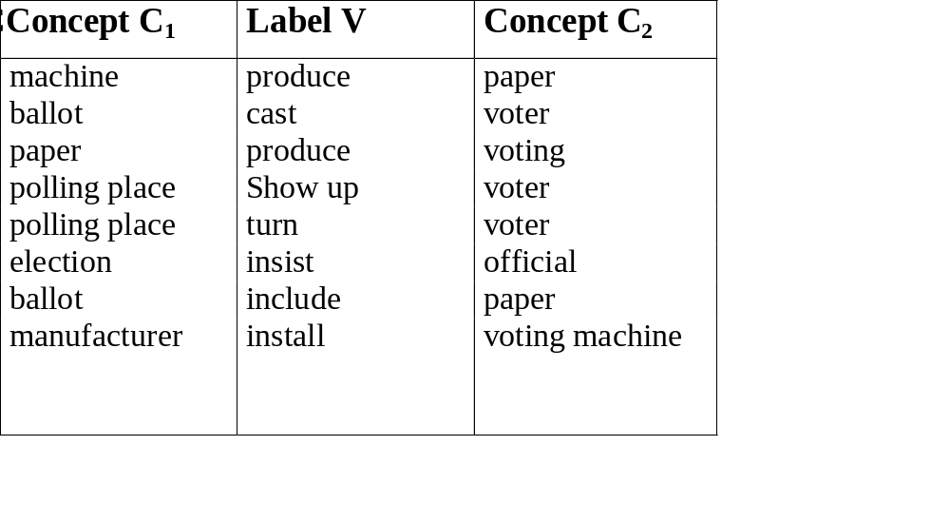
Experiments –RCL method
Table III RCL method example triples

Slide 50
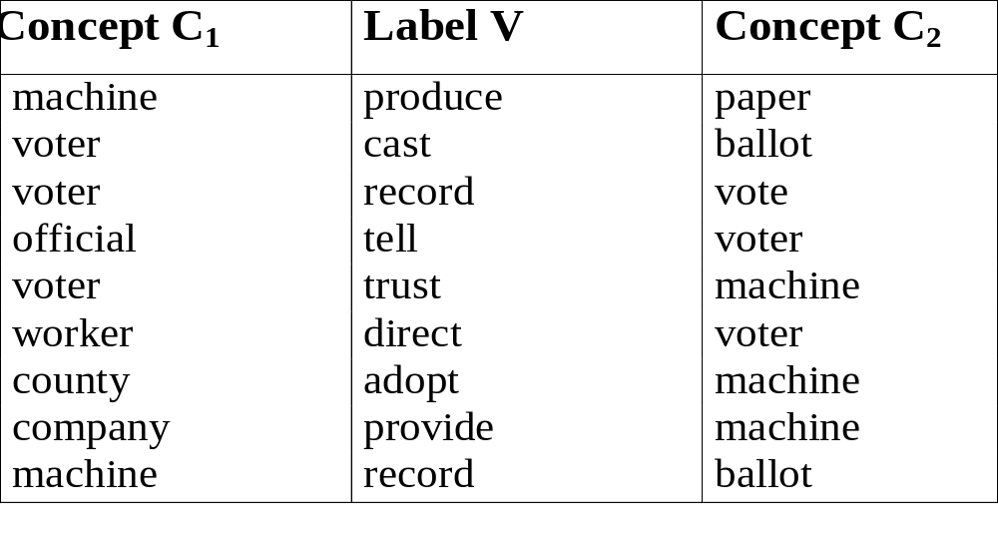
Experiments –SVO method
Table IV SVO method example triples

Slide 51
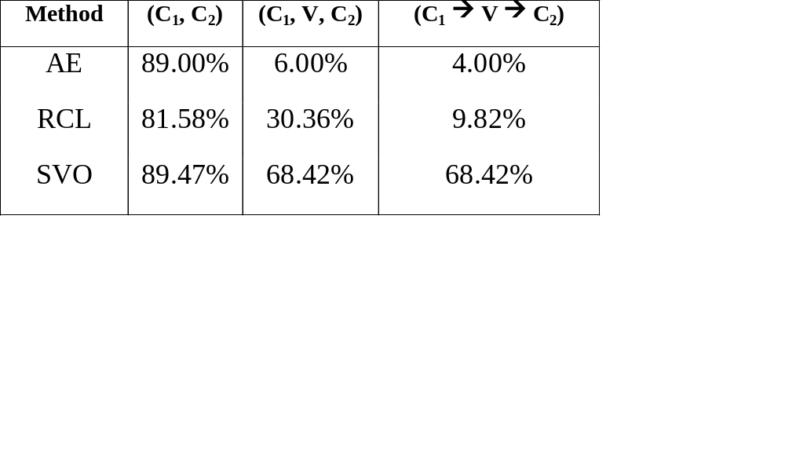
Comparisons
Table V Accuracy comparisons

Slide 52
Conclusions and Future Work
  Presented techniques for automatic ontology extraction from texts
  Combination of knowledge-base (WordNet), machine learning, information retrieval, syntactic patterns and heuristics
  For concept extraction, WNSCA gives good precision and WNSCA + POP gives good recall
  For taxonomy extraction, SCL and compound word heuristics are quite useful. The naïve Bayes classifier works well for SCL
  For non-taxonomy extraction, SVO method has good accuracy, but
    Require using syntactical parsing
    Coverage (recall) not good

Slide 53
Conclusions and Future Work
  Both WNSCA and SVO are unsupervised method whereas SCL is a supervised one - what about un-supervised SCL?
  The quality of extracted concepts heavily influences subsequent ontology extraction tasks
  Better word sense disambiguation method would help to produce better taxonomy extraction results using WordNet
  Consideration of other syntactic/semantic information may be needed to further improve non-taxonomical relation extraction
    Prepositional phrases
    Use WordNet
    Incorporate other knowledge
  More experiments with larger text collections

Slide 54
Thanks!
I am grateful to the CSC Department of UNC Charlotte for hosting my visit.
Special thanks to Dr. Zbigniew Ras for his
inspirations and continuous support over many
years.

