Slide 1
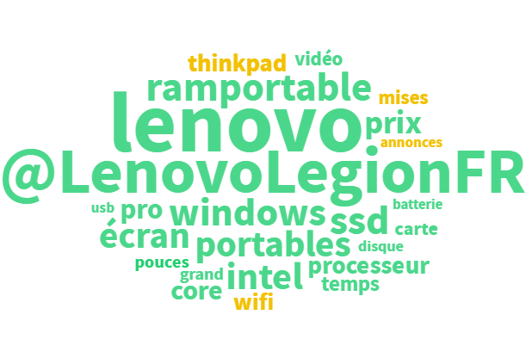
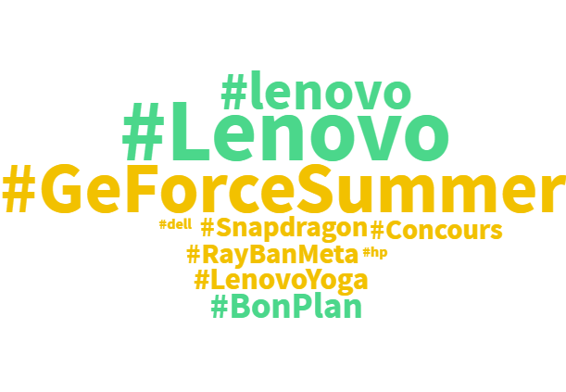
Lenovo Topic Modelling – Top Themes and Hashtags Clouds August '25

