Slide 1
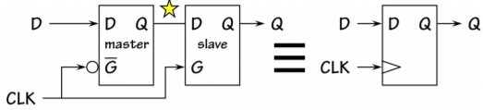

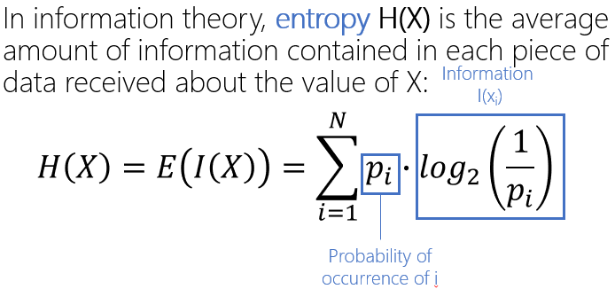
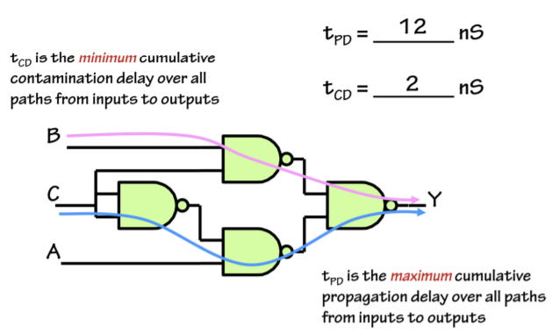
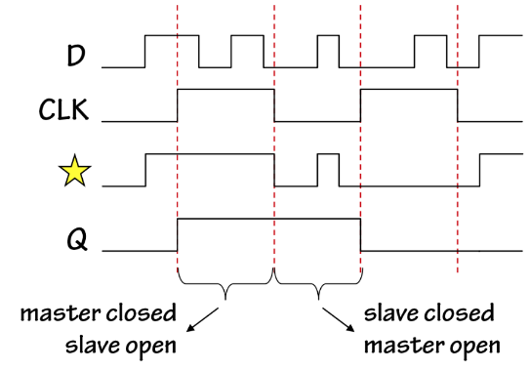

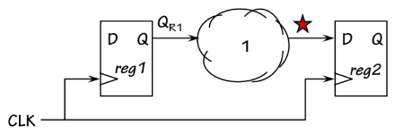
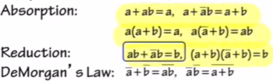

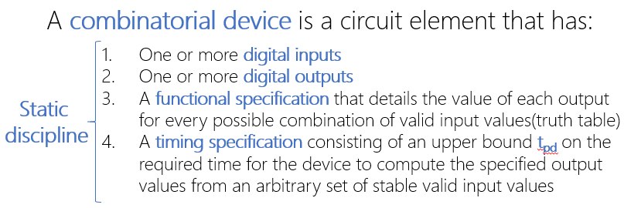
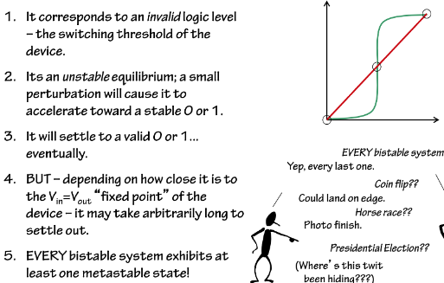
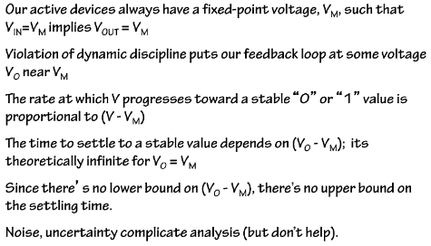
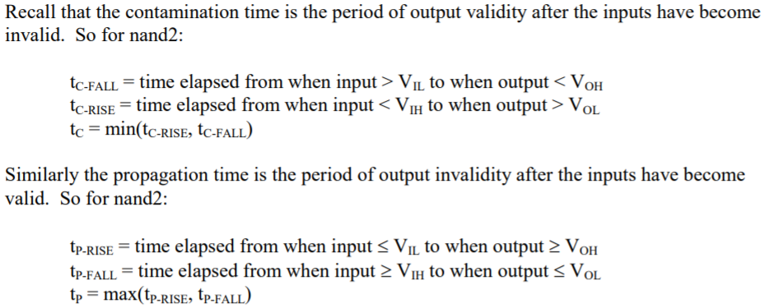
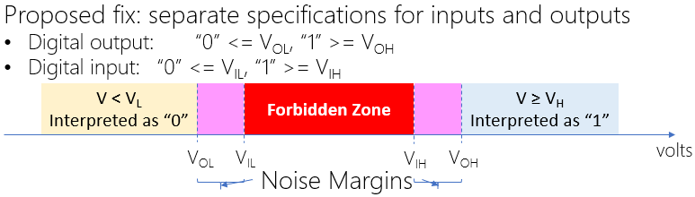
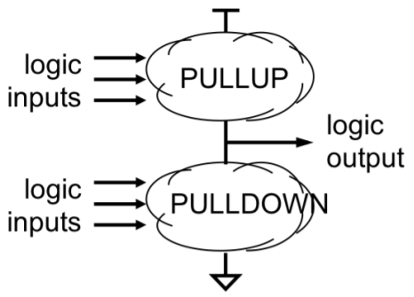
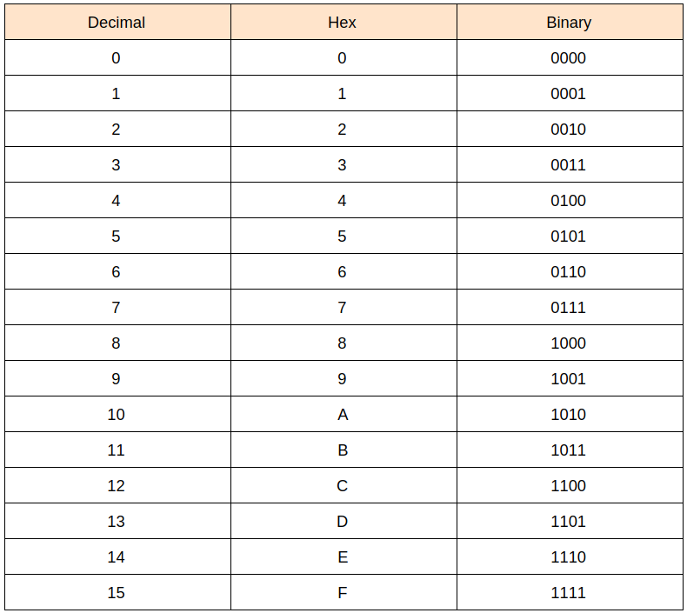
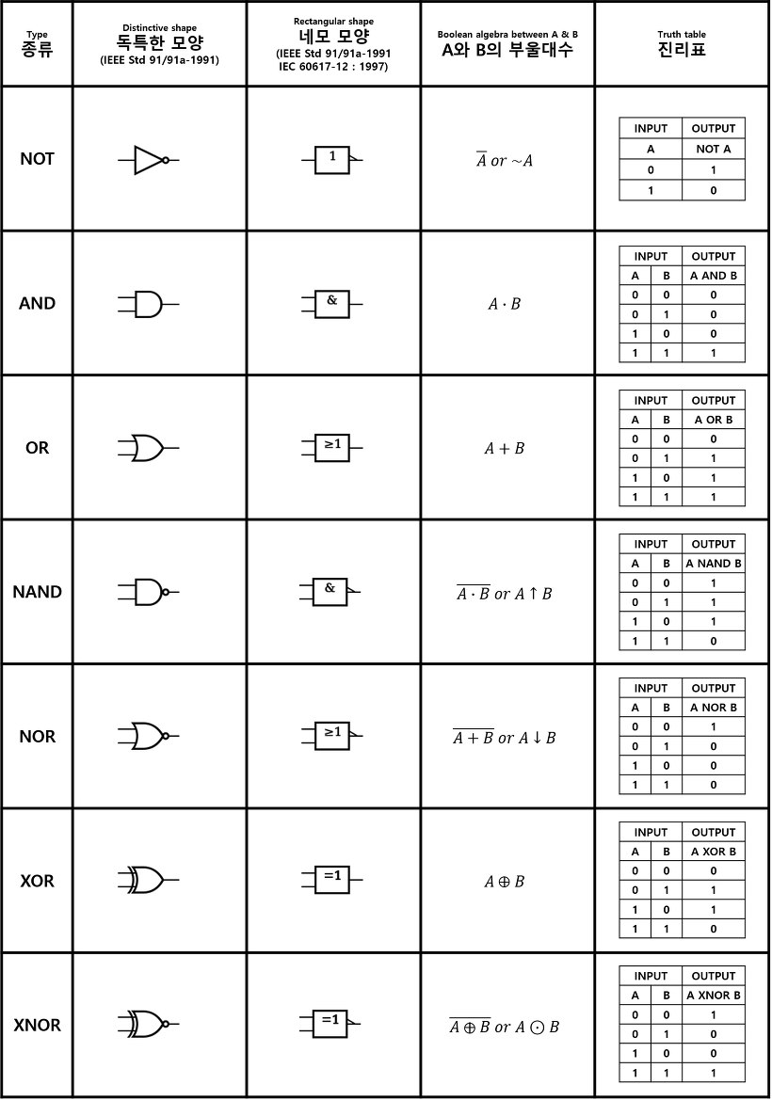
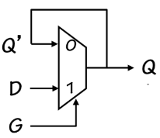
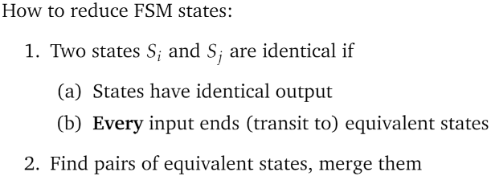
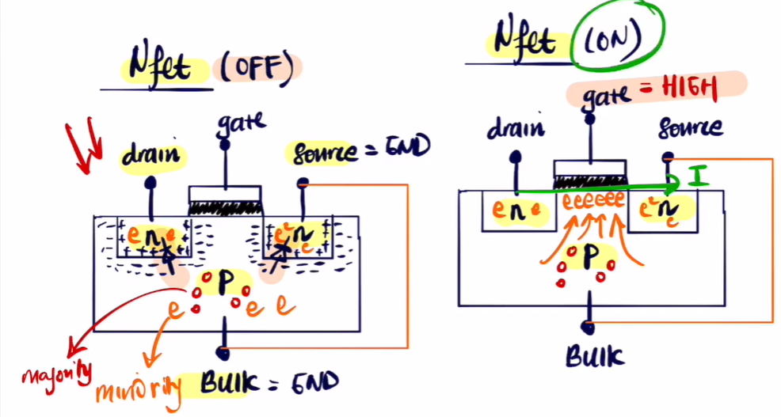
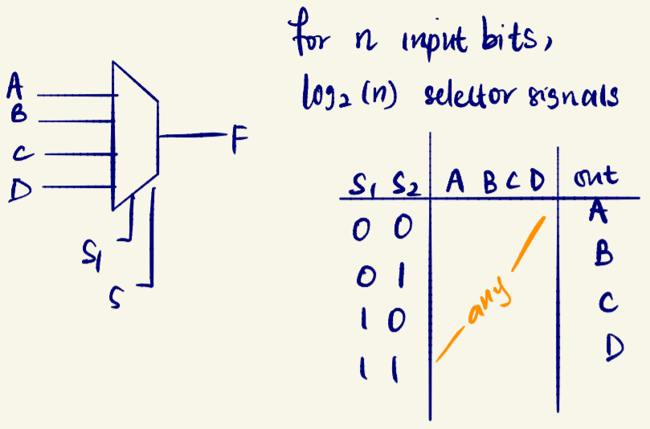
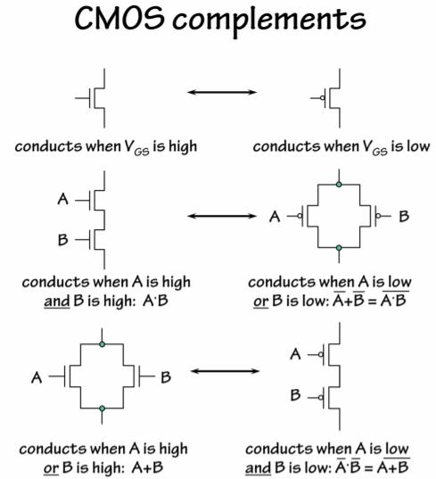

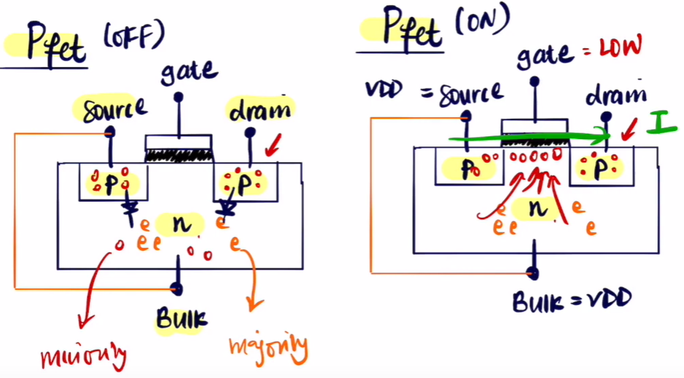
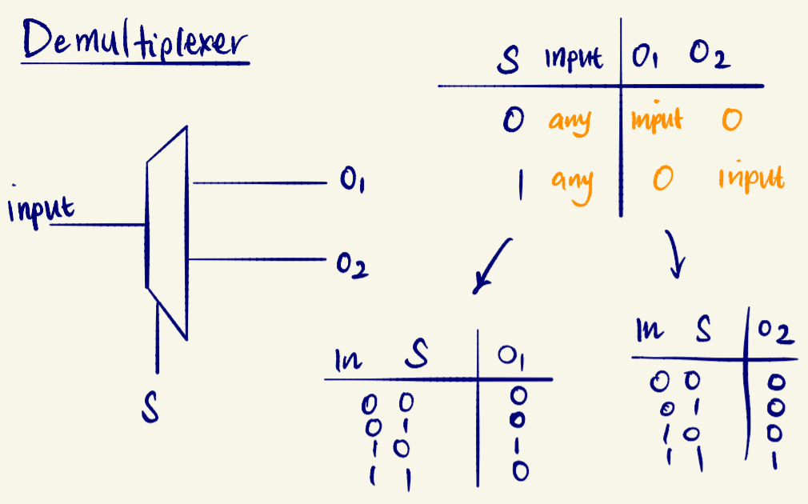


Information resolves uncertainty
Encoding-assign representations of info
$t_{pd}:time delay from valid input to valid output$(max)
$$t_{cd}:time delay from invalid input to invalid output(min)$$
Register/Flip Flop
t_{CD} of a Register (or sequential logic unit with registers and CLs in it) is the time taken for invalid CLK input to produce an invalid final output
t_{PD} of a Register (or sequential logic unit with registers and CLs in it) is the time taken for valid CLK input to produce a valid final output
N
choices
Narrow
to
M
choices
Entropy is the lower bound on the number of bits we need to represent this information.
Event of storing invalid value is called the metastable state, as shown in the figure below
$$\log_{2}\left(\frac{N}{M}\right)$$
For x-input devices-$2^{2^{x }}possible devices(gates)$
To fix metastable, introduce more delay
NOT
Gain = (V_{oh}-V_{ol})/(V_{ih}-V_{il})
AND
Pullup: All Pfets
Pulldown: All Nfets
D-latch
1: Write mode, input D
0: Memory mode, input Q’
Dynamic discipline:
t_{setup}= 2t_{PD}
t_{hold}= t_{PD}
t_{setup}=min. time the voltage on wire D needs to be stable before the clock edge changes from 1 to 0
t_{hold} =min. time the voltage on wire D needs to be stable after the clock edge changes from 1 to 0.
OR
NAND
Clock skew is the max diff in clock signal arrival times across all flip flops
NOR
XOR
XNOR

Slide 2
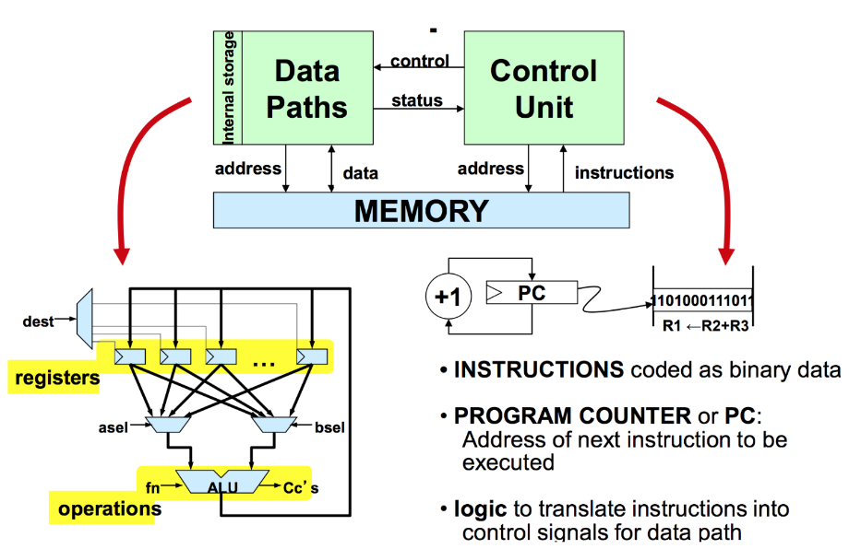
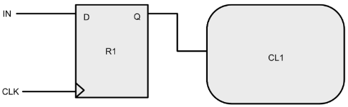
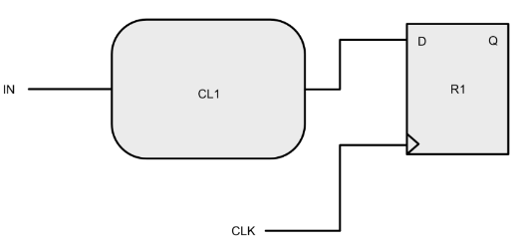
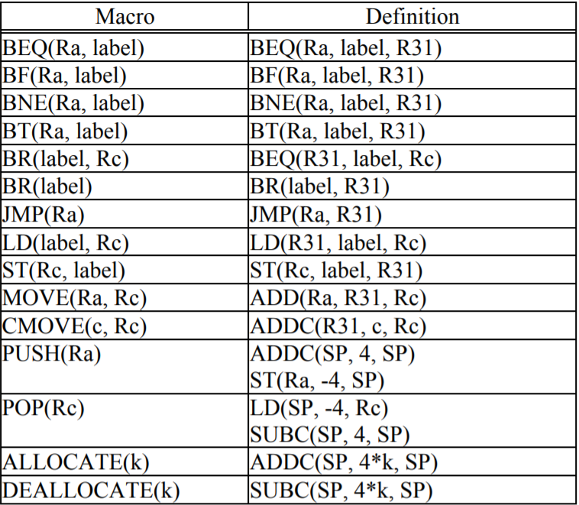
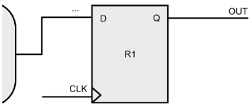
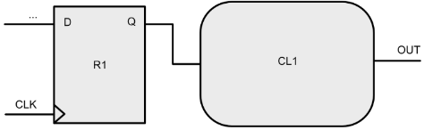
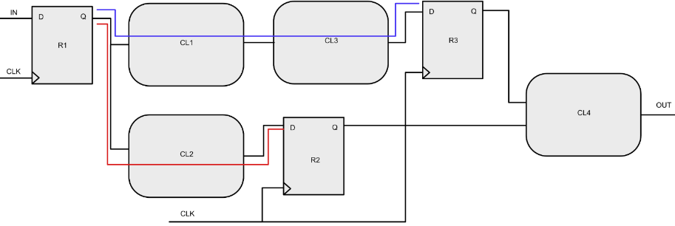
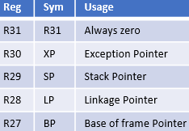
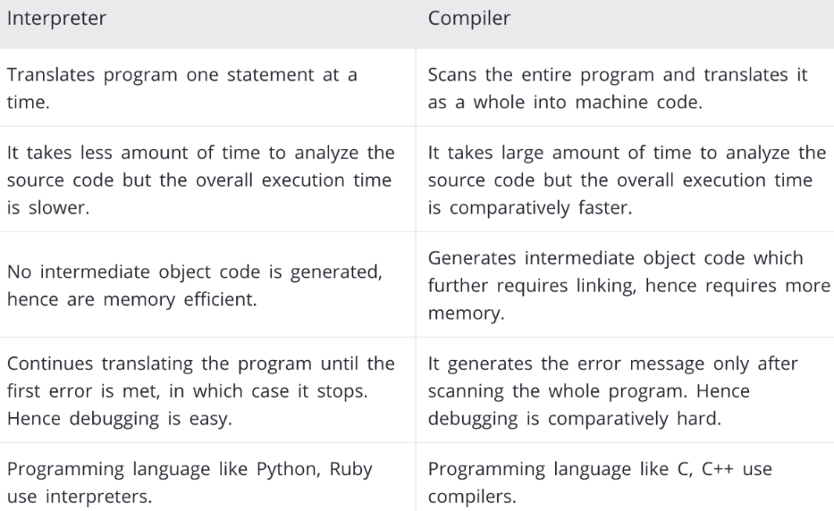
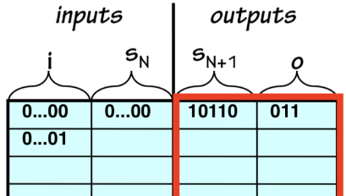
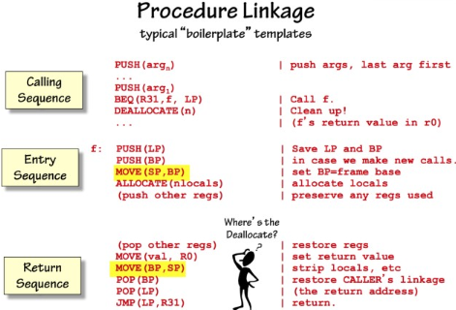
t_{setup}:time taken for the input to be stable before the clock changes from 1 to 0
t_{hold}:time taken for the input to be stable after the clock changes from 1 to 0
CPU
1: Calling Sequence –
Arguments
CMOVE(4,R1)
PUSH(R1)
2: Calling Sequence-
Branching and Cleanup
BR(square,LP)
DEALLOCATE(1)
HALT()
3: Entry Sequence
PUSH(LP)
PUSH(BP)
MOVE(SP,BP)
Step 4: The Actual Code
PUSH(R2)
LD(BP,-12,R2)
MUL(R2,R2,R0)
5: Exit Sequence -Pop
Regs from Actual Code
pops whatever register
that was used
POP(R2)
6: Standard Exit
Sequence
MOVE(BP,SP)
POP(BP)
POP(LP)
JMP(LP)
BR(square, LP) . This means to store the value of PC + 4 to register R28/ LP if R31 is equal to zero (which is always true since R31 is reserved register to 0), and then move PC to the address of ’square
literal computation of ’label’:
(a) Count how many lines of instructions are there between BR and the first line of instruction of the function ’label’ (not including BR but including that first line of instruction of function ’label’)
(b) There’s 2 lines of instructions for each PUSH or POP, and 1 line of instruction for each of every other β instruction.
(c) So the first instruction of function ’square’ is actually 3 lines away from BR(Square, LP), 1 line from DEALLOCATE(1), 1 line from HALT(), and 1 line from the first instruction of PUSH - which is ADDC.
The literal (in the 32-bit machine code) is this number (the number of instructions from BR to the first instruction of the function ’square’) subtracted by 1, hence the literal is 2.
BP-12 is always the address of the first argument. If there’s a second, third argument, then the address of it in the stack will be BP-16, BP-20, etc.
Always PUSH arguments in REVERSE order, meaning push argument n, then argument n-1, then argument n-2, ..., and finally argument 1.
6. A memory contains both instructions and stack
7. Registers are in the CPU, not part of the memory (RAM)
8. We only have limited registers, and the ALU (logic unit) can only access registers to perform computations, so we need stack in the memory, i.e: a temporary space to perform computation and execute function code.
9. Each time you call a function (this case, is function square), the stack grows (arguments pushing, entry sequence, and registers pushing) When the function returns (or ends), the stack diminishes (exit sequence, and pops)
11. When you PUSH(Rx), you are storing the CONTENT of Rx into the memory to the address pointed by SP
12. When you POP(Rx), you are loading the CONTENT of the memory with address pointed by SP back to register Rx
Memory address: 0x168 The initial content of SP is 0. When ALLOCATE(90) is executed, it increases the content of SP by 90 * 4 = 360. Therefore, the stack starts at address 0x168 (in hex).
Input->Register
Input->CL->Register
t_{S}= t_{S,R1}
t_{H}= t_{H,R1}
t_{S}= t_{PD,CL1} + t_{S,R1}
t_{H}= t_{H,R1} - t_{CD,CL1}
t_{PD}: time taken to produce a valid output after the CLK rise turns valid
t_{CD}: time taken to produce a invalid output after the CLK rise turns invalid
Register->Output
Register->CL->Output
t_{PD}= t_{PD,R1}
t_{CD}= t_{CD,R1}
t_{PD}= t_{PD,R1} + t_{PD,CL1}
t_{CD}= t_{CD,R1} + t_{CD,CL1}
address of “array”? 0x000000EC (59 lines of instructions/ content above “array” )
t_{BLUE}= t_{PD,R1} + t_{PD,CL1} + t_{PD,CL3} + t_{S,R3}
t_{RED}= t_{PD,R1} + t_{PD,CL2} + t_{S,R2}
Min CLK period = max(t_{BLUE}, t_{RED})
FSM:
Moore: output is drawn on states and depends on states
Mealy: output is drawn on transitions arcs and depends on both inputs and states
SP points to the available memory location to write to (first unused stack space).
BP points to the base of the stack, or equivalently first item pushed to the stack.
FSM as programmable machine
2^{i+s} words(input-state combo)
different FSM(in red box)
1. Central Processing Unit (CPU): containing several registers, as well as logic for performing a specified set of operations on their contents.
2. Memory: storage of N words of W bits each, where W is a fixed architectural parameter, and N can be expanded to meet needs.
3. Input/ Output: Devices for communicating with the outside world.
4. Connection bus that connects all the three components together.
Von neumann model
Done after execution
Decisions are made during run time, after execution
Slows program execution
Done before execution
Decisions are made during compile time, before execution
Slows program development

Slide 3
Reg | Sym | Usage
R31 | R31 | Always zero
R30 | XP | Exception Pointer
R29 | SP | Stack Pointer
R28 | LP | Linkage Pointer
R27 | BP | Base of frame Pointer

Slide 4
