Slide 1

Jinghao Yan
Adam Jiang
UC Berkeley

Slide 2


Slide 3

Extension of Erika Chin’s work on character-level taint tracking
Aimed at detecting command injection attacks:
  SQL Injection
  XSS
  Path traversal
  Shell command injection
Tracking can be limited to Strings
Notes:
Taint tracking reveals what data gets touched by user input
Attacks are injected into web applications in the form of strings, so we can limit the scope of tracking to strings

Slide 4

Source Tainting: augment the Java Servlets implementation to mark user input as tainted (Tomcat 6)
  Form input (GET/POST)
  Headers: Cookies, session IDs
Taint Propagation: augment string classes to track taint status (IBM JDK 6)
Sink Checking: at each sink, detect attacks by checking that control data is not tainted

Slide 5

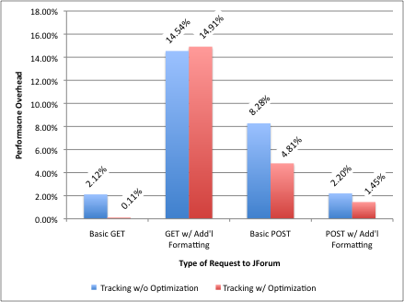
Character level tracking: a step up from string-level tracking
Macro-benchmarks using JForum showed up to 15% overhead
  Can we do better by representing taint differently?
Notes:
Instead of string level
Motivation

Slide 6

Focus on taint propagation
  Source tainting will need minor modifications
  Details on sink checking are well-documented
Optimize taint propagation performance
  Two representations for performance and flexibility
  Focus on common case: single interval
  But keep the character-level granularity: integer-array bitmap
Develop more rigorous measurements
  Microbenchmarking
  Profiling

Slide 7

Builds on top of the benefits of Erika Chin’s approach:
  One-time server-side change
  Easy adoption and deployment
Optimized for the common case:
  Tainted portions of strings usually contiguous
  Sink checking of intervals more common and efficient
Memory-efficient
  Better cache performance
  Fewer operations to copy and shift integer array

Slide 8

Some inherited limitations:
  Serialization does not store taint status
  May lose taint information via string operations with chars/char arrays
  Vulnerable to malicious web developers
  Format & regular expressions not retrofitted
Separate data structure with multiple representations introduce complexity

Slide 9


Slide 10

Java.lang.String
Java.lang.StringBuffer
Java.lang.StringBuilder
Javax.security.TaintSet*
  Java.lang is a protected package
* Our data structure

Slide 11

Single interval:
  General untrusted user input
  Substrings/combinations of (1)
  Defines a whole interval [a, b) as tainted (everything else untainted)
Bit set:
  Handles higher granularity
  Each bit corresponds to the character’s taint status
  Copy is created only when necessary—otherwise reused (substring, concatenating strings where at most one is tainted, etc)
Notes:
Length easier for implementation and optimization but [start, end) more intuitive so I’ll go with that in the presentation

Slide 12

Int offset:
  Index of the first possible tainted character
  If negative, represents position in taintbits (in bits)
Int length:
  Length of the single interval or taintbits (in bits)
Int[] taintbits:
  Null if single interval
  Bits represent taint status otherwise
Concatenation
Untainted, outside interval
Tainted
Untainted, within interval
null
offset
length
taintbits
111110000111110000000000111111
Notes:
Length easier for implementation and optimization but [start, end) more intuitive so I’ll go with that in the presentation

Slide 13

Concatenation
Untainted, outside interval
Tainted
Untainted, within interval
offset0
length0
Offset1
length1
offset3
length3
offset2
Length2=length0 + length1
Offset4=offset3
length3
length2
length4

Slide 14

50
200
.substring (50, 200)
[offset4, offset4 + length4), taintbits = [11…,…00…,…11]
[offset4-50, 200), taintbits = [11…,…00…,…11]
Strings are immutable, so we can share taintbits
  StringBuffer/Builder are mutable so substring requires a copy of relevant portions of taintbits
  Shared as much as possible
Currently factory tests for taint in the region (if not, returns null)
Notes:
Shared as much as possible (e.g. concatenating with an untainted string)

Slide 15

[offset5, 200), taintbits = …
offset0
length0
[offset0, offset0 + length0 + 200), taintbits = [111…,…0…,…1]
Concatenation
Creates an integer array large enough to hold 200 + length0 bits
Fills the first length0 bits with 1s
Copies the [-offset5, -offset5 + 200) bits of the source string’s taintbits to the [length0, length0 + 200) bits of the destination string’s taintbits

Slide 16
PREVIOUS IMPLEMENTATION
OUR IMPLEMENTATION
City
Punctuation State
Temp = Punctuation.concat(State)
Temp2 = City.concat(Temp)
City.concat(City)
City
Punctuation State
Temp = Punctuation.concat(State)
City.concat(Temp)
City.concat(City)
B | e | r | k | e | l | e | y
B | e | r | k | e | l | e | y
T | T | T | T | T | T | T | T
[0, 8), taintbits = null
,
C | A
,
C | A
null
null
null
null
, |  | C | A
, |  | C | A
null
null
B | e | r | k | e | l | e | y | , |  | C | A
B | e | r | k | e | l | e | y | , |  | C | A
T | T | T | T | T | T | T | T | F | F | F | F
B | e | r | k | e | l | e | y | B | e | r | k | e | l | e | y
B | e | r | k | e | l | e | y | B | e | r | k | e | l | e | y
T | T | T | T | T | T | T | T | T | T | T | T | T | T | T | T
[0, 16), taintbits = null

Slide 17

Pure interval set:
  Succumbs to pathological cases like
  for (String s : user_input)
  result += s + “,”;
Pure bitmap
  Handles above case, but generally inefficient
Single interval + boolean array hybrid
  Possible consideration
Use “all tainted” (single interval: [0, ∞)) constant
  Saves memory (reuses same object), potential operations (e.g. its substring is all tainted)
  Complicates logic
  Must change source tainting code

Slide 18


Slide 19

Many iterations of attempted testing
Learned about many Java pitfalls

Slide 20

Used custom class (Stopwatch) to track time using System.nanoTime()
Recorded start/end stop of each test, tracked difference in an ArrayList
for i in 0 to TESTLIMIT:
do initialization not part of the test
stopwatch.start()
do test
stopwatch.stop()

Slide 21

Dead-code elimination
System.nanoTime() precision
Compiler recompilation (JIT)
Flushing I/O

Slide 22

Same base Stopwatch class, but accounted for compiler optimizations
Added warm-up code (many iterations of test code before recording)
Added extraneous prints outside the “tested” code

Slide 23

Issues:
Determining steady state
  Could not check for recompilation
  High variance due to outliers
Inexplicable test results:
  toLower() ran faster on 1024 length string than 12

Slide 24

External framework (Benchmark)
  http://www.ibm.com/developerworks/library/j-benchmark2/
  Calls Runnable class 60 times
  Determines steady state, restarts with recompilation
  Determines average running time and standard deviation
Each trial invoked the framework once and was one JVM instantiation

Slide 25
Class Testing:
Testing(){var initialization}
run(){
// do test with vars
}

Slide 26
Caveats:
Loss of flexibility
Benchmark time includes fixed time cost for all tests
toString() output is very messy, processed by bash script
One output is the average of many runs, cannot get individual times
Need external script to run test n times

Slide 27
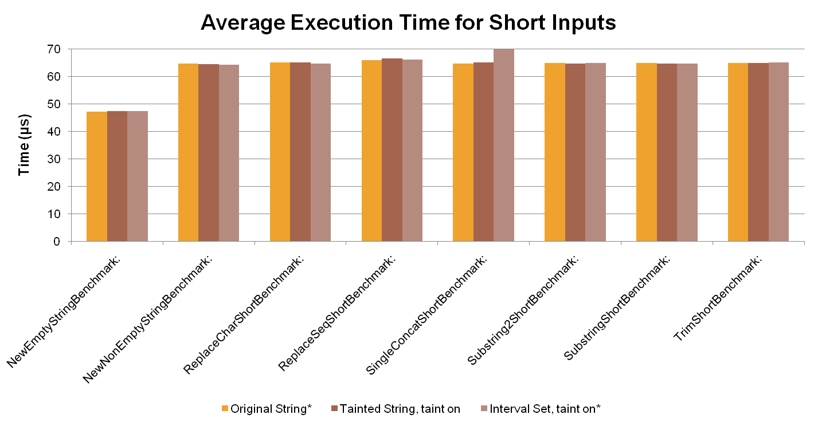
^120μs
*Tomcat running as background process

Slide 28
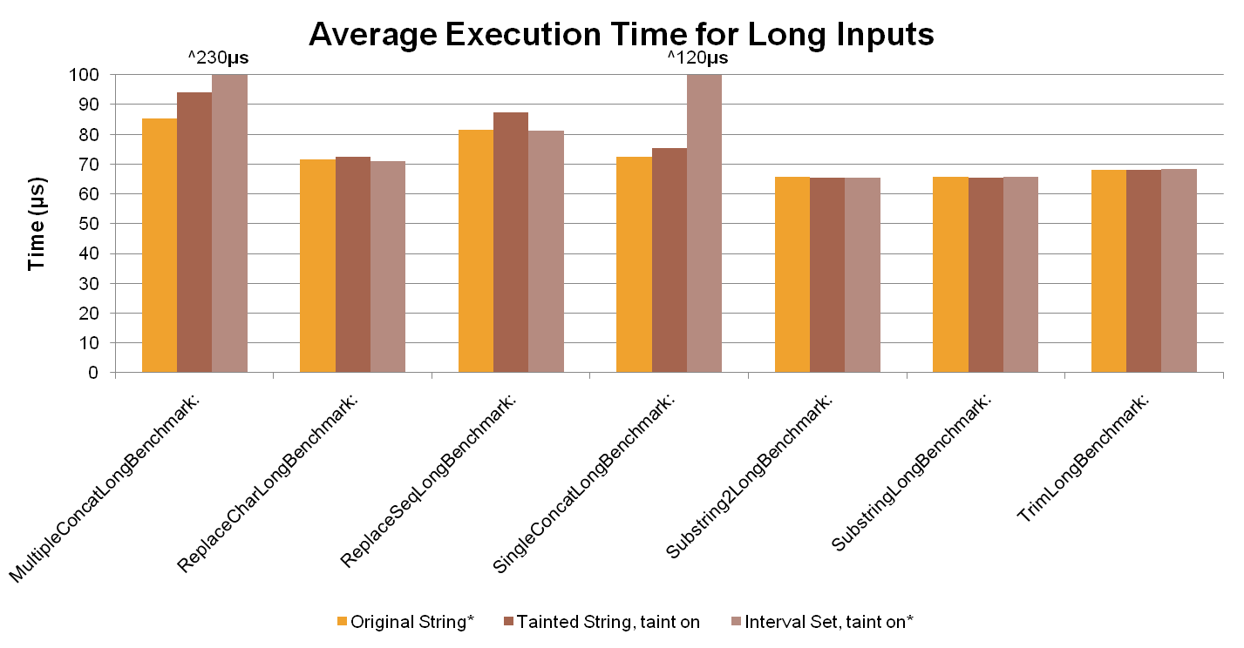
*Tomcat running as background process

Slide 29
Analysis:
Marginal gains in a subset of the tests
  Actual gains may be larger due to Tomcat process
Large costs of unknown origin in concatenation

Slide 30

Microbenchmarks:
Run all without Tomcat
Test multiple taint cases
Macrobenchmarks:
JForum/JProfiler
  Compare with Erika’s actual benchmarks
  Measure number of taint intervals in strings
Another webapp?

Slide 31



