Slide 1


北京电子科技职业学院
if语句嵌套结构
Simple application of if multi branch statement

Slide 2

目 录
catalogue
01
if语句嵌套结构实例演示
If statement nested structure example demonstration
02
if语句嵌套结构基本格式
Basic format of if statement nested structure
03
if语句嵌套结构简单应用
Simple application of if statement nesting structure

Slide 3
1
if语句嵌套结构实例演示
If statement nested structure example demonstration

Slide 4
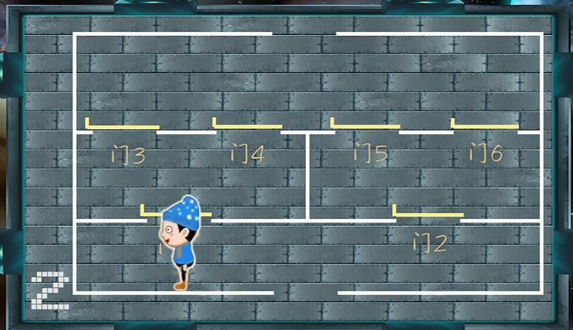
1. if语句嵌套结构实例演示
实例介绍:
example introduction:

Slide 5
2
if语句嵌套结构基本格式
Basic format of if statement nested structure

Slide 6
2. if语句嵌套结构基本格式
Basic format of if statement nested structure
if…else嵌套语句的格式： If... Else nested statement format:
其中表达式可以是任意表达式，语句可以是一条语句，也可以是复合语句。执行过程：如果表达式1为真，继续判断表达式2如果为真，那么执行语句1；如果表达式1为真，表达式2为假，那么执行语句2；如果表达式1为假，继续判断表达式3如果为真，那么执行语句3；如果表达式1为假，表达式3为假，那么执行语句4。
The expression can be any expression, and the statement can be a statement or a compound statement. Execution process: if expression 1 is true, continue to judge expression 2. If expression 2 is true, execute statement 1; If expression 1 is true and expression 2 is false, execute statement 2; If expression 1 is false, continue to judge expression 3. If expression 3 is true, execute statement 3; If expression 1 is false and expression 3 is false, statement 4 is executed.
if(表达式1 statement1)
if(表达式2 statement2)
语句1 sentence1
else
语句2 sentence2
else
if(表达式3 statement3)
语句3 sentence3
else
语句4 sentence4
执行描述：
Execution Description:

Slide 7
2. if语句嵌套结构基本格式
Basic format of if statement nested structure
流程图：flow chart:
True
表达式1
False
Statment1
True
表达式2
False
True
表达式3
False
Statment2
Statment3
语句1
语句2
语句3
语句4
Sentence1
Sentence2
Sentence3
Sentence4

Slide 8
3
if语句嵌套结构简单应用
Simple application of if statement nesting structure

Slide 9
3.if语句嵌套结构简单应用
Simple application of if statement nesting structure
语句编写
编程实现，输入一个点的x和y坐标，输出该点属于哪个象限。
Programming, input the X and Y coordinates of a point, and output which quadrant the point belongs to.
main()
{
}
int x,y;
scanf("%d%d",&x,&y);
if(x>0)
if(y>0)
printf("该点属于第一象限!\n")
else
printf("该点属于第四象限!\n");
else
if(y>0)
printf("该点属于第二象限!\n");
else
printf("该点属于第三象限!\n");
算法设计：Algorithm design:
1、定义两个整型变量；
2、输入两个整数；
3、利用嵌套语句判断横坐标和纵坐标的大小；
4、输出象限；
Define two integer variables;
Enter two integers;
Using nested statements to judge the size of abscissa and ordinate;
Output quadrant;
运行结果
20 -30↙
该点属于第四象限!

Slide 10
北京电子科技职业学院
End

