Slide 1


北京电子科技职业学院
一维数组元素的引用方法
Reference method of one-dimensional array elements

Slide 2

目 录
catalogue
01
一维数组元素引用实例演示
One dimensional array element reference example demonstration
02
一维数组元素引用的格式
Format of one-dimensional array element reference
03
一维数组元素引用的举例
Examples of one-dimensional array element references

Slide 3
1
一维数组元素引用实例演示
One dimensional array element reference example demonstration

Slide 4
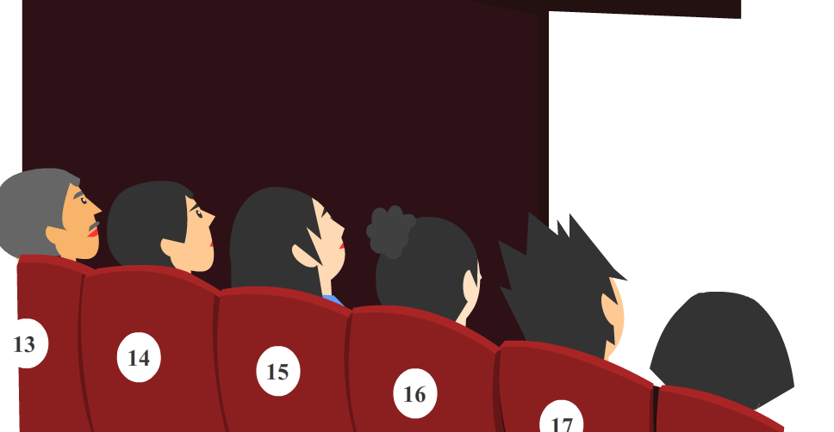
1.一维数组实例演示
One dimensional array instance demonstration
实例介绍：example introduction:
影院座位连续，人员调动
Continuous seats and personnel transfer in the cinema
内存空间连续，内容修改
Continuous memory space, content modification

Slide 5
2
一维数组元素引用的格式
Format of one-dimensional array element reference

Slide 6
2.一维数组的定义
Definition of one-dimensional array
数组引用格式：
Array reference format:
数组名[下标] Array name [subscript]
下标为整数，从0开始，最大值为长度-1，下标要用方括号括起来。
The subscript is an integer, starting from 0. The maximum value is length -1. The subscript should be enclosed in square brackets.
例如：For example:
int a[5]={2,7,9,4,3};
a[0] | a[1] | a[2] | a[3] | a[4]
2 | 7 |  | 4 | 3
8
9
如果执行语句a[2]=8，结果会变化。
If the statement a[2]=8 is executed, the result will change.

Slide 7
3
一维数组元素引用的举例
Examples of one-dimensional array element references

Slide 8
2.一维数组的定义
Definition of one-dimensional array
输入10个学生的某一门功课成绩，求出这些学生该门功课的平均成绩、最高分?
Input the scores of 10 students in a certain subject, and find out the average scores and the highest scores of these students in that subject?
语句编写Statement writing
main()
{
}
int a[10],i,max;
float ave,s=0;
算法设计如下：The algorithm is designed as follows:
for(i=0;i<10;i++)
scanf("%d",&a[i]);
1、定义一个整型数组a，长度为10；
1. Define an integer array a with a length of 10;
max=a[0];
for(i=0;i<10;i++)
{ s=s+a[i]; //累加求总成绩
if(a[i]>max) max=a[i];//求最高分
}
2、通过scanf语句进行数组元素赋值；
2. Assign values to array elements through scanf statements;
3、将第一个元素设为最高分；
3. Set the first element as the highest score;
ave=s/10; //求平均成绩
printf("ave=%.2f,max=%d\n",ave,max);
4、通过累加求和得到10学生的总成绩，同时通过比较得到最高分；
4. Get the total score of 10 students by accumulating and summing, and passGet the highest score by comparison
运行结果Running results
5、除以10就得到平均成绩； Divide by 10 to get the average score;
90 80 88 75 98 67 78 95 93 85↙
6、输出平均分、最高分； Output average score, maximum score
ave=84.90,max=98

Slide 9
总 结
Summary
通过实例理解一维数组元素引用的原理
Understand the principle of one-dimensional array element reference through examples
01
02
熟悉了一维数组元素引用的格式
Familiar with the format of one-dimensional array element reference
03
能够利用一维数组解决实际问题
Be able to use one-dimensional array to solve practical problems

Slide 10
北京电子科技职业学院
End

