Slide 1


BEIJING POLYTECHNIC
Definition of algorithm
Notes:
这是第一次课

Slide 2
Learning goals
Overview of the course：
Course schedule: 2 classes/week, 22 classes （11weeks）in total
Course objectives：
By studying syntax rules, data types, data operations, statements, system functions and program structure of C language, students can master the basic concepts and methods of program design, and then use C to solve general application problems, laying a good foundation for the various development of practical programs.

Slide 3
Learning goals
Assessment methods for this course：N+2
Assessment methods | N（40%） |  |  |  |  | 2（60%）
Assessment details | attendance | homework | classroom performance |  |  | class notes | final exam
proportion | 10 | 20 | 10 |  |  | 20 | 40

Slide 4
Learning goals
I hope you will achieve the following goals：
1.Master basic knowledge of algorithms；
2.Be able to draw flow charts of algorithms；
3.Write and debug simple c language programs using DEVCPP.

Slide 5

directory
01
demonstration of algorithm
02
Algorithm definition and Programming structure
03
Examples of algorithm

Slide 6
1
Demonstration of algorithm

Slide 7






1.Example of algorithm

Slide 8
2
Definition of algorithm
Three major structures of programming

Slide 9
2-1.Definition of algorithm
Definition ：
When solving problems in real life, the steps and methods formulated to solve problems are called algorithms。

Slide 10
2-2.Characteristics of the algorithm
Characteristics ：
（1）Finiteness：The steps involved in an algorithm must be finite, not infinite.
（2）Definiteness: The goal of each step in the algorithm must be unambiguous.
（3）Validity: Each step in the algorithm must be executed effectively if it is 000000000000executed.
（4）Zero or more inputs: Some algorithms require some input data, while 00000000000000000000000others may not.
（5）One or more outputs: Each algorithm should have at least one output that 00000000000000000000000reflects the final result of the problem.

Slide 11
2-3.Three major structures of programming
Three major structures：
（1）Sequential structure: step by step. (linear)
（2）Select structure: Perform different steps depending on 0000000000000000000conditions. (There are branches)
（3）Loop structure: Repeat some steps. (Looped)

Slide 12
2-3.Three major structures of programming
practice：
1.Which of the following conclusions is correct？
A. The algorithmic steps of a program are reversible
B. An algorithm can go on forever
C. There is only one algorithm to do one thing
D. The design of algorithm should follow the principle of simplicity and convenience
2.What is the finiteness of an algorithm？
A. The algorithm must contain output
B. Every step in the algorithm is executable
C. The steps of the algorithm must be limited
D. None is true

Slide 13
2-3.Three major structures of programming
practice：
3.What are the three major structures of programming？
A. Sequential structure
B. Select structure
C. Loop structure
D. None of the above
4.Which of the following is a loop structure？
conditions？
false
true
false
conditions？
true
A
B.
A.
C.
A
B
A
B

Slide 14
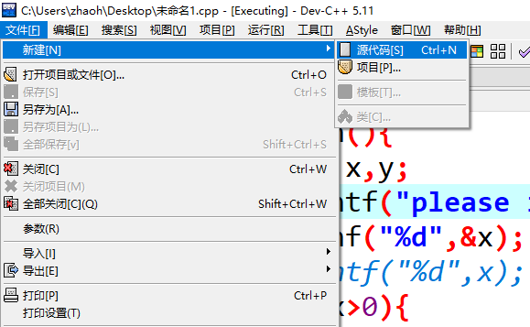
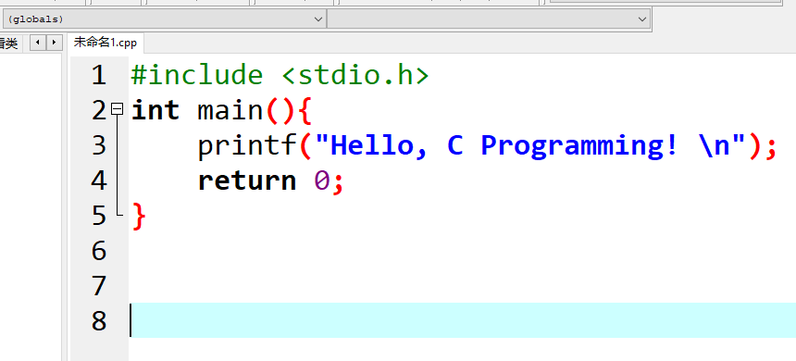
2-3.Three major structures of programming
Hello C Programming：

Slide 15
3
Examples of algorithm

Slide 16
3-1. Examples of algorithm
To find the value of y, please draw a flow chart of the algorithm.
Algorithm description：
（1）Enter the value of x；
（2）If x is greater than 0, y is 2x-1,
Then go to step 5; Otherwise, proceed to Step 3；
（3）If x is equal to 0, y is 0,
Then go to step 5; Otherwise, proceed to Step 4;
（4）y is 3x+1；
（5）Output the value of y.

Slide 17
3-2. Flow chart -- symbol representation
common symbol for flow charts：
Start-stop box
Input/output box
Processing box
Judge box
process line
Flowchart generally consists of three parts：
（1）The box that represents the corresponding operation；
（2）Flow lines with arrows；
（3）Necessary text inside and outside the box.

Slide 18
3-2. Flow chart -- sequential structure
Sequential structure flow chart：
思考：
A
How to use C language to calculate the sum of two numbers？
B
Implementation process：
Perform A and then B.

Slide 19
3-2. Flow chart -- sequential structure
practice ：
start
a,b,s
#include <stdio.h>
main(){
int a,b,s;
a = 2;
b = 3;
s = a + b;
printf("s=%d\n",s);
}
a=2
b=3
s=a+b
s
stop

Slide 20
3-2. Flow chart -- Select structure
Selection structure flow chart：
思考：
true
false
conditions？
A
B
How to judge whether a number is odd or even？
Implementation process：
Check the condition first. If the condition is correct, perform A; otherwise, perform B.

Slide 21
3-2. Flow chart -- sequential structure
start
practice ：
num
#include<stdio.h>
int main()
{
int num;
printf("please input a number : ");
scanf("%d",&num);
(num%2==0)?printf("even"):printf("odd");
}
printf()
scanf()
num%2==0?
true
false
even
odd
stop

Slide 22
3-2. Flow chart -- Loop structure
Loop structure flow chart：
思考：
conditions？
false
true
How to print the 10 numbers 10 to 19?
A
Implementation process：
First judge the condition, if the condition is true, execute A, and then rejudge the condition.Otherwise, break out of the loop.
Notes:
In classin, only the students on the stage can speak. I'm sorry that some students missed the opportunity to speak last time because they couldn't come on the stage. I started the mode of taking turns on the stage. This time, all students can have the opportunity to speak freely.
Last time, we learned three structures of programming: sequential structure, branch structure and loop structure. The loop structure has not been explained yet. In this class, we finish the loop structure, and then explain the concepts and applications of constants and variables in C language.
First judge the condition, if the condition is true, execute A, and then rejudge the condition.Otherwise, break out of the loop.

Slide 23
3-2. Flow chart -- sequential structure
practice ：
start
#include <stdio.h>
int main ()
{
/* for loop */
for( int a = 10; a < 20; a = a + 1 )
{
printf("a 的值： %d\n", a);
}
return 0;
}
a<20？
false
true
printf()
stop
Notes:
first we need to determine whether a is less than 20, if the condition is satisfied, output the value of A, if not, terminate the program.
In the for loop, the first expression represents the initial value, the second expression represents the judgment condition, and the third expression represents the step size. When executed for the first time, the value of A is 10, which satisfies the condition, so it prints, and a increments by 1. The second time, when a is 11, the program will execute the output.

Slide 24
3-4. Example algorithm answer
Can you draw a flow chart of the algorithm to find the value of y？
begin
input x
true
false
x>0
y=2x-1
true
false
x=0
y=0
y=3x+1
output y
end
Notes:
Let's look at the next exercise.Can you draw a flow chart of the algorithm to find the value of y?

Slide 25
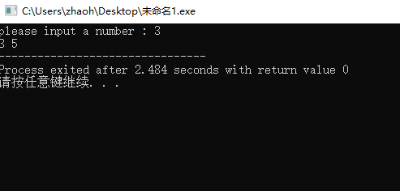
3-4. Example algorithm answer
#include <stdio.h>
int main(){
int x,y;
printf("please input a number : ");
scanf("%d",&x);
// printf("%d",x);
if(x>0){
y= 2*x-1;
}
else if(x==0){
y=0;
}
else if(x<0){
y=3*x+1;
}
printf("%d %d",x,y);
return 0;
}
Notes:
We can implement this algorithm by programming.#include <stdio.h>,Only with this header file can we use functions such as scanf and printf.

Slide 26
conclusion
01
Understand algorithm definition and characteristics through examples
02
Be able to draw flow charts using flow chart symbols
03
Understand the three major programming structures

Slide 27
北京电子科技职业学院
End

