Slide 1
SCALLOPseq
Analyst meeting
19 Oct 2020

Slide 2
Agenda
Fine tune analysis plan
Discuss timelines

Slide 3
1. Phenotype preparation
All proteins, including values <LOD
Rank-based inverse normal transformation
Covariates regressed out
Renormalised
*Discussion point on multimodal/other non-normal traits and whether normalising is the most appropriate

Slide 4
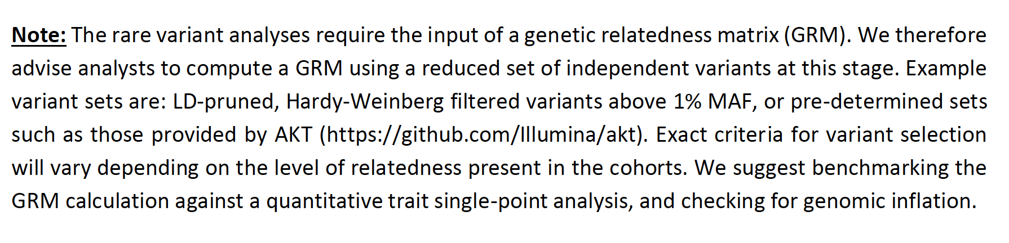
2. Data prep
Variant and sample QC
Files needed for single variant assoc (e.g. .bed/.bim/.fam)
VCF files – for RVA
Genetic relatedness matrix (GRM)

Slide 5
3. Single variant-based association
To consider:
Time to run the assoc
Indexing of files (tabix)
Formatting files

Slide 6
Timeline for single variant assoc
Covariate prep
Phenotype prep
GRM
Assoc
File indexing & formatting
DEADLINE: 15 January 2021

Slide 7
4. Rare variant analysis – SMMAT
Phase 2 to be implemented by individual cohorts, Phase 1 and 3 to be carried out centrally
Fit null generalised linear mixed model (GLMM)
Run SMMAT
Run SMMATmeta
Generate SNP info file (group definition file)
Phase 1
Phase 2
Phase 3
Notes:
GRM is to model covariance structure of random effects/accounts for population structure

Slide 8
4. Rare variant analysis – SMMAT
Phase 2 to be implemented by individual cohorts, Phase 1 and 3 to be carried out centrally
Fit null generalised linear mixed model (GLMM)
Run SMMAT
Run SMMATmeta
Generate SNP info file (group definition file)
Phase 1
https://github.com/hmgu-itg/burden_testing/wiki
Phase 2
Phase 3
Notes:
GRM is to model covariance structure of random effects/accounts for population structure

Slide 9
4. Rare variant analysis
Sharing of data
We have no single preferred way to do this
Google drive, Globus, Dropbox
SFTP
File sizes and runtimes for rare variant analysis (Phase 2)
1 phenotype, 4 conditions, all chromosomes
65x22 = 1430min = ~24 CPU hours
~1.5GB RAM usage
~3GB data saved on disk
Notes:
1 phenotype, 1 condition, chr11 only
MaxRSS: 1082M
Data saved on disk: 70M
Elapsed time: 00:26:03 (exon_regulatory)
1 phenotype, 4 conditions, chr11 only
~65min
134.1MB

Slide 10
4. Rare variant analysis - timeline
If VCF files for all cohorts are ready, Phase 1 (generation of group files) can start immediately
See Slide 11 or analysis plan for what the SNP file should look like
DEADLINE FOR PHASE 1
Sending over of variant lists: : 20 November 2020
Generation of group files:
TENTATIVE DEADLINE FOR PHASE 2:
TENTATIVE DEADLINE FOR PHASE 3:

Slide 11
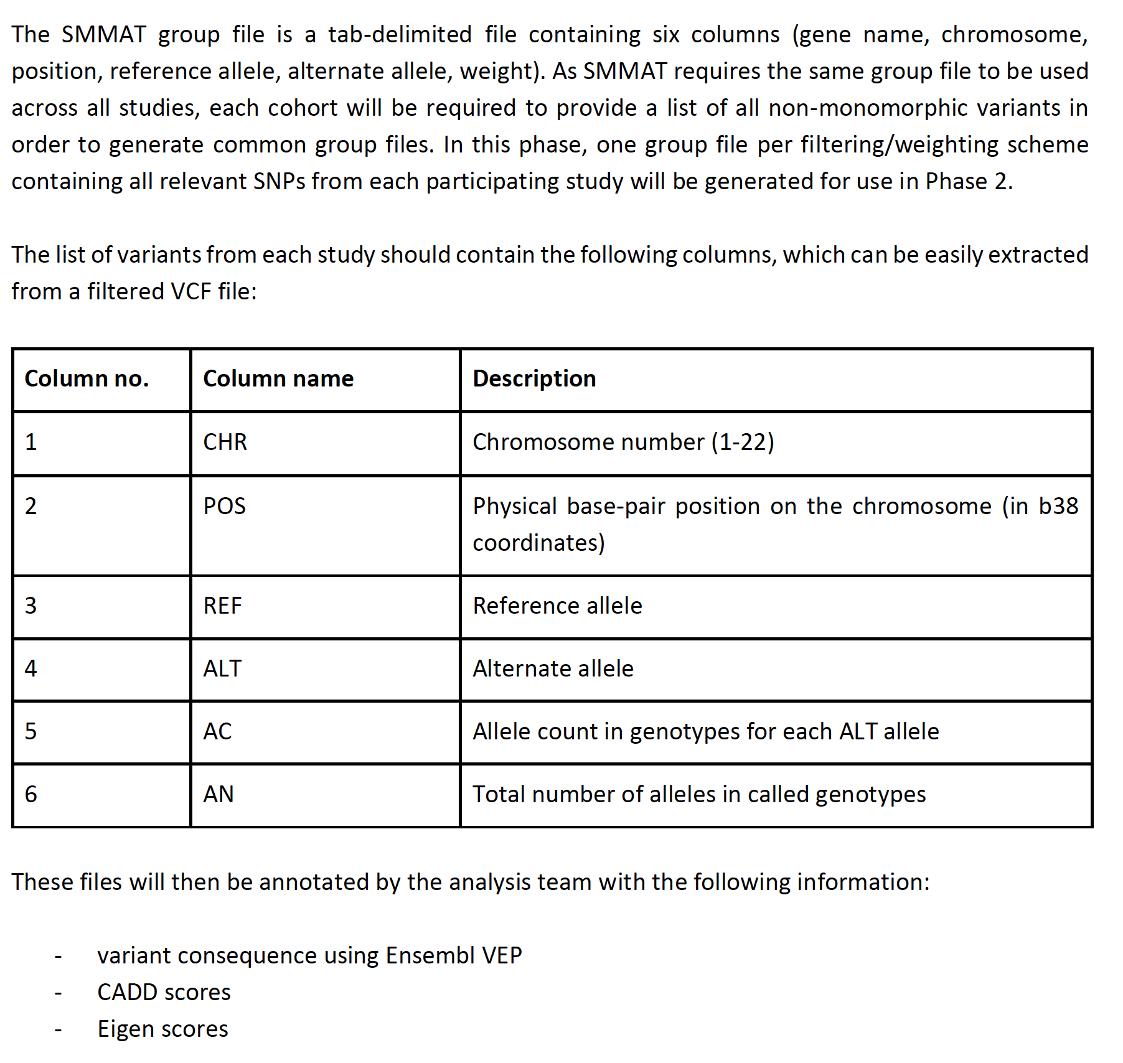

Slide 12
AOB

Slide 13
Next meeting
Early December

