Slide 1
Google doc
15/3/2021

Slide 2
Addresses & navigation
EndNote libraries, https://jhz22.user.srcf.net/INF/latest/
Google doc, https://docs.google.com/document/d/1yiIX541kvI5efPJR_K1qCa9AO2VbhhgGOPB7AKe_xGY/edit#
Google directory, https://drive.google.com/drive/folders/1IS2GNZzzD2d6vWWJKTmqFL5R_XNuGyeY

Slide 3
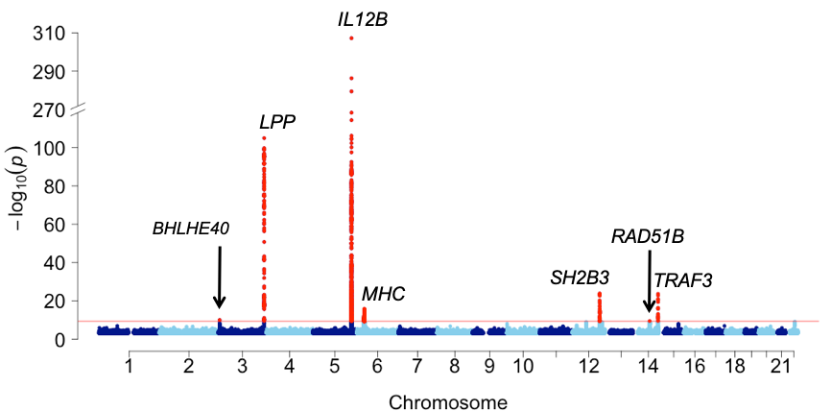
SCALLOP-INF IL.12B

Slide 4
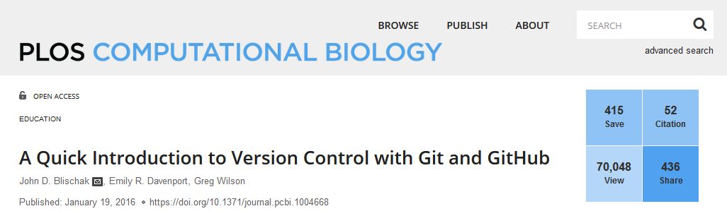
An introduction?
John D. Blischak, Emily R. Davenport, Greg Wilson. A Quick Introduction to Version Control with Git and GitHub. PLOS Comp Biol. January 19, 2016, https://doi.org/10.1371/journal.pcbi.1004668

Slide 5
A well-established routine
Do some experiments and save your in silico work in a “safe” place.
Backup on a media (e.g. other folder or “USB” to move around).
Make some changes in one of the above.
Leave some notes and possibly date them!
However, with multiple files in multiple projects (formal work, experiments) we loose track; a version control system (e.g., Concurrent Versions System or CVS, but it was rather complicated).

Slide 6
A SCALLOP-INF routine
Create a GitHub repository (INF) on day one.
Clone it to csd3.
Initiate new tasks and make changes on csd3.
Synchronise codes (not data) from local (csd3) to remote (GitHub).
Pull a copy at home computer.
A host of resources are available and a simple markdown becomes a gh-page (https://pages.github.com/).

Slide 7
The outcome and other examples
SCALLOP-INF.
pQTLtools. Some functions linking R/gap, R/TwoSampleMR, coloc; articles on METAL_forestplot, p, log(p),…
PGSP.
Consortium (HGI, SCALLOP-Seq)/other projects.
Tracking with GitKraken.

Slide 8
cambridge-ceu
Initial ideas from Praveen/Bram (others?)
Savita created the GitHub organisation.
Regular meetings were held in 2019.
CEU-journal-club was used to call journal clubs?
csd3, CEU-scientific-meetings, GitHub-matters, turboqq, turboman, ProGem, phenoscanner…
…
cambridge-ceu.github.io

Slide 9
cambridge-ceu.github.io
Repositories.
csd3. R, VEP (loftee, dbNSFP, genome-wide annotation), hail,…
CEU-journal-club. Discussed papers, IF.
CEU-scientific meetings. lookup (so many messages!), media information (which channel I don’t know?), online facilities (so many tips!), meetings (where is my Excel sheet?).
GitHub-matters. Technical information (could be local).
Hostings
METAL. study-level significance (one pass through -/+/n/p).
TwoSampleMR, ProGem, phenoscanner. Easier access.

Slide 10
TwoSampleMR
MS data only with OR, P available.
TwoSampleMR offers getse but not exported; read_data was designed to take in P/log10(P) but the latter did not work.
Changes were then made as a branch, to be merged into the Bristol master. https://github.com/MRCIEU/TwoSampleMR
The documentation.

Slide 11
Reflections
INTERVAL SomaLogic data – sentinel identification (2-d Manhattan plot, 3d plotly graph, …), joint-conditional analysis, annotation (VEP and GARFIELD), coloc, MR.
SCALLOP-INF.
…?
February 2021 documentation: csd3 page, pQTLtools page, cambridge-ceu page, personal page.

Slide 12
A new paradigm of collaborations
Individual functions/data.
Collation as package.
Canonical implementation.
Examples – pQTLtools.
A new look (DNS name?) for cambridge-ceu.github.io (esp, csd3).

