Slide 1
PW-pipeline
A PathWay pipeline

Slide 2
Methods
Pathway analysis using GWAS summary statistics conceptually involves several steps,
Associate SNP-based results with genes,
Investigate their correlations,
Mirror these to known biological pathways and functions.
The statistical significance is assessed typically via P values or FDRs.

Slide 3
Why it is necessary
A primary rationale is to facilitate analysis esp. different software require different formats with respect to GWAS summary statistics and pathway databases.
To perform many secondary analyses using results from pathway analyses. These may or may not be familiar to everyone.
Practically, the simple interface also facilitate high performance computing. For instance MAGENTA and PASCAL could be very time-consuming for interactive use. Most often one needs to make a copy of MAGENTA rather than a centrally available version, but a pipeline will do away with this.

Slide 4
Software included in the pipeline
Full name | Abbreviation | Reference
Meta-Analysis Gene-set Enrichment of variaNT Associations | MAGENTA | Segre, et al. (2010)
Generalized Gene-Set Analysis of GWAS Data | MAGMA | de Leeuw, et al. (2015)
Pathway scoring algorithm | PASCAL | Lamparter, et al. (2016)
Data-Driven Expression Prioritized Integration for Complex Traits | DEPICT | Pers, et al.(2015)

Slide 5
USAGE
INPUT. GWAS summary statistics (repro.txt), e.g.,
SNP A1 A2 freqA1 beta se P N chr pos
rs4970634 a g 0.6730 -0.1970 0.0216 6.433e-20 70423 1 39364617
SYNTAX. pwp.sh repro.txt
OUTPUT. One can choose software, e.g., MAGENTA, MAGMA.

Slide 6
References
Pers TH et al.(2015) Biological interpretation of genome-wide association studies using predicted gene functions. Nat Commun. 6:5890. doi: 10.1038/ncomms6890.
Segre AV, et al (2010). Common Inherited Variation in Mitochondrial Genes Is Not Enriched for Associations with Type 2 Diabetes or Related Glycemic Traits. PLoS Genet. 12;6(8). pii: e1001058. doi: 10.1371/journal.pgen.1001058
de Leeuw C, et al. (2015) MAGMA: Generalized Gene-Set Analysis of GWAS Data. PLoS Comput Biol. 11(4): e1004219. doi: 10.1371/journal.pcbi.1004219
Lamparter D, et al. (2016) Fast and Rigorous Computation of Gene and Pathway Scores from SNP-Based Summary Statistics. PLoS Comput Biol. 2016 Jan 25;12(1):e1004714. doi: 10.1371/journal.pcbi.1004714

Slide 7
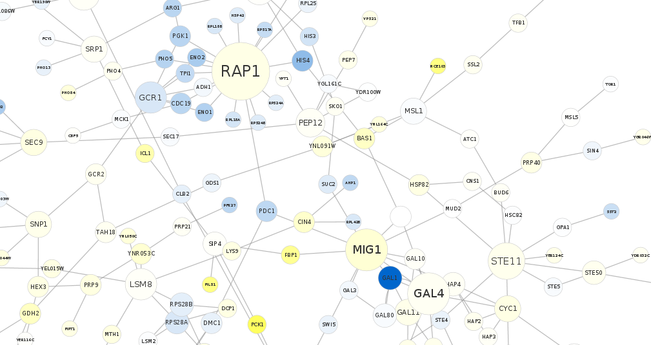
A sketch (CytoScape)

