Slide 1
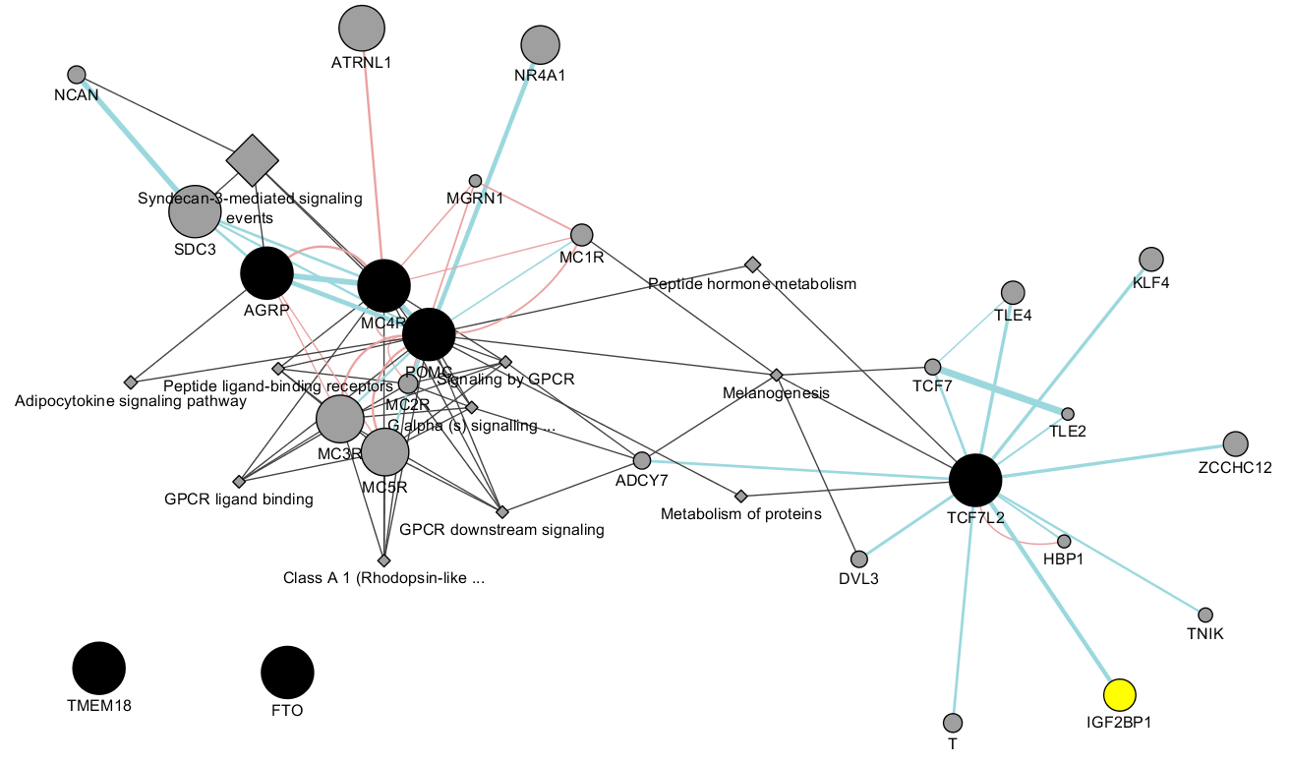
PW-pipeline
A PathWay pipeline for GWAS summary statistics

Slide 2
Rationale
Named analogously to FM-pipeline introduced earlier, the aim of the pipeline is to
facilitate setup of software.
accommodate input of GWAS summary statistics, pathway databases and software outputs, which allow for comparisons.
obtain additional statistics such as FDR and perform network analysis, which could be difficult to users.

Slide 3
Elements in the pathway analysis
We consider pathway analysis using GWAS summary statistics, which conceptually involves several steps,
Associate SNP-based results with genes,
Investigate their correlations,
Mirror these to known biological pathways and functions.
The statistical significance is assessed typically via P values or FDRs.

Slide 4
Support for software
Full name | Abbreviation | Reference
Meta-Analysis Gene-set Enrichment of variaNT Associations | MAGENTA | Segre, et al. (2010)
Generalized Gene-Set Analysis of GWAS Data | MAGMA | de Leeuw, et al. (2015)
Pathway scoring algorithm | PASCAL | Lamparter, et al. (2016)
Data-Driven Expression Prioritized Integration for Complex Traits | DEPICT | Pers, et al.(2015)

Slide 5
How to use
INPUT. GWAS summary statistics (repro.txt), e.g.,
SNP A1 A2 freqA1 beta se P N chr pos
rs4970634 a g 0.6730 -0.1970 0.0216 6.433e-20 70423 1 39364617
OUTPUT. One can choose software, e.g., MAGENTA, MAGMA.
SYNTAX. pwp.sh repro.txt
Examples are given to get SNP positions from specific builds base on UCSC; more details are available from /genetics/bin/PW-pipeline and https://github.com/jinghuazhao/PW-pipeline.

Slide 6
Issues resolved during the implementation
R has associate packages pre-installed for all users additional to default.
export R_LIBS=/genetics/bin/R:/usr/local/lib64/R/library
MAGENTA is in MATLAB and largely requires user copy and interactive use.
compiled version to be explored
DEPICT would need user-specific setup of Python.
export PATH=/genetics/bin/anaconda2/bin:$PATH
export PYTHONPATH=/genetics/bin/anaconda2/lib/python2.7/site-packages
tissue_plot.py and network_plot.py
PASCAL needs a more recent version of OpenBLAS than provided
MAGENTA and PASCAL could be very time-consuming and are ideally run on clusters.
qsub -pe make -5

Slide 7
Features of the pipeline
mp. Multiple precision flag, at least for DEPICT when set it will handle very large |z| for which the P-value is zero and –log10(P) infinity.
min_gs_size. Minimum size of a gene set, which is 10 by default for MAGENTA whereas DEPICT is five.
max_gs_size. Maximum size of a gene set, which is 2000 by default for MAGENTA.
p_threshold. This is to compromise the suggestion that DEPICT is needed for both 5E-8 and 5E-5.
nr_repetitions. Number of random sampling to obtain FDR via DEPICT.
It is possible to have an Excel workbook containing results from all software. Additional analysis such as FDR for PASCAL, and cluster/network analysis.

Slide 8
Features of individual software
MAGENTA. Confounding effects on gene association scores are identified and corrected for, without requiring genotype data.
MAGMA. Similar to MAGENTA in spirit.
PASCAL. Gene scores are obtained by aggregating SNP p-values from a GWAS meta-analysis while correcting for LD using a reference population.
DEPICT. It is a computational framework for gene prioritization, GSEA and tissue/cell type enrichment analysis.

Slide 9
Database by software
Databases |  | MAGENTA | MAGMA | PASCAL | DEPICT
GO_terms_BioProc_MolFunc | 9,433
Ingenuity_pathways | 92
KEGG_pathways | 168
PANTHER_BioProc | 241
PANTHER_MolFunc | 252
PANTHER_pathways | 141
 | 10,327 | x | x | x
MSigDB v6.0/c2 | 4,731 | x | x | x
MSigDB v6.0 | 17,779 | x | x | x
depict | 10,968 |  |  |  | x
depict_discretized_cutoff3.2 | 14,462 | x | x | x | x

Slide 10
Power comparison using a benchmark
Common database | Nominal | Bonferroni | FDR<0.05 from software | FDR<0.05 from R | Running time
MAGENTA | 1,091 | 15 | 265 | 263 | +7 days
MAGMA | 585 | 0 |  | 0 | almost instant
PASCAL | 1,896 | 72 |  | 340 | <3 days
DEPICT | 2,569 | 93 | 1,418 | 1,272 | <1 hr

Slide 11
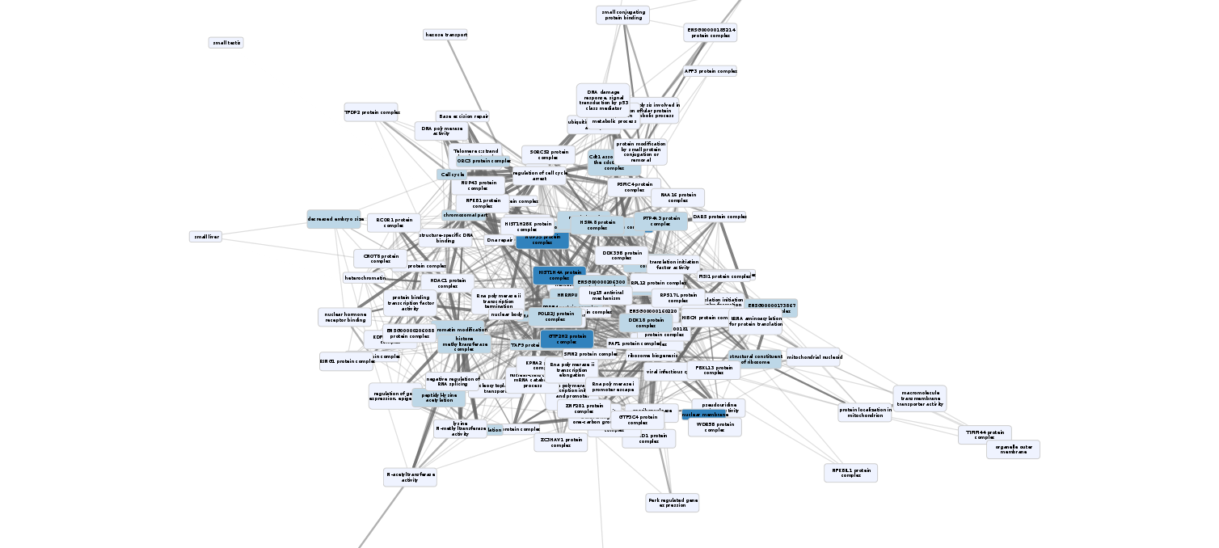
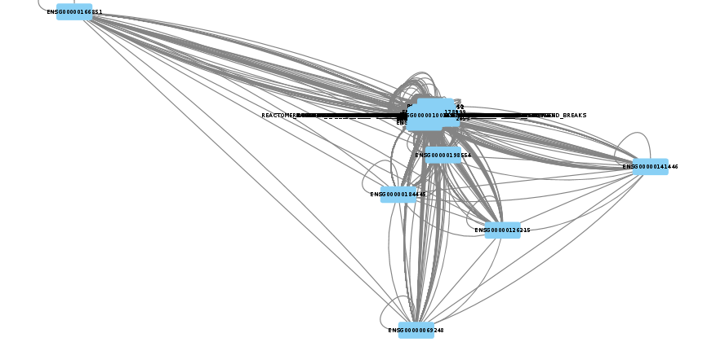
Self-organised map/Network plots

Slide 12
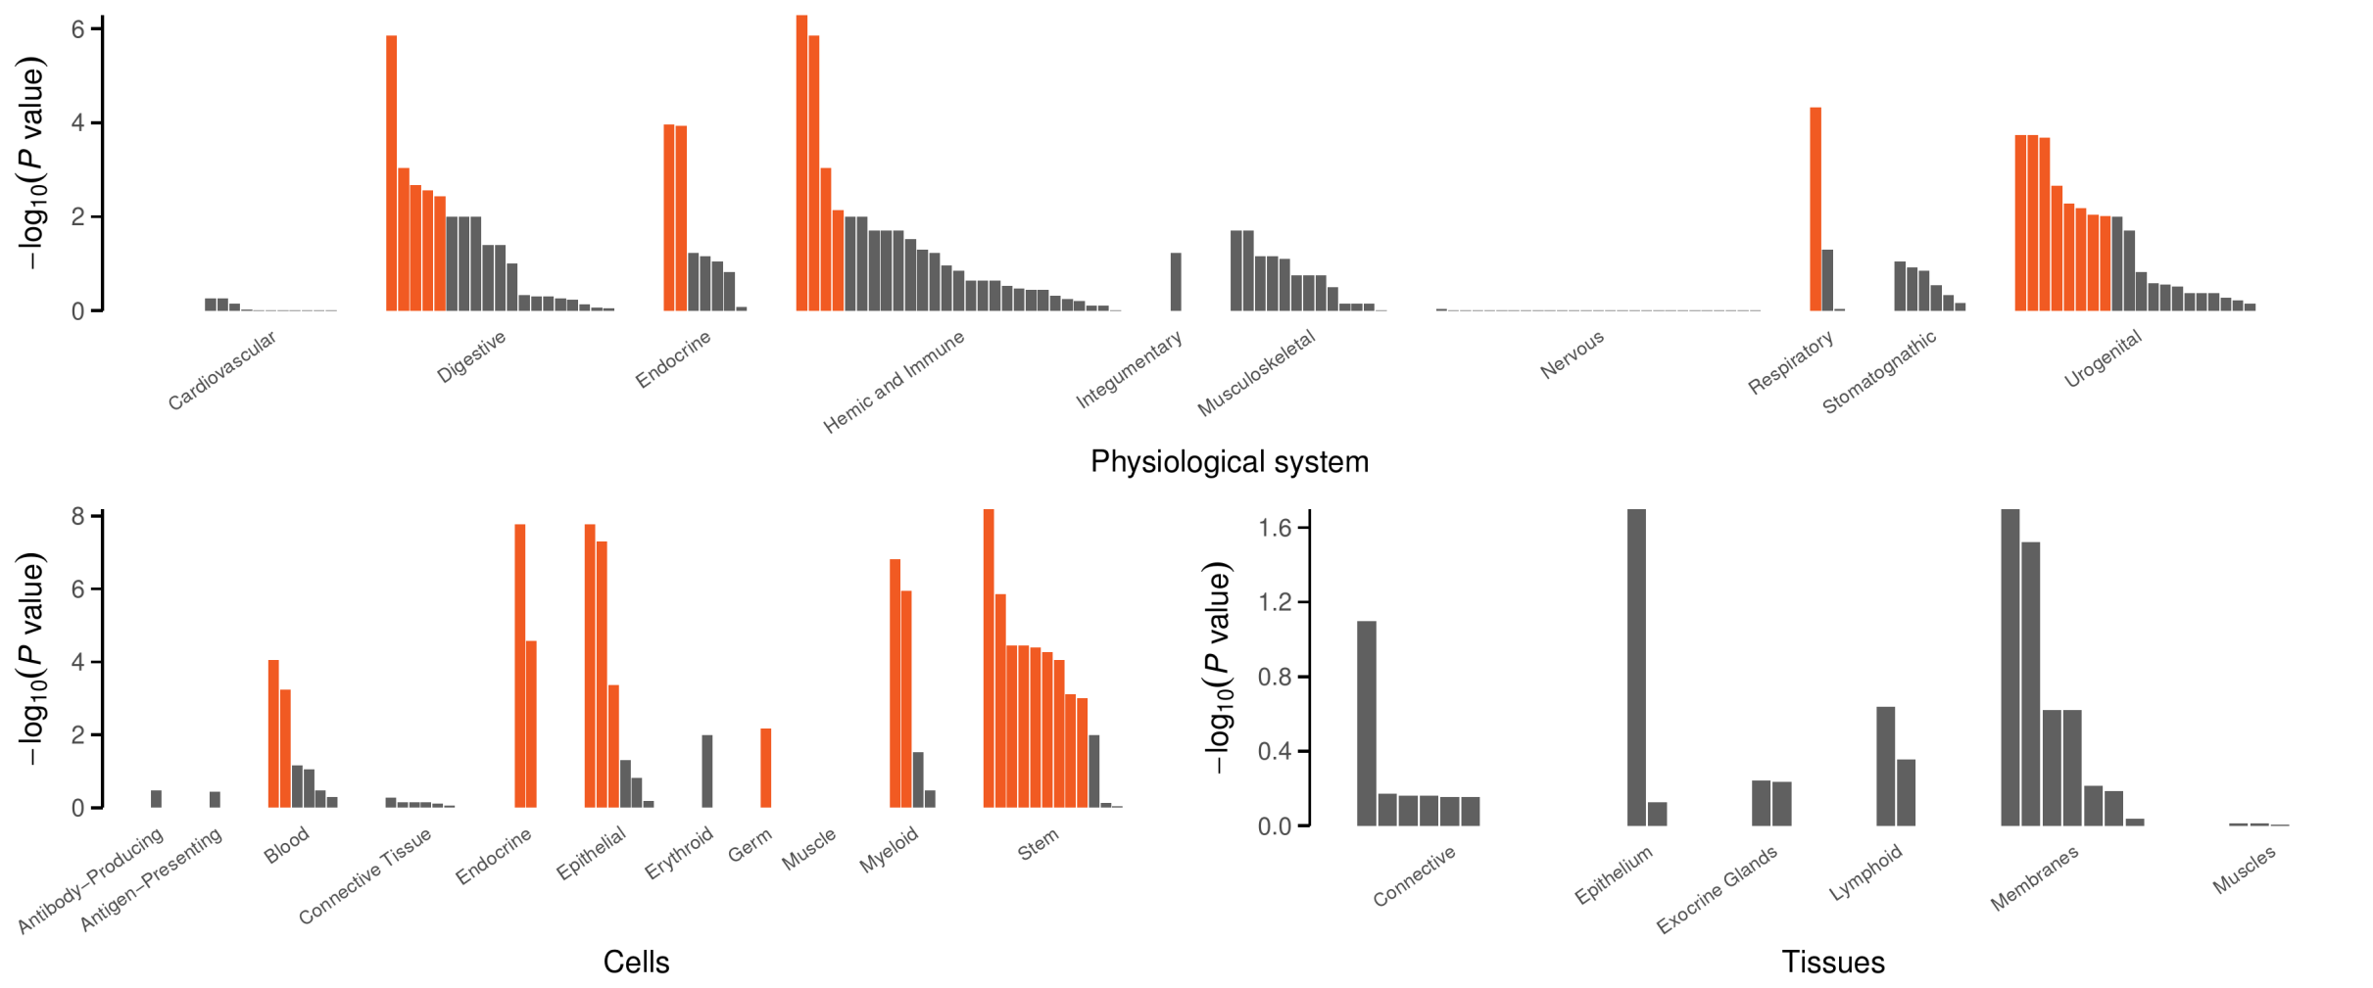
Tissue plots

Slide 13
Which software to use
It has been comfortable here with MAGENTA, so it would still be a starting point. However, it is desirable to use with other databases from MSigDB or DEPICT, the latter also facilitate network analysis.
When seeking more power, PASCAL is the next choice as it is the closest to DEPICT in that respect.
DEPICT features tissue enrichment analysis which can be coupled with GTEx data as implemented in FUSION/TWAS-pipeline/MetaXcan.
We are open to other software such as DAVID, DEPICT adapted for exome data, inverse normal transformed version, etc.
To ease interpretation, we can use MSigDB/c2 for instance.

Slide 14
Final remarks
The common database
facilitates cross-software comparison.
allows for correlation between software to be calculated.
The pipeline
takes advantage of the database to perform cluster analysis including affinity propagation clustering as well as build networks.
Generates simple interaction format (SIF) and edge list (EL) formats which can be fed into Cytoscape for visualisation using a variety of layouts and analysis through many plugins. Further extensions are possible.
At the very least, use the setup for GWAS, e.g., MAGENTA + common database + clusters.

Slide 15
References
Segre AV, et al (2010). Common Inherited Variation in Mitochondrial Genes Is Not Enriched for Associations with Type 2 Diabetes or Related Glycemic Traits. PLoS Genet. 12;6(8). pii: e1001058. doi: 10.1371/journal.pgen.1001058
de Leeuw C, et al. (2015) MAGMA: Generalized Gene-Set Analysis of GWAS Data. PLoS Comput Biol. 11(4): e1004219. doi: 10.1371/journal.pcbi.1004219
Lamparter D, et al. (2016) Fast and Rigorous Computation of Gene and Pathway Scores from SNP-Based Summary Statistics. PLoS Comput Biol. 2016 Jan 25;12(1):e1004714. doi: 10.1371/journal.pcbi.1004714
Pers TH et al.(2015) Biological interpretation of genome-wide association studies using predicted gene functions. Nat Commun. 6:5890. doi: 10.1038/ncomms6890.

