Slide 1
PW-pipeline
A PathWay pipeline

Slide 2
Methods
Pathway analysis using GWAS summary statistics conceptually involves several steps,
Associate SNP-based results with genes,
Investigate their correlations,
Mirror these to known biological pathways and functions.
The statistical significance is assessed typically via P values or FDRs.

Slide 3
Rationale
To facilitate use of software whose setup is difficult for many.
MAGENTA is in Matlab and largely requires user copy and interactive use.
DEPICT would needs user-specific setup of Python.
PASCAL needs a more recent version of OpenBLAS than provided
MAGENTA and PASCAL could be very time-consuming and are ideally run on clusters.
To accommodate input of GWAS summary statistics, pathway databases and software outputs, which allow for comparisons.
To perform additional analyses such as FDR and network analysis, which could be another barrier to users.

Slide 4
Software details
Full name | Abbreviation | Reference
Meta-Analysis Gene-set Enrichment of variaNT Associations | MAGENTA | Segre, et al. (2010)
Generalized Gene-Set Analysis of GWAS Data | MAGMA | de Leeuw, et al. (2015)
Pathway scoring algorithm | PASCAL | Lamparter, et al. (2016)
Data-Driven Expression Prioritized Integration for Complex Traits | DEPICT | Pers, et al.(2015)

Slide 5
USAGE
INPUT. GWAS summary statistics (repro.txt), e.g.,
SNP A1 A2 freqA1 beta se P N chr pos
rs4970634 a g 0.6730 -0.1970 0.0216 6.433e-20 70423 1 39364617
SYNTAX. pwp.sh repro.txt
OUTPUT. One can choose software, e.g., MAGENTA, MAGMA.
Examples are given to get SNP positions from specific builds.

Slide 6
References
Pers TH et al.(2015) Biological interpretation of genome-wide association studies using predicted gene functions. Nat Commun. 6:5890. doi: 10.1038/ncomms6890.
Segre AV, et al (2010). Common Inherited Variation in Mitochondrial Genes Is Not Enriched for Associations with Type 2 Diabetes or Related Glycemic Traits. PLoS Genet. 12;6(8). pii: e1001058. doi: 10.1371/journal.pgen.1001058
de Leeuw C, et al. (2015) MAGMA: Generalized Gene-Set Analysis of GWAS Data. PLoS Comput Biol. 11(4): e1004219. doi: 10.1371/journal.pcbi.1004219
Lamparter D, et al. (2016) Fast and Rigorous Computation of Gene and Pathway Scores from SNP-Based Summary Statistics. PLoS Comput Biol. 2016 Jan 25;12(1):e1004714. doi: 10.1371/journal.pcbi.1004714

Slide 7
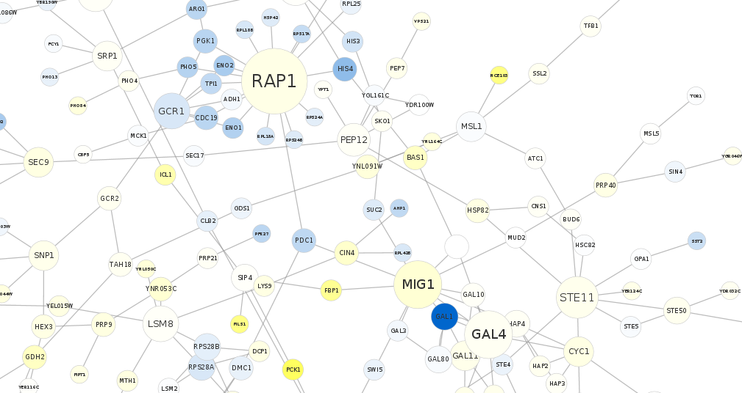
A sketch (CytoScape)

